Slide 1
Andrew McCarthy
University of the
West of England

Slide 2

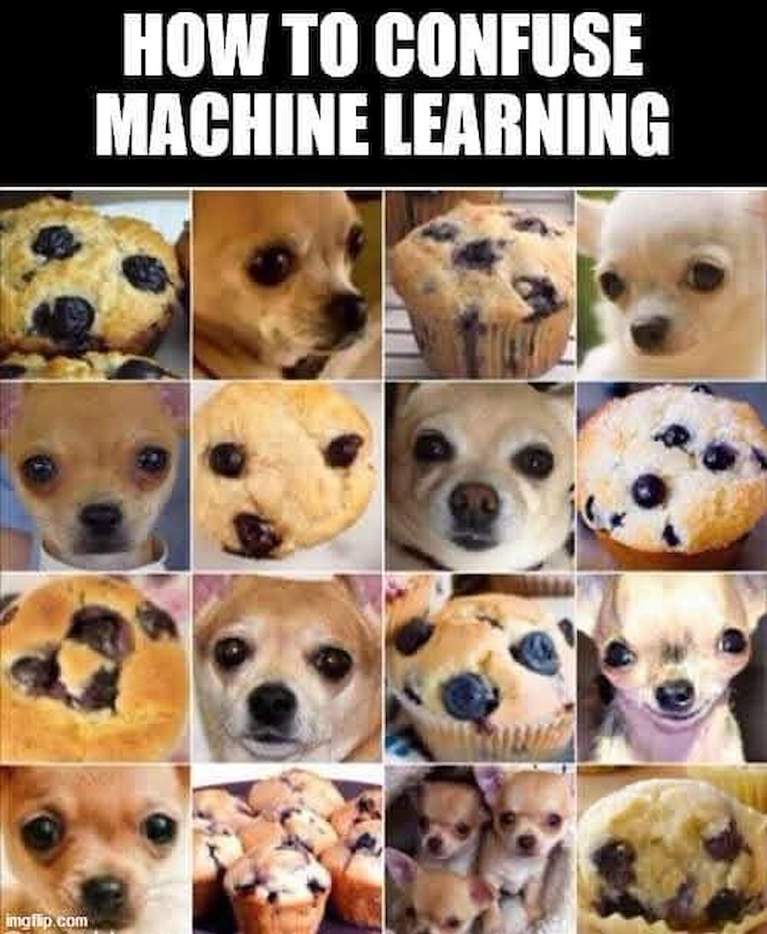
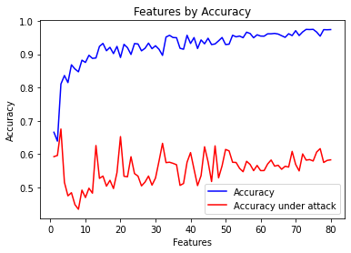
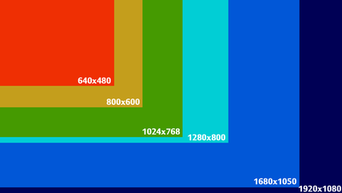
Interactive Methods for Improving Robustness of Neural Networks against Adversarial Attacks
1
2
3
CLICK TO START
9
3
4
5
6
7
8
10
11
12
13
14
15
16
17
18
19
20
21
22
23
24
25
26
27
28
29
1
30
2
mins
mins
mins
secs
secs
secs
secs
secs
secs
secs
secs
secs
secs
secs
secs
secs
secs
secs
secs
secs
secs
secs
secs
secs
secs
secs
secs
secs
secs
secs
secs
secs
secs
Andrew6.McCarthy@live.uwe.ac.uk

