Slide 1
Amy Ertan
Royal Holloway University London

Slide 2

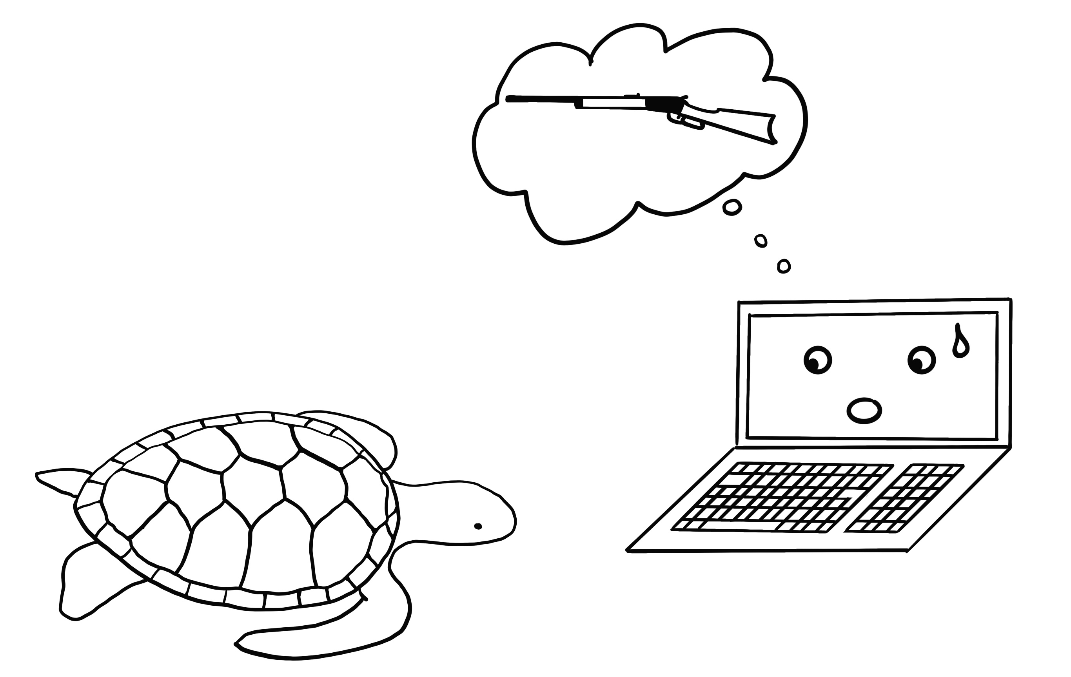
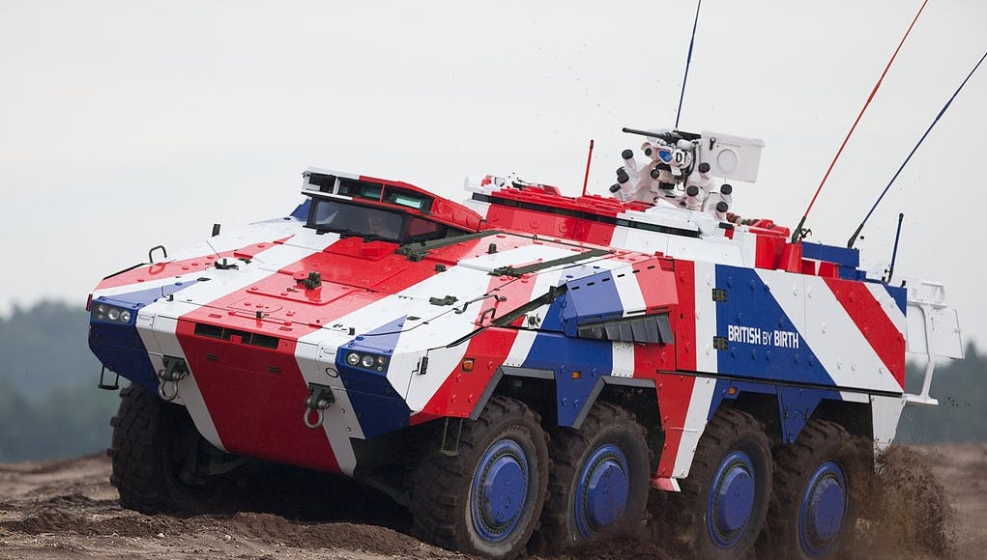

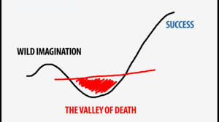


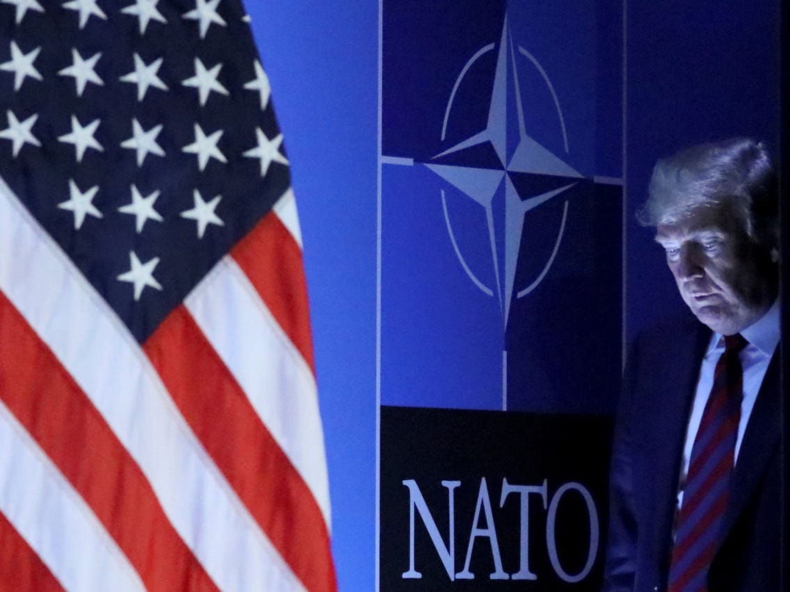


The Security Implications of
AI-enabled Technology in the Military
1
2
3
CLICK TO START
9
3
4
5
6
7
8
10
11
12
13
14
15
16
17
18
19
20
21
22
23
24
25
26
27
28
29
1
30
2
(1) So WHAT?
(2) Exploring
approaches
(3) Findings
to date
mins
mins
mins
secs
secs
secs
secs
secs
secs
secs
secs
secs
secs
secs
secs
secs
secs
secs
secs
secs
secs
secs
secs
secs
secs
secs
secs
secs
secs
secs
secs
secs
secs
@AmyErtan www.amyertan.com

