Slide 1
Ayden Clay
Cranfield University

Slide 2

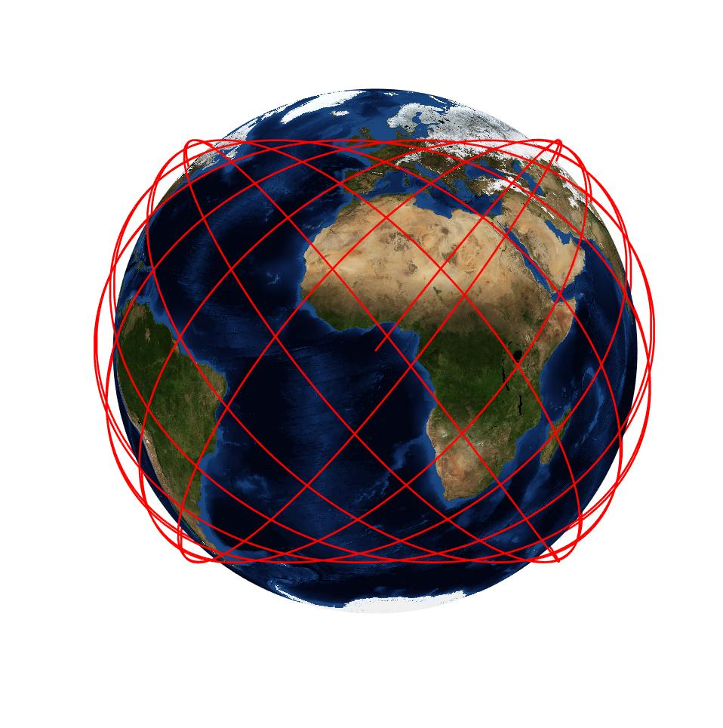
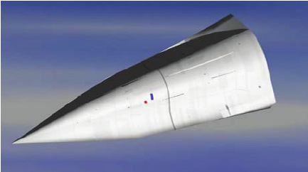
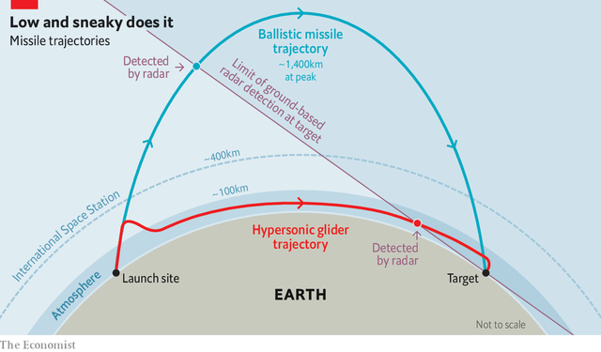
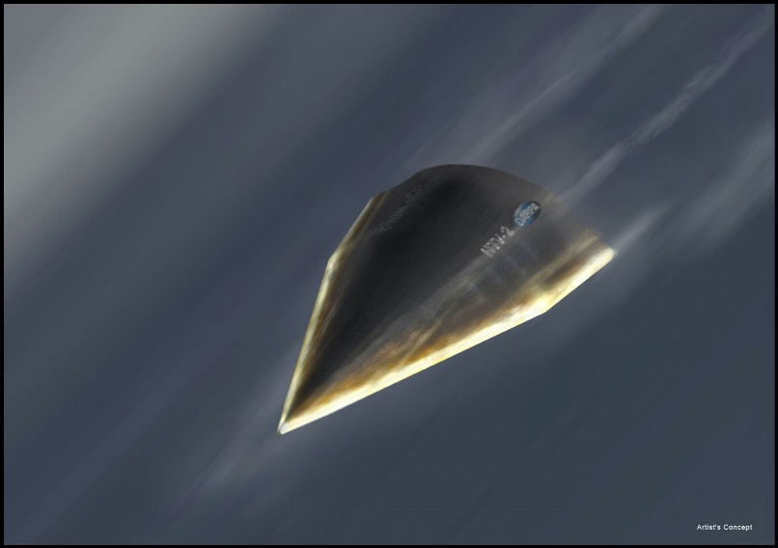
Trajectory Optimization of Complex Air Vehicles
1
2
3
CLICK TO START
9
3
4
5
6
7
8
10
11
12
13
14
15
16
17
18
19
20
21
22
23
24
25
26
27
28
29
1
30
2
mins
mins
mins
secs
secs
secs
secs
secs
secs
secs
secs
secs
secs
secs
secs
secs
secs
secs
secs
secs
secs
secs
secs
secs
secs
secs
secs
secs
secs
secs
secs
secs
secs

