Slide 1

Obliterated Firearms Markings Documented in an African Country
Bailey Henwood, PhD Researcher
BSc (Hons), MSc
Defence and Security Doctoral Symposium
November 2022

Slide 2
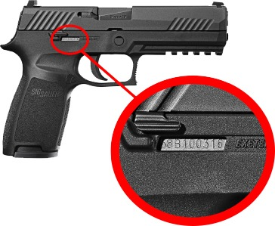
Serial Numbers and Weapon Identification
Serial numbers are applied to SALW, in addition to generic manufacturing marks identifying the year, model, and factory of manufacture.
Serial numbers are used to support the identification throughout a weapons lifetime;
  Through manufacturing
  Onward shipping
  Export/Import
  Ownership transfers
  Sales (civilian)
  Forensic/criminal investigations

Slide 3
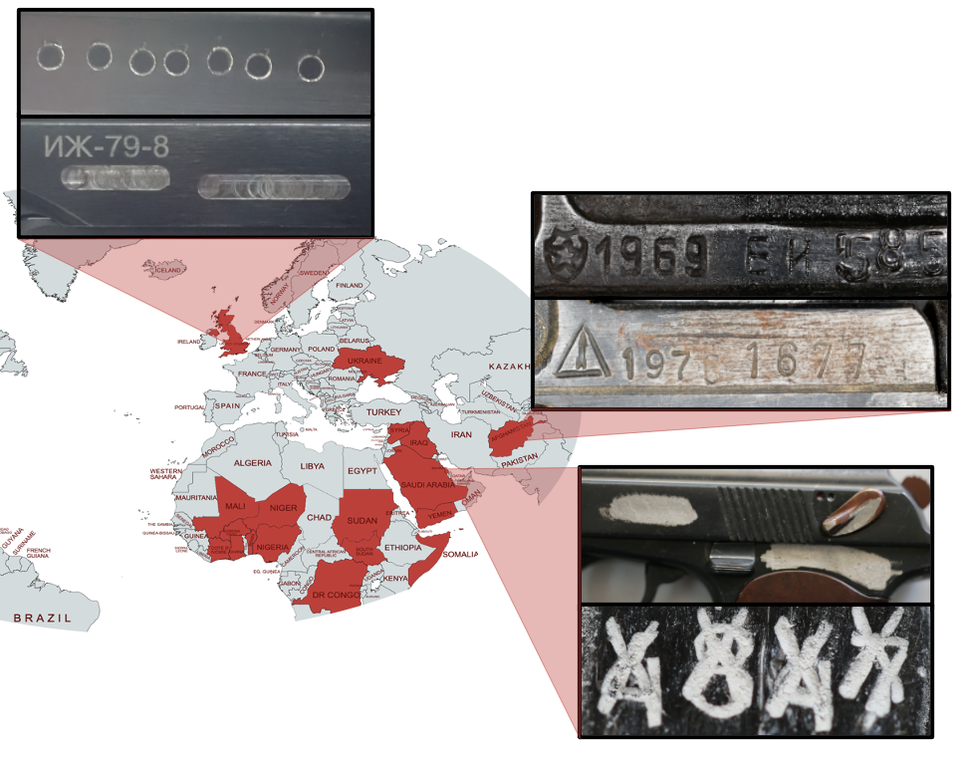
Weapon Sanitisation and Obliterations
Across the globe, serial numbers are used to trace SALW through both licit and illicit networks.
In many regions around the world, weapons that were once held legally have been diverted into illicit networks and sanitised by actors within these networks.
Knowing that seized weapons can be traced through their lifecycle using the serial number, it is common to find serial numbers and other identifiers removed from weapons used in illicit activity. When the serial numbers are removed, traceability is compromised

Slide 4
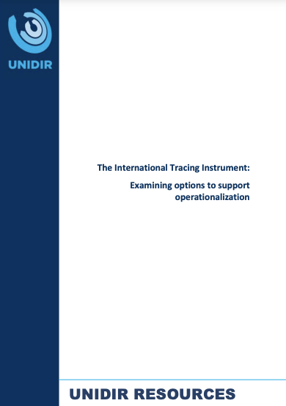
The International Tracing Instrument
A politically binding United Nations agreement outlining the challenges faced in illicit weapon tracing.
Provisions include increased marking, utilising technologies to recover obliterations, and improving engagement with manufacturers, law enforcement and end users.
In light of the ITI, efforts have been made to increase the capacity and skillsets for serial number recovery.

Slide 5
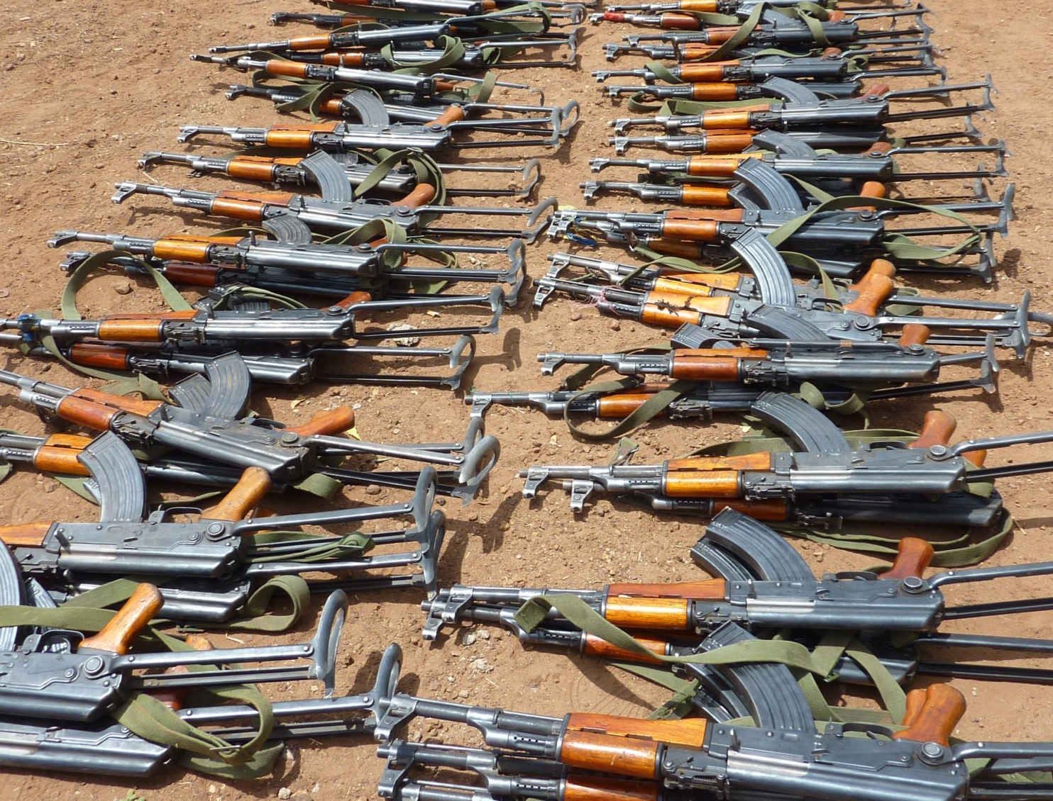
“Country X”
Primary factors in illicit trafficking of weapons include:
International stakeholder engagement
Terrorism
Clan Conflict
Poor stockpile management
Opposing force attacks
Country X was under a complete Arms embargo due to the lack of formal government and continuous conflict. This was partially lifted in 2013. A massive influx of weapons began in support of the newly formed federal government to combat a well-established ISIS-linked terrorist group.
Many legally donated or purchased weapons have been found in the hands of the terror networks since the embargo lifted with the unique identifying marks removed.

Slide 6
Aim of the Study
Analyse the local obliteration techniques in the region to understand the technical capabilities and forensic awareness
Assign an “obliteration code” to each weapon as part of a larger piece of work

Slide 7
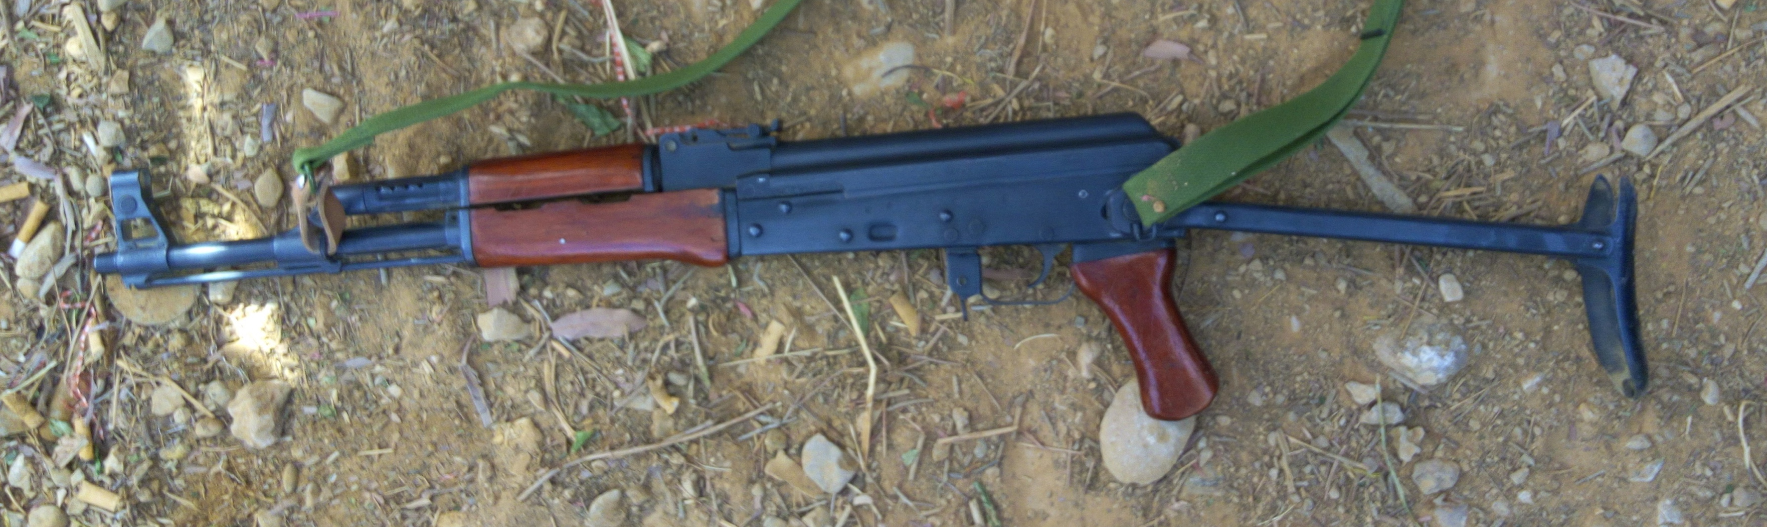
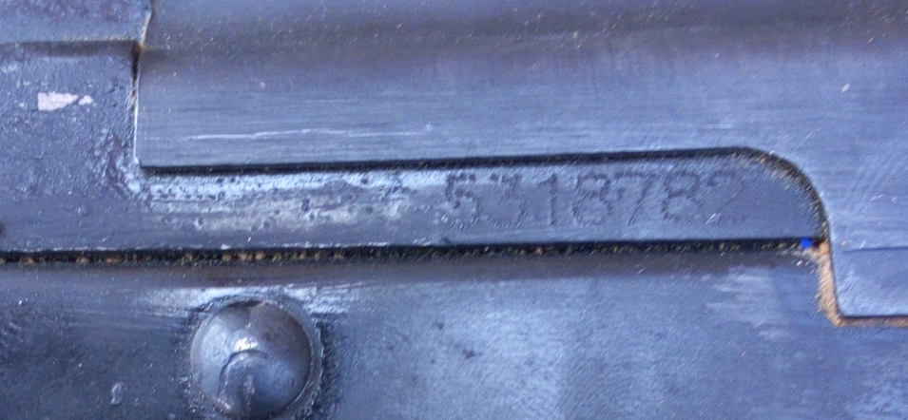
Materials
126 weapons documented by Conflict Armament Research Field Teams
Originally recovered by the Federal Government, Police Units and Military Units
Each weapon had identifying marks removed

Slide 8
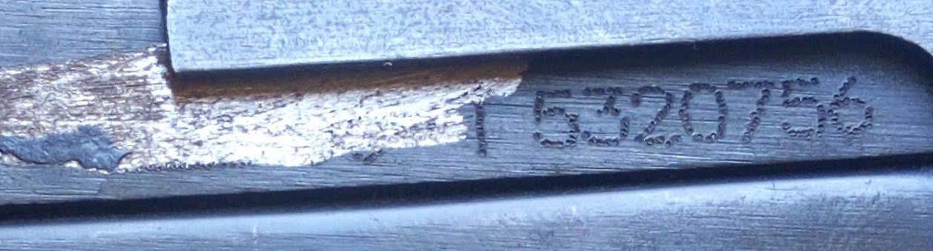
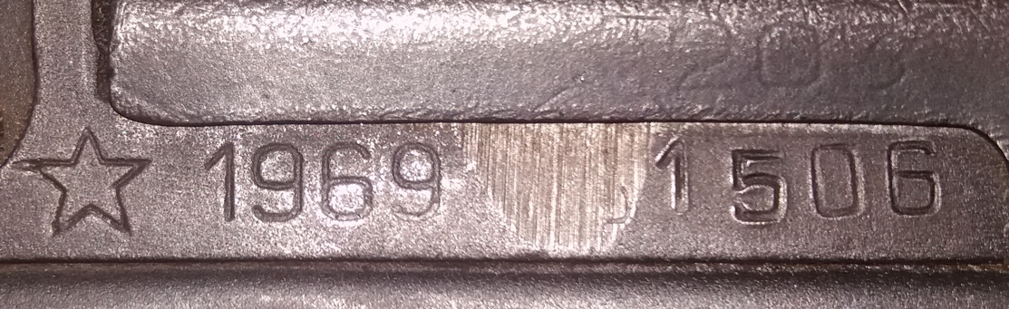
Samples
Two typical examples of the obliterated area on the documented firearms. These photographs are the primary data source used throughout this project, in addition to collected contextual information such as recovery location, date, and provenance (if known).
Two examples of the types of photographs examined. A Type 56-1 (top) and an AKM rifle (bottom).

Slide 9
Analysis
Toolmark analysis
Patterns of obliteration
Development of new methodology to approach weapon sanitisations
  Class characteristics to identify tool type.
  Not aiming to identify one individual tool- scope for future work.
  Identifying key features of each obliteration.
  Extent, Specific Marks, Directionality and Additional Concealment.
  Using the above patterns, a new system to codify obliterations has been established.

Slide 10
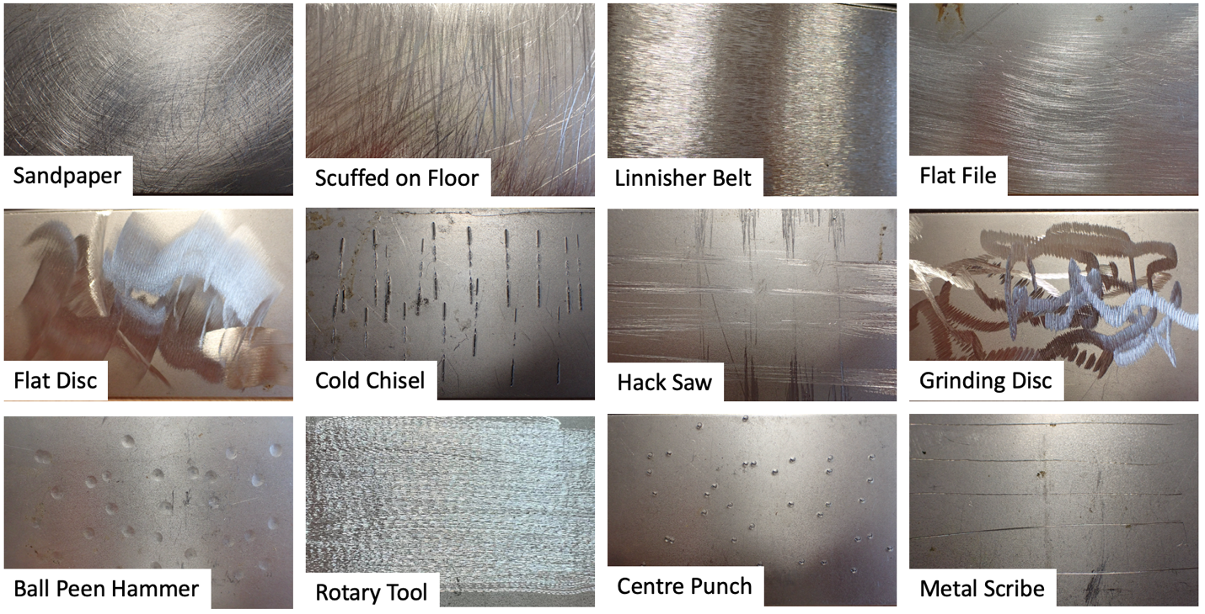
Tool Mark Analysis

Slide 11
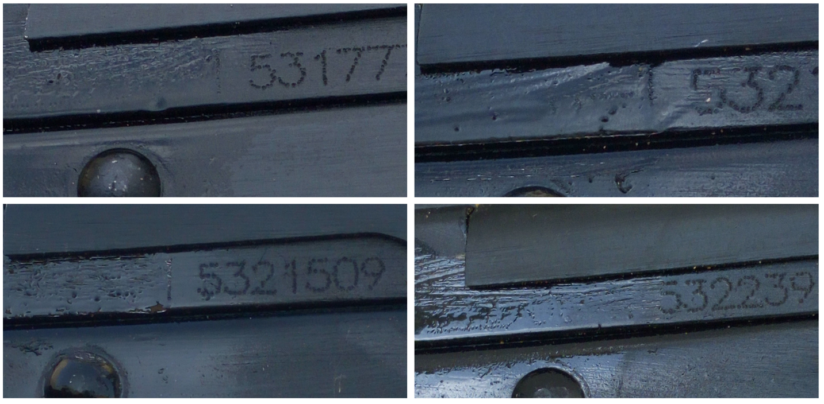
Patterns of Obliteration
A pattern is established ONLY when the following conditions are satisfied:
  Same tool type
  Same extent
  Same marks removed
  Same directionality
  Same concealment

Slide 12
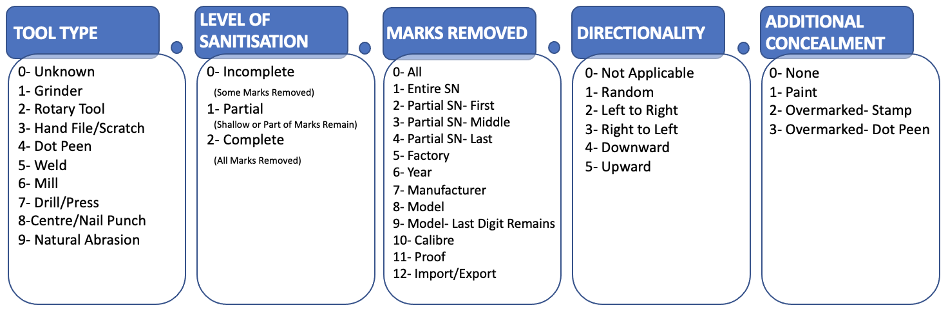
Obliteration Codes- Novel Methodology
The code for each obliteration is given as “T#.S#.M#.D#.C#”
T S M D C

Slide 13
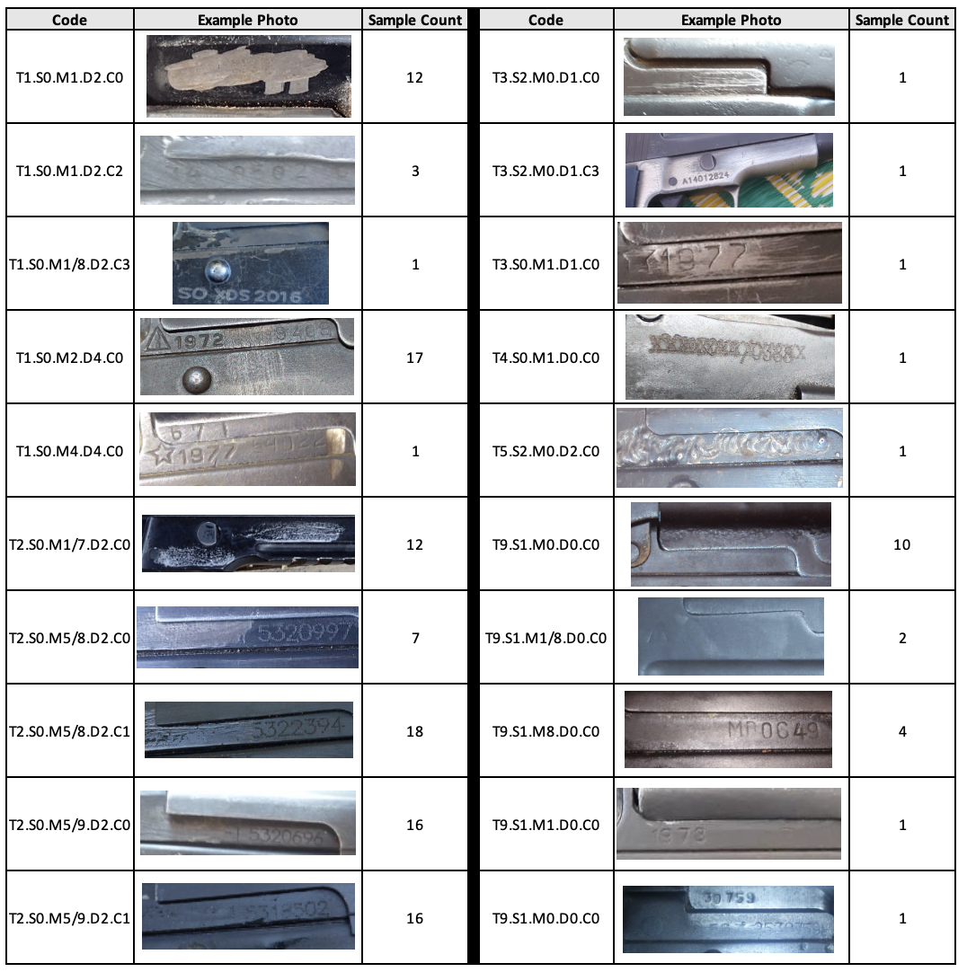
Results
Twenty codes identified within the documented weapons

Slide 14
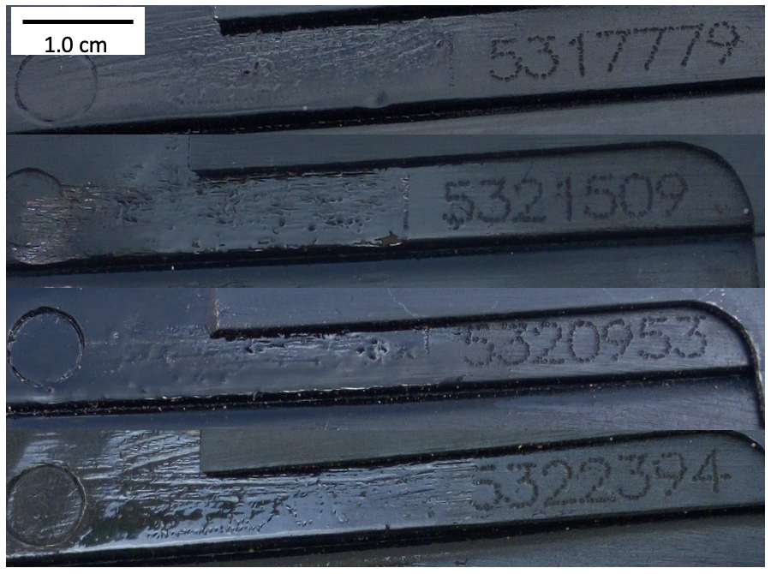
T2.S0.M5/8.D2.C1
This coding system will connect weapons obliterated within one terrorist node, aiding investigations, and can be applied to any weapon system.

Slide 15
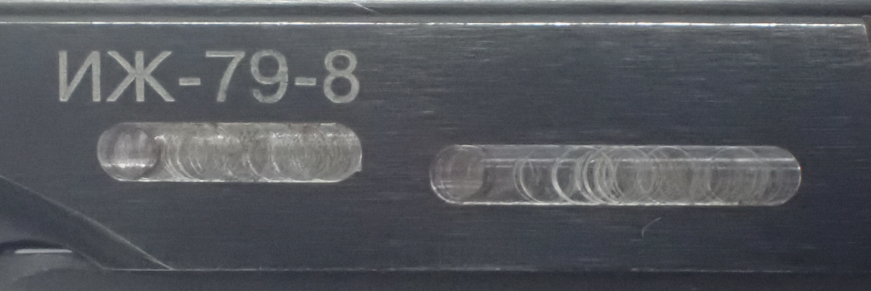
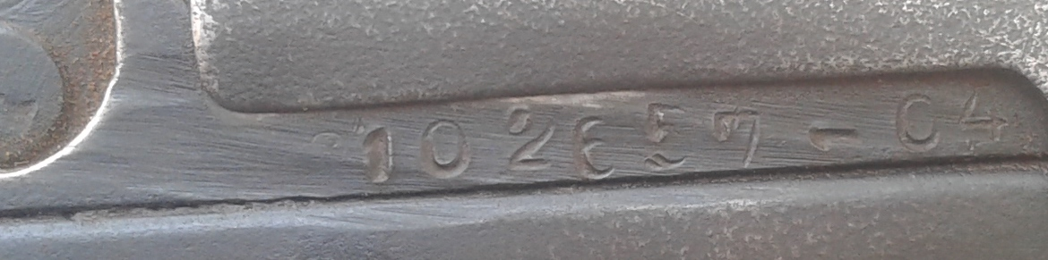
Motivation to Conceal the Weapon Identity
Legitimate weapons sell for higher values on the illicit market, leading perpetrators to retain marks that will prove its origin.
Serial numbers will be removed, but the factory mark will be retained.
In Country X, the identifying marks are removed, however the serial number is often reapplied or left semi-intact.

Slide 16
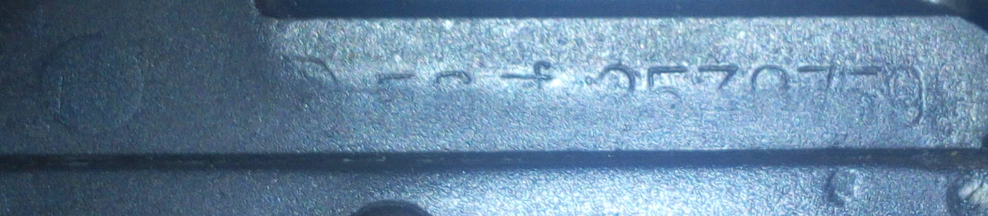
Forensic Awareness & Technical Capability
Actors are unaware of forensic recovery capability, or
The individuals are following directive from their command chain to remove the marks.

Slide 17
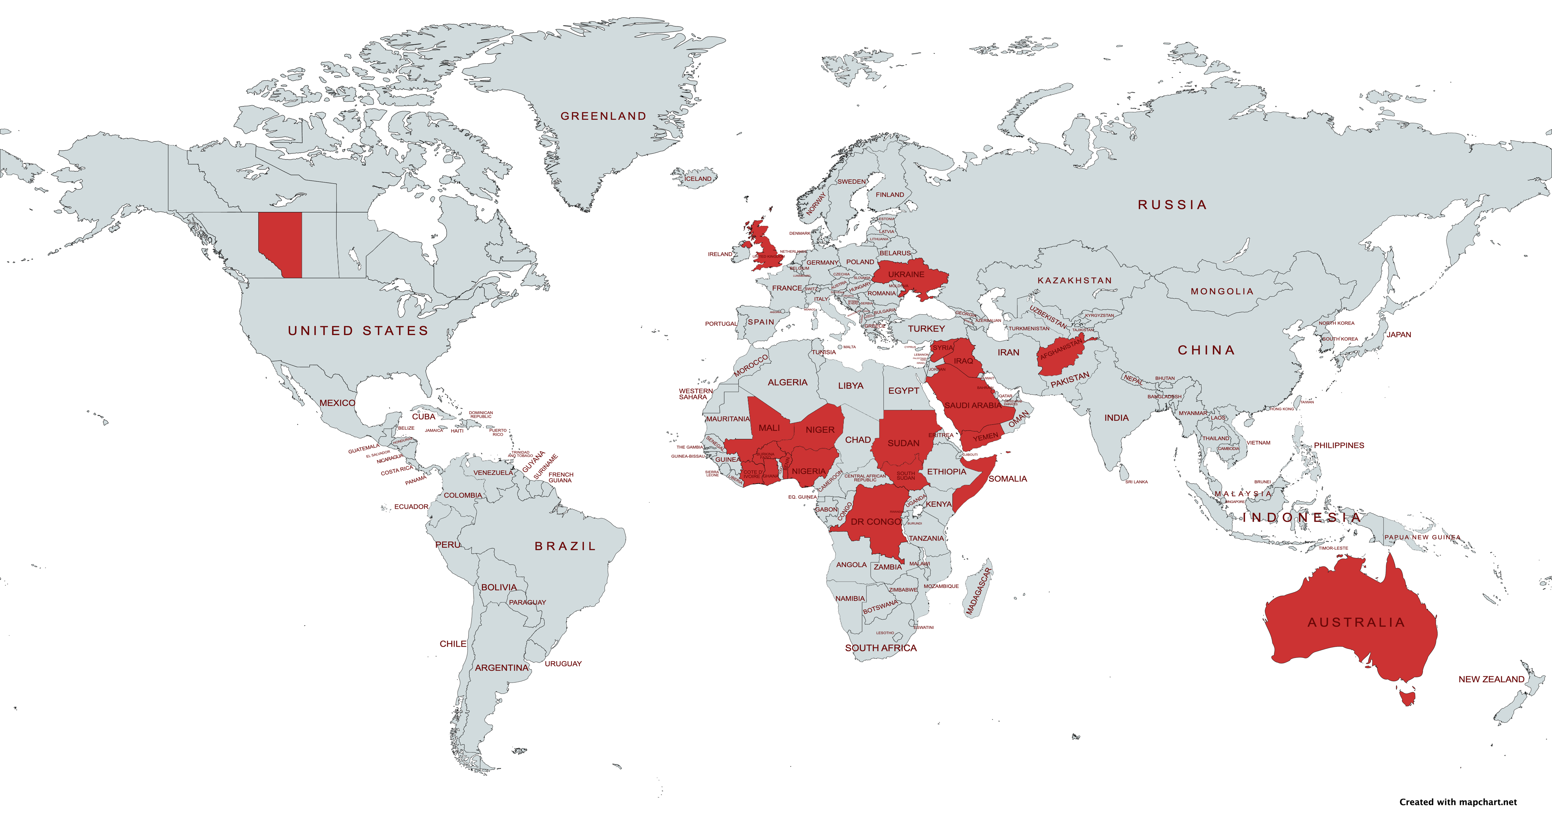
Future Work
Using the methodology established in this study, obliterated weapons from 20 countries around the world will be analysed. The obliteration codes in each country will be statistically compared around the world to establish the efficacy of determining where an obliteration was done based on the prevalence of codes in each region. This will increase the capability in tracking and tracing illicit weapons in support of the International Tracing Instrument.

Slide 18
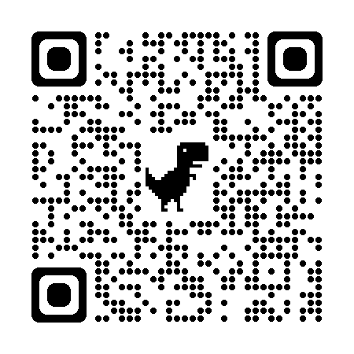

Questions?
Contact
bailey.henwood@cranfield.ac.uk
Special thanks are given to the Cranfield Defence and Security Workshops, Conflict Armament Research Field Teams and to Mr. David Baldwin.
For more information on Conflict Armament Research’s Documentation work, scan the QR code below

