Slide 1
Thomas Campbell
University of Oxford

Slide 2
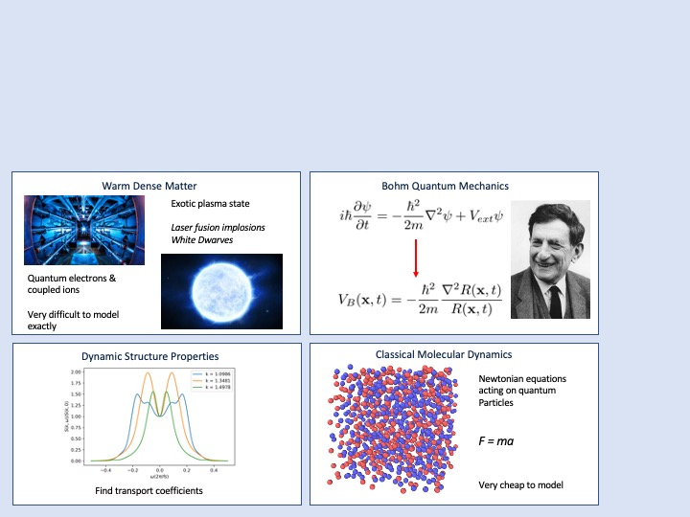

Bohmian Molecular Dynamics Simulations of Warm Dense Matter
1
2
3
CLICK TO START
9
3
4
5
6
7
8
10
11
12
13
14
15
16
17
18
19
20
21
22
23
24
25
26
27
28
29
1
30
2
mins
mins
mins
secs
secs
secs
secs
secs
secs
secs
secs
secs
secs
secs
secs
secs
secs
secs
secs
secs
secs
secs
secs
secs
secs
secs
secs
secs
secs
secs
secs
secs
secs
NIF laser image:
CC BY-SA 3.0/Damien Jemison/LLNL

