Slide 1
An uncertainty quantification and aggregation framework for system performance assessment in industrial maintenance
Presenting author: Alex Grenyer
Email: a.h.grenyer@cranfield.ac.uk
By Alex Grenyer, John Ahmet Erkoyuncu, Sri Addepalli and Yifan Zhao
03/11/2020
Notes:
Hello and welcome to my presentation on uncertainty quantification and aggregation for system performance assessment in industrial maintenance
My name is Alex Grenyer and I’m a PhD researcher at Cranfield University
My research centres on uncertainty quantification techniques for maintenance planning
Developing an intelligent system that learns from a combination of quantitative equipment data and qualitative heuristic estimates to forecast the level of uncertainty through the in-service phase of complex systems

Slide 2
Overview
Introduction
Research background
Framework development
Framework implementation
Discussion & conclusions
Notes:
First I’ll run through the context and research background of the paper, covering existing techniques to combine quantitative and qualitative uncertainties;
Give an overview of the framework development process along with key mathematical formulae, functions and assumptions made;
Illustrate implementation of the framework utilising a bespoke heat exchanger test rig, quantifying and aggregating the resulting uncertainties;
Then finally discuss the results, strengths and limitations of the framework along with conclusions and future work in this area.

Slide 3




Introduction
Increased uncertainty
Data quality and availability
Expert opinion / experience
Environmental conditions
Maintainer performance
Maintenance scheduling
Equipment availability
Turnaround time
Increasing technological complexity
Optimise
Optimum
Impact measure on system resulting in improved reliability and decision-making
?
?
Quantitative
Qualitative
Combine
Notes:
The technological complexity of modern engineering systems is increasing exponentially, requiring rigorous and accurate determination of optimum maintenance scheduling, equipment availability and turnaround time whilst allowing for overruns and unforeseen costs.
These are hampered by increased uncertainty driven by data quality and availability – as well as the qualitative influence of workers, expert opinion, experience and environmental conditions – that can result in under or over estimation.
Complex systems feature multiple sub-elements interacting simultaneously and nonlinearly with each other and the environment on multiple levels. Uncertainty quantification in this context generally only considers quantitative, measured data.
An aggregation of quantitative and qualitative uncertainties is necessary to capture their full system impact.
This influences system reliability and, therefore, decisions made around system maintenance.
To this end, a framework is presented to quantify and aggregate compound uncertainties to be assessed against a predetermined acceptable level of uncertainty.

Slide 4
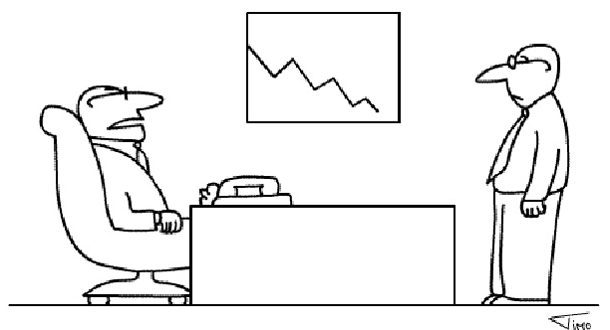
Research background
Uncertainty classification
Degree of information, or lack of, known about a given entity
Difference between recorded and true value of measured entity
Probability of loss or gain in that entity
Uncertainty
Error
Risk
How does your gut feel?
Type A, quantitative
Type B, qualitative
Measured data
Data availability
Data quality
Human factors
Maintainer performance
Part availability
“It would appear, Hopkins, that your gut feel was only indigestion.”
Notes:
Uncertainty is defined as the degree of information, or lack of, known about a given entity
Error is the difference between the recorded and true value of a measured entity
The resulting risk is the probability of loss or gain of the value of that entity
The Guide to the Expression of Uncertainty in Measurement (GUM) has been implemented in a range of UQ-related applications and describes 2 key types of uncertainty:
Type A, quantitative uncertainty sourced from measured data, expressed by the standard deviation of the dataset
Type B, qualitative uncertainty from factors such as technical knowledge and expert experience as well as environmental conditions

Slide 5
Research background
Combining quantitative and qualitative uncertainty
Standard 5-stage process
Identify the measurand
Identify uncertainty sources and associated PDFs
Quantify uncertainties (simulation)
Aggregate uncertainties
Report analysis results
GUM applies coverage factors for qualitative estimates
Underestimation of total uncertainty
Pedigree assessment
Equate qualitative estimates in line with quantitative data
Expert knowledge / opinions scored against predefined criteria
Scores correspond to predefined measures of geometric standard deviation (GSD)
Notes:
These approaches typically follow 5 core stages:
Identify the measurand;
Identify uncertainty sources and associated PDFs;
Quantify uncertainties (simulation);
Aggregate uncertainties;
Report analysis results
Coverage factors are applied in the GUM to accommodate for qualitative estimates, which can lead to underestimation of total uncertainty and cannot be confidently applied in dynamic CES.
The pedigree approach is a widely renowned and verified method to equate qualitative estimates in line with quantitative data.
Expert knowledge and opinion is scored according to predefined criteria to permit quantitative performance and reliability assessment.
Ciroth presented a process to improve uncertainty estimation by gauging qualitative uncertainty factors through the pedigree approach
Estimates were attributed by their geometric standard deviation (GSD), where inputs fit to the lognormal distribution.
For the analysis of data from varying sources and measured in different units, uncertainty factors need to be independent of scaling effects present in the arithmetic standard deviation
Using GSD as the uncertainty measure overcomes this scale dependency.

Slide 6
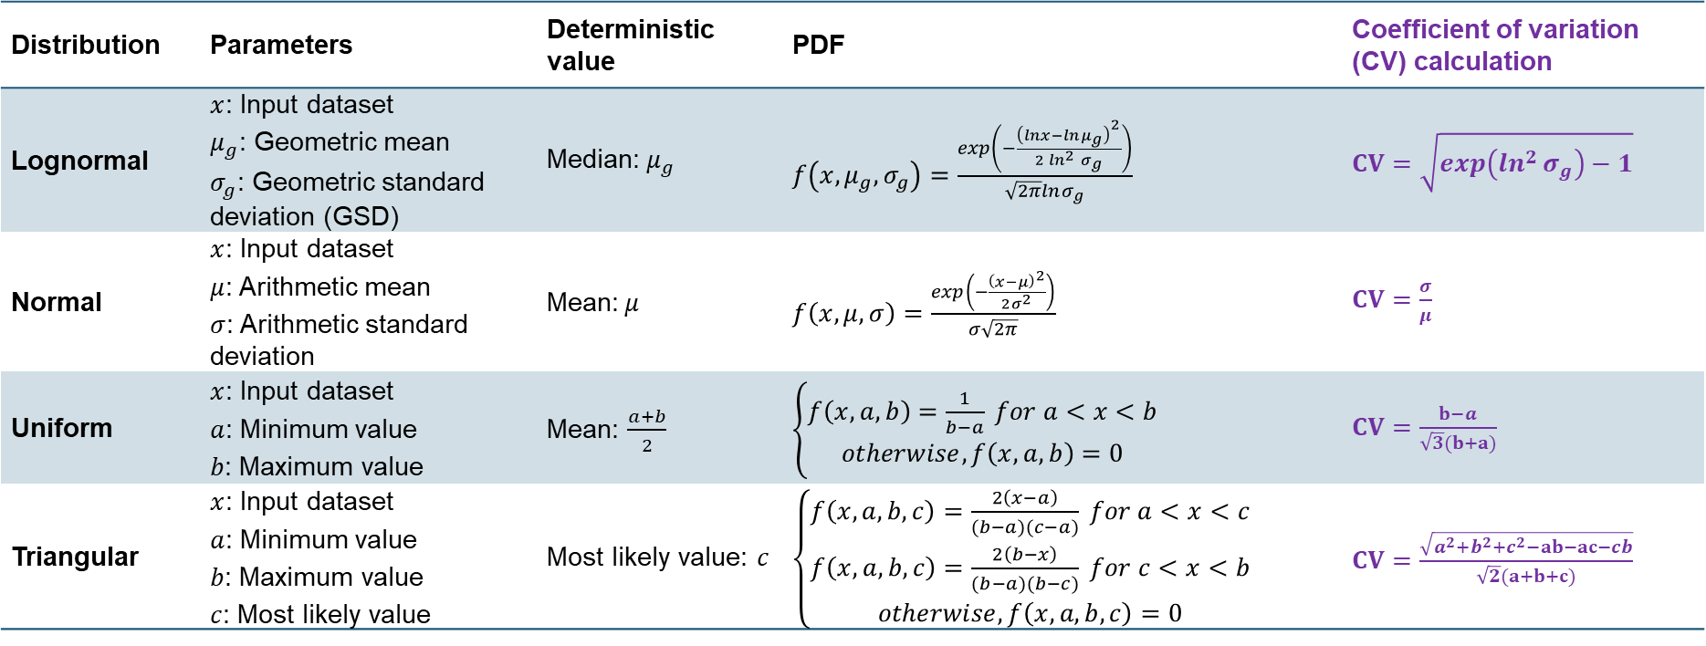
Research background
Distribution | Parameters | Deterministic value | PDF | Coefficient of variation (CV) calculation
Lognormal | $x$: Input dataset $μ_{g}$: Geometric mean $σ_{g}$: Geometric standard deviation (GSD) | Median:$μ_{g}$ | $f\left(x,μ_{g},σ_{g}\right)=\frac{\exp\left(−\frac{{\left(lnx−lnμ_{g}\right)}^{2}}{2\ln^{2}{σ_{g}}}\right)}{\sqrt{2π}lnσ_{g}}$ | $CV=\sqrt{\exp\left(\ln^{2}{σ_{g}}\right)−1}$
Normal | $x$: Input dataset $μ$: Arithmetic mean $σ$: Arithmetic standard deviation | Mean:$μ$ | $f\left(x,μ,σ\right)=\frac{\exp\left(−\frac{{\left(x−μ\right)}^{2}}{2σ^{2}}\right)}{σ\sqrt{2π}}$ | $CV=\frac{σ}{μ}$
Uniform | $x$: Input dataset $a$: Minimum value $b$: Maximum value | Mean: $\frac{a+b}{2}$ | $\left\{\begin{aligned}f\left(x,a,b\right)=\frac{1}{b−a} for a<x<b \\ otherwise, f\left(x,a,b\right)=0\end{aligned}\right.$ | $CV=\frac{b−a}{\sqrt{3}(b+a)}$
Triangular | $x$: Input dataset $a$: Minimum value $b$: Maximum value $c$: Most likely value | Most likely value: $c$ | $\left\{\begin{aligned}f\left(x,a,b,c\right)=\frac{2\left(x−a\right)}{(b−a)(c−a)} for a<x<c \\ f\left(x,a,b,c\right)=\frac{2\left(b−x\right)}{(b−a)(b−c)} for c<x<b \\ otherwise, f\left(x,a,b,c\right)=0\end{aligned} \right.$ | $CV=\frac{\sqrt{a^{2}+b^{2}+c^{2}−ab−ac−cb}}{\sqrt{2}(a+b+c)}$
Notes:
In order to aggregate uncertainties represented by different PDFs, a ratio between the standard deviation and the mean is obtained via the coefficient of variation (CV), given as a percentage to represent uncertainty.
Muller defined a set of equations to convert symmetric and asymmetric PDFs to their respective CVs, shown in this table
Given as a dimensionless measure of variability, the CV can be used as a measure of uncertainty for each input and aggregated to give a representative total.
This was the method selected and applied in the framework, detailed in the following slides.

Slide 7
Research background
Many uncertainty quantification approaches follow the 5-stage process defined in the GUM
Consideration of qualitative factors not sufficient for complex systems
Considerations of qualitative uncertainty
Pedigree approach
Compound aggregation of quantitative and qualitative uncertainties given by different PDFs
Coefficient of Variation
Formulae to denote inputs of varying PDFs by respective CVs are defined
Aggregate CVs from a mix of symmetric and asymmetric PDFs in a compound manner is unclear
Notes:
The majority of UQ approaches follow variations of the 5-stage process defined in the GUM, but this does not adequately consider qualitative attributes required for more complex engineering systems
Considerations of qualitative uncertainty are best made through the pedigree approach.
Identification of the most appropriate distribution function to represent each input is key to assess its uncertainty.
The approach described by Ciroth and Muller can be used to quantify and aggregate compound uncertainties through their respective CVs, applied to a range of symmetric and asymmetric distributions.
While formulae to denote inputs of varying distributions by their respective CVs are defined, a method to aggregate CVs from a mix of symmetric and asymmetric distributions in a compound manner was unclear.
This is necessary to establish compound uncertainty estimates represented by different distributions with a high level of confidence.

Slide 8
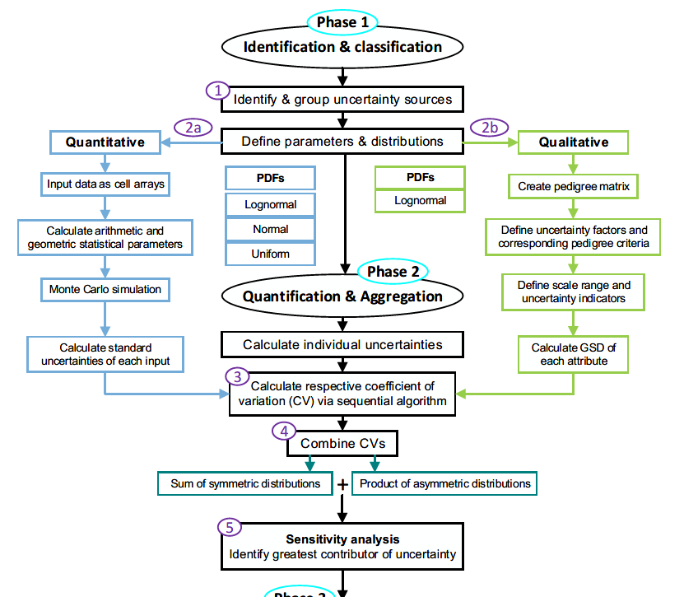
Framework development: Compound uncertainty aggregation
Notes:
The compound aggregation framework was developed in MATLAB and comprises of 5 core steps:

Slide 9
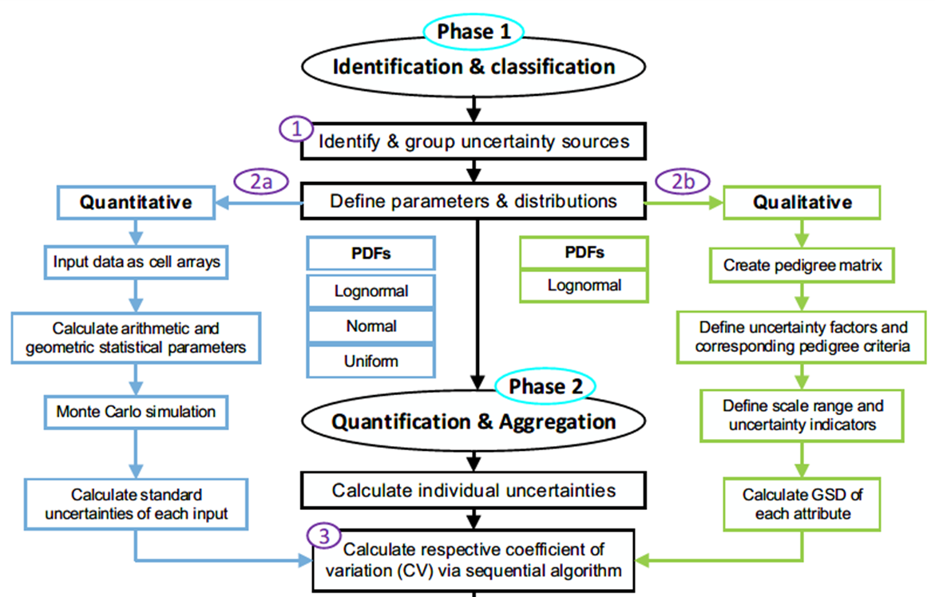
Framework development: Compound uncertainty aggregation
Step 1
Step 2
Step 2a
Notes:
Step 1, similar to that of the GUM, identifies and groups the uncertainty sources as inputs according to their type – quantitative or qualitative
Step 2 calculates relevant statistical parameters for each input via Monte Carlo simulation and the pedigree matrix for respective types, elaborated in 2 sub steps:
Step 2a considers quantitative data, which is imported to MATLAB and indexed in cell arrays to accommodate varying data sizes
The arithmetic and geometric mean and standard deviation are calculated, as well as maximum and minimum values of each input variable.
Monte Carlo simulations are run for lognormal, normal and uniform distributions for a predefined number of points (default 10,000).
The standard deviation is then calculated using the simulated data for each distribution type. For lognormal parameters, the geometric mean and standard deviation is calculated. Normal and uniform distribution parameters are arithmetic.

Slide 10
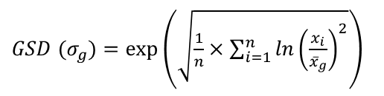
Framework development: Compound uncertainty aggregation
Step 2b
Step 3
$GSD (σ_{g})=\exp\left(\sqrt{\frac{1}{n}×\sum_{i=1}^{n}{{\ln\left(\frac{x_{i}}{{\overline{x}}_{g}}\right)}^{2}}}\right)$
Notes:
Step 2b scores the qualitative factors against predefined pedigree criteria.
The ideal case for these is a minimal uncertainty and a pedigree score of 1.
Scores of 2-5 have progressively higher uncertainties owing to their representative criteria.
The scores for each factor correspond to an uncertainty indicator, given as GSD, defined according to the subjective impact each factor has on the system.
The GSD is calculated from the indicator values obtained from one or multiple sources. If the uncertainty indicators are obtained from a single source, the GSD is given as the square root of the indicator.
If they are obtained from multiple sources, the GSD is given by this equation, modelled by the lognormal distribution.
Ideally, and especially in the case of complex systems, the definition of pedigree criteria and related uncertainty indicators should be made by a diverse selection of suitably qualified individuals.
Step 3 calculates the CV for each input. In order for uncertainties from different data types represented by different distributions to be aggregated, they must be considered on an equal scale.
These are calculated within the framework by a sequential algorithm according to the specified input and distribution type.
Summary tables are then generated for the quantitative and qualitative inputs detailing key parameters calculated in Steps 2 & 3.

Slide 11
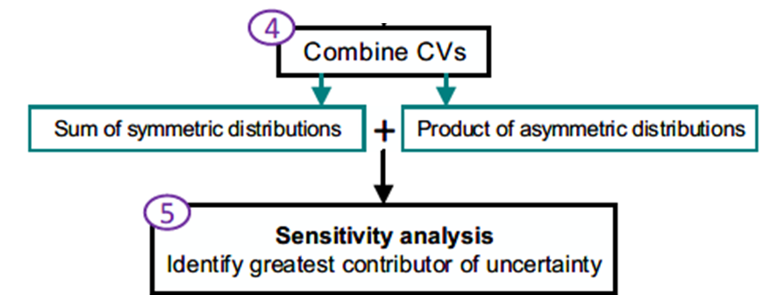
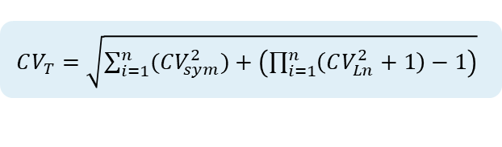

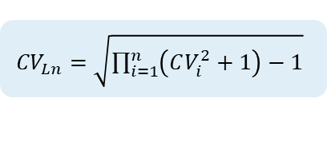
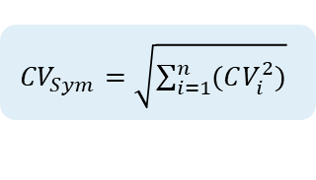

Framework development: Compound uncertainty aggregation
Step 4
1
${CV}_{Sym}=\sqrt{\sum_{i=1}^{n}{(CV_{i}^{2})}}$
2
${CV}_{Ln}=\sqrt{\prod_{i=1}^{n}{\left(CV_{i}^{2}+1\right)}−1}$
3
$μ_{T}{CV}_{T}=μ\sqrt{CV_{Sym}^{2}+CV_{Logn}^{2}}$
4
$CV_{T}=\sqrt{\sum_{i=1}^{n}{(CV_{sym}^{2}})+\left(\prod_{i=1}^{n}{\left(CV_{Ln}^{2}+1\right)}−1\right)}$
Express total as standard deviation
5
$$σ_{T}=μ_{T}CV_{T}$$
Notes:
Step 4 combines the respective CVs.
Normal and uniform distributions are symmetric – the arithmetic mean is equal to the mode and does not change when uncertainty increases.
They can therefore be aggregated additively by the root-sum-square in Eq1
Lognormal distributions are asymmetric – the arithmetic mean will change with increasing or decreasing uncertainty. These inputs are aggregated multiplicatively by Eq2
To combine these with symmetric distributions, a new arithmetic mean needs to be calculated to account for the shifting uncertainty, by Eq3
To account for this, the framework splits the calculated CVs of quantitative inputs according to distribution type. The sum of symmetric attributes are added to the product of lognormal attributes by Eq4
This allows the aggregated CV of both quantitative and qualitative data to be determined as a measure of total uncertainty.
Since CV is defined as the ratio between the standard deviation and the mean, the output follows a normal distribution.
The uncertainty can be expressed back as standard deviation via Eq5

Slide 12
Framework development: Compound uncertainty aggregation
Step 5
Visualisation of results
Total estimated uncertainty
Individual contributions
Given against predetermined acceptable level of uncertainty
Notes:
Step 5 visualises the calculated and combined uncertainties in to assess their comparable impact on the system.
The visualisation consists of the total estimated uncertainty along with individual contributions via local sensitivity analysis.
This is a widely used method to determine the relative impact of input variables to the compound uncertainty, calculated using partial derivatives. The resulting factors are plotted over the relative total to visualise their impact.
These are given against a predetermined acceptable level of uncertainty shown as a colour bar on the y-axis – shown in the results of the case study

Slide 13
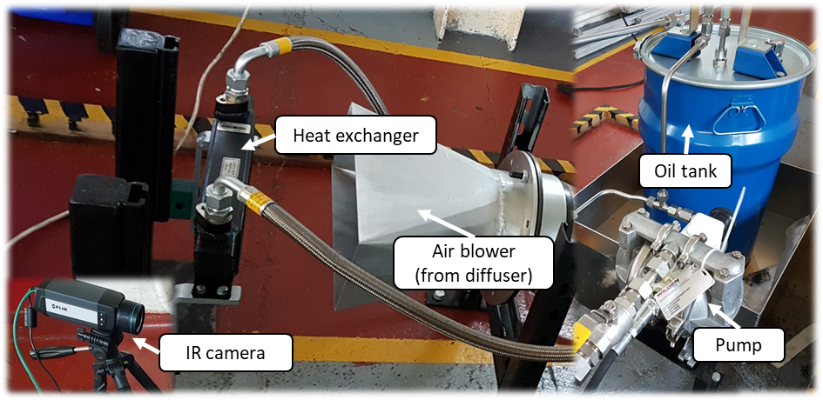
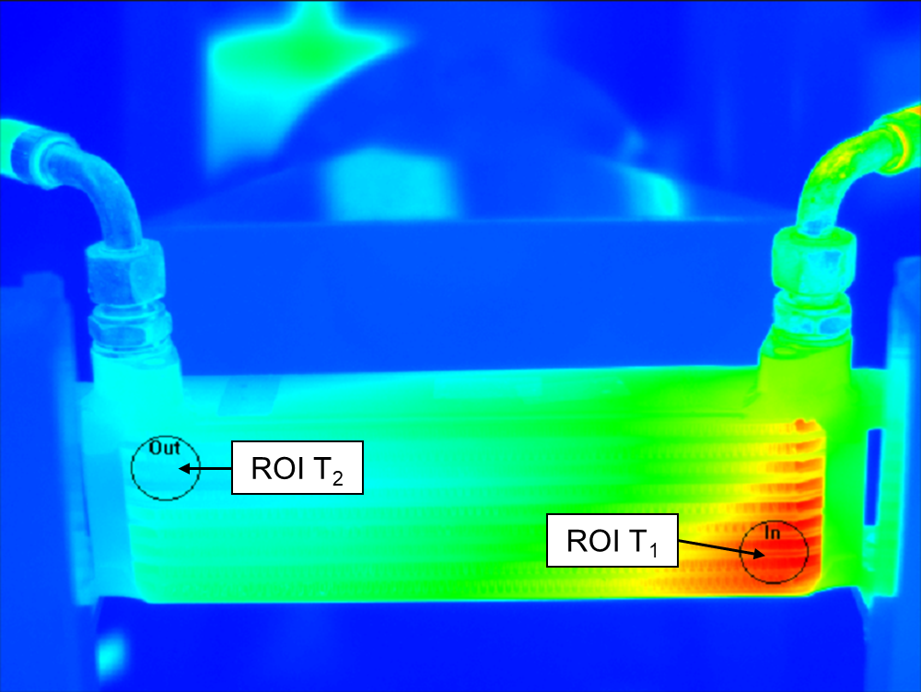

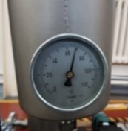
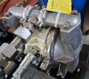

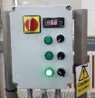
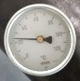
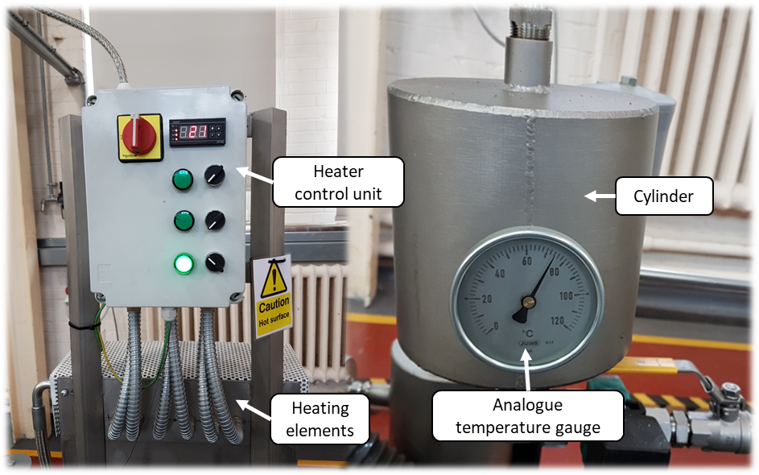
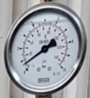
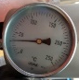
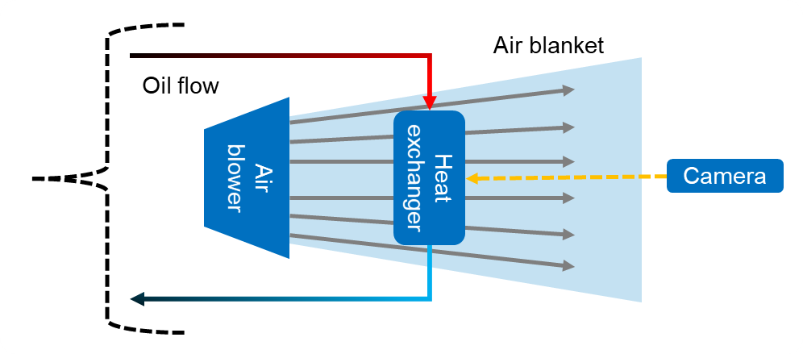
Framework implementation: Heat exchanger test rig
Flow
P₁
T₀
Oil tank
Pump
Heater
T₄
T₁
Air blower
Heat exchanger
P₂
T₂
Cooler
(Water tank, if required)
T₃
Hot fluid (oil)
Max temp: 80°C
Max pressure: 2bar
Flow rate: 0.00025m³/s
Cold fluid (air)
Min temp: 20°C
Pressure: 1bar
Flow rate: 0.83m³/s
Notes:
The framework was applied to a bespoke heat exchanger test rig consisting of a hot closed loop system and a cold open loop system
The design comprised of subsystem modules housing component and fluid interactions that interact in a non-linear manner.
This, as well as subjective opinions and actions of operators, influence uncertainties in the assessment of system performance and the HEx itself.
Oil temperature at the inlet and outlet was measured using infrared thermography
Thermodynamic analysis involving oil viscosity and temperature decrease through connecting pipes was not considered as it was out of scope for this application
Recordings were taken once the system had reached operating temperature, 80°C, at steady state
6 sets of 10 recordings were made manually for each parameter with 20 minute intervals between each set to allow the temperature to reset.
To enable effective heat transfer, the air blower must be in operation. This created an air blanket around the HEx unit, disrupting the temperature measurements for the camera
All other parameters were recorded via in-line analogue dials. Many of these gave readings on different interval scales, varying the measurement accuracy, and therefore resulted in an increased uncertainty.
Additional attributes such as parallax error and ambient temperature further increased the uncertainty in measurement. The flow rate of the oil constantly fluctuated from 0-15 L/min owing to the nature of the air-operated pump. This made an accurate reading of mean flowrate unobtainable, so was discounted from the input parameter list.

Slide 14
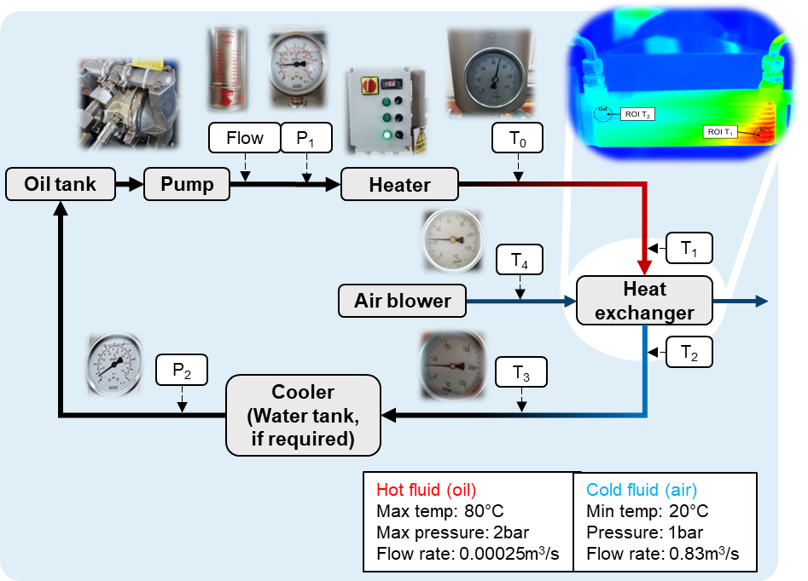
Framework implementation: Heat exchanger test rig
Step 1: Identify parameters & distributions
Quantitative recordings
Parameter | Distribution
T1, HEx In (°C) | Lognormal
T2, HEx Out (°C) | Lognormal
T3, Temp dial out (°C) | Normal
T4, Temp blower (°C) | Uniform
P1, Pressure pre-HEx (bar) | Normal
P2, Pressure post-HEx (bar) | Uniform
Qualitative factors (Lognormal)
Measurement reliability
Environmental conditions
Basis of estimate
Reading accuracy
Sample size
Notes:
Step 1: 6 quantitative parameters and 5 qualitative factors were identified:
Temperature readings of the HEx inlet (T1) and outlet (T2) given by the IR camera were modelled by the lognormal distribution as the fluid temperature gradually decreased once reaching operating temperature.
This gave a skewed result with slightly different mean values for each set of readings.
The temperature reading given by the in-line dial after the HEx (T3) was modelled by the normal distribution as the higher reading interval gave a more constant mean, though with a greater spread in deviation
Oil pressure before passing through the HEx (P1) was also modelled by the normal distribution
Blower air temperature (T4) and oil pressure post HEx (P2) were modelled by the uniform distribution as they were constant throughout
The 5 qualitative factors, modelled by the lognormal distribution, were:
Measurement reliability
Basis of estimate
Reading accuracy
Environmental conditions
Sample size

Slide 15
Framework implementation: Heat exchanger test rig
Step 2a: Quantitative recordings
Parameter | Reading interval | Reading error | Distribution | Mean | Standard deviation | Min | Max
T1, HEx In (°C) | 0.1°C | - | Lognormal | 64.9839 | 1.0158 | 62.6000 | 66.2000
T2, HEx Out (°C) | 0.1°C | - | Lognormal | 27.4887 | 1.0280 | 26.0000 | 28.7000
T3, Temp dial out (°C) | 5.0°C | ±2.0°C | Normal | 35.8333 | 1.8645 | 32.5000 | 37.5000
T4, Temp blower (°C) | 2.0°C | ±0.5°C | Uniform | 18.0000 | 0.0000 | 18.0000 | 18.0000
P1, Pressure pre-HEx (bar) | 0.5 bar | ±1.0 bar | Normal | 1.7511 | 0.0765 | 1.6000 | 1.8000
P2, Pressure post-HEx (bar) | 0.5 bar | ±0.3 bar | Uniform | 0.3000 | 0.0000 | 0.3000 | 0.3000
Notes:
Step 2a: The quantitative statistical parameters given by the recordings and Monte Carlo simulation are summarised here
The reading intervals and errors contribute to the qualitative factors

Slide 16
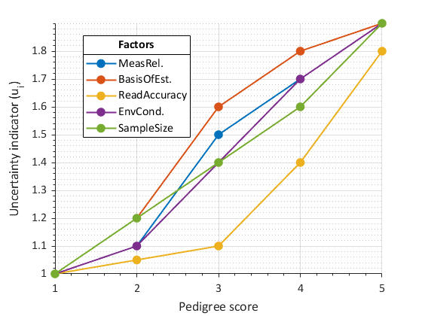
Framework implementation: Heat exchanger test rig
Step 2b: Qualitative factors – Pedigree matrix
Score Factor | 1 | 2 | 3 | 4 | 5
Measurement reliability | Data is < 2 months old and/or recorded by fully calibrated sensor or fully qualified person | Data is < 6 months old and/or recorded by fully calibrated sensor or fully qualified person | Data is < 12 months old and/or recorded by fully qualified person | Data is > 12 months old and/or recorded by fully qualified person | Age or source of data unknown or > 12 months old
Basis of estimate | Best possible data, use of historical field data, validated tools and independently verified data, given by fully qualified expert | Smaller sample of historic data, parametric estimates, internally verified data, some experience in the area | Limited available data, unverified, inexperienced opinions | Incomplete data, small sample, educated guesses, indirect approximate rule of thumb estimate | No experience in the data
Reading accuracy | Measurements taken using fully calibrated and accurate equipment: ±0.1°C, ±0.1 bar | Measurements taken using recently calibrated but less accurate equipment: ±0.5°C, ±0.5 bar | Measurements taken using recently calibrated but less accurate equipment: >±1.0°C, >±1.0 bar | Measurements taken using accurate equipment that may need recalibrating | Measurements taken using un-calibrated and inaccurate equipment
Environmental conditions | Data recorded under specific consistent conditions or a specified range of conditions from area under study | Data recorded in generally consistent conditions with fluctuations specified | Data recorded in generally consistent conditions, changes not specified | Data recorded in a range of unspecified conditions | Data from unknown or distinctly different areas
Sample size | > 20 | > 10 | > 5 | < 5 | Unknown
Uncertainty indicators
Factor / score | 1 | 2 | 3 | 4 | 5
Measurement reliability | 1.00 | 1.10 | 1.50 | 1.70 | 1.90
Basis of estimate | 1.00 | 1.20 | 1.60 | 1.80 | 1.90
Reading accuracy | 1.00 | 1.05 | 1.10 | 1.40 | 1.80
Environmental conditions | 1.00 | 1.10 | 1.40 | 1.70 | 1.90
Sample size | 1.00 | 1.20 | 1.40 | 1.60 | 1.90
Notes:
Step 2b: The 5 qualitative factors were scored by defined pedigree criteria detailed here and in the appendix of the paper.
The factors were based on adjusted examples from literature to apply to the case study
These correspond to uncertainty indicators. For the heat exchanger, the uncertainty indicators were obtained from a single source and their GSD is therefore given as the square root of the corresponding indicator

Slide 17
Framework implementation: Heat exchanger test rig
Step 3: Calculate individual CVs
Quantitative factors
Qualitative factors
Parameter | Distribution | CV
T1, HEx In (°C) | Ln | 0.0157
T2, HEx Out (°C) | Ln | 0.0276
T3, Temp dial out (°C) | Normal | 0.0517
T4, Temp blower (°C) | Uniform | 0.0000
P1, Pressure pre-HEx (bar) | Normal | 0.0432
P2, Pressure post-HEx (bar) | Uniform | 0.0000
Factor | Dist. | CV
Measurement reliability | Ln | 0.2048
Basis of estimate | Ln | 0.2383
Reading accuracy | Ln | 0.0244
Environmental conditions | Ln | 0.0477
Sample size | Ln | 0.1694
Notes:
Step 3: The summary tables with calculated CV for each input are given here for quantitative and qualitative factors respectively, calculated using the equations shown earlier.

Slide 18
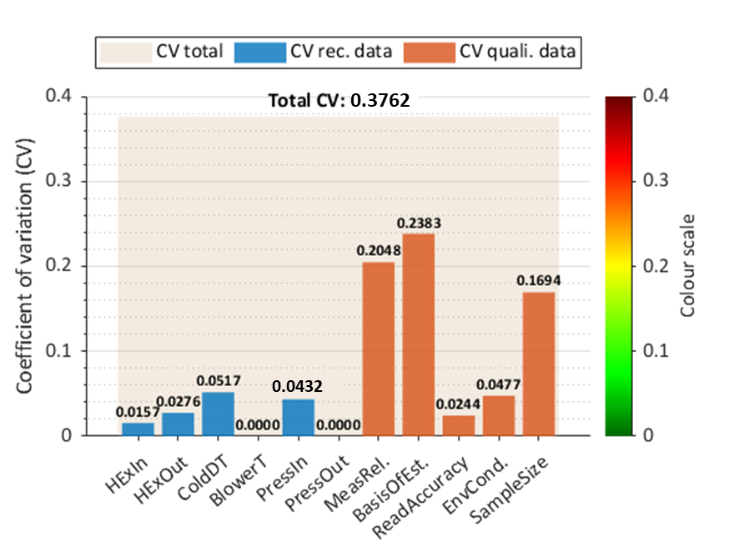
Framework implementation: Heat exchanger test rig
Step 4: Combine CVs
Step 5: Visualise results
Combined coefficient of variation
PDF | CV comb. | CV agg. | CV_{T}
Ln recorded | 0.0317 | 0.3701 | 0.3762
Ln pedigree | 0.3688
Norm. recorded | 0.0674 | 0.0676
Uni. recorded | 0.0000
Notes:
Step 4: The combined CV of each PDF is shown in Table 4, aggregated for symmetric and asymmetric distributions and total CV.
For Step 5, the visualisation illustrates the relative CV of each quantitative input, in blue, and qualitative input, in orange, against the aggregated total in cream
The colour bar represents the acceptability of the relative factors according to predefined scales.
Further development will allow results to be compared through sensitivity analysis

Slide 19
Discussion and conclusions
Purpose: Enhance system performance assessment through quantification and aggregation of compound uncertainties
Achieved through coefficient of variation (CV)
Developed existing techniques
Identify factors outside acceptable levels
Select the best suited PDF for each input
Enhanced performance assessment and corresponding maintenance planning for CES and respective subsystems
Notes:
The framework was designed to enhance system performance assessment through the quantification and aggregation of compound uncertainties. These arise as a result of different recording methods and assumptions made about the system and are modelled by different distributions.
The use of CV to represent uncertainty enabled effective quantification of these compound uncertainties.
Previous work in this area enabled the aggregation of individual quantitative uncertainties with qualitative through the pedigree matrix
The capability to aggregate uncertainties represented by a mix of distributions is further developed here through an indication of factors that lie outside acceptable levels, as well as a function to allow the user to view and select the best suited distribution for each input.
Acceptable levels of uncertainty are user-defined according to the application and visualised by the colour bar.
Benefits of this framework include enhancements to performance assessment and corresponding maintenance planning for complex systems and respective subsystems.

Slide 20
Discussion and conclusions
Further development – Framework
Determine qualitative input uncertainty indicators from multiple sources (surveys / interviews)
Determination of acceptable uncertainty parameters to be scaled according to calculated CV
Improved techniques to determine sensitivity coefficients for each input
Account for correlations between input parameters
Forecast quanitified uncertainties through the in-service life
Notes:
Further development of the framework is required to allow for determination of uncertainty indicators for qualitative inputs given my multiple sources, such as surveys or interviews.
This can be done separately, but an integrated process would be more efficient.
Similarly, determination of acceptable uncertainty parameters for each input will be performed within the framework.
Step 5 of the framework requires further development to determine sensitivity coefficients for each input
Correlations between input parameters will also be accounted for, as well as the forecasting of quantified uncertainty through the in-service life

Slide 21
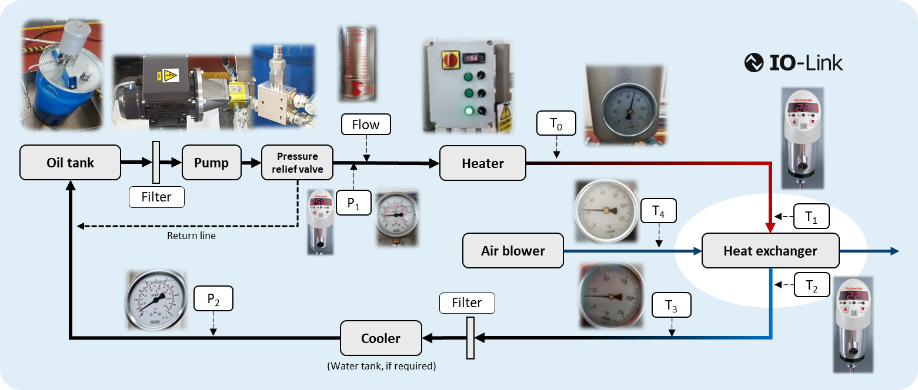
Discussion and conclusions
Further development – Heat exchanger
Digital temperature & pressure sensors
Motorised pump
(constant flow rate)
Notes:
The heat exchanger rig has been since been upgraded to resolve the issues in flow rate and temperature reading through the air blanket produced by the blower.
A new centrifugal pump has been fitted and digital temperature and pressure sensors have been installed, using the IO-Link interface.
This will improve data quality and allow for more consistent recordings to be made for uncertainty assessment.

Slide 22

Alex Grenyer
PhD Researcher
Cranfield University
E: a.h.grenyer@cranfield.ac.uk

