Slide 1
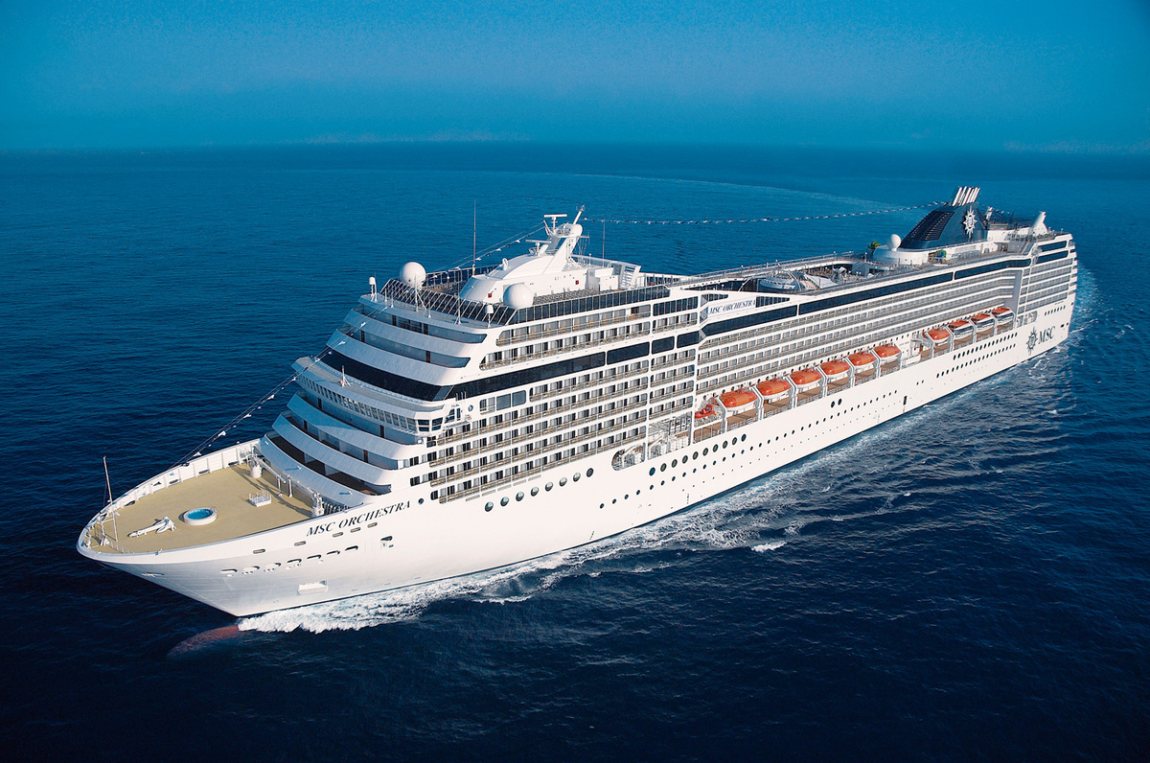
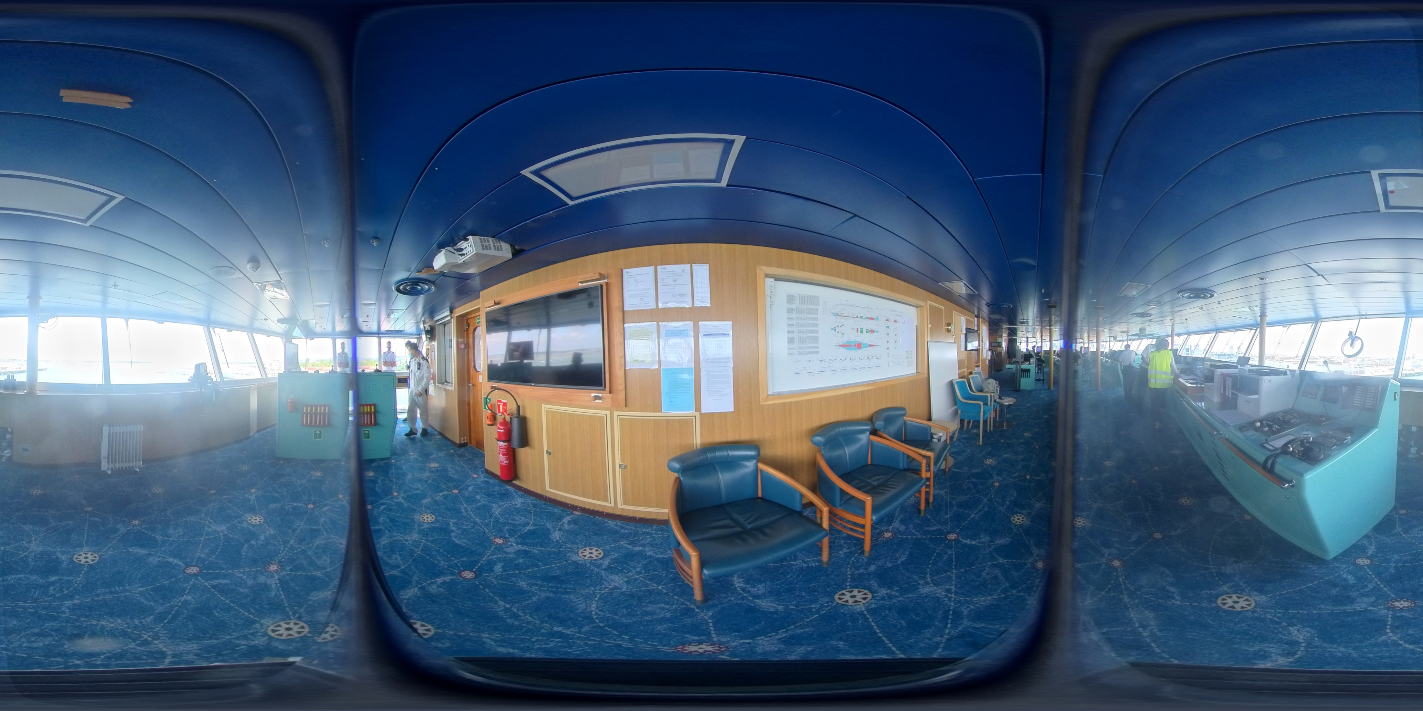


Virtual Reality Interactive Training for Maritime Crews in Response to Terrorist Attacks on Cruise Ships
Selina Robinson & Dr Amy Meenaghan, University of Portsmouth
Aims and Objectives
Aim: To create an informed and effective training package, presented in Virtual Reality (VR), to improve the response to potential terrorist threat on board passenger vessels.
Objectives:
1) Conduct a comprehensive literature review to guide understanding of potential threat.
2) Engage in discussion with industry, security and governmental representatives to inform development of an evidence-based training package
3) Produce, test and refine training package through collaborative training with Ship Masters, Security Personnel and Crew members.
Virtual Reality (VR) as a training tool
While the use of simulated environments have been demonstrated to be effective in facilitating the development of intuitive, implicit and functional knowledge (Swaak et al., 1998), useability issues (such as cumbersome headsets and the experience of cybersickness; Costello, 1993) slowed the uptake of immersive environments as training tools on a wide scale. Recent rapid technological development, plus a reduction in associated costs, mean that VR is now being considered as a viable and effective tool within the domains of education and training. Simulated environments show great potential for allowing demonstration of learning objectives, repeated practice of practical skills, and ongoing and responsive feedback and feedforward (Gibson et al., 2009). The benefits are particularly great when applied to learning tasks that involve hard to replicate or risky scenarios (Hopewell, 2008). Equally, the immersive nature of the VR experience increases learner engagement, improving the transfer of knowledge and skill acquisition to the real world (Witmer & Singer, 1998).
VR was chosen as a suitable medium for the presentation of the training package in development, as, alongside the benefits noted above, the Cruise Ship Industry has been greatly impacted by the Covid-19 pandemic. As such, the provision of a financially viable training tool that can be accessed remotely and during flexible working hours is key for uptake on a wide scale.
Progress to date
This project is part of a wider portfolio of teaching, training and research resources being developed by the University of Portsmouth’s Virtual Crime Lab (VCL), based in the School of Criminology and Criminal Justice (SJJC). The VCL promotes and develops VR, AR and 360 imaging tools. The Maritime Security Project aims to demonstrate the capacity for refining cognitive and decision-making processes using VR.
VR 360-video images , 3D photogrammetry capture and 360 capture of the bridge of one passenger ferry and one cruise liner. These have been converted into simulated environments that can be viewed on a laptop screen or HMD (Head Mounted Device).
Drone images have been taken to further inform and assess risk of attack and to support implementation of VR.
Interviews have been conducted with relevant personnel from the Maritime Industry (including cruise line MDs, ship masters and crew, security personnel, representatives from relevant governmental organisations and the police) to assess risk and current response.
Collaborations have been discussed and agreed with key training organisations in the field.
A thorough review of current guidance from relevant organisations (including the IMO) and training provision from jurisdictions including the UK and the US has been undertaken.
A series of workshops with interested parties is underway This, alongside information gathered in 2) and 3) above is being used to create a comprehensive training package.
Background
Despite increasing concern from policymakers and maritime security experts regarding the risk of terrorist attacks on maritime vessels (e.g. Trelawny, 2013), research within this domain remains somewhat neglected. To date, such attacks have been mercifully rare. Nonetheless, the potential for significant casualties and loss of life, particularly when considering ‘soft’ targets such as cruise liners and passenger ferries, indicate the need for robust training schedules for captains and crew members (see Bowen et al., 2011).
Research indicates some overlap between piracy and maritime terrorism (e.g. Joubert, 2013), however it is important to understand the inherent differences in motivation and operationalisation of these forms of attack to ensure an accurate assessment of risk, and an appropriate application of security measures. The financial focus of most incidents of piracy means that much of the risk is largely endured by commercial shipping vessels. Conversely, the desire for political gain associated with terrorism puts passenger vessels at increased risk as a result of the anticipated global media response (Joubert, 2013). Current training provision in relation to crew member response to a terrorist incident on a passenger vessel is limited, and in the opinion of experts in the field, outdated and ineffective. This project aims to address this gap in understanding and provision.
Implications
The simulation is designed flexibly to allow for adaptation to different types of vessel and a wider range of threats (e.g. piracy, hijacking, biological attach, cyberattack, suicide bombing and drone attack). This can then be extended to other modes of transport. Future directions for simulation development will be assessed on an ongoing bases in consultation with industry experts.;

