Slide 1
Dan Powell
Centre for Defence Engineering

Slide 2
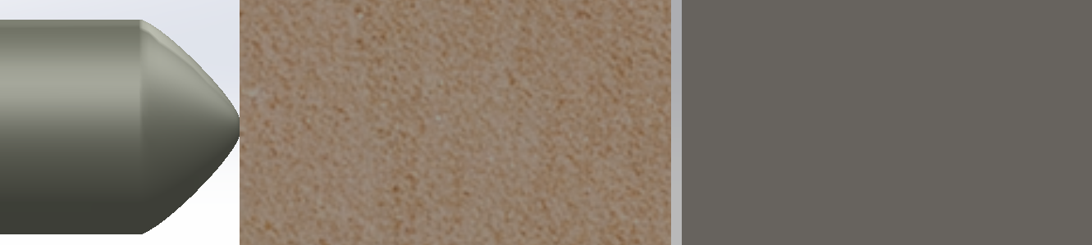

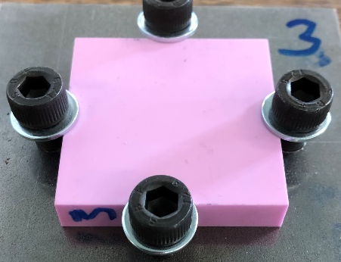
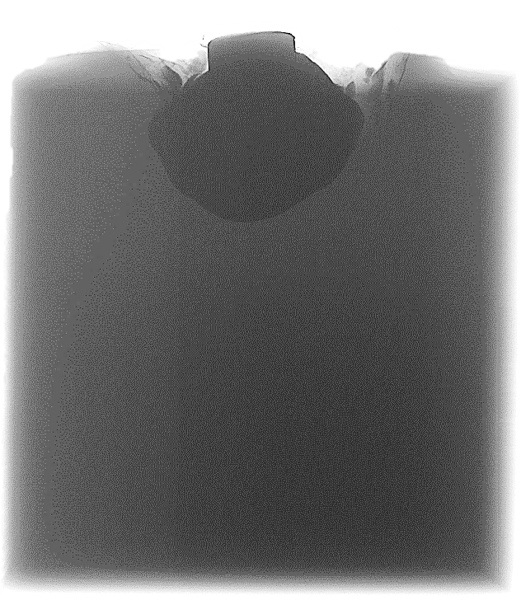
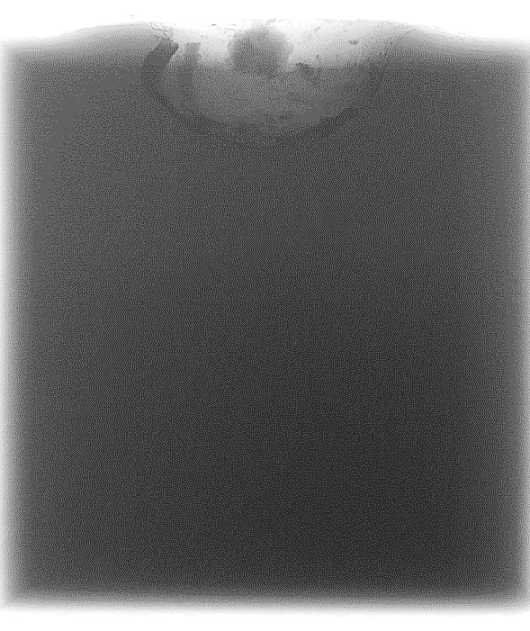
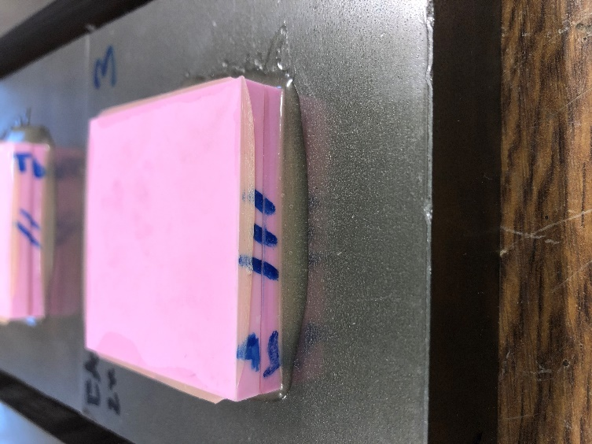

Little layer. Big results.
Penetrator
17:1 length:diameter
Up to 80 cm long
1700-2000 m/s
Ceramic
Hard and brittle
Several cm thick
Interlayer
Adhesive layer
50-500 μm thick
Metal
Energy-absorbing backing
Several cm thick
Notes:
EPH&SP6

