Slide 1

A DECISION SUPPORT SYSTEM TO IMPROVE SERVICE QUALITY IN MULTIMODAL RAPID RAIL SYSTEMS: A BAYESIAN PERSPECTIVE
Seda Ugurlu, Emel Aktas, Ilker Topcu
Istanbul Technical University

Slide 2


Outline
Introduction
Literature Review
Methodology
A Case Study
Results and Discussion
Conclusion

Slide 3
Introduction
Increasing transit ridership due to
Higher capacity, cost efficiency
Less environmental stress (i.e. low emissions & energy use)
Service quality
The key to promote transit ridership
Service quality in multimodal transportation systems
Integration of different types of modes and services
Interaction of various factors (time, comfort, etc.)
Customer perception
Notes:
Recent efforts on transportation planning and urban policy making often focus on increasing transit ridership
The ultimate goal of increasing the share of transit would result in
decreased environmental stress with lower gas emissions and higher energy efficiencies as well as
increased quality of life in urban areas by less congestion and less pollution.

Slide 4
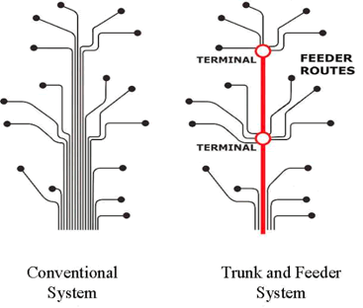
Introduction (cont’d)
Multimodal transportation → at least one transfer
Walking
Transfer
Walking
Origin
Bus
Metro
Destination
Access
Main
Egress
Trunk and feeder lines:
Trunk → high-capacity/high speed
routes connecting important nodes
Feeders → connect these nodes to
departure and destination points.
Notes:
A specific type of multimodal transportation system is trunk and feeder systems which offer high speed for travelers and high capacity&operational efficiency for service providers.

Slide 5
Introduction (cont’d)
A Bayesian Belief Network to handle
the multistage nature of multimodal travels and the integration between different services
interaction among the related factors (i.e. travel mode, travel time, comfort, etc.)
uncertainties and incomplete knowledge about customer perceptions
Bayesian Belief Network (BBN)
a new methodology to evaluate the service quality
a decision support system to identify improvement policies

Slide 6
Literature Review
Structural equation modeling (Roorda, Ruiz, 2008; Shiftan et al., 2008; Chou,Kim, 2009)
to capture the interactions among quality factors
Simulation (Hsu, 2010; Rietveld et al., 2001)
to evaluate specific service quality factors in multimodal transportation systems
Quality index formulations with regression analysis (Estupinan,Rodriguez, 2008; Debrezion et al., 2009)
Quality evaluation with gap/impact anaylsis (Morpace,Cambridge Sys., 1999; Brons et al., 2009)
Notes:
An extensive literature review on evaluation of service quality in transportation systems

Slide 7
Bayesian Belief Networks
A network-based framework for representing and analyzing models involving uncertainty
uncertainty is handled with the use of Bayesian statistics
network representation of problems is used
Knowledge structure as a network
Variables depicted as nodes
arcs represent probabilistic dependence between variables
conditional probabilities encode the strength of dependencies
Factored joint probability distribution as a directed graph
structure for representing knowledge about uncertain variables
computational architecture for computing the impact of evidence on beliefs

Slide 8
An Example for A Factored Joint Distribution
X₁
X₁
X₁
X₁
X₁
X₂
X₂
X₂
X₂
X₃
X₃
X₃
X₅
X₅
X₅
X₆
X₄
X₆
X₄
p(x₁, x₂, x₃, x₄, x₅, x₆) = p(x₆ | x₅) p(x₅ | x₃, x₂) p(x₄ | x₂, x₁) p(x₃ | x₁) p(x₂ | x₁) p(x₁)
p(x₆ | x₅)
p(x₅ | x₃, x₂)
p(x₄ | x₂, x₁)
p(x₃ | x₁)
p(x₂ | x₁)
p(x₁)

Slide 9
Bayes Rule
A₂
A₃
A₄
A₁
p(A,
B)
p(B
|
A)p(A)
p(A
|
B)
=
=
E
p(B)
p(B)
A₆
A₅
p(E
|
A
)p(A
)
p(E
|
A
)p(A
)
p(A
|
E)
=
i
i
=
i
i
i
p(E)
∑
p(E
|
A
)p(A
)
i
i
i
Based on definition of conditional probability
p(A_{i}|E) is posterior probability given evidence E
p(A_{i}) is the prior probability
P(E|A_{i}) is the likelihood of the evidence given A_{i}
p(E) is the preposterior probability of the evidence
Notes:
This may be skipped in the presentation.

Slide 10
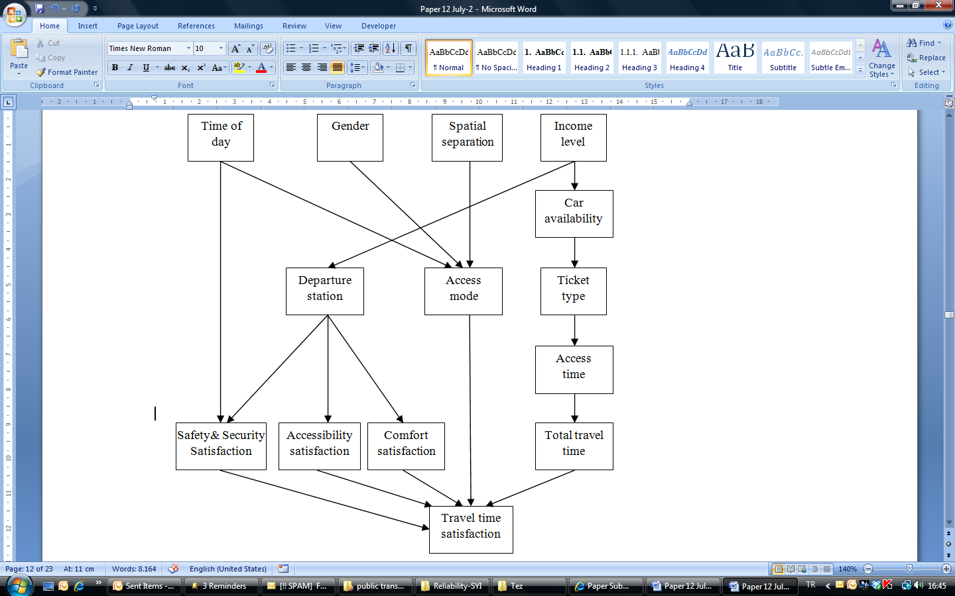
Inference Using Bayes Theorem
Inference mechanism of BBNs
finding the probability of an event, given a set of evidence
by applying Bayes Theorem sequentially

Slide 11
Learning of BBNs
Learning of parameters of conditional probabilities from data
Define a distribution type and a prior distribution
Update the distribution based on the observations in data to obtain the posterior distribution
The network structure
Causal relationships based on expert knowledge
Learning from database based on search methods (i.e. greedy search, simulated annealing, genetic algorithms)

Slide 12
Proposed Methodology
The steps of our methodology:
Identification of key variables through literature review
Dimension reduction by factor analysis
Specification of causal map using expert knowledge
Construction of final BBN and calculating conditional probabilities
Sensitivity analysis and identification of key variables

Slide 13
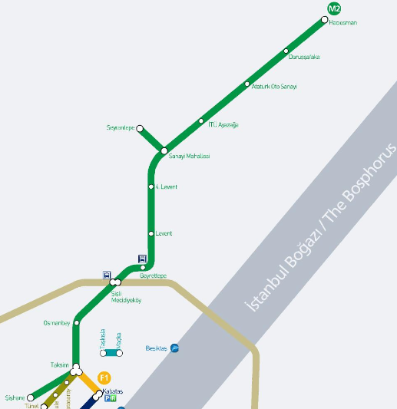
A Case Study
Evaluation of service quality of a trunk and feeder system in Istanbul
Trunk line → metro line in Istanbul (green line in the Figure).
Feeder lines → connecting lines to metro stations (One is the light brown line showing bus rapid transit)

Slide 14
Dataset
Dataset obtained from a survey (conducted by the local organization for metro systems, Istanbul Ulasim AS)
750 responses in 2010
Data was collected at the stations of the metro line with a stratified sampling plan based on the number of passengers using each station.
Dataset included the access part of the transit travels but not the egress part.
Thus, we characterize the multimodal transit travels only with the access and main parts of the travels.

Slide 15
Specification of key variables
After literature review and factor analysis, the variables used for evaluating service quality of multimodal transportation systems
Variable | States
Access mode | Walking, bus, BRT, funicular, minibus, taxi, private vehicle
Departure station | Taksim, Osmanbey, Gayrettepe, Sisli, Levent, Dort Levent
Spatial separation of origin | Close or distant
Time of day | Peak, Off peak, late night
Access time | Length of access time
Total travel time | Length of total travel time
Travel Time satisfaction | Satisfaction level related to travel time
Accessibility satisfaction | Satisfaction level related to accessibility
Safety & Security satisfaction | Satisfaction level related to safety & security
Comfort satisfaction | Satisfaction level related to comfort
Income level | Level of income
Gender | Female or Male
Car availability | No ownership, Owner but not available or Available
Ticket type | Regular ticket, Frequent traveler or Travel card

Slide 16
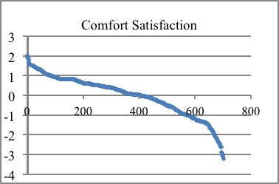
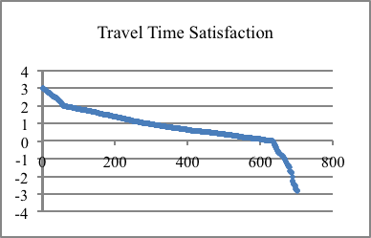
States of the variables
Continous variables (i.e. travel time) have been transformed into discrete variables wrt. breakpoints in the data

Slide 17
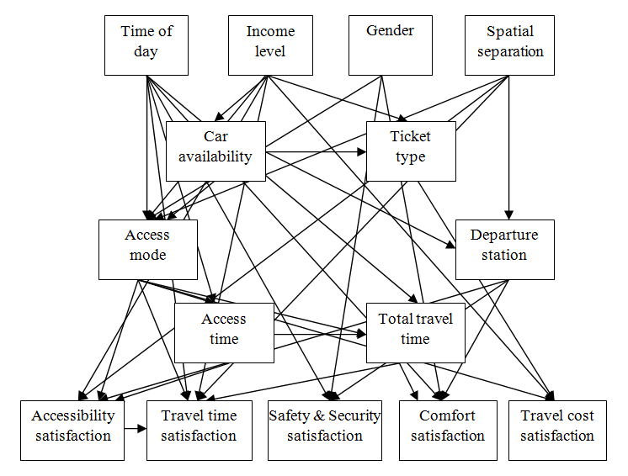
The preliminary causal map
3 experts (an urban planner , a civil engineer , an academician). were asked to specify causal relations. The resulting map:

Slide 18
Construction of BBN
Relationships are revised with experts in order to maintain the acyclic structure of the BBN. The final causal map:
the prior probability specified for “income level” is unconditional because there are no parent nodes
Conditional probability of “access mode” is formulated as:
P(AccessMode|TimeofDay, Gender, SpatialSep., TicketType) = P(AccessMode, TimeofDay, Gender, SpatialSep., TicketType) / P(TimeofDay, Gender, SpatialSeperation, TicketType)

Slide 19
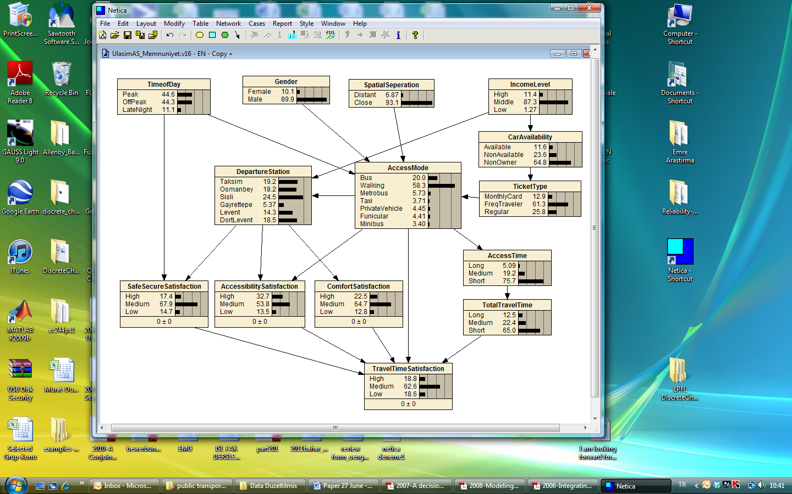
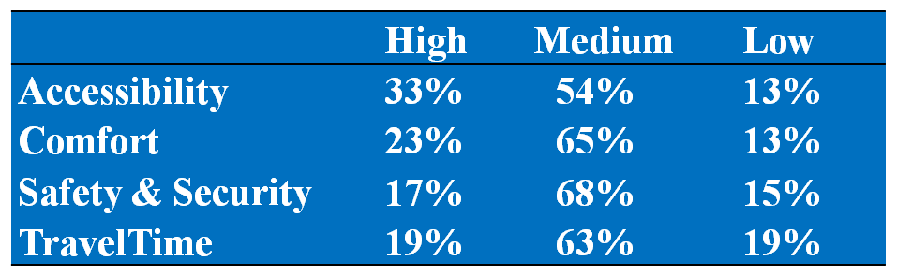
Complied BBN
Beliefs for satisfaction levels

Slide 20
Calculating Posterior Probabilities When an Evidence is Known
If the traveler’s mode is bus, this additional information is represented as
P*(AccessMode=Bus; Acc.Mode=Walking; AccessMode=Metrobus; AccessMode=Taxi; AccessMode=PrivateVehicle; AccessMode=Funicular; AccessMode=Minibus) = (1;0;0;0;0;0;0)
The posterior probability P* is calculated as,
P*(AccessMode, TimeofDay, Gender, SpatialSep., TicketType) = = P(TimeofDay, Gender, SpatialSep., TicketType | AccessMode) x P*(AccessMode) = [P(AccessMode, TimeofDay, Gender, SpatialSep., TicketType) x P*(AccessMode)]/ P(AccessMode).

Slide 21
Calculating Posterior Probabilities When an Evidence is Known (cont’d)
Posterior probability distribution of “travel time satisfaction” when “access mode” is known in our BBN
 | Travel Time Satisfaction
 | High | Medium | Low
No additional Information | 18.8% | 62.6% | 18.6%
Access Mode Is Bus | 20.3% | 60.6% | 19.1%
Access Mode Is Walking | 14% | 71.6% | 14.3%
Access Mode Is Metrobus | 31.2% | 39.2% | 29.7%
Access Mode Is Taxi | 29.1% | 41.9% | 29.1%
Access Mode Is Private Vehicle | 30.8% | 39.3% | 29.9%
Access Mode Is Funicular | 27.9% | 44.2% | 27.9%
Access Mode Is Minibus | 32.3% | 36.9% | 30.8%

Slide 22
Sensitivity Analysis
Sensitivity analysis to identify relative importance of those variables affecting a variable of interest
In our final BBN, travel time satisfaction is the main performance indicator . So sensitivity analysis of travel time satisfaction is:
Node | Mutual Info | Quadratic Score
Accessibility satisfaction | 0.05479 | 0.0103149
Access mode | 0.04759 | 0.009749
Total travel time | 0.01967 | 0.0042372
Safety&security satisfaction | 0.01699 | 0.0036876
Comfort satisfaction | 0.00981 | 0.0021108
Notes:
The ‘‘Mutual Info’’ column of Table 7 shows how much the variable can affect the query node (travel time satisfaction) using the mutual info sensitivity measure. The higher the mutual info sensitivity measure, the more effective the parent variable. The ‘‘Quadratic Score’’ column of Table 7 compares the sensitivities for each of the findings nodes. It is seen from the table that travel time satisfaction is most sensitive to accessibility satisfaction and access mode, followed by total travel time, safety & security satisfaction and comfort satisfaction.

Slide 23
Results and Discussions
The most important variable of the multimodal travels: access (feeder) mode.
In terms of travel time satisfaction; accessibility satisfaction and access mode are more effective variables than total travel time.
The performance dimensions, comfort, safety & security and accessibility satisfaction are closely related to departure station of the trunk line (interchange station).

Slide 24
Conclusion & Future research
A BBN approach for performance evaluation of multimodal transportation systems to handle the complexity of
the integrated services,
incomparable variables and
uncertainties regarding customer perceptions
Future research:
Incorporating the policy dimension in the BBN
Learning of BBN network structure from database based on search methods (i.e. greedy search, simulated annealing, genetic algorithms)

Slide 25
Thank you Questions?

