Slide 1

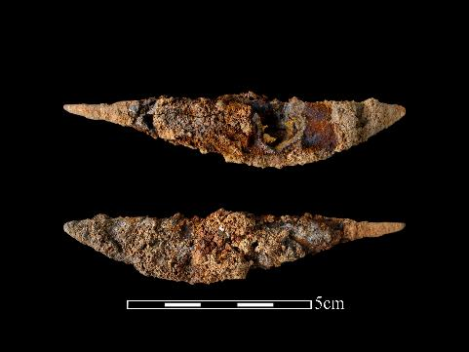
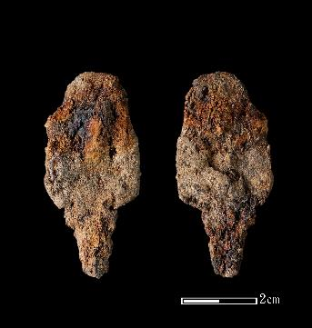
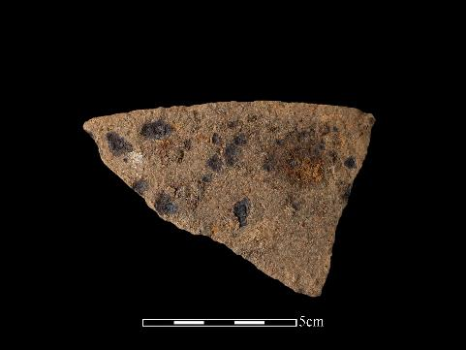
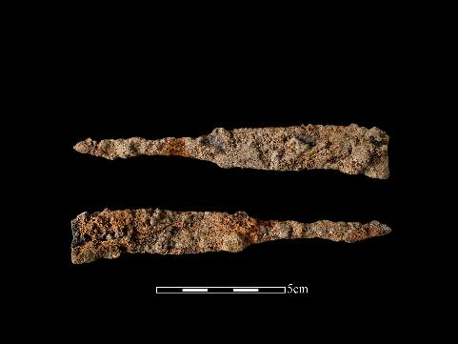
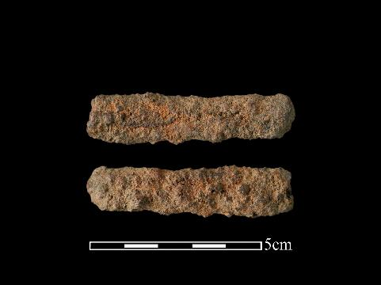
Preliminary Analysis of Iron Remnants from Three Archaeological Sites in Central and Eastern Taiwan
Chih-Ling Leeª, Ke-Hung Liu^{b}, Yu-Pei Chen^{c}, Nathaniel Erb-Satulloª
ª Cranfield Forensic Institute, Cranfield University, UK
^{b} National Museum of Natural Science, Taichung, Taiwan
^{c} National Taiwan University, Taipei, Taiwan
Notes:
Preliminary Analysis of Iron Remnants from Three Archaeological Sites Taiwan, here are some pictures of the iron objects from central Taiwan.

Slide 2
Preface
Chih-Ling’s research focuses on reevaluating the provenances of iron artifacts from various sites in Taiwan. Today, she is going to present the results of her previous works and discuss some recent investigations that she has just initiated. Due to the lack of a comparable slag inclusion database for Taiwanese iron artifacts, determining their origins has been a challenging task. During the past few years of fieldwork in central Taiwan, Chih-Ling has collected dozens of iron samples in this area and received loads of blocks, iron samples from other senior researchers, so it should now be feasible to reinvestigate the objects.
Notes:
Okay, Hello everyone, I am Chih-Ling, I am currently pursuing doctoral degree at Cranfield Forensic Institute. My research focuses on reevaluating the provenance of iron artifacts from different sites in Taiwan. Having previously engaged in archaeological excavations in central Taiwan for several years, I became interested in understanding the manufacturing processes and sources of the iron artifacts unearthed in this region. Therefore, I pursued a master's degree in Archaeological Science at UCL, where I began to explore these topics.
Today, I will present the results of my previous analyses and discuss some recent investigations I have just initiated. Due to the lack of a comparable slag inclusion database for Taiwanese iron artifacts, determining their origin or recipe has been a challenging task. During the past few years of fieldwork in central Taiwan, I have collected dozens of iron samples in this area and received loads of blocks, iron samples from other seniors so I think now it is time to reinvestigate the objects. I would greatly appreciate any feedback and insights from all of you as I continue to work on my research. Thank you!

Slide 3
Research Background
During the past few decades, it has been widely believed that bloomery artifacts found in Taiwan archaeology were locally produced, while cast iron might have been imported/exchanged from mainland China. The argument needs to be refined since cast iron has long been the dominant ironworking technology in China. However, bloomery smelting technology has also been adopted in peripheral regions, leading to the establishment of several local workshops.
As for Taiwan, there is evidence of our own bloomery iron tradition in Northern Taiwan during the Iron Age, yet different waves of colonization history complicate the story of iron objects unearthed during excavations. We have not yet deciphered the exact provenance of Taiwanese iron objects with an objective, statistical approach.
Notes:
In ancient iron technology, there were two main pathways for making iron. The first is the bloomery or direct method, which extracts iron from a solid state at lower temperatures (ca.1000c). Another method is known as the casting or indirect method, which extracts iron from a liquid state at higher temperatures (ca. 1300c). Over the past few decades, it has been widely believed that bloomery iron wares found in Taiwan were locally produced, while cast iron might have been exchanged from mainland China.
However, the argument needs refinement, as cast iron has long been the dominant iron technology in China. But bloomery smelting technique has also been adopted in peripheral regions as well, leading to the establishment of several local workshops. The use of bloomery method can be considered as a strategy, or the so-called “technological choice” in regions with limited labor and natural resources such as prehistoric, indigenous Taiwan.
As for Taiwan, we have our own bloomery tradition conducted by indigenous people in Northern Taiwan during the Iron Age, yet the Dutch and the Spanish once colonized the island in the early 17th century; also, Han Chinese, the Qing dynasty officially occupied the island since the late 17th century; again, the Japanese defeated Han people and ruled the area until the end of WWII. All of these complicate the story of iron objects unearthed during excavations. But we haven‘t yet deciphered the exact provenance of Taiwanese irons with an objective, statistical approach.

Slide 4
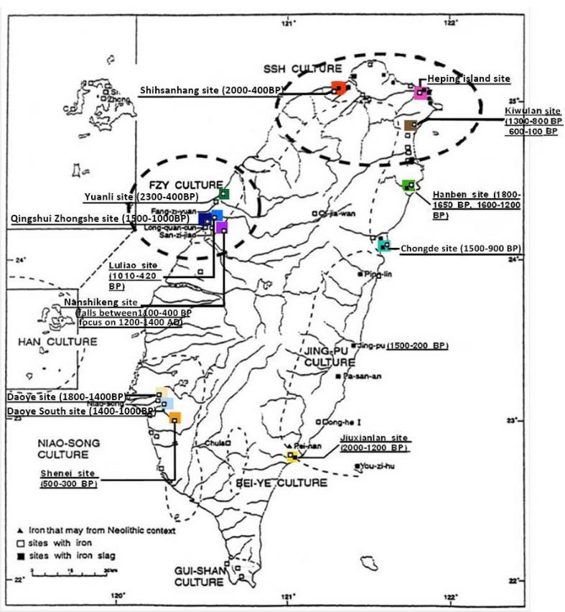
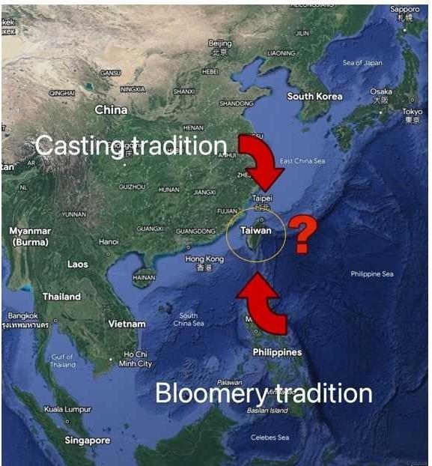
Iron traditions in Taiwan
Fig. 1. Two different smelting traditions: Bloomery iron from Southeast Asia; Casting iron from China (Revised from Google Earth 2023)
Fig. 2. The distribution of iron and slag in archaeological sites in Taiwan
(Revised from Chen 2000: 166)
Notes:
Picture on the left, I want to demonstrate Taiwan's geographic location, just right between the casting tradition from China and the bloomery tradition From Southeast Asia. Taiwan did not have a significant influx of Han Chinese settlers until the 17th century. The island was primarily inhabited by indigenous peoples before then. The social development of ancient indigenous peoples in Taiwan was basically organized into tribes, and in the later period, it have evolved into scattered chiefdoms.
We often found both cast iron and bloomery iron products at various Iron Age sites across the island, but the overall types are quite simple, mainly daily, household tools like blades, axes, nails, and arrowheads, with no more than ten different types. Besides, somehow different sites have varying iron tools, but so far, the issue is not clear.
It is worth mentioning that the evidence of ironworking residues, such as slags and “furnace” lining, have only been found in the eastern part of Taiwan, despite iron artifacts being widespread throughout the island. And again, we are not quite sure why that is the case.
As for the picture on the right, it illustrates several major sites with iron artifacts or residues that have been unearthed.

Slide 5
Previous research on iron objects in central Taiwan
Notes:
So first, I would like to show some of my previous work on several iron objects in central Taiwan.

Slide 6
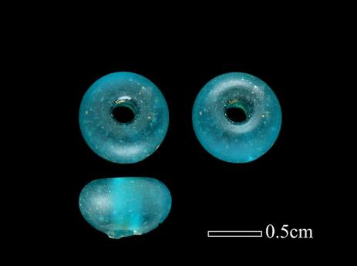
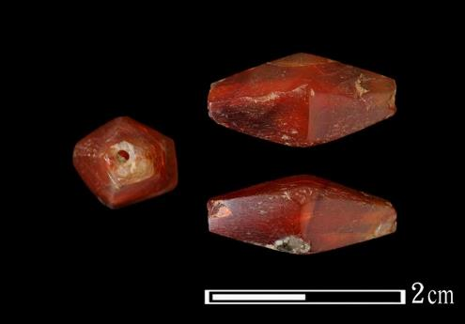
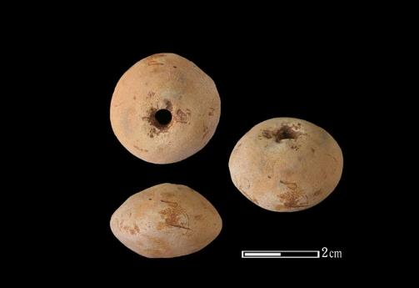
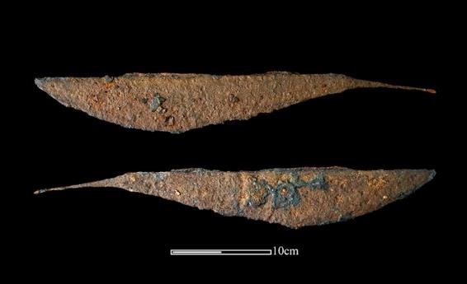
Brief introduction of the Nanshikeng and Luliao site
The Nanshikeng site
late Iron Age site
ca. 1100-400 BP, (12th- 14th century AD).
Small-scale settlement
numerous ash pits (firing pottery→midden)
Pottery, spindle whorls, iron objects, glass/agate, bronze coins, animal bones, etc.
Lack of stone tools and the use of iron tools
The Luliao site
late Iron Age site
ca. 1000-400 BP, (16th century AD).
Large-scale settlement
Discernable cultural layer and burials, ash pits
Pottery, iron objects, glass/agate beads, bronze coins and bell, animal bones, bone tools, etc.
Few chipped stone axes and hammerstones
Notes:
Nanshikeng site is a late Iron Age site located in central Taiwan, which dates back to around 1100 to 400 years before present, with AMS dating results primarily indicating the 12th to 14th century. Nanshikeng was once inhabited by the ancestors of the Papora tribe, a Plains Indigenous people in central Taiwan. Nanshikeng situated between two streams at the foot of a mountain, the site's cultural layer is often quite thin, making it challenging to identify.
Archaeological teams have unearthed numerous ash pits at the location. They suspect that these pits were initially used for firing pottery and were later repurposed as middens. The pits have yielded pottery sherds, shells, animal bones, and various artifacts, including iron objects, bronze coins (dating to the early 12th century of the Northern Song Dynasty), glass beads, bone tools and more. The absence of stone tools suggests that ancients may have participated in exchange networks with coastal peoples from the north or Han Chinese from mainland China to acquire household items, including various iron tools.
The Luliao site, located 5 kilometers north of the Nanshikeng (about 50-minutes’ walk), is another late Iron Age site in central Taiwan. However, Luliao covers an area roughly ten times the size of Nanshikeng. Luliao dates back to around 1000 to 400 years ago, although recent excavation conducted this year have provided dating results suggesting a later period, around 400 years before present.
Like Nanshikeng, Luliao has revealed plenty of ash pits, middens, and some burials, although the cultural layer is thicker and more discernible. As to the iron artefacts, Luliao surpasses Nanshikeng in both quantity and diversity. Besides, there are few stone tools, including chipped stone axes and hammerstones, various bone tools along with significant amount of glass and agate beads have been unearthed as well.

Slide 7
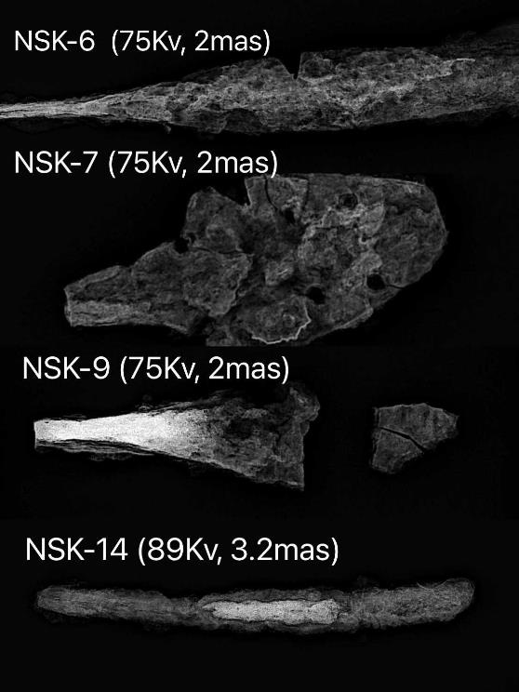
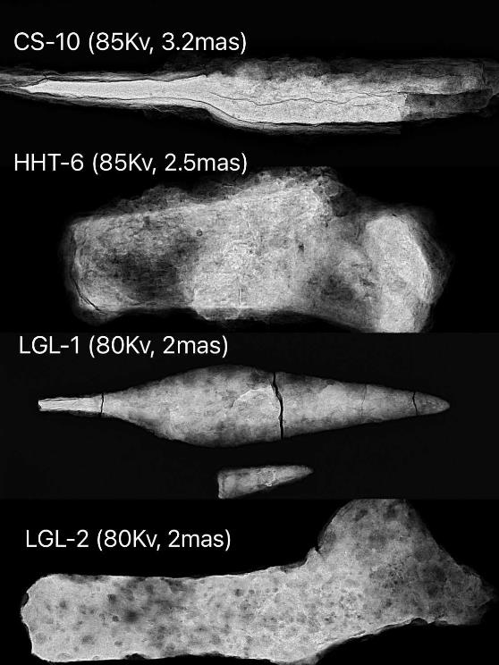
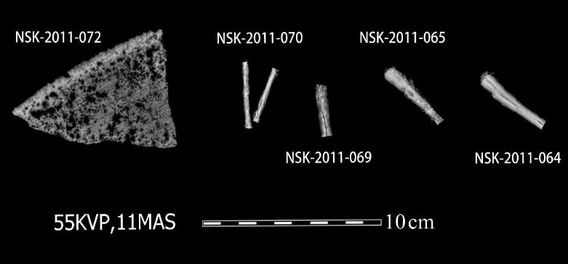
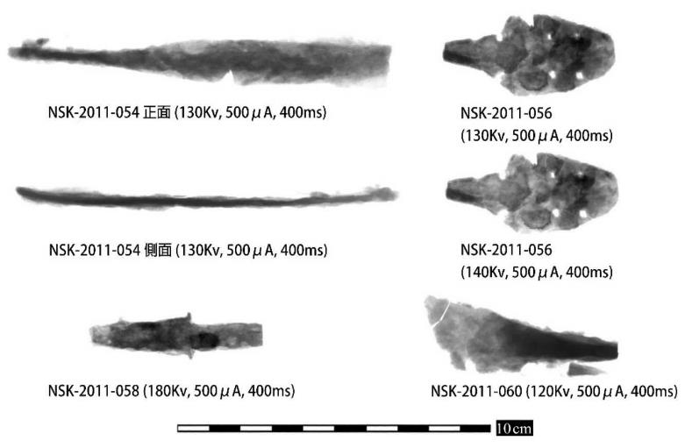
X-Ray Photos
Fig. 3. X-Ray and CT-scanning images of iron samples from central Taiwan. (Photo sizes will be adjusted in the official report)
Notes:
Since destructive analysis is inevitable in the study of slag inclusions within irons, it is crucial to understand their original contours and preservation conditions before sample preparation.
To achieve this, photographs are taken using X-ray or CT scanning, and I select a relatively well-preserved area to cut a small chip and mount it into resin block. In my previous work, I collaborated with the Scientific Analysis Laboratory of the National Palace Museum in Taipei to conduct CT-scanning. Some iron artifacts underwent X-ray imaging at a private medical radiology clinic. More recently, X-ray analyses were performed at Cranfield Forensic Institute.

Slide 8
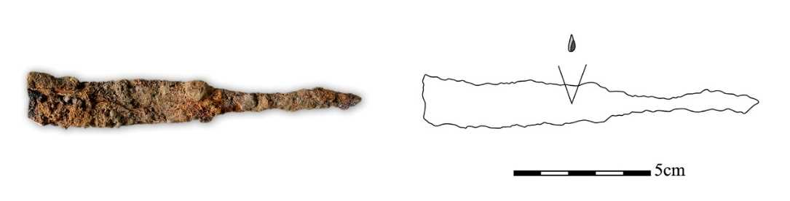
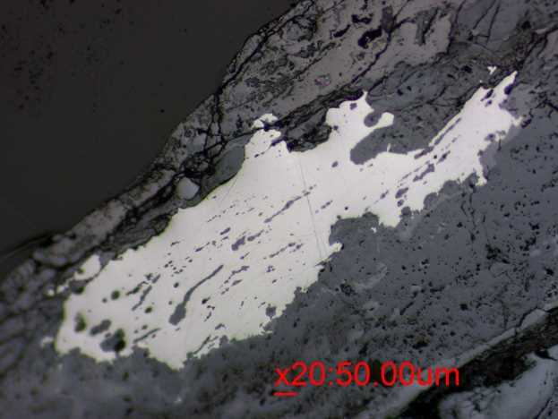
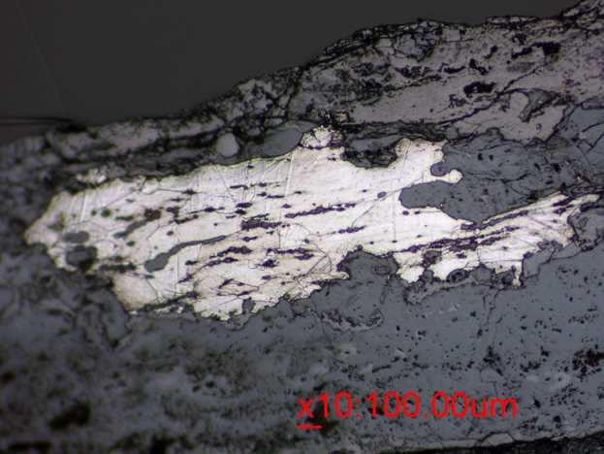
Metallography
NSK-6 Knife (spine)
Large ferrite grains.
Elongated slag stringers.
No trace of dispersed pearlite.
Hard to identify trace of decarburization or heat treatment .
Likely underwent furnace cooling.
Fig. 4. left: before etching; after etching, SEM, BSE, 100X.
Notes:
The purpose of metallographic analysis is to understand the morphology of iron crystals and the possible thermal treatment processes involved.
This is a part of spine in Nanshikeng-6. The structure consists of large ferrite grains, without clear signs of intense hammering deformation, while the elongated stringers in the middle indicate that the object had been forged.
There is no trace of dispersed pearlite around the grain boundaries, suggesting the structure is closed to pure iron. It is hard to identify any traces of decarburization or heat treatment based on the remaining iron. As ferrite grains are large, suggesting the artifact likely underwent furnace cooling.

Slide 9
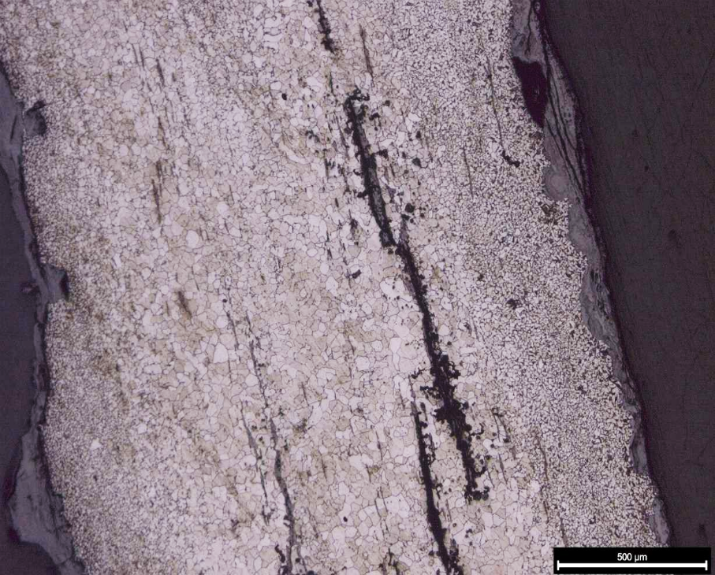
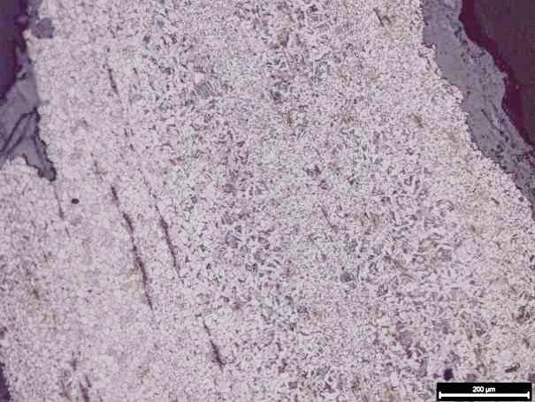
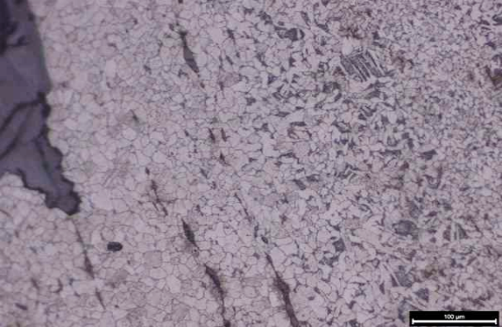
A3：L-Shape Iron Sheet
Hypo-eutectoid steel.
Elongated slag stringers.
Two strips of Widmanstatten structure, indicate (air) quenching.
Difference in cooling rates.
Fig. 5. Two strips of Widmanstatten structure under OM, PPL.
Notes:
This one is a L-shape iron from Luliao, it mainly consists of ferrite in the center, with ferrite and pearlite at the edges as a hint of slightly carburized process, along with slag stringers at the interface between.
We can see wo strips of Widmanstatten structure present, indicating the object has been forged at high temperature followed by rapid air cooling. Since ferrite grains are smaller on the two sides, it reveals the difference in cooling rates between the inner and outer areas.

Slide 10
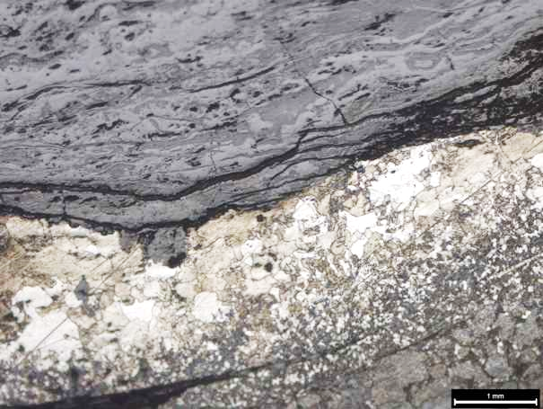
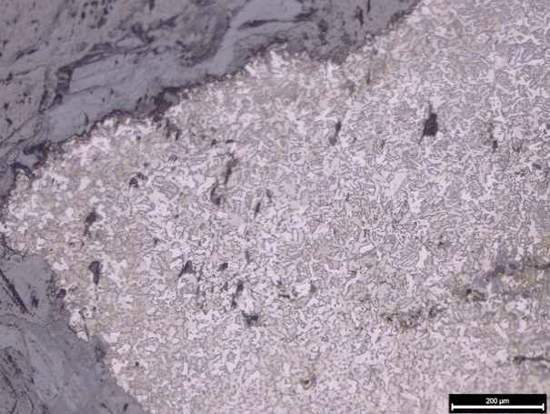
B14：Arrowhead
C11： Nail
Fig. 6. Remaining iron reveals ferrite structure, with pearlite dots.
Fig. 7. A mixture of Widmanstatten ferrite and pearlite grains.
Hypo-eutectoid steel.
The carbon content is unevenly distributed, with a mixture of Widmanstatten ferrite and pearlite along the grain boundaries.
Quenching results in the formation of an acicular structure.
The distribution of ferrite is uneven, with dispersed pearlite.
The layered structure suggests a history of repeated folding and forging.
Notes:
B14 has large ferrite grains on one side and dispersed pearlite grains on the other side. The layered yet corroded structure indicates repeated folding and forging during smithing. Folded structures with weld lines in between.
C11 is a nail from Luliao, featuring an overall hypo-eutectoid steel structure with unevenly distributed carbon content. One side reveals higher carbon than the other, with ferrite grains surrounded by fine, tiny pearlite dots. The opposite side displays a mixture of Widmanstatten structure with pearlite along the grain boundaries. The use of quenching results in an acicular structure, which increases hardness but reduces malleability.

Slide 11
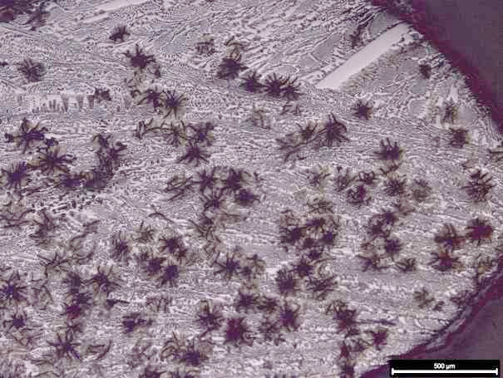
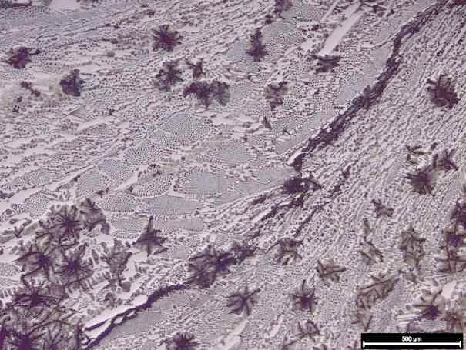
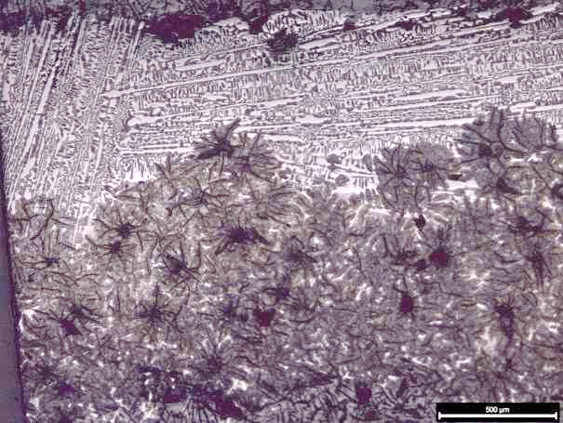
E15：Fragment of Caldron (?)
Fig. 8. The distribution of graphite flakes from the tip (left) to the center (right).
MCI (Mottled Cast Iron) reveals graphite flakes distributed within a white cast iron matrix (ledeburite).
Its properties fall between those of white and grey cast iron.
Notes:
E15 is perhaps a sherd of casting caldron. The overall structure is Mottled Cast Iron, which reveals graphite flakes distributed within a white cast iron matrix.
Its properties fall between those of white and grey cast iron.
The inner and outer areas experienced different cooling rates, which is a common occurrence in casting objects. Since ledeburite is inherently brittle, it is necessary to undergo annealing and graphitization of some of the cementite structure to enhance the malleability.

Slide 12
Overall Metallography
Iron artifacts from the Nanshikeng site (6 objects) and the Luliao site (23 object) have comparable metallographic structures.
Bloomery process with repeatedly folding and forging smithing, and a small amount of mottled cast iron objects (3 items).
The ancient craftsmen were indeed aware of the need for heat treatment to different purposes. Nearly all nails or needles have undergone quenching, resulting in a lath martensite or Widmanstätten structure. Other samples mainly consisted of large-grain ferrite or ferrite with fine pearlite dots interspersed.
Notes:
In the analysis of iron artifacts from the two site, it was observed that they have comparable metallographic structures. These Iron artifacts were primarily produced using bloomery process with repeatedly folding and forging smithing. Additionally, there were a small amount of mottled cast iron.
Regarding heat treatment, metallography reveals that most of the iron artefacts were made of low-carbon steel or soft iron. It is worth mentioning that the ancient craftsmen were indeed aware of the need for heat treatment tailored to different purposes. Nearly all iron nails or needles have undergone quenching, resulting in a lath martensite or Widmanstätten structure after water or air quenching on the outer surface, while the core remains ferritic.
As for knives, given that their blades were heavily corroded, I analysed the part of their spine and it appears to consist of ferrite, with at most a small amount of pearlite in the tang. So, they have a soft texture and relatively poor preservation condition, with no evidence of heat treatment observed in the remaining iron.
In overall, apart from quenching to increase hardness, there are no traces of the other heat treatment such as tempering, normalizing, or annealing in bloomery objects, making the metallography rather straightforward.

Slide 13
Slag Inclusion Analysis and the Concept of NRCs
What are iron slag inclusions? Iron slag inclusions are impurities that remain within the metal and can be defined simply as residue found in iron artifacts produced through smelting and smithing processes.
In provenance studies of iron objects, a common strategy is to analyse the chemistry of slag inclusions in relation to ore deposits and ferrous working wastes such as slags.
Experimental analyses (e.g., Blakelock et al. 2009, Dillmann and L’Héritier 2007, Buchwald 2005) have shown that certain compounds, such as magnesium, aluminum, silicon, potassium, calcium, titanium, and manganese oxides (above 0.1%), are "non-reduced" in slag inclusions. The ratio of these compounds remains constant for each iron object throughout the bloomery process.
The concept of non-reduced compounds helps differentiate between technological recipes of iron objects also distinguishes between direct and indirect iron production. By grouping ferrous remnants and understanding their relationships, we can identify potential production origins.
Notes:
So, what are iron slag inclusions? Iron slag inclusions are impurities that remain within the metal and can be defined as residue found in iron artifacts produced through smelting and smithing processes. These inclusions could provide us insights into the manufacturing process and the origin of the smelting materials.
In provenance studies of irons, a common strategy is to analyse the chemistry of slag inclusions in relation to ore deposits and ferrous remains such as slags. By comparing the differences in elements, we can discuss the relationships between irons, slags, and potential ores.
Experimental analyses have shown that certain compounds, are "non-reduced" in slag inclusions. The ratio of these compounds remains constant for each iron object throughout the whole bloomery process. Non-reduced compounds are less affected by thermal energy.
So, the concept of non-reduced compounds can help us differentiate between technological recipes of iron objects, and also distinguishes between bloomery and casting production. By grouping ferrous remnants and understanding their relationships, we can identify potential production origins. Also, by evaluating ironmaking models over time, we could probably unveil the patterns of variation and evolution in ironworking sites.

Slide 14
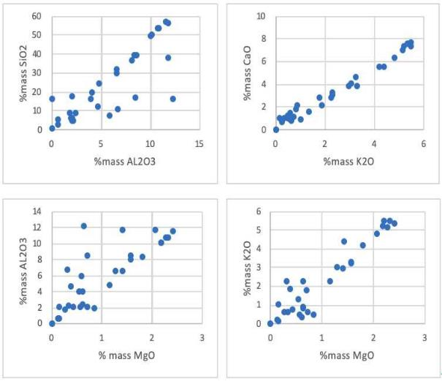
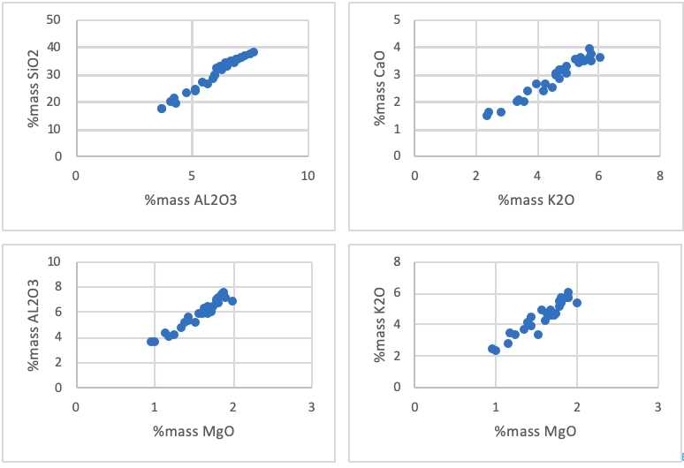
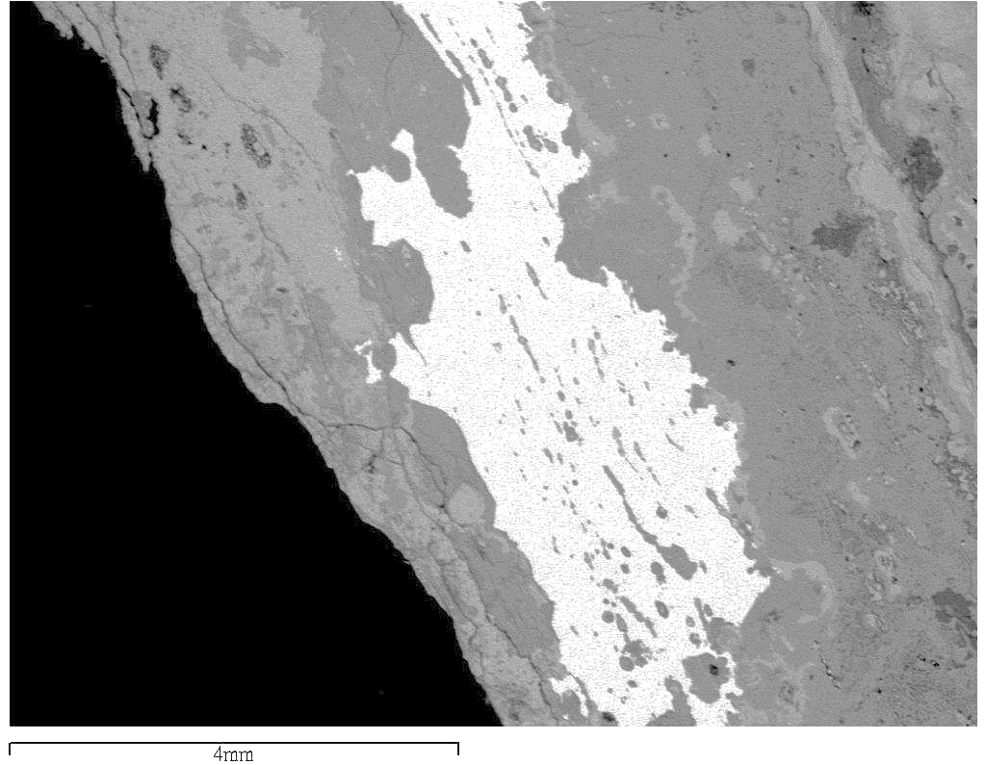
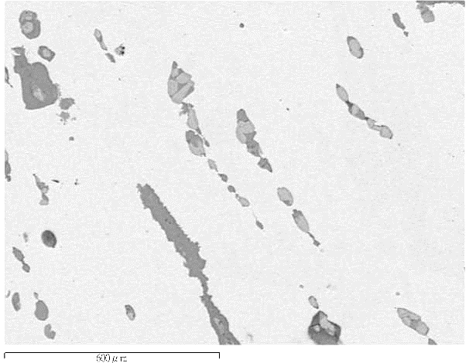
A preliminary Analysis of Iron Specimens in Central Taiwan
According to the method proposed by Dillmann and L’Héritier (2007), different families of slag inclusions can be recognized.
The results reveal that the slag inclusions found on iron objects in central Taiwan are primarily derived from the smelting stage. In most cases, the scatter plots for NRCs display a positive correlation or linear distribution for each object.
Based on the composition of slag inclusions, out of the 29 specimens, three iron objects were made of Mottled Cast Iron, while the rest were generally made by bloomery process. Only NSK-10 might be a decarburized steel.
Fig. 9. The NRC couples in B14.
Fig. 10. The NRC couples in C11.
Fig.11. NSK-2011-054 (Iron blade) SEM (BEI) (left: 100 X, right: slag inclusions 1000 X）
Notes:
According to the method proposed by Dillmann and L’Héritier (2007), different families of slag inclusions can be recognized, such as those produced during smelting, smithing, and those altered by local concentration effects. This can be achieved by simple bivariate plot or using PCA to test the ratio of Non-Reduced Compounds.
So, I used two different SEM-eds machines to analyse the chemistry of slag inclusions in iron objects from the two sites. I avoid to circle the blocky wustite (FeO) within inclusion as it may dilute the overall composition of other elements. I then averaged the data of oxides and generated bivariate plots of the NRC oxides. The results reveal that the slag inclusions found on irons in central Taiwan are predominantly derived from the smelting stage.
In most cases, the scatter plots for NRCs tend to display a positive correlation or linear distribution for each object. This may be attributed to heavy corrosion on the outer surface, as smithing inclusions tend to form near the surface layer or along with welding lines, which may not be preserved after hundreds of years.
Based on the composition of slag inclusions, out of 29 samples, three iron objects were made of Malleable Cast Iron, while the rest were generally made by bloomery process. Only NSK-10 is a decarburized steel, based on the composition and metallography, it might be produced through a liquid-state decarburization process.

Slide 15
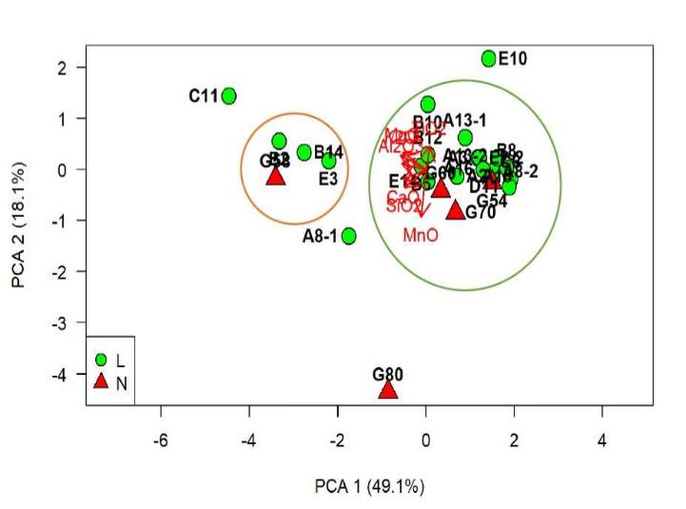
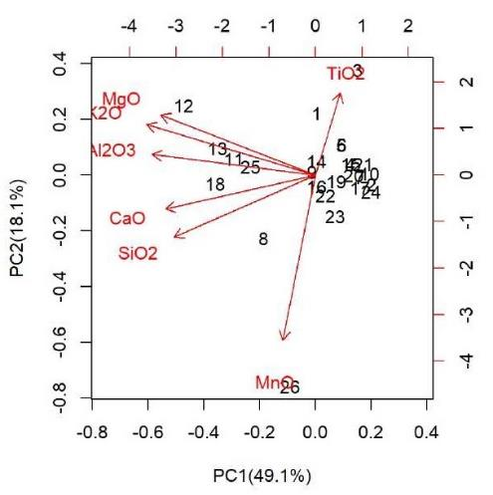
Comparative Chemical Analysis of Slag Inclusions in Iron Artifacts Excavated from Central Taiwan
The results reveal that the iron objects from the Luliao and Nanshikeng sites in central Taiwan share similar characteristics. In PC2, most samples show a low content of titanium and slight presence of manganese.
On the other hand, in PC1, two distinct groups can be identified based on different concentrations of magnesia, alumina and other compounds. Samples within the larger group exhibit lower levels of the oxides.
Furthermore, the data for A13-1 and A13-2 overlap with each other, since they come from the same zip bag, they are likely belonging to the same artifact.
Fig. 12. PCA(TRUE),N=26（L refers to Luliao, N refers to Nashikeng）
Fig. 13. Plot of PC1, PC2 and the NRCs
Notes:
Here I applied PCA on the NRCs of slag inclusion chemistry on 26 iron objects in central Taiwan. The results reveal that the iron objects from the Luliao and Nanshikeng sites share similar characteristics.
In PC2, most samples show a low content of titanium and with a hint of manganese. While in PC1, two distinct groups can be identified based on different concentrations of magnesia, alumina and other compounds. Samples within the larger group reveal lower levels of these oxides.
Besides, the data for A13-1 and A13-2 overlap with each other, since they come from the same zipper bag, they are likely belonging to the same artifact.

Slide 16
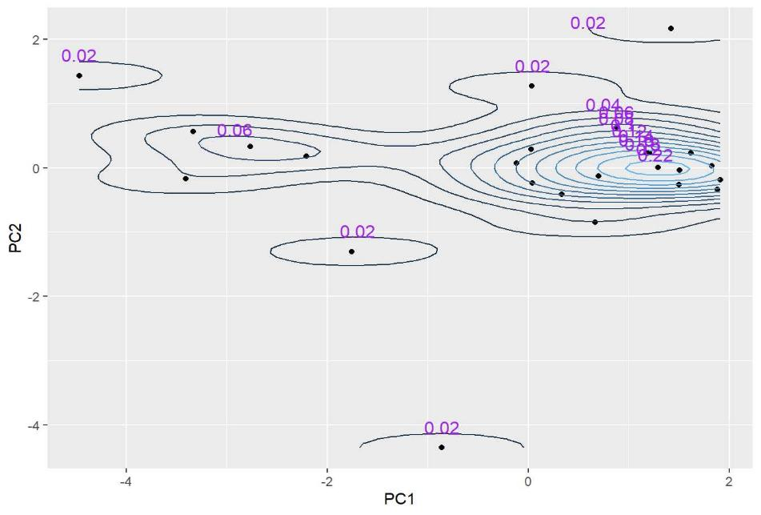
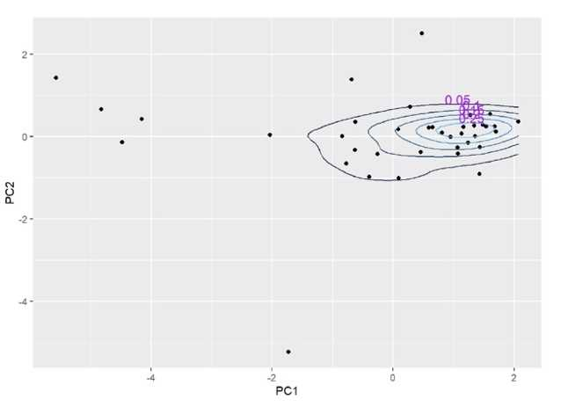
The chemistry of NRCs between corroded and uncorroded iron specimens
Fig. 14. KDE(TRUE) N=26, slag inclusion data derived from metallic metal phase, relatively well-preserved.
Fig. 15. KDE (TRUE) N=38, slag inclusion data derived from both corroded and non-corroded specimens.
Notes:
And I also tried to use Kernel Density Estimation to group iron object. Kernel Density Estimation (KDE) is a statistical technique used to estimate the probability density function of a continuous dataset. It works by placing a smooth, bell-shaped kernel at each data point to create a continuous probability distribution, which is It helpable for identifying patterns.
The proximity of contour lines reveals data point concentration and their level of similarity or density within an area. Denser contour lines indicate data points are more compacted or share similar characteristics within a region, while sparser contours indicate a more dispersed data distribution. In Figure XX, we can see that the slag inclusion data from 26 well-preserved display two distinct clusters. However, when an additional 12 corroded samples are included, the grouping results become obscured and unclear.

Slide 17
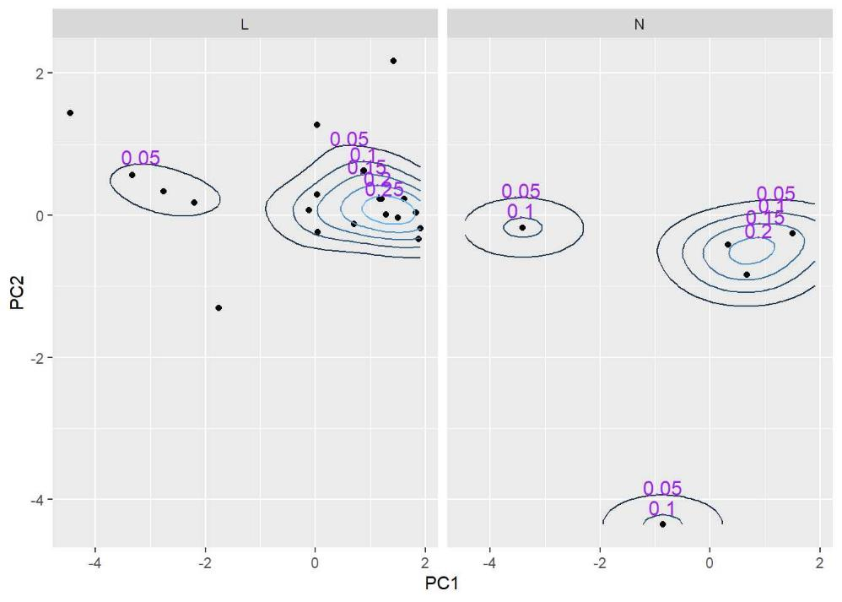
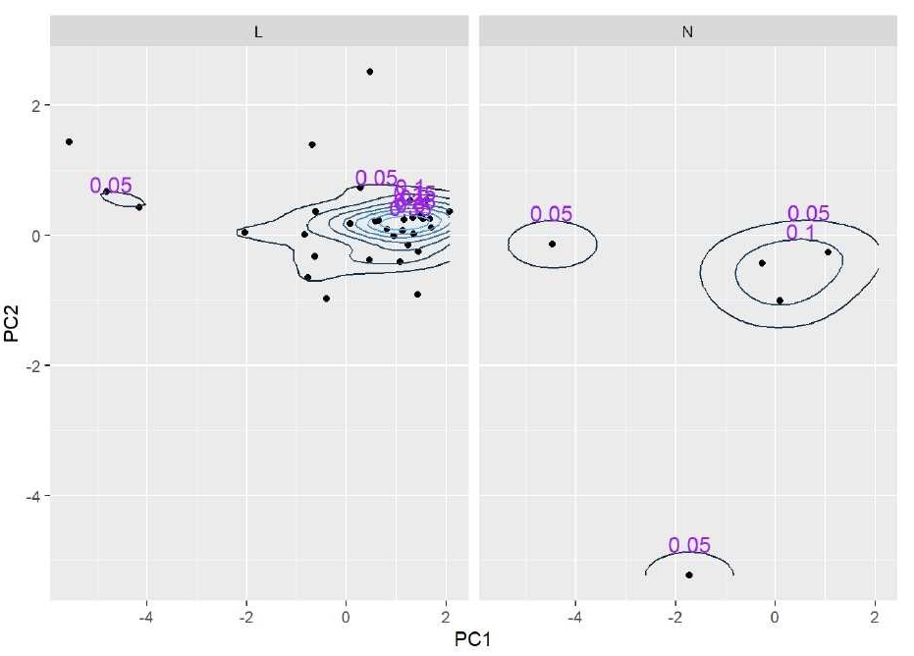
Fig. 16. KDE(TRUE) N=26, “L” refers to the iron objects from Luliao while “N” refers to those from Nanshikeng, all in good condition.
Fig. 17. KDE (TRUE) N=38, the contour of the left plot is irregular as it includes additional corroded specimens from Luliao.
Notes:
Once again, when I separate the data points based on their respective sites, I observe that in the left plot, where corroded samples are excluded, the contours display a smooth and easily distinguishable pattern with two clusters. However, in the right plot, where corroded samples are included, it becomes evident that some data points deviate from the expected contours, leading to irregular outline.
To some degree, I think this reveals the influence of the diverse chemistry present in corroded samples on the overall data. Although in this case, we can still differentiate between two clusters if we categorize the plots based on their respective sites. However, if we combine them, as I have mentioned before, the task becomes challenging.

Slide 18
Ongoing research on iron slags in Eastern Taiwan (Chongde site)
Notes:
Let us talk about my ongoing research that I am currently working on. I will show you some OM pictures of the slags derived from Eastern Taiwan.

Slide 19
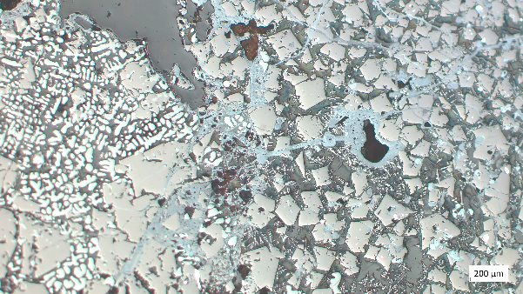
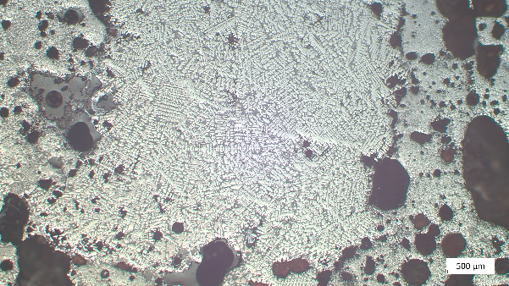
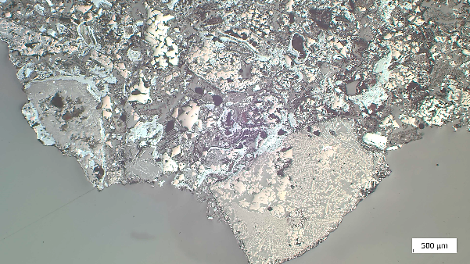
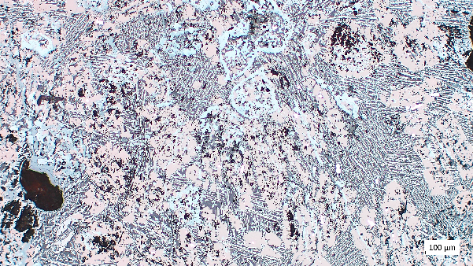
Iron Slags from the Chongde site (1500-900BP) in Eastern Taiwan
From the OM observation, the majority of specimens are primary smithing slags. There are also a few pieces that reveal signs of secondary smithing or partially reacted ore (smelting).
Fig. 18.
Type B, CT-18, XP-2.5X, globular wustite, ulvospinel, iron prills, charcoal.
Fig. 19.
Type A, CT-7, XP-1.25X, voids, dendritic and globular wusite, ulvospinel, iron prills.
Fig. 21.
Type E, CT-17, PPL-5X, skeletal laths of ilmentite, subhedral cubes are ulvospinel, consolidated iron and prills, feathery dendrites of silicates in glass.
Fig. 20.
Type C, CT-10, XP-1.25X, fragments of hammerscale, with charcoal and almost everything during smithing.
Notes:
Optical microscope analysis is currently being conducted to confirm that within 22 slag samples, most of them are primary smithing slags, with plano-convex bottoms and iron particles scattered. However, there are also a few pieces that reveal markers of secondary smithing or partially reacted ore, as a hint of smelting activity.
These samples were all derived from surface collection, not from general excavations. Here I classified the slag into porous slag, dense slag, sandy slag, etc. based on their morphology. Although we have not collected any typical tap slag or metallic tone furnace slag so far.

Slide 20
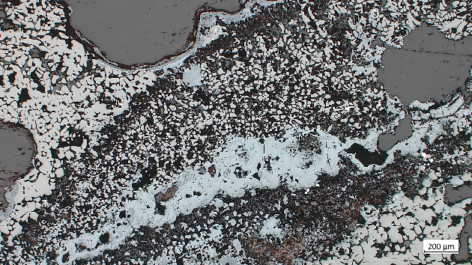
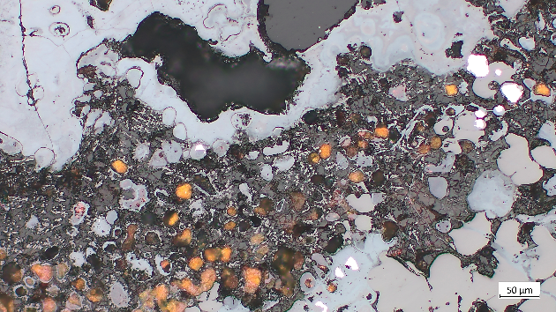
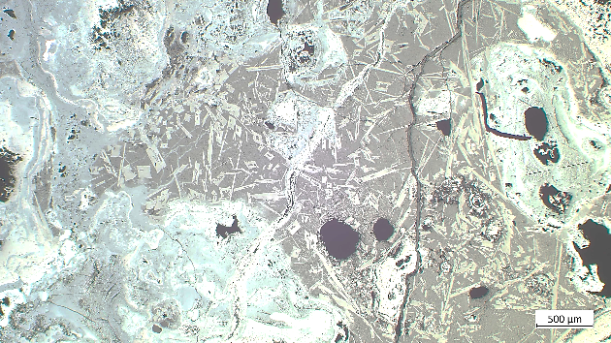
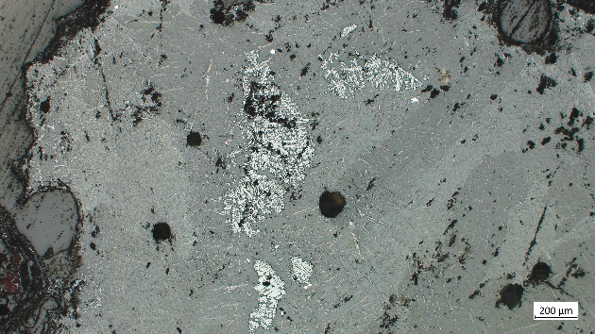
Iron Slags from the Chongde site in Eastern Taiwan
Can it be ascertained whether the iron artifacts unearthed during excavation are derived from local smelting?
Fig. 22.
CT-2, XP-2.5X, the sample was surrounded by an outer layer of corroded metallic iron.
Fig. 23.
CT-2, XP-10X, semi-smelted or partially reacted magnetite sand ore, globular wustite and iron prills.
Fig. 24.
Semi-processed billet, CT-4, PPL-1.25X, weathered, Ti-rich iron with few metallic islands remained.
Fig. 25.
Type D, CT-3, XP-2.5X, hammerscale within smithing slag, fayalite-kirschsteinite intergrowth phase.
Notes:
Afterwards, I will compare the chemistry of 32 Chongde slag samples collected near the excavation site with that of 5 recently unearthed iron artifacts, to determine whether they are locally produced or not.

Slide 21
Conclusion
Previous research towards the composition of slag inclusions in Taiwanese irons mainly focused on the concentrations of titanium and manganese, which are most relevant to the ores.
Chih-Ling attempted to explore the correlation of iron artifacts unearthed in the two Iron Age sites in central Taiwan. The result indicates that iron assemblages from the two sites share similar traits in slag inclusion chemistry.
Based on Chen‘s analysis of magnetite sand, a potential ore, from coastal area near the Shisanhang site in northern Taiwan, The chemistry pattern of iron artifacts excavated from the site is align with the one from local sand ore. However, as Chih-Ling analysed several iron artifacts from central Taiwan, the presence of manganese content in most samples making it difficult to determine their origin.
There are no residues of iron production in the western half of Taiwan, and to date, the "smelting recipes“ of iron assemblages in Taiwan have not been objectively constructed. The provenance of iron objects requires more analysis from other parts of Taiwan, particularly at sites with trace of iron working residues.
We can clarify whether the bloomery irons were all locally produced or some of them might have been imported from adjacent regions around East or Southeast Asia.
Notes:
Previous research towards the composition of slag inclusions in Taiwanese irons mainly focused on the concentrations of titanium and manganese, which are most relevant to the ores. As you can see, here I attempt to explore the correlation of iron artifacts unearthed in two Iron Age sites in central Taiwan.
The result indicates that iron assemblages from the two sites share similar traits in slag inclusion chemistry. Based on Prof. Chen's analysis of magnetite sand, a potential ore, from the coastal area near the Shisanhang site in northern Taiwan, I expect that the titanium content in slag inclusions of iron artifacts from northern Taiwan to be lower than 10wt%, while manganese content will be difficult to detect, display as not detected. The iron artifacts from the Shisanhang site also align with this pattern, so, easy to say the irons there were likely derived from local sand ore. However, as I analysed several iron objects from central Taiwan, I found that the manganese content in most samples ranged from 1-4wt%, making it difficult to determine their origin. Given that there are no residues of iron production in the western half of Taiwan, and to date, the "smelting recipes" of different iron artifact clusters in Taiwan have not been objectively constructed, the reasons behind the division among iron artifacts from central Taiwan remain unclear.
The provenance of iron objects from the region still requires more analysis and statistical examination, along with samples from other parts of Taiwan, particularly at sites with trace of iron working residues. We can then clarify whether the bloomery irons were all locally produced or some of them might have been imported from adjacent regions around East or Southeast Asia.

Slide 22
Further Work
We can establish connections between the ratios of the NRCs and potential source materials, to explore any trends or changes and gain insights into the causes of variations observed among different iron clusters.
The chemistry of slag inclusions between well-preserved metal and weathered phase. To what extend the taphonomy environment affects the ratio of NRCs and to the final explanation.
Project aims of Chih-Ling’s PhD
How many smelting recipes can we discover within the iron objects? Tell apart between direct and indirect process iron.
Did the ancients apply different recipes on different tools when smelting?
What is the correlation between different iron assemblages and slags on the island?
Can we draw a possible diffusion route of the iron assemblages in Taiwan and map the clusters with a temporal and spatial sequence?
Notes:
Furthermore, we can connect the NRC ratios to potential source materials like ores, fuel ash, and technical ceramics. This could help us spot any trends or shifts in fuel or ore composition during smelting, shedding light on the differences in iron clusters that we have observed.
Now, in general, we rely on well-preserved, intact metallic iron in artifacts to get uncontaminated slag inclusion data. Weathered or corroded, rusty irons often do not work for our quantitative comparisons since they might skew the overall results. Unfortunately, the iron objects I collected from central Taiwan are not in well preservation due to their taphonomy environment – with acidic red soil and the frequent occurrence of typhoons and heavy rainfall under Taiwan’s subtropical climate. However, the KDE plots suggest that we can still differentiate between the two clusters. In the near future, I plan to compare inclusions from weathered and fresh metal layers within individual artifacts from different assemblages to understand how the taphonomy environment affects (or do not really affect) the ratio of NRCs.
Up to now, my previous report had a limited sample size (only around 30 samples in total). After years of collecting iron samples, I am thrilled to piece together the puzzle and construct a compelling narrative. So, for my PhD project, I am looking forward to answer questions like: How many smelting recipes can we uncover within these iron objects? Can we distinguish between direct and indirect process iron? In a nutshell, I aim to set up a database for iron objects especially for slag inclusions in Taiwan. Second, I want to investigate whether ancient metallurgists used different recipes or formulas for crafting various types of tools when smelting. Like if the compositions of arrowheads are more similar to each other than they are to the composition of, say, nails or blades within a single assemblage.
Third, I would like to understand the correlation between different iron assemblages and slags on the island. Ultimately, I hope to map the clusters with a temporal and spatial sequence to identify any trends or variations in slag inclusion chemistry across different sites in Taiwan.

Slide 23
Key Reference
Blakelock, E. et al. (2009). Slag inclusions in iron objects and the quest for provenance: an experiment and a case study. Journal of Archaeological Science 36(8), 1745–1757.
Charlton, M., Humphris, J. (2019). Exploring ironmaking practices at Meroe, Sudan—a comparative analysis of archaeological and experimental data. Archaeological and Anthropological Sciences 11, 895-912.
Charlton, M. (2015). The last frontier in “sourcing”: the hopes, constraints and future for iron provenance research. Journal of Archaeological Science 56, 210-220.
Charlton, M.F, Blakelock, E., Martinón-Torres, M., Young, T. (2012). Investigating the production provenance of iron artifacts with multivariate methods. Journal of Archaeological Science 39, 2280-2293.
Coustures, M. P. (2003). The use of trace element analysis of entrapped slag inclusions to establish ore-bar iron links: Examples from two Gallo-Roman iron-making sites in France (Les Martys, Montagne Noire, and Les Ferrys, Loiret). Archaeometry 45(4), 599-613.
Dillmann, P., L'Héritier, M. (2007). Slag inclusion analyses for studying ferrous alloys employed in French medieval buildings: supply of materials and diffusion of smelting processes. Journal of Archaeological Science 34(11), 1810-1823.
Notes:
This is the list of my key references, and that’s all, thank you all for listening.

