Slide 1
Anastassia Milleret
University of Birmingham

Slide 2

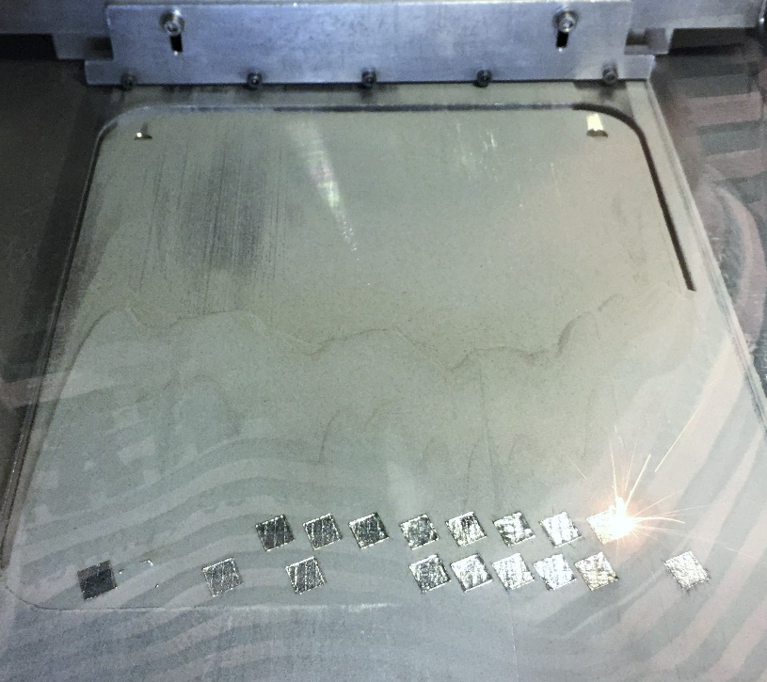
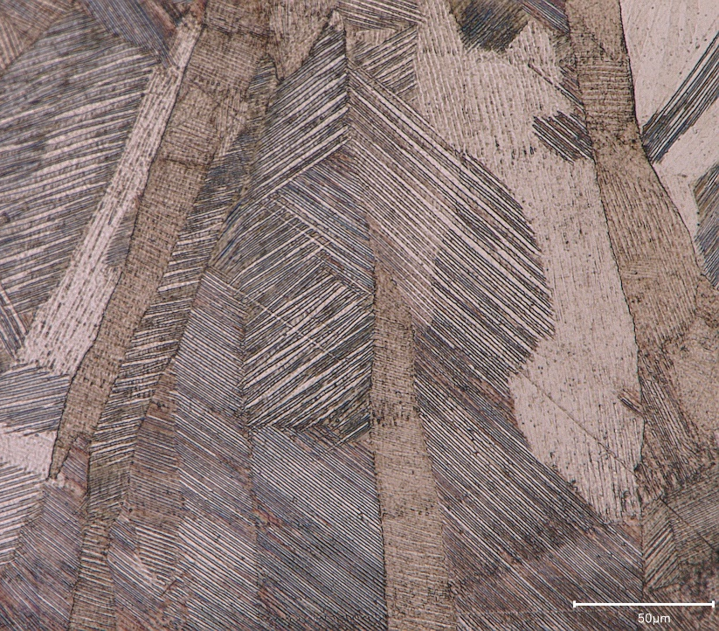
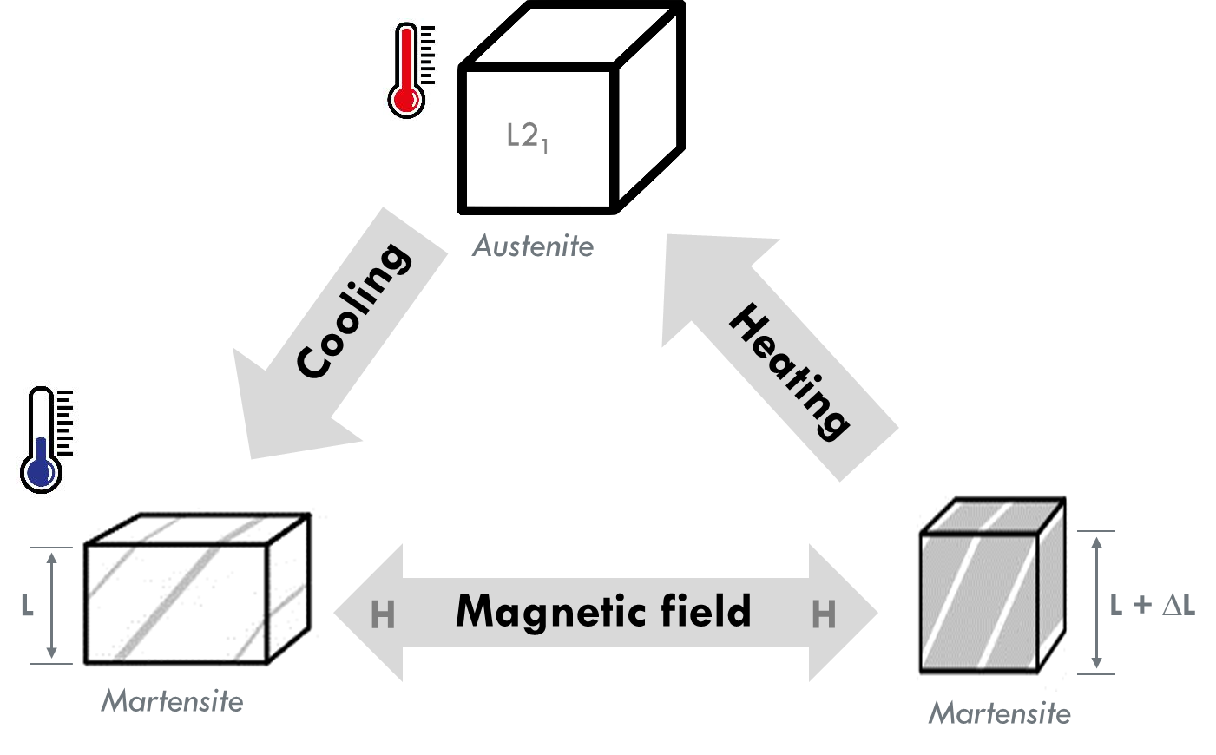

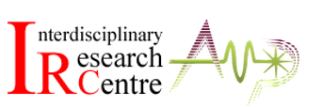


4D Printing of Magnetic Shape Memory Alloys
1
2
3
CLICK TO START
9
3
4
5
6
7
8
10
11
12
13
14
15
16
17
18
19
20
21
22
23
24
25
26
27
28
29
1
30
2
mins
mins
mins
secs
secs
secs
secs
secs
secs
secs
secs
secs
secs
secs
secs
secs
secs
secs
secs
secs
secs
secs
secs
secs
secs
secs
secs
secs
secs
secs
secs
secs
secs
Ni₂MnGa

