Slide 1

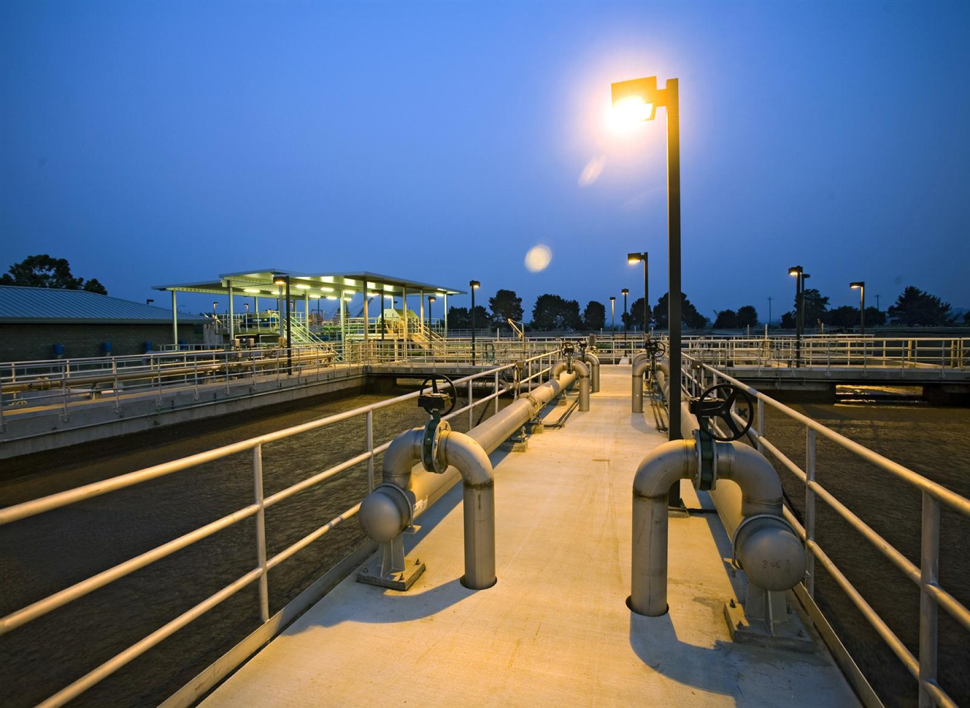
Improving Energy Efficiency in Wastewater Treatment. Identification of Key Parameters and Key Performance Indicators
Pablo Campo-Moreno
Cranfield Water Science Institute
ecoSTP16, 28 June 2016

Slide 2
Energy Consumption in WWTPs
Common to all EC countries
> 22,500 WWTPs
96% 2nd treatment
Energy!
Thousands GWh/y
Increase in energy prices
More regulation
More intensive WWTPs
More energy
Greenhouse gas emissions
Notes:
Within the EU-27, the total number of Urban Wastewater Treatment plant are 22.558 (agglomerations > 2.000 pe3), where 96% of them include secondary, nutrient removal or more stringent treatment4. A similar ratio applies to wastewater in EU big cities, with 586 big cities that comprise 250.2 million pe5.
􏰀 Taking into account that the total population in the EU-27 is around 500.7 million6 and assuming an energy intensity use from the urban wastewater treatment (Figure 1) of 30 kWh/pe·year7, we can estimate a total energy consumption associated to this sector of 15,021 GWh/year.

Slide 3
Is there any way?
Need standard methodology
Not measured
Difficult to estimate due to high variability
Gathered data but what to do with it?

Slide 4


International and National Standards
Lack of normative documents specific for energy in WTTPs
Horizontal Standards:
EN ISO 50001 Energy management system
EN 16231 Energy efficiency benchmarking methodology
EN16247-1 Energy Audits-Part 1: General requirements
National Standards:
UNI - CEI/TR 11428 Energy management - Energy audits

Slide 5
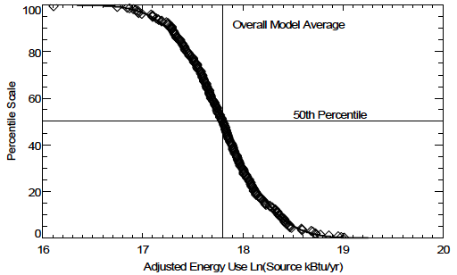
Awwa Research Foundation Energy Benchmarking in WWTPs
ln(Es) = 15.8741
+ 0.8944 × ln(influent average Mgal/d)
+ 0.4510 × ln(influent BOD mg/L)
− 0.1943 × ln(effluent BOD mg/L)
− 0.4280 × ln(influent average/influent design)
− 0.3256 × (Trickling filter? Yes-1, No-0)
+ 0.1774 × (Nutrient removal? Yes-1, No-0)
Notes:
Benchmarking compares energy consumption to a given standard.
American water works association adopted by US EPA (Energy Star programme)
Fadj = ln(Es)/17.8 (17.8 mean value 50% percentile)
75% is the cut off

Slide 6
Key Performance Indicators
A key performance indicator (KPI) is a metric used to evaluate factors that determine the treatment efficacy at each operation unit.
KPIs relate energy usage (kWh) with removal balances of pollutants (Flow, TSS, COD, NH₄, N, P and Pathogens).
Selected KPIs have to be monitored on a regular basis by on-line sensors or sample collection.

Slide 7
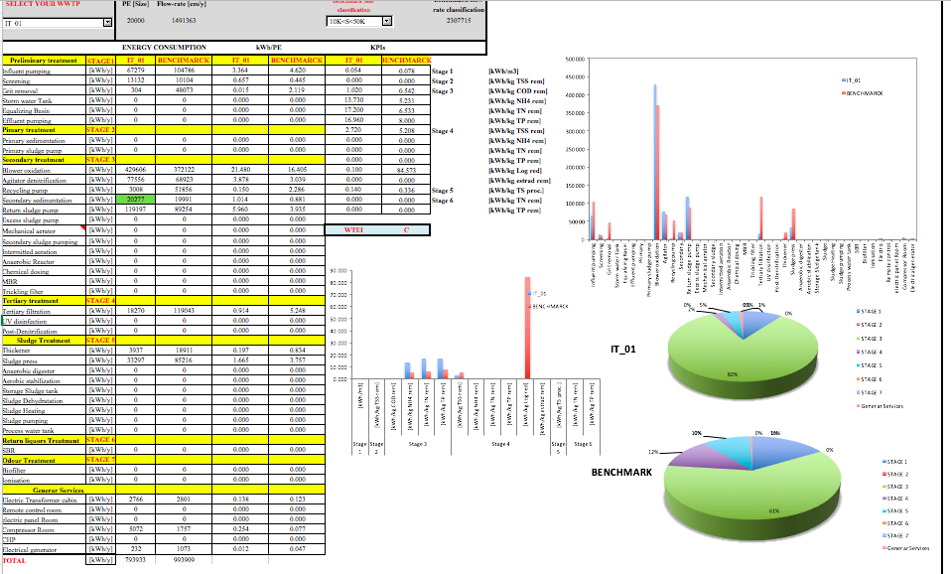
Water Treatment Energy Index

Slide 8
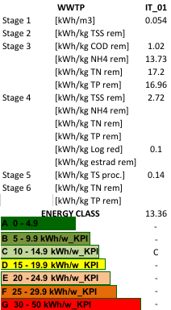
Water Treatment Energy Index Cont.
KPIs can be combined to obtain a composite index (wastewater treatment energy index, WTEI).
WTEI will allow simple comparisons of WWTPs along with benchmarking and monitoring.

Slide 9
Thank you!
Questions?
For more information please visit
www.enerwater.eu
ENERWATER Workshop June 28th at 17:30

