Slide 1
Board Games as a Behavioural Collection Method
Tatjana Sidorenko
Notes:
Hello and welcome! Today I will be presenting a paper called “Board Games as a Behavioural Collection Method”

Slide 2
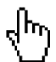

Outline
So what?
Sent at 10:15
Background
Methodology
Sent at 10:15
Sent at 10:15
Simulations & Validations
Conclusion
Sent at 10:16
Sent at 10:16
Notes:
Here is the brief outline of what I will be talking about today. You will also notice that the structure oddly resembles headings in a paper, hmm, what a coincidence!
And I would like to begin with setting the foundation and hopefully answering the classic question – so what?

Slide 3
We are living a digital life
What Happens Every Minute on the Internet in 2020, Visual Capitalist, 2020
Notes:
More and more people go online. On this graph, the jump from 2014 to 2020 does not appear to be as large, until you look at the units!

Slide 4



Businesses are going paperless
Notes:
More and more businesses are going paperless, and many day-to day things such as purchasing goods, reading the news, socialising, paying bills, applying for documents is done online.

Slide 5
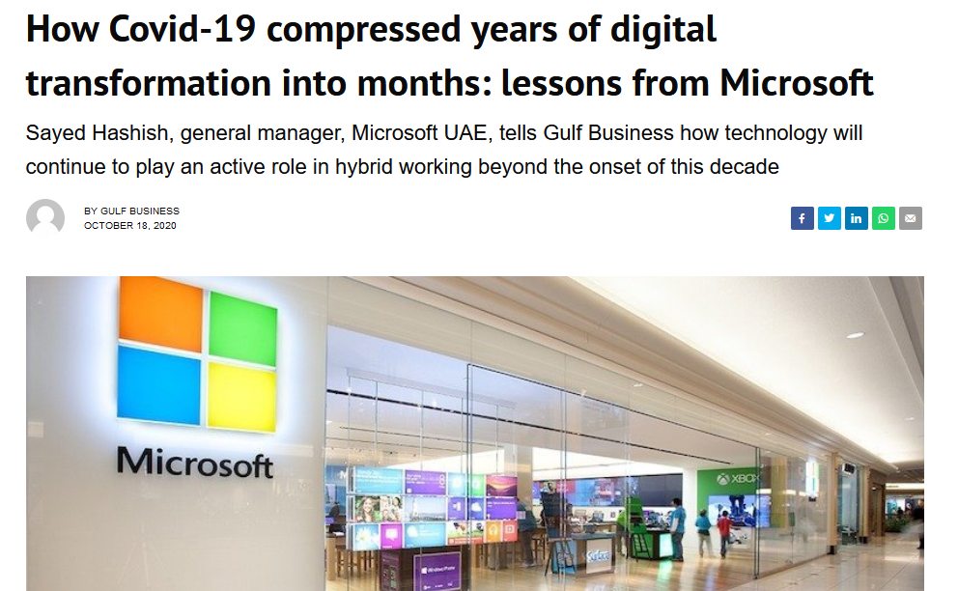
Digitisation accelerated
Source: Gulf Business, Oct 2020
Notes:
Especially with the current situation – many companies are transitioning to hybrid and WFH models, which makes internet and digital devices virtually irreplaceable. Of course, there is another side to this.

Slide 6

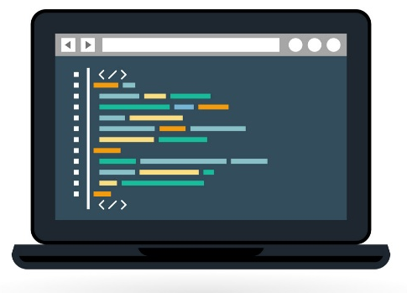

Malicious actors

Slide 7

Source: Visual Capitalist, 2017

Slide 8
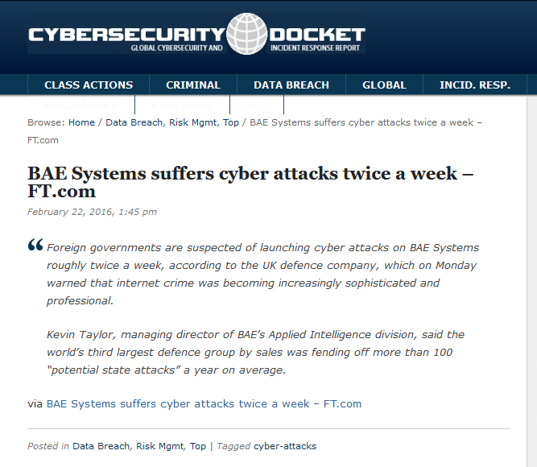
Impact of cyber attacks
Source: http://www.cybersecuritydocket.com/2016/02/22/bae-systems-suffers-cyber-attacks-twice-a-week-ft-com/
Notes:
More than 100 times a year

Slide 9

Understanding people at the keyboard

Slide 10


Current approaches

Slide 11
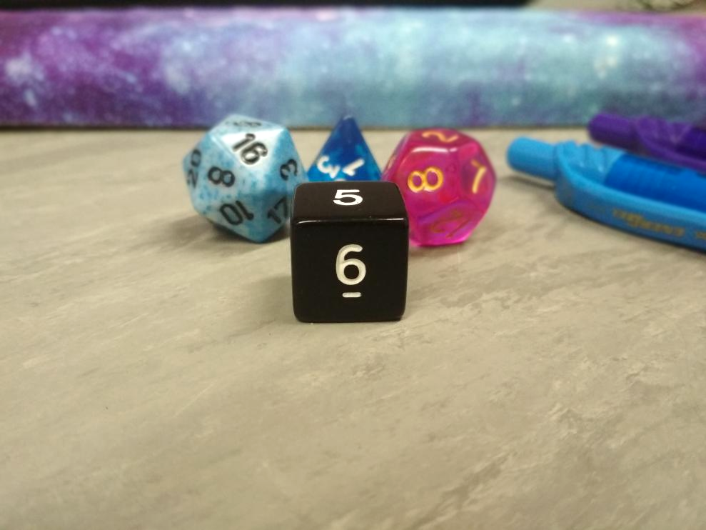
Notes:
First of all, I have refined the game mechanics.

Slide 12

Outline
So what?
Sent at 10:15
Background
Methodology
Sent at 10:15
Sent at 10:15
Simulations & Validations
Conclusion
Sent at 10:16
Sent at 10:16

Slide 13





Basic motivations
REVENGE
RECREATION
PROFIT
PRESTIGE
IDEOLOGY
Seebruck, R. (2015). A typology of hackers: Classifying cyber malfeasance using a weighted arc circumplex model. Digital Investigation, 14, 36–45. https://doi.org/10.1016/j.diin.2015.07.002

Slide 14
Basic motivations
REVENGE
RECREATION
PROFIT
PRESTIGE
IDEOLOGY
Seebruck, R. (2015). A typology of hackers: Classifying cyber malfeasance using a weighted arc circumplex model. Digital Investigation, 14, 36–45. https://doi.org/10.1016/j.diin.2015.07.002

Slide 15
Basic motivations
REVENGE
RECREATION
PROFIT
PRESTIGE
IDEOLOGY
Seebruck, R. (2015). A typology of hackers: Classifying cyber malfeasance using a weighted arc circumplex model. Digital Investigation, 14, 36–45. https://doi.org/10.1016/j.diin.2015.07.002

Slide 16
Basic motivations
REVENGE
RECREATION
PROFIT
PRESTIGE
IDEOLOGY
Seebruck, R. (2015). A typology of hackers: Classifying cyber malfeasance using a weighted arc circumplex model. Digital Investigation, 14, 36–45. https://doi.org/10.1016/j.diin.2015.07.002

Slide 17
Basic motivations
REVENGE
RECREATION
PROFIT
PRESTIGE
IDEOLOGY
Seebruck, R. (2015). A typology of hackers: Classifying cyber malfeasance using a weighted arc circumplex model. Digital Investigation, 14, 36–45. https://doi.org/10.1016/j.diin.2015.07.002

Slide 18
Basic motivations
REVENGE
RECREATION
PROFIT
PRESTIGE
IDEOLOGY
Seebruck, R. (2015). A typology of hackers: Classifying cyber malfeasance using a weighted arc circumplex model. Digital Investigation, 14, 36–45. https://doi.org/10.1016/j.diin.2015.07.002

Slide 19
Types of attackers
Script kiddie
Hacktivist
Counter-culture
State-affiliated
Cyber criminal
Insider

Slide 20

Surveys

Slide 21

Interviews?

Slide 22
Interviews?

Slide 23
Observations

Slide 24
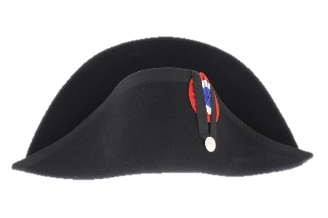
Role play

Slide 25
Outline
So what?
Sent at 10:15
Background
Methodology
Sent at 10:15
Sent at 10:15
Simulations & Validations
Conclusion
Sent at 10:16
Sent at 10:16

Slide 26
Creating a game: Goals in mind
Be engaging
Be reproducible
Easy to play and run
Have a way to easily capture the gameplay

Slide 27
Creating a game: Existing approaches
GM
Cards
Notes:
Player agency – players have the choice of what they want to do
The requirements
The game should be fairly free-flowing, by this I mean that it should not force players to follow just one scenario, but on the other hand it should satisfy its primary purpose – data collection.
There are two main approaches that are common in board games – using cards to drive the gameplay and using a Games Master – GM, who plays the role of all characters that players encounter, as well as decides the environment, such as weather (combinations of the two approaches are also possible)
Tabletop RPGs have been suggested, as they are a primary example of using a GM to control the game.

Slide 28
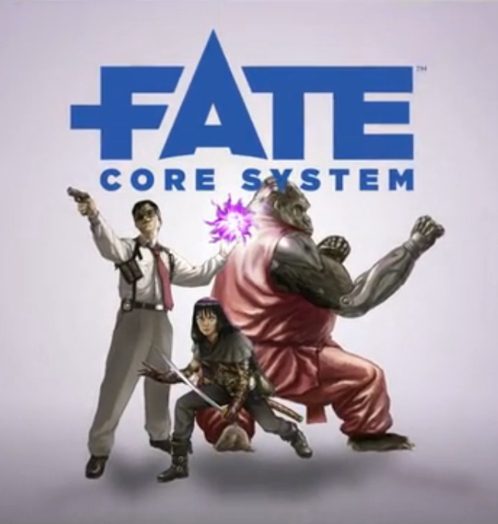

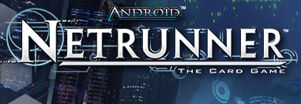
Recreational games
Notes:
FATE needs players collaborating against a GM. Now, as you know hackers mostly work alone except for ‘marriages of convenience’. So another approach was needed

Slide 29
Game concept
Players
GM
Notes:
Treat this as a game manual – you have 3 decks….
Board layout (later)
I have talked about how the current idea was developed, now I will talk about what it is.
Hackers are trying to complete a set of goals by attacking a fictional organisation.
Players represent hackers, a GM represents the fictional organisation that they are trying to hack.
Each role of hackers, i.e. blackhat, hacktivist, script kiddy will be given a different set of winning conditions at the start of the game.
Players mostly do not cooperate with each other (state of organisation is still tracked)
Now I will talk about how player gameplay is different from a GM gameplay

Slide 30
Cards: basic decks
Technique
Role
Counter-technique
 
Information
Scenario
Opportunity

Slide 31



Information sources
◻
Case studies

Scenarios
Role cards
▪
Other literature
i
Info cards
&
MITRE
ATT&CK
Technique cards
Opportunity cards
Survey
Counter-technique cards
Notes:
Here is the breakdown of all game card decks (except for Techniques deck, which I am going to talk about separately) split into their respective information sources.
Techniques and Counter-Techniques have their title and description sourced from an attack taxonomy, with additional information, such as technique pre-requisites or consequences sourced from the survey.
Info and Opportunity decks are gathered from case studies, and, in part, from the survey.
Scenarios are sourced from case studies described in literature

Slide 32
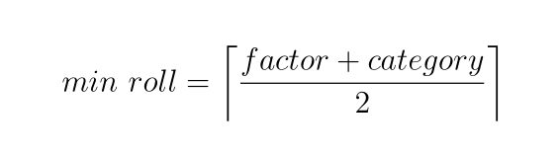
Determining success: a story of the lucky number
Notes:
Coin - > 6-sided die

Slide 33
Category: Cyber Kill chain
Survey
Delivery
Breach
Affect
Source: How cyber attacks work, NCSC
Notes:
As a foundation to some of the game mechanics, a simplified kill chain was used as a framework, with the idea that techniques failing in the setup phase will have less negative consequences than in the later stages.

Slide 34
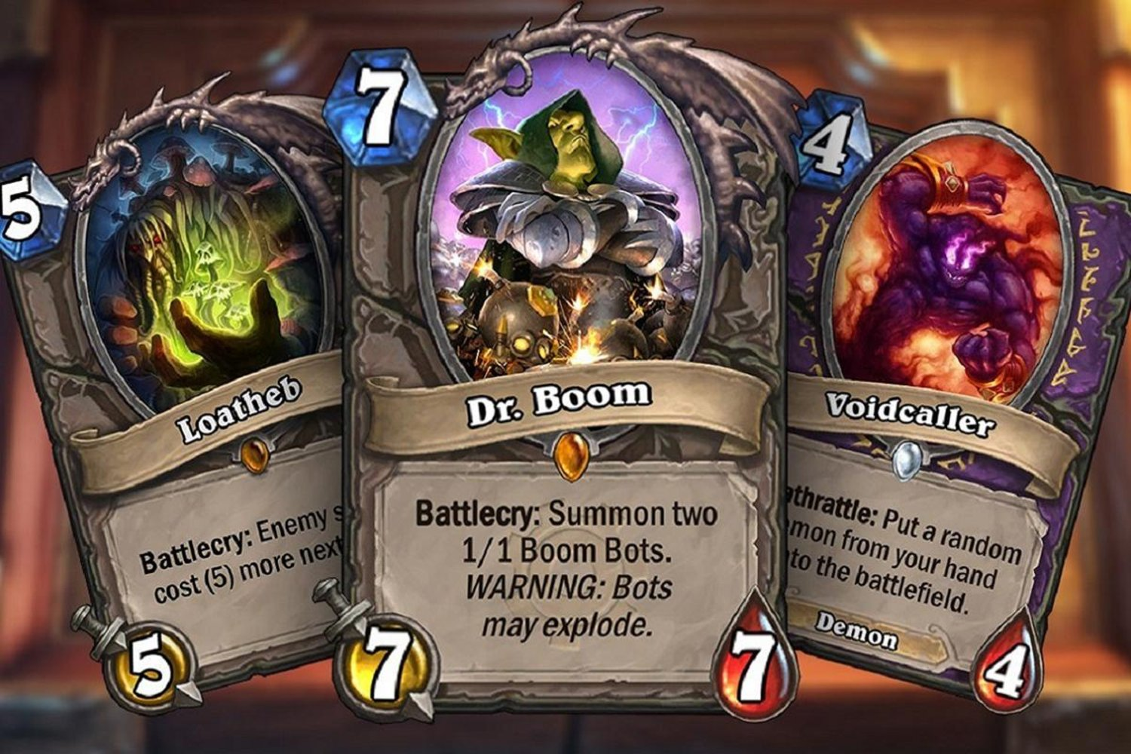
Prototyping cards: Information display inspiration
Notes:
This idea is not novel, for example Heartstone, numbers used as a game mechanics element

Slide 35
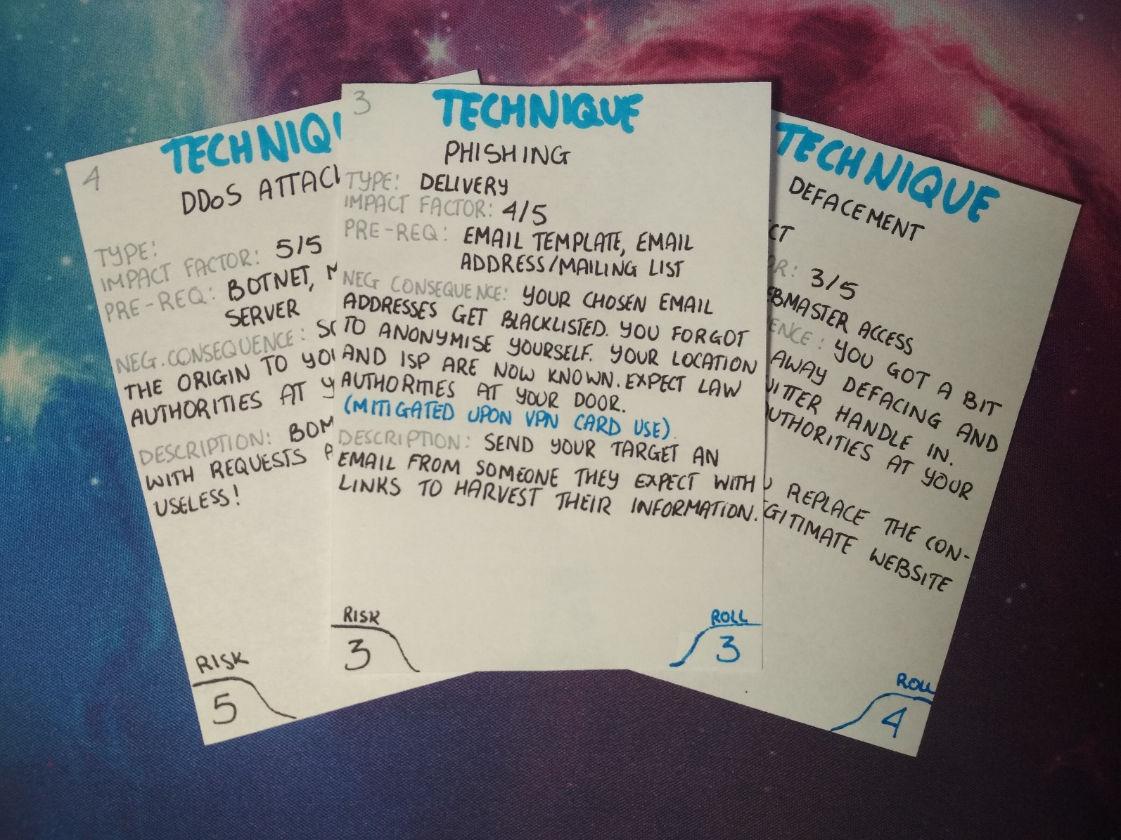
Prototyping cards: Making cards I

Slide 36
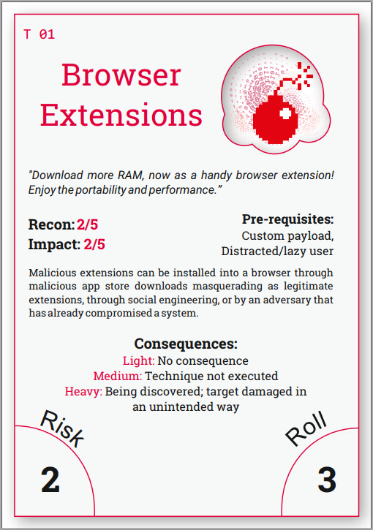

Prototyping cards: Making cards II
Notes:
Card prototypes

Slide 37
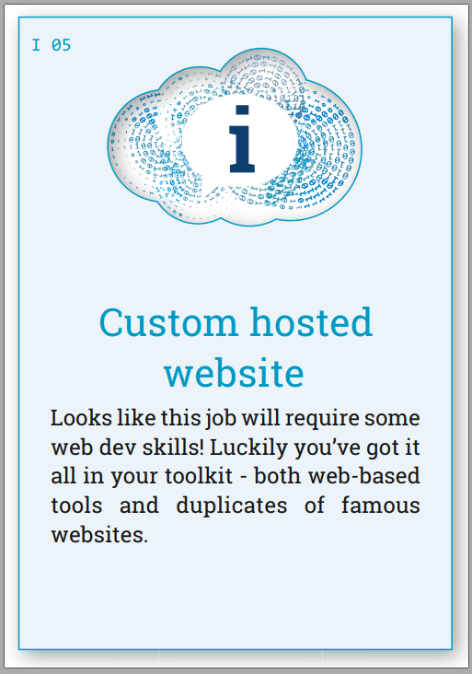
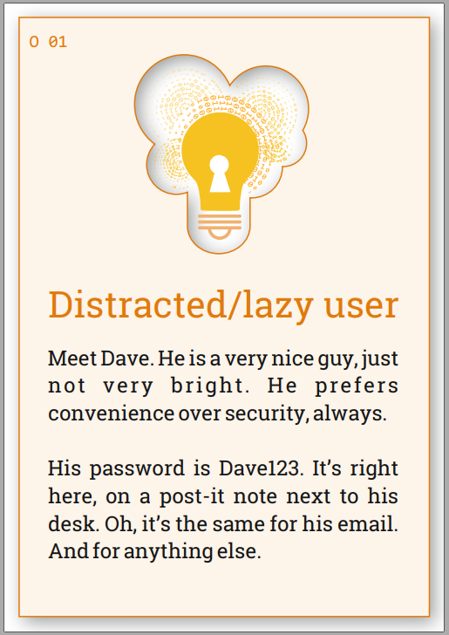
Extracting decisions: notation
T 04
Deck type
T = Technique
O = Opportunity
I = Information
C = Counter-technique
R = Role
Identification number
(Resets with each deck)
Notes:
So naturally this takes us to the next stage of the project: Extracting decisions. It is important to capture them as they occur, to ensure the most efficient use of time. To enable this each game card has a unique identifying number to quickly record the fact the card has been used. Each number consists of a single letter that represents the deck this card has come from (see slide) and the number of this card in the deck to distinguish the cards within the same deck.

Slide 38
Extracting decisions: notation
Technique
Counter technique (optional)
Role
R02 T09 (GM C05) 3 S
R15 T04 1 F cs 1
R02 T05 2 F cs 1
R02 T05 (GM C07) 1 F cs 2
Die roll
Consequence
(from the list on the card)
Outcome
Notes:
We have a way to represent a player and their role, as well as what technique they have used. The next aspect of extracting and recording decisions is assembling all information together. We also need other information, such as whether technique has succeeded or not and if it has not succeeded what were the consequences. The shorthand notation allows noting key decisions as the game takes place.

Slide 39
Outline
So what?
Sent at 10:15
Background
Methodology
Sent at 10:15
Sent at 10:15
Simulations & Validations
Conclusion
Sent at 10:16
Sent at 10:16

Slide 40
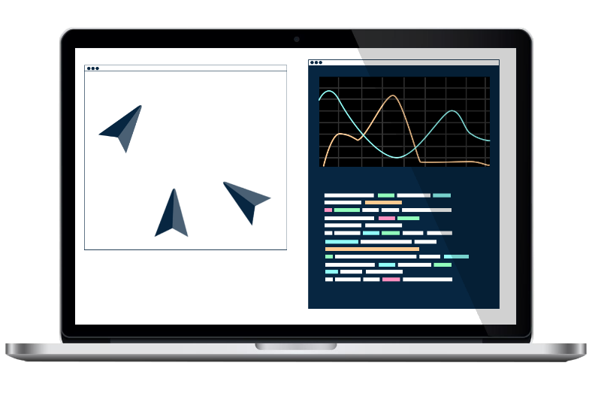
Game to simulation mapping
Notes:
Many iterations of the game – playing this out is time-consuming, so this is where the sim comes into play

Slide 41

Heatmap of attacks
Notes:
Running the same role over and over in different concentration can help us deduce emerging patterns, effectively creating a ‘heatmap’ of attacks

Slide 42
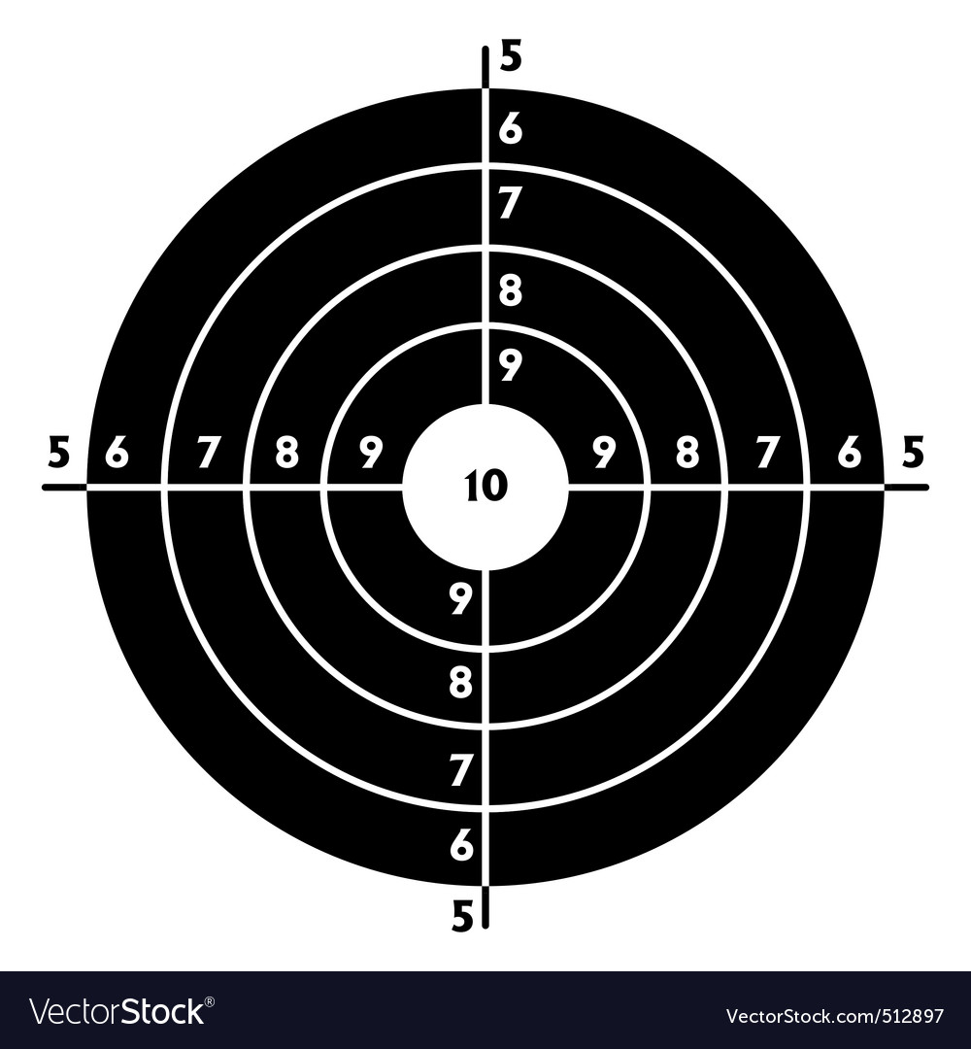
Monitoring the goals
Notes:
Fundamental goal stays the same – hacktivists would want to get their message across, regardless of whether it’s environmental or political
Online infrastructures would contain employees’ records/public-facing websites, even though the exact contents will vary
So we can hypothesise that the decisions can transfer across scenarios.

Slide 43
Outline
So what?
Sent at 10:15
Background
Methodology
Sent at 10:15
Sent at 10:15
Simulations & Validations
Conclusion
Sent at 10:16
Sent at 10:16

Slide 44

Conclusion
Notes:
Role play + games = more structure
Fictional scenario -> step away from real selves, adopt fictional persona -> less self-censoring
Literature was used to create the game to keep it realistic
A framework was used to make sure the game is reproducible and easy to play and record
Simulation will allow to cover what the game cannot
The game has a solid grounding in literature and backed up by experimental data from the players
This helps to inform the defensive posture

Slide 45
Summary
Cyber attacks are becoming more ubiquitous
To inform the defensive posture, we need to understand attackers better
Existing methods (interviews/questionnaires, observations, role play) do not provide enough coverage
Games help us address some of these problems
A hybrid cards/games master approach has been designed, taking inspiration from recreational games
Game resources use literature, taxonomy papers, news stories and a survey as sources
A chess-like game notation has been developed to represent decisions taken in the game
An approach alongside running games is the use of a simulation, that will validate the game as well as provide more data
Notes:
Here is everything I have talked about in this presentation. Thank you for listening, I will be happy to take any questions

Slide 47
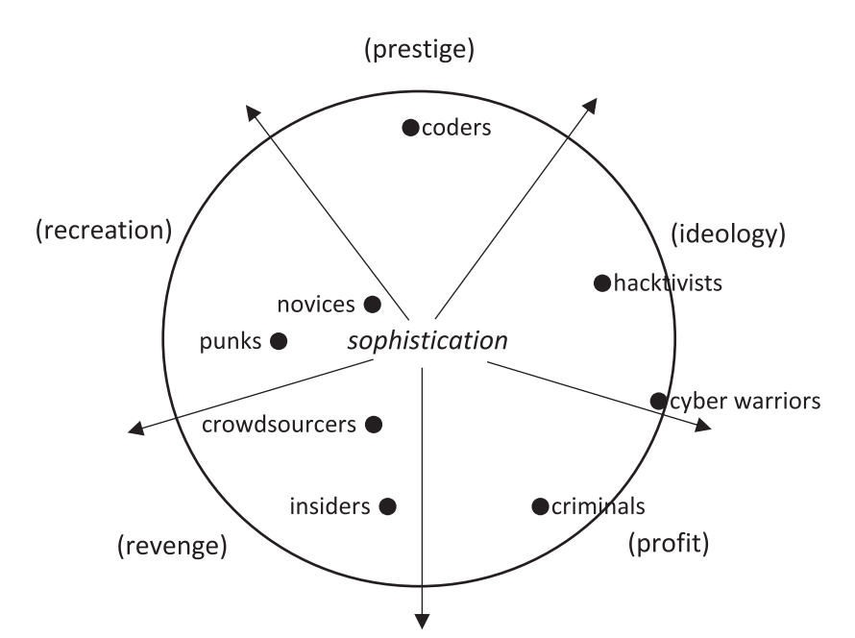
Hacker topologies
Seebruck, R. (2015). A typology of hackers: Classifying cyber malfeasance using a weighted arc circumplex model. Digital Investigation, 14, 36–45. https://doi.org/10.1016/j.diin.2015.07.002
Notes:
Explain diagram -> we want to figure out which one are the hackers, that break into our network
Here is a very simplistic view of some of the hacker types with a very basic outline for their motivations as well as their approximate skill set – those on the outside of this circle are considered to be more skilled. Ideally, we want to figure out who is who based on what they do with the network.
[Those topologies can be mapped to characters, each will have a type and series of tasks completion of which will end the game]

Slide 48
Playtesting plan
Game hosted
Notes:
The following playtest plan is in place.
Virtual playtests using a platform such as Tabloro/Zoom.

Slide 49
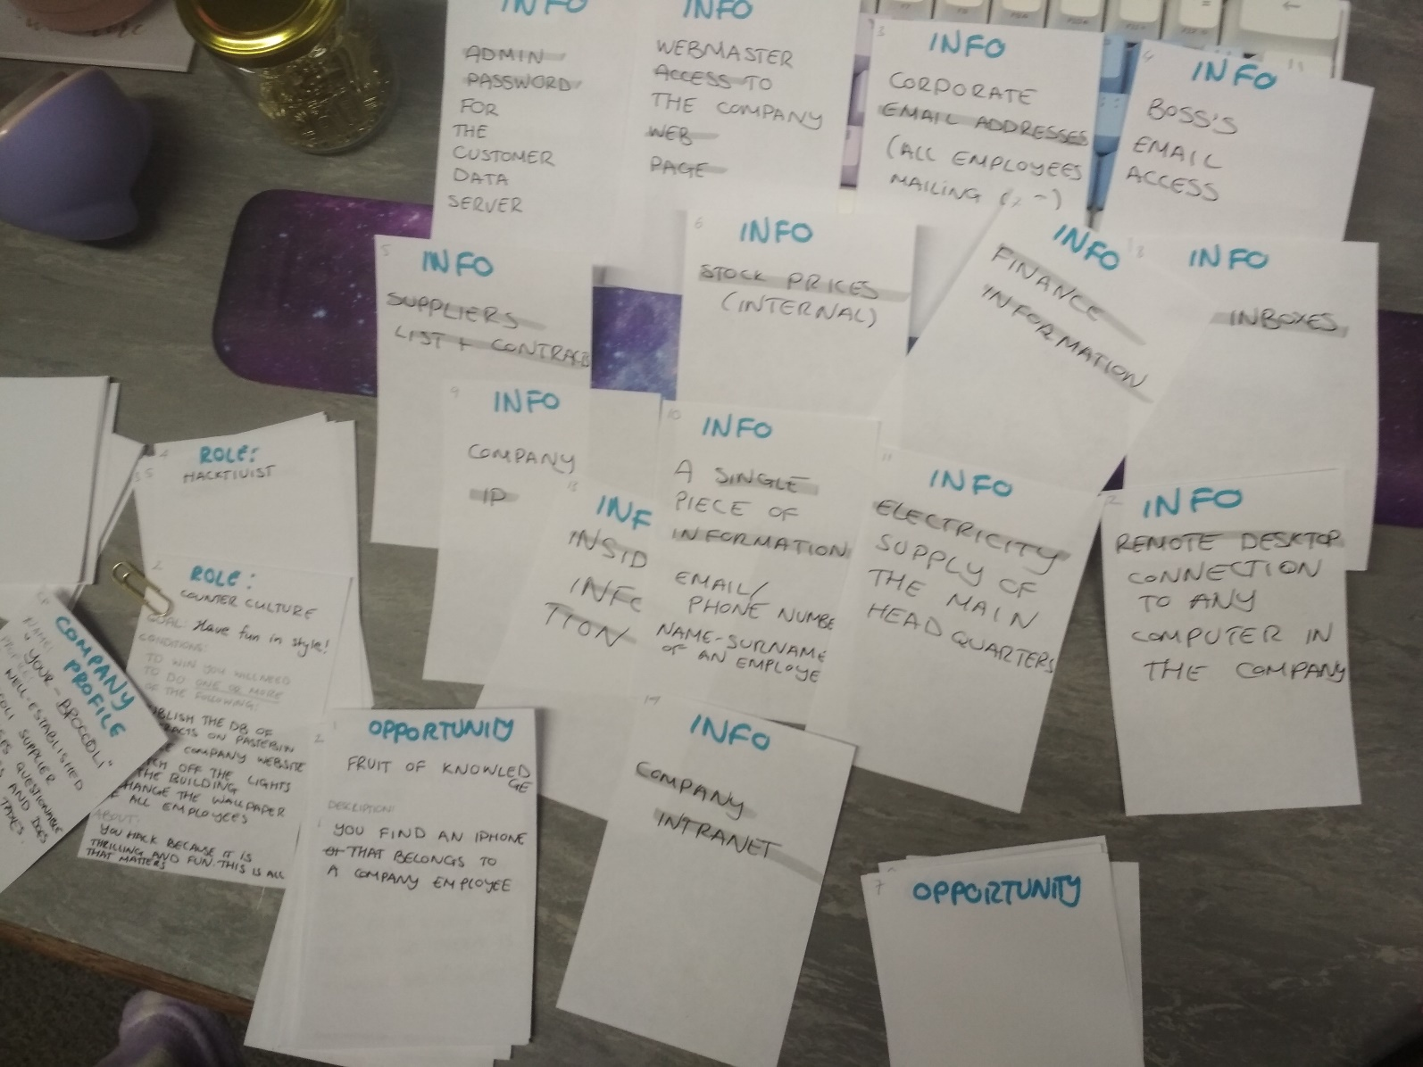
Prototyping cards: Work in progress
Notes:
Prototype 2 has become more formalized – we have upgraded from post-it notes to A7 sheets of paper!
Now with Delphi study refinement out of the way
Built up on game mechanics
A7 cards – playing cards size
Sample values
[demo]

Slide 50
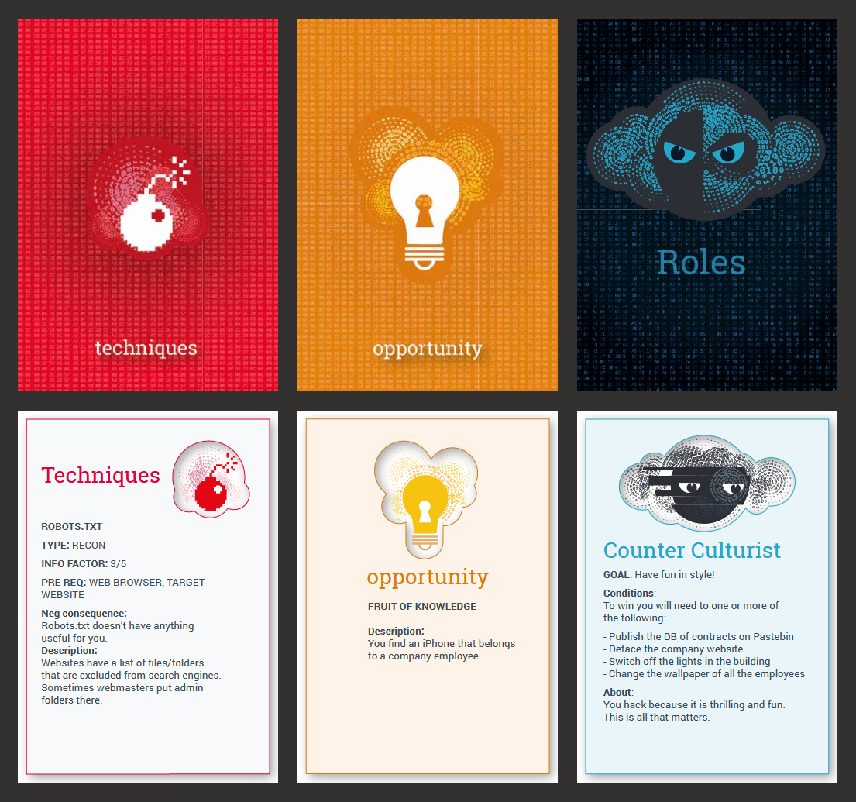
Prototyping cards: Cards designs
Notes:
Identity
Distinguishing decks
Information distribution is going to change

Slide 51


Survey datasets
survey v1
survey v2
survey v3
combined results
Notes:
Delphi approach revised
Academics + reward incentive pool 1 + reward incentive pool 2

Slide 52
Populating the cards
Technique
SQL Injection
Attack framework
Type: breach
Pre-req: an editor, SQL knowledge
Impact: 5/5
Trouble: Have you cleared those logs?
Experts
Notes:
The game will consist of cards
content of the cards will be populated by the collective opinion of experts
Attack techniques from an attack framework
Now I am going to talk about what have I done since last time…

Slide 53
Simulation: Initial prototype
First goal stage achieved
Second goal stage achieved
Third goal stage achieved
Goal achieved
Notes:
From the perspective of an attacker
Represents goal progression
Non-spatial – rather than translating to physical space (e.g. maps or network) it represents an abstract concept.

Slide 54
Simulation: Prototype
Notes:
non-spatial model and individual progression of each hacker, represented by a cross.

