Slide 1
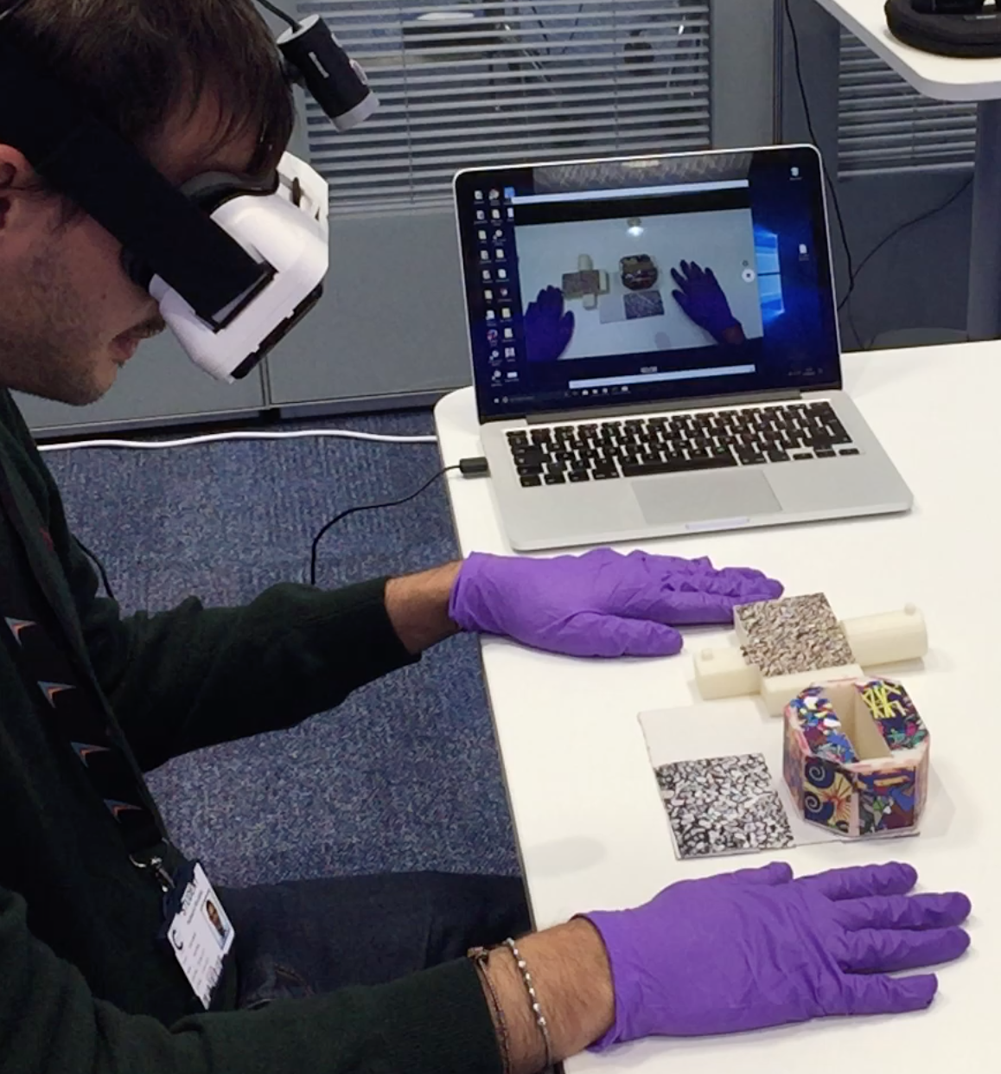
3
2
1

Slide 2
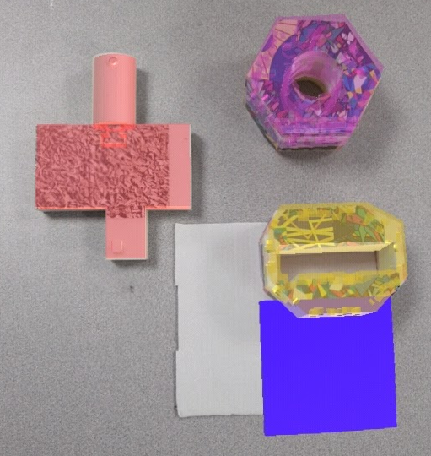




2
∆α
$$y_{2}$$
$$x_{2}$$
$$y_{1}$$
∆y
1
$$x_{1}$$
∆x

Slide 3
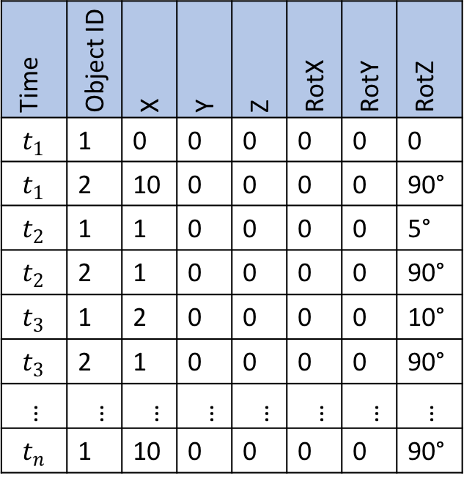
Time | Object ID | X | Y | Z | RotX | RotY | RotZ
$$t_{1}$$ | 1 | 0 | 0 | 0 | 0 | 0 | 0
$$t_{1}$$ | 2 | 10 | 0 | 0 | 0 | 0 | 90°
$$t_{2}$$ | 1 | 1 | 0 | 0 | 0 | 0 | 5°
$$t_{2}$$ | 2 | 1 | 0 | 0 | 0 | 0 | 90°
$$t_{3}$$ | 1 | 2 | 0 | 0 | 0 | 0 | 10°
$$t_{3}$$ | 2 | 1 | 0 | 0 | 0 | 0 | 90°
… | … | … | … | … | … | … | …
$$t_{n}$$ | 1 | 10 | 0 | 0 | 0 | 0 | 90°

