Slide 1
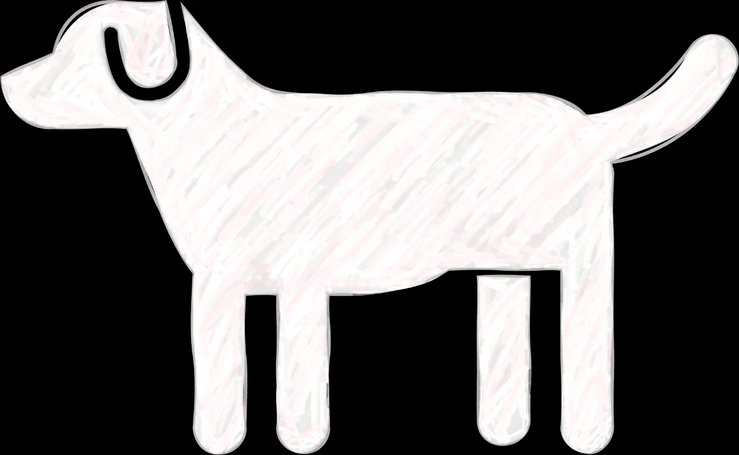
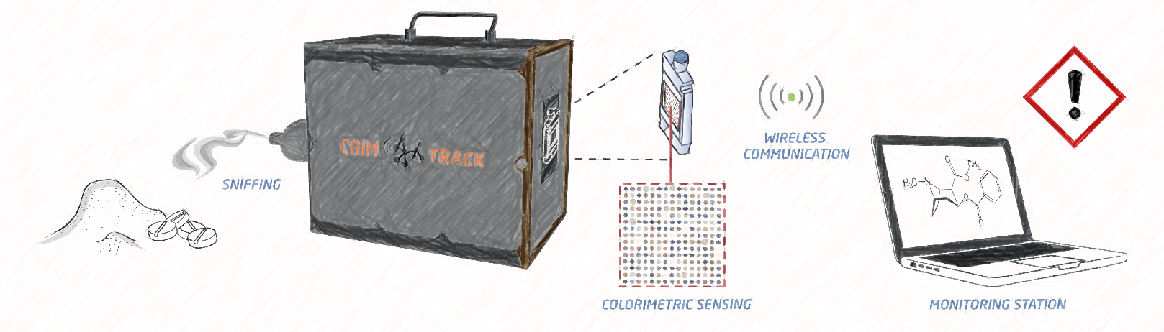
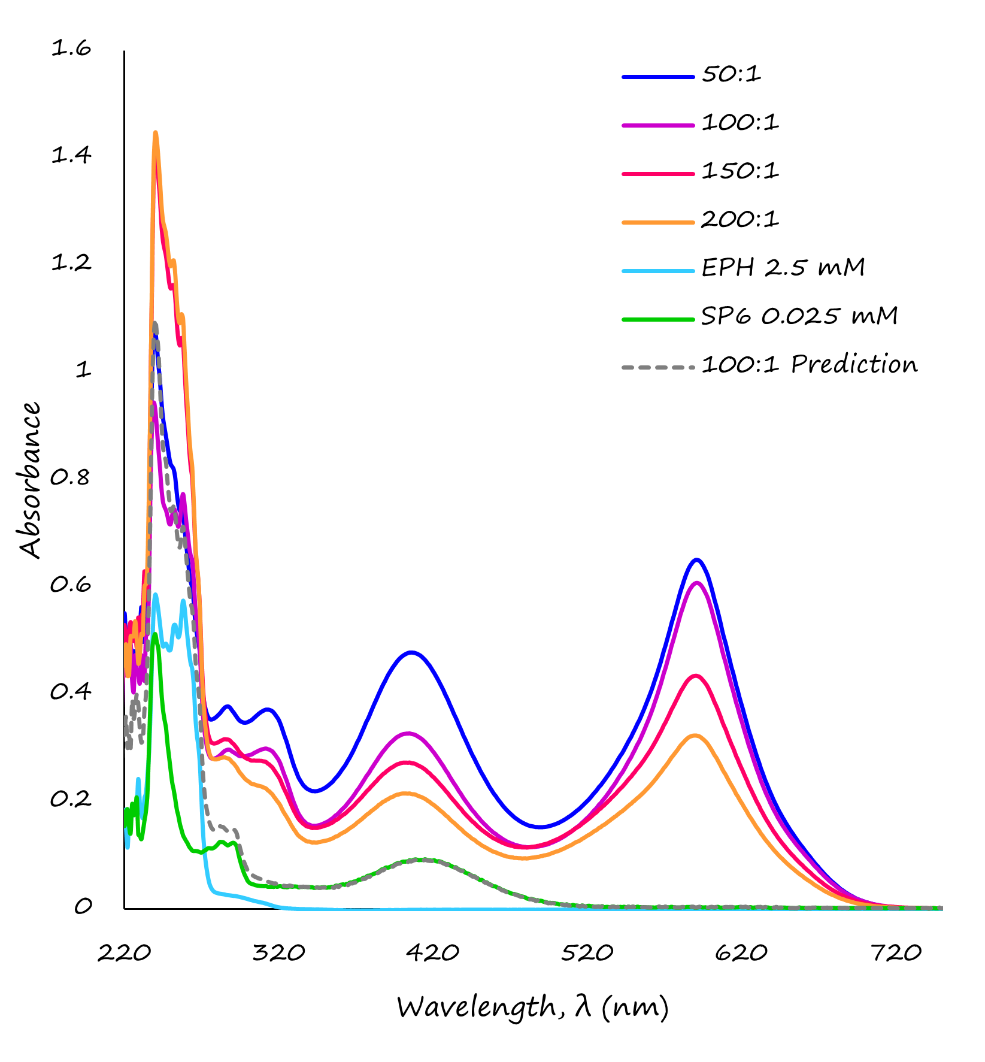
Getting a Whiff of Crime: The Chemistry Behind Detection of Illicit Substances by a New Sniffer Dog
Getting a Whiff of Crime: The Chemistry Behind Detection of Illicit Substances by a New Sniffer Dog
1
2
2
3
3

