Slide 1

Current practice and challenges towards handling uncertainty for effective outcomes in maintenance
Paper results
Alex Grenyer
27/11/19

Slide 2
Introduction
Research background
Survey questionnaire & interviews with industry
AHP implementation
Core challenges summary & validation
Paper conclusions
Tackling highlighted challenges
Agenda

Slide 3
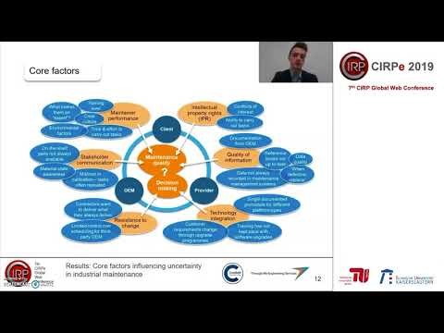
CIRPe video presentation
https://www.youtube.com/watch?v=_-RZL-QMBZs

Slide 4
Research background
Decision-making techniques
Analytical hierarchy process (AHP)
Goal
Widely implemented
Criteria 1
Criteria 2
Criteria 3
Criteria 4
Criteria 5
Pairwise comparisons
Enables accurate identification of most significant factors
Alternative 1
Alternative 2
Alternative 3
SWOT analysis
Strengths
Weaknesses
Quickly identify factors in a group setting
S
W
O
T
Can result in a plethora of factors that can’t be quantified with available resources
Opportunities
Threats

Slide 5
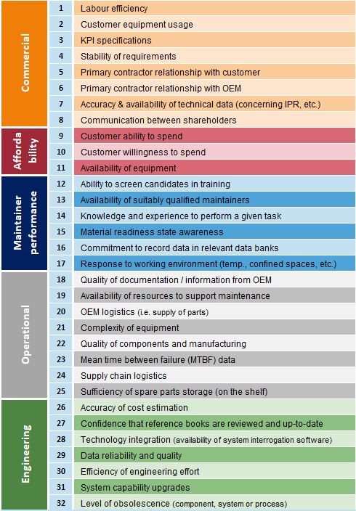
Survey questionnaire & interviews with industry
Pedigree score | 1 | 2 | 3 | 4 | 5
Years of experience | <5 | 5 to 9 | 10 to 14 | 15 to 20 | >20
Survey & interviews
Current role
Relevant prior to current role
Mean
Weighted mean

Slide 6
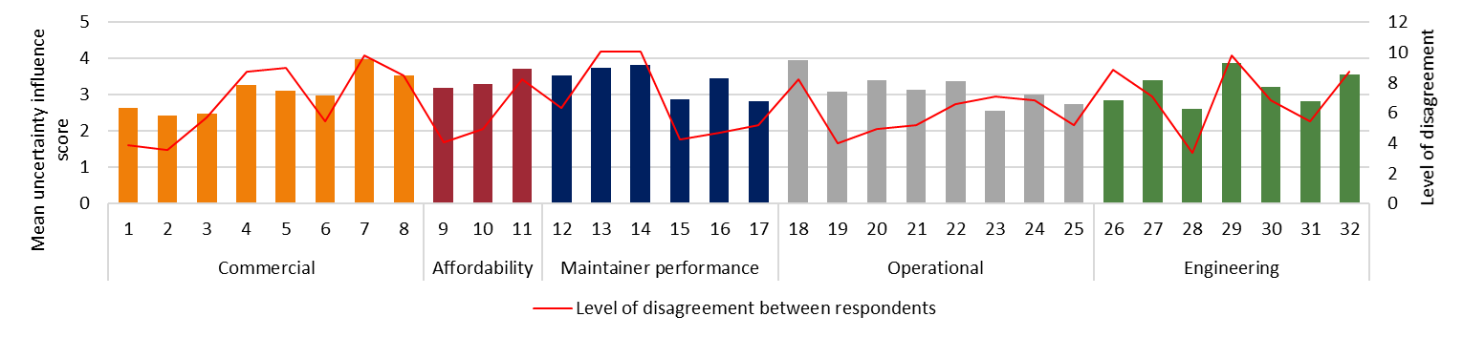
Survey questionnaire & interviews with industry
Accuracy & availability of technical data (IPR)
Quality of information from OEM
Standard
Equipment availability
Data reliability & quality
OEM logistics
(supply of parts)
Weighted with pedigree

Slide 7
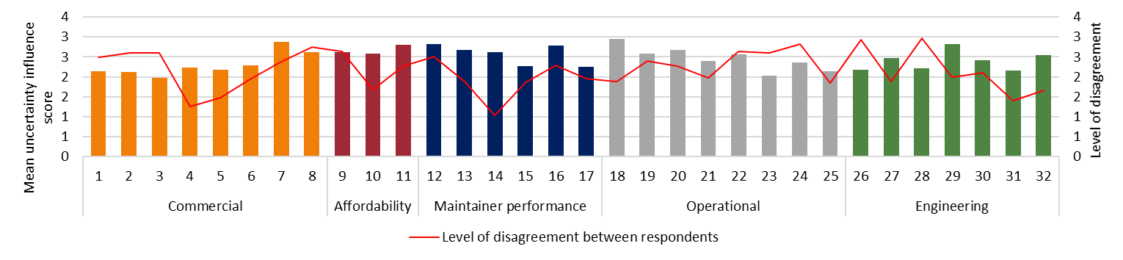
Survey questionnaire & interviews with industry
Pedigree score | 1 | 5
Years of experience | <5 | >20
Factors with greatest influence are the same for this application
Changes level of disagreement
Pedigree score | 1 | 5
Years of experience | >20 | <5

Slide 8
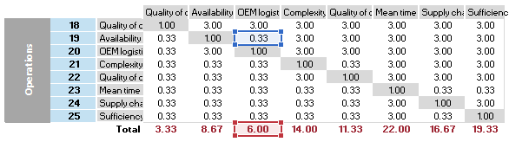
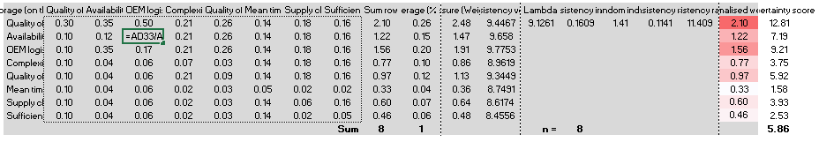
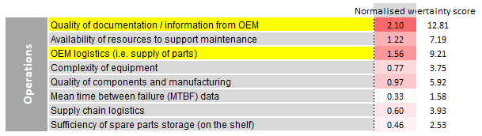
AHP implementation
Pairwise comparison
Normalised weight

Slide 9
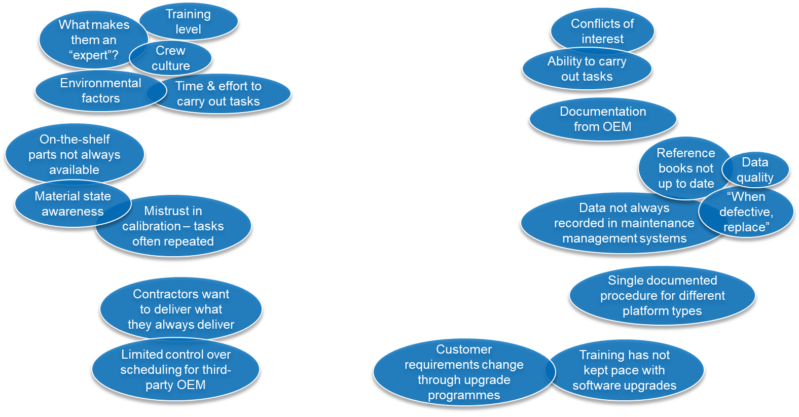
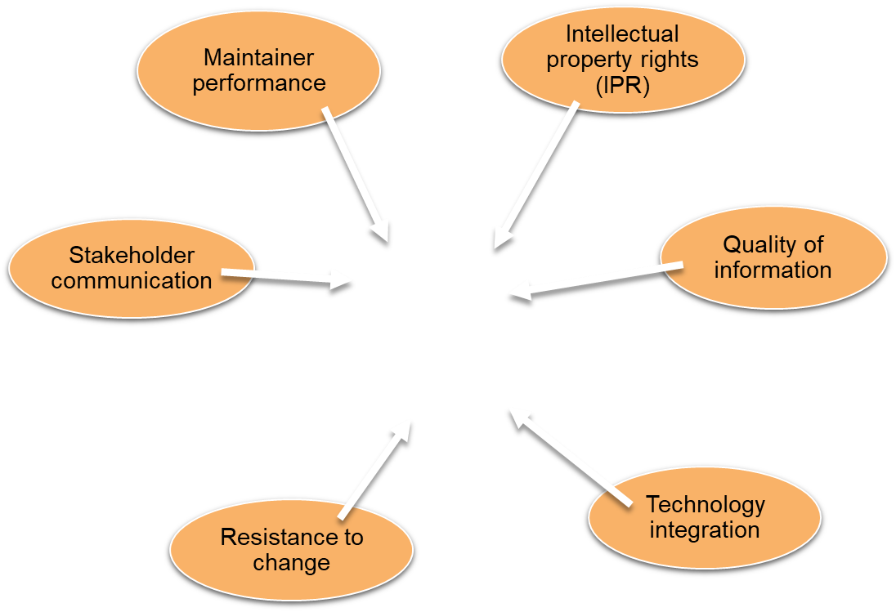
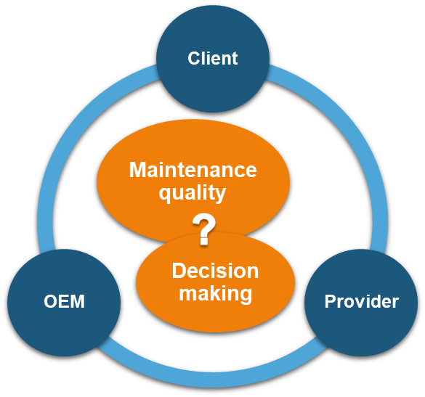
Results: Core factors influencing uncertainty in industrial maintenance

Slide 10
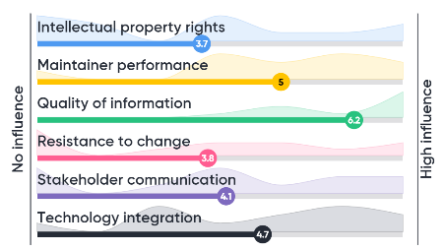
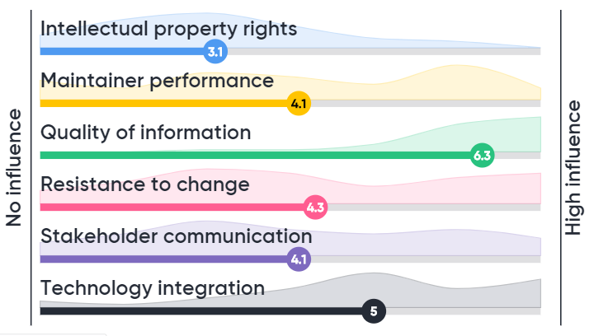
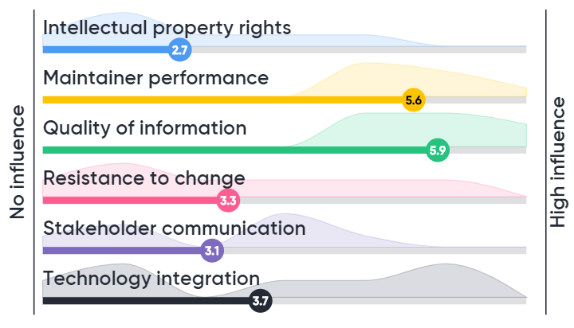
Validation – Wider industrial input
SCAF workshop
ISMOR workshop

Slide 11
Conclusions
Refined questionnaire
Pedigree assessment
Respondent pedigree
Derivation of pedigree criteria is subjective
Determined through interviews and academic input
Analytical hierarchy process
Multiple data repositories, many of which are not linked and have duplications
AHP
Identify Core challenges influencing uncertainty
Shared understanding of material state is required
Enabled weighted ranking of most significant factors
Holistic view allows for more informed and effective decisions
Validated with wider industry

Slide 12




Conclusions
Trade-off
Risk
Availability
Uncertainty
Challenges
Capability
Cost
Efficiency
Quality
Material state awareness
Knowledge

Slide 13


Alex Grenyer
PhD Researcher
Cranfield University
E: a.h.grenyer@cranfield.ac.uk
W: www.cranfield.ac.uk/centres/throughlife-engineering-services-institute

