Slide 1
James Bremner
Transport

Slide 2
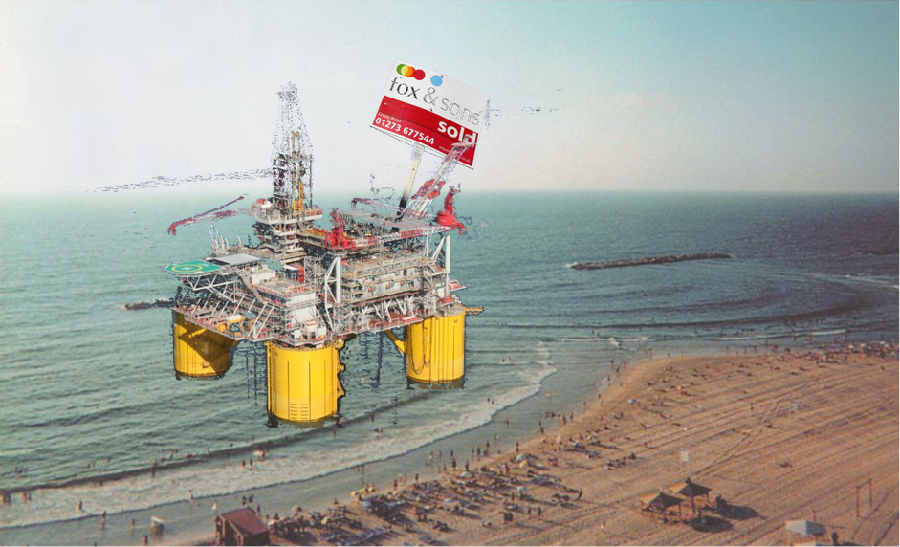
THIS AREA OF YOUR SLIDE WILL BE COVERED BY A TIMER

