Slide 1
Engy Moussa
Cambridge University

Slide 2

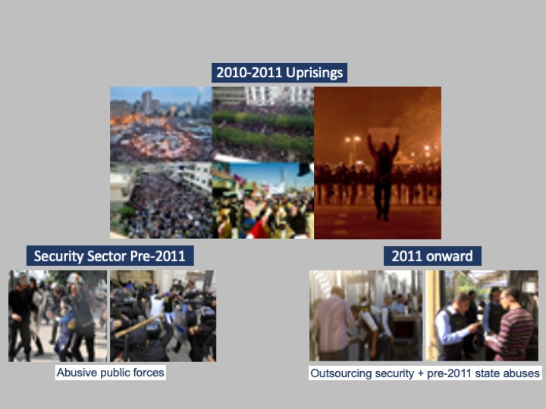
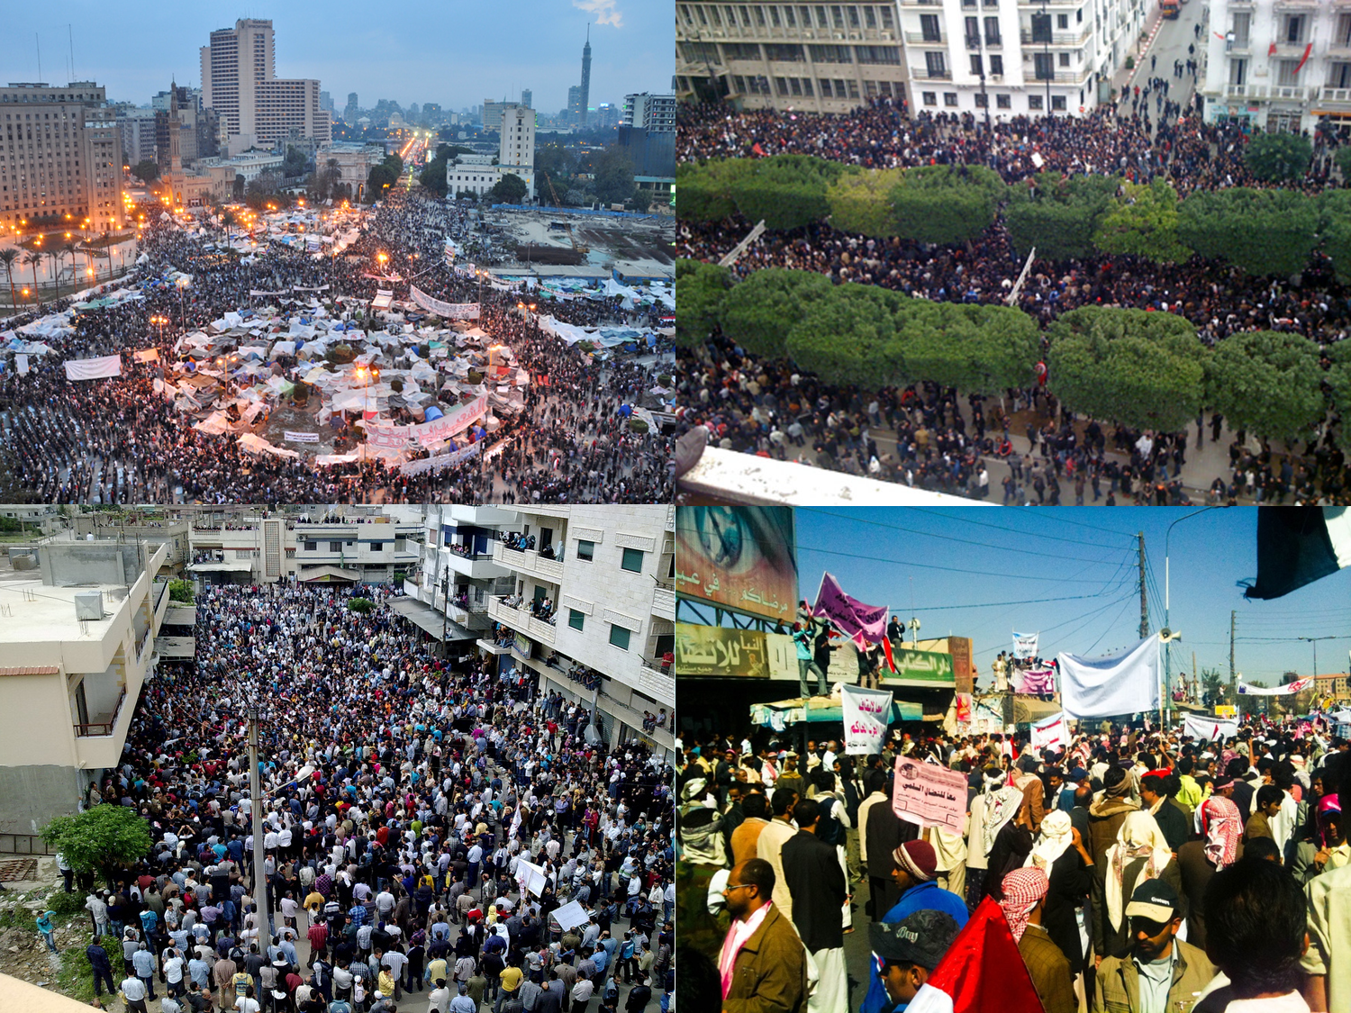
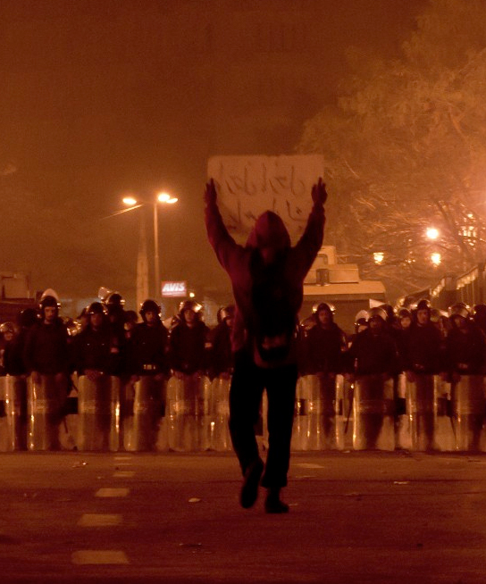
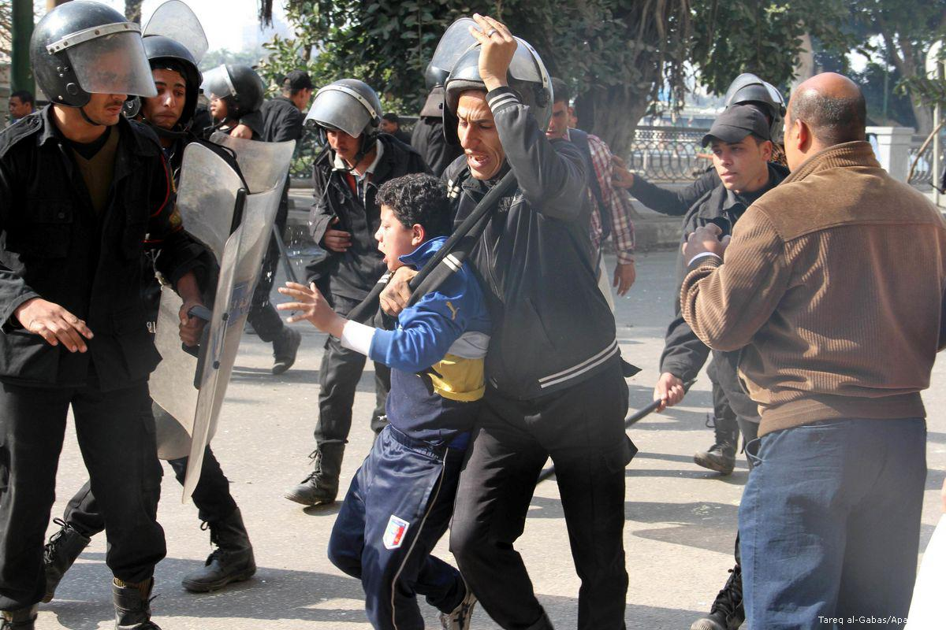
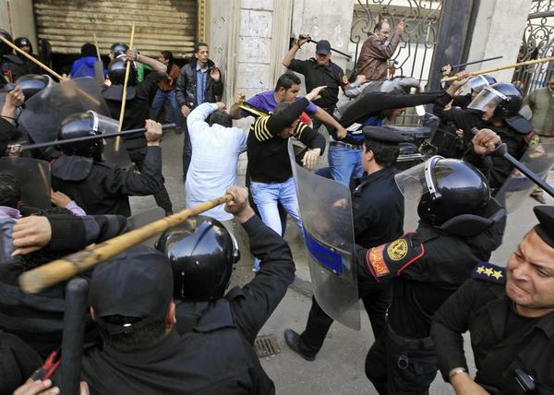
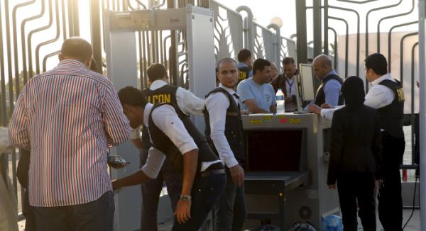
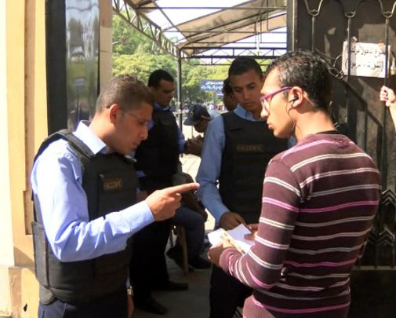
Privatising Security Post-Arab Uprisings
1
2
3
CLICK TO START
9
3
4
5
6
7
8
10
11
12
13
14
15
16
17
18
19
20
21
22
23
24
25
26
27
28
29
1
30
2
mins
mins
mins
secs
secs
secs
secs
secs
secs
secs
secs
secs
secs
secs
secs
secs
secs
secs
secs
secs
secs
secs
secs
secs
secs
secs
secs
secs
secs
secs
secs
secs
secs

