Slide 1
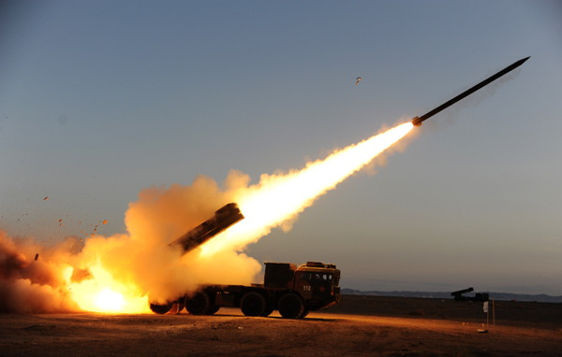
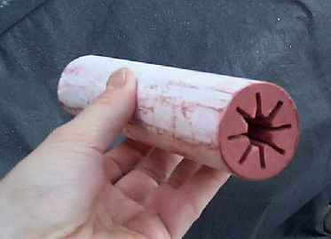
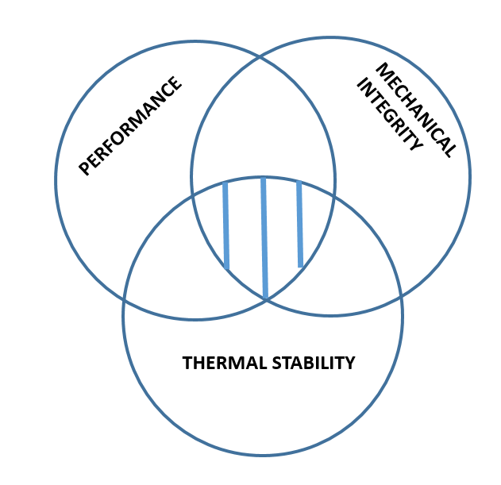
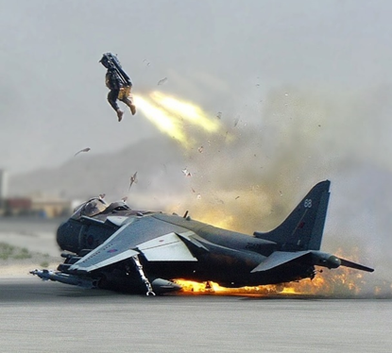
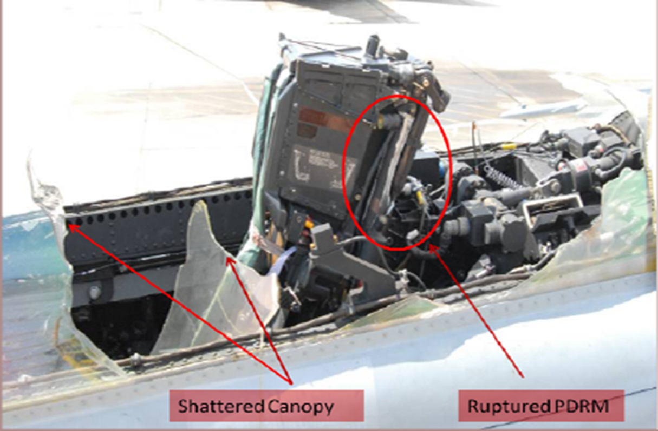

‘TAKING THE HEAT’ – DEVELOPING PROPELLANTS FOR HIGH-TEMPERATURE APPLICATIONS
Research Target
Present
SEAMLESS
PERFORMANCE
ACCIDENTS

