Slide 1
Figure 5.1. UPLD Framework overview

Slide 2
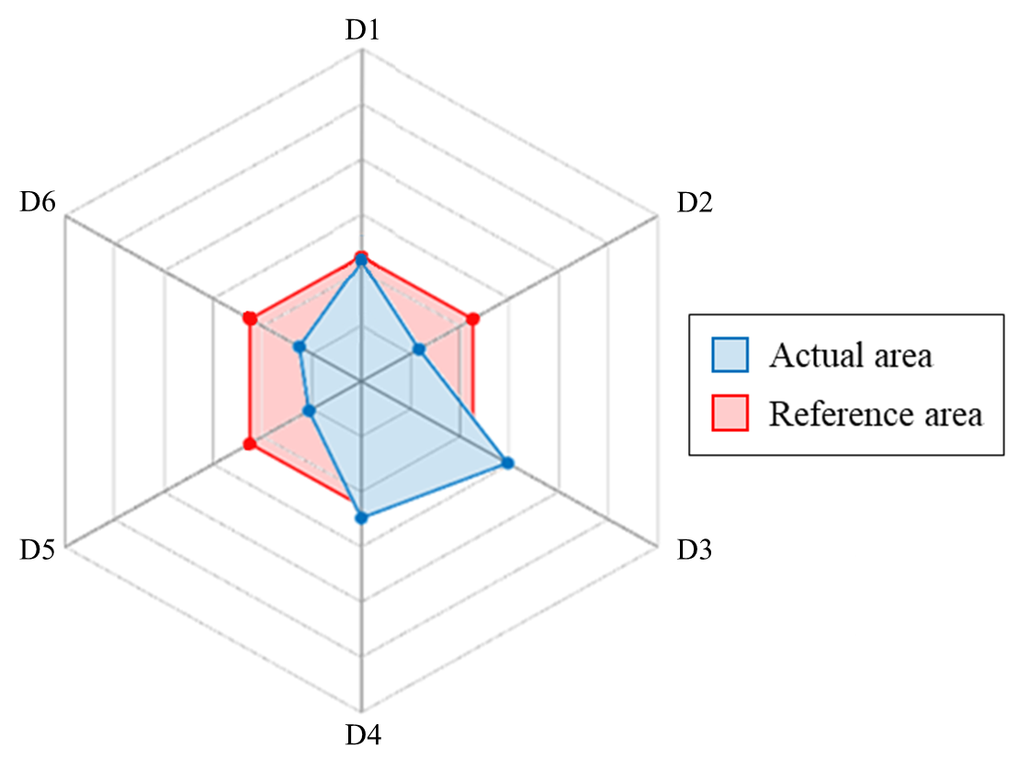
Figure 5.2. Spatial geometry actual vs. reference shape area example

Slide 3
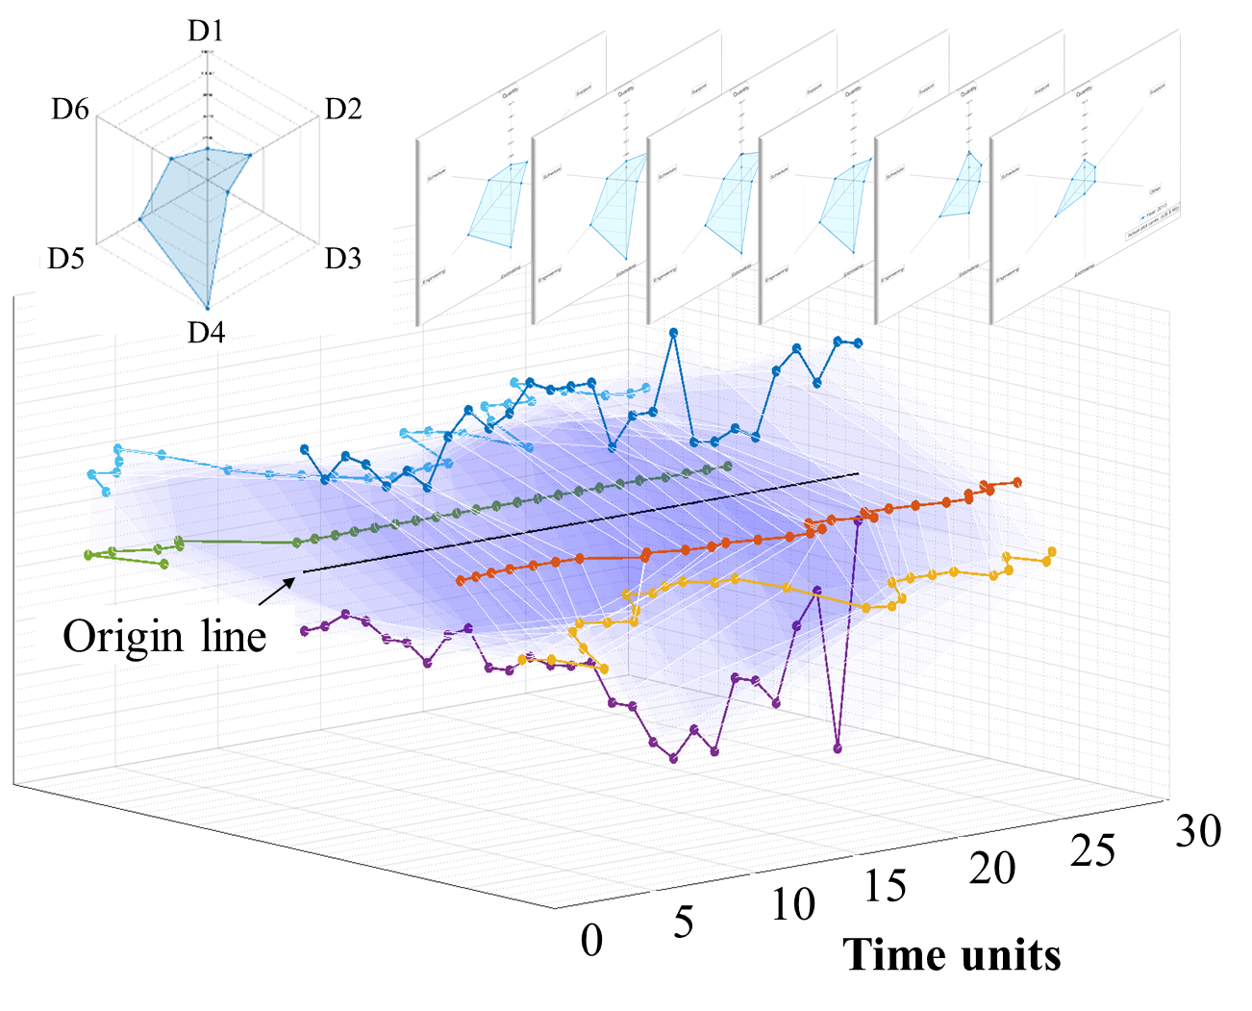
Figure 5.3. Stacked plot example

Slide 4
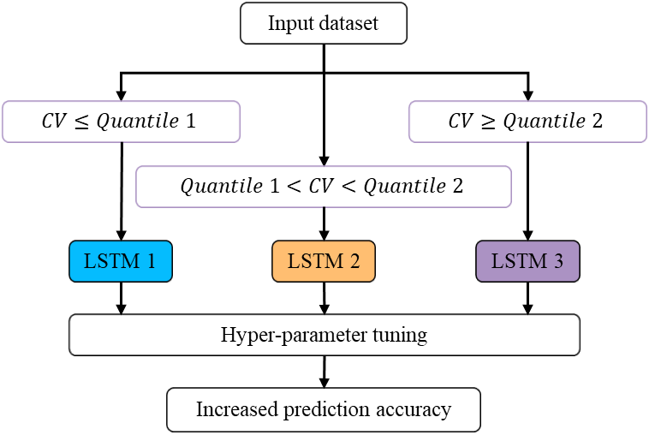
Figure 5.4. LSTM network allocation according to input parameters

Slide 5
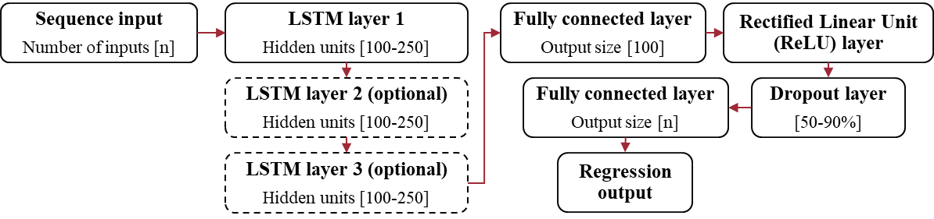
Figure 5.5. Hyperparameter setup metrics: Network structure

Slide 6
Table 5.1. Hyperparameter setup metrics: Training options
Training options | Value range
Solver | Adam, SGDM, RMS prop
Max. Epochs | 150-250
Initial learn rate | 0.005-0.01
Learn rate drop factor | 0.1-0.5

Slide 7
Case study 1: SAR data

Slide 8
Spatial geometry
(a)
(b)
Figure 5.6. SAR data: (a) Change in actual and reference shape area over time and (b) change in symmetry

Slide 9
Spatial geometry
Cumulative increase

Slide 10
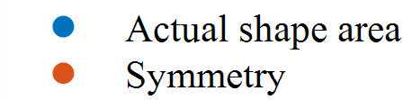


Spatial geometry Correlation factor
(a)
(b)
$$\text{Y}\text{ = 0.}2699e^{−0.079x}$$
$R^{2}=0.8537$
$$\text{Y}\text{ = 0.2461}e^{−0.089x}$$
$R^{2}=0.8125$
Figure 5.7. SAR data: (a) Percent change for cumulative increase and (b) correlation matrix

Slide 11
Spatial geometry Correlation factor
Figure 5.9. SAR data: Actual vs. symmetry correlation factor if assuming linear trend in cumulative % increase
Figure 5.8. SAR data: Actual vs. symmetry correlation factor for exponential trend

Slide 12
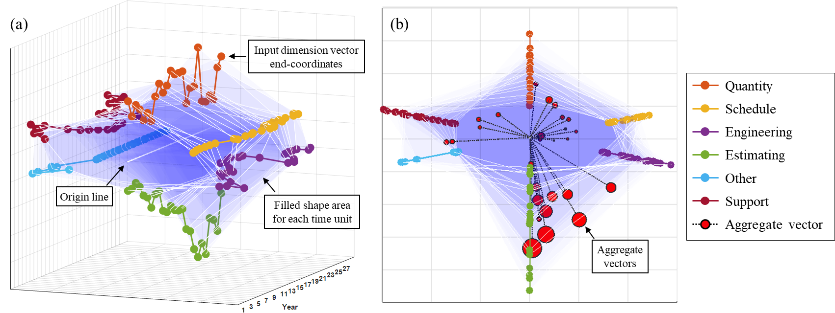
Figure 5.10. SAR data: (a) Stacked vector 3D plot and (b) face-on with aggregated vectors over 28-year period

Slide 13
LSTM parameter split
US SAR data
Not scaled
Variable | Range | Std Dev | Mean | Median | Mode | CV
Quantity | 3 | 2 | 2 | 3 | 3 | 1
Schedule | 3 | 1 | 3 | 3 | 1 | 1
Engineering | 3 | 1 | 2 | 3 | 1 | 1
Estimating | 3 | 2 | 3 | 3 | 1 | 1
Other | 3 | 3 | 3 | 3 | 2 | 1
Support | 3 | 2 | 2 | 3 | 1 | 1
Scaled
2
2
Variable | Range | Std Dev | Mean | Median | Mode | CV
Quantity | 3 | 1 | 2 | 3 | 3 | 2
Schedule | 3 | 1 | 3 | 3 | 1 | 2
Engineering | 3 | 1 | 2 | 3 | 1 | 1
Estimating | 3 | 1 | 3 | 3 | 1 | 2
Other | 3 | 3 | 3 | 3 | 2 | 3
Support | 3 | 1 | 2 | 3 | 1 | 2
1
2
3
2
Figure 5.11. SAR data: Summary statistics for each input and corresponding LSTM network allocation

Slide 14
LSTM architecture
Sequence input
Engineering
LSTM layer 1
Hidden units 110
Fully connected layer
Output size 100
Rectified Linear Unit (ReLU) layer
Dropout layer
50%
Fully connected layer
Output size 4
Regression output
LSTM 1
LSTM layer 1
Hidden units 240
Sequence input
Quantity, Schedule Estimating, Support
Fully connected layer
Output size 100
Rectified Linear Unit (ReLU) layer
LSTM layer 2
Hidden units 240
Dropout layer
50%
Fully connected layer
Output size 1
Regression output
LSTM 2
LSTM layer 3
Hidden units 240
Fully connected layer
Output size 100
Rectified Linear Unit (ReLU) layer
Sequence input
Other
LSTM layer 1
Hidden units 150
Dropout layer
50%
Fully connected layer
Output size 1
Regression output
LSTM 3
Figure 5.12. SAR data: LSTM network input allocation and structure following hyperparameter tuning

Slide 15
Table 5.2. SAR data: Defined training options following hyperparameter tuning
Training options | LSTM 1 | LSTM 2 | LSTM 3
Solver | SGDM | Adam | Adam
Max. Epochs | 235 | 200 | 130
Initial Learn Rate | 0.003 | 0.002 | 0.002
Learn rate drop factor | 0.14 | 0.11 | 0.10

Slide 16
Forecasts
(a)
(b)
Year
Year
Figure 5.13. SAR data: Observed vs. predicted uncertainty for (a) initial forecast and (b) updated forecast

Slide 17
Table 5.3. SAR data: Observed vs. predicted symmetry and aggregate vectors
 | Symmetry |  |  |  | Aggregate vector magnitude
Time | Observed | Predicted | Diff. | % Diff. | Observed | Predicted | Diff. | % Diff.
18 | 81.44 | 87.71 | 6.27 | 7% | 0.51 | 0.65 | 0.14 | 24%
19 | 76.35 | 71.30 | 5.05 | 7% | 0.34 | 0.65 | 0.31 | 62%
20 | 64.47 | 60.25 | 4.23 | 7% | 0.59 | 0.66 | 0.07 | 11%
21 | 53.23 | 60.66 | 7.43 | 13% | 0.67 | 0.65 | 0.03 | 4%
22 | 62.47 | 65.30 | 2.82 | 4% | 0.38 | 0.61 | 0.23 | 47%
23 | 55.55 | 74.49 | 18.94 | 29% | 0.45 | 0.55 | 0.10 | 21%
24 | 71.55 | 88.60 | 17.05 | 21% | 0.30 | 0.49 | 0.20 | 50%
25 | 76.11 | 97.51 | 21.40 | 25% | 0.03 | 0.48 | 0.45 | 177%
26 | 80.37 | 80.68 | 0.31 | 0% | 0.02 | 0.55 | 0.53 | 185%
27 | 54.18 | 42.64 | 11.54 | 24% | 0.49 | 0.66 | 0.17 | 29%
28 | 72.53 | 27.33 | 45.20 | 91% | 0.34 | 0.77 | 0.43 | 78%

Slide 18
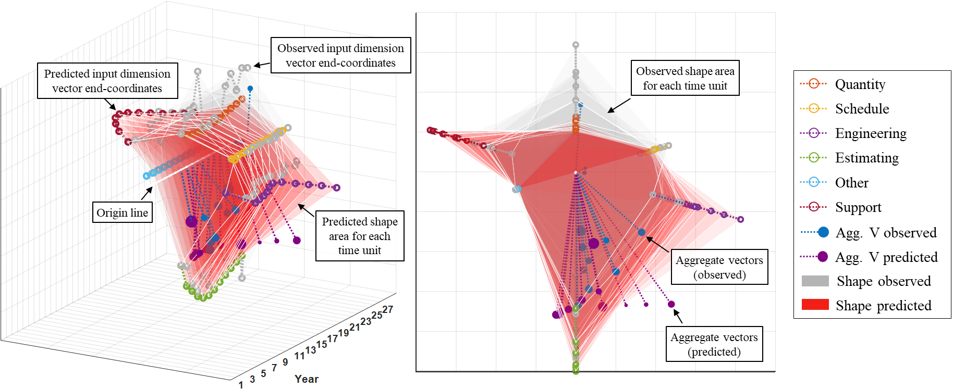
Figure 5.14. SAR data: Stacked 3D vector plot including observed and predicted data

Slide 19
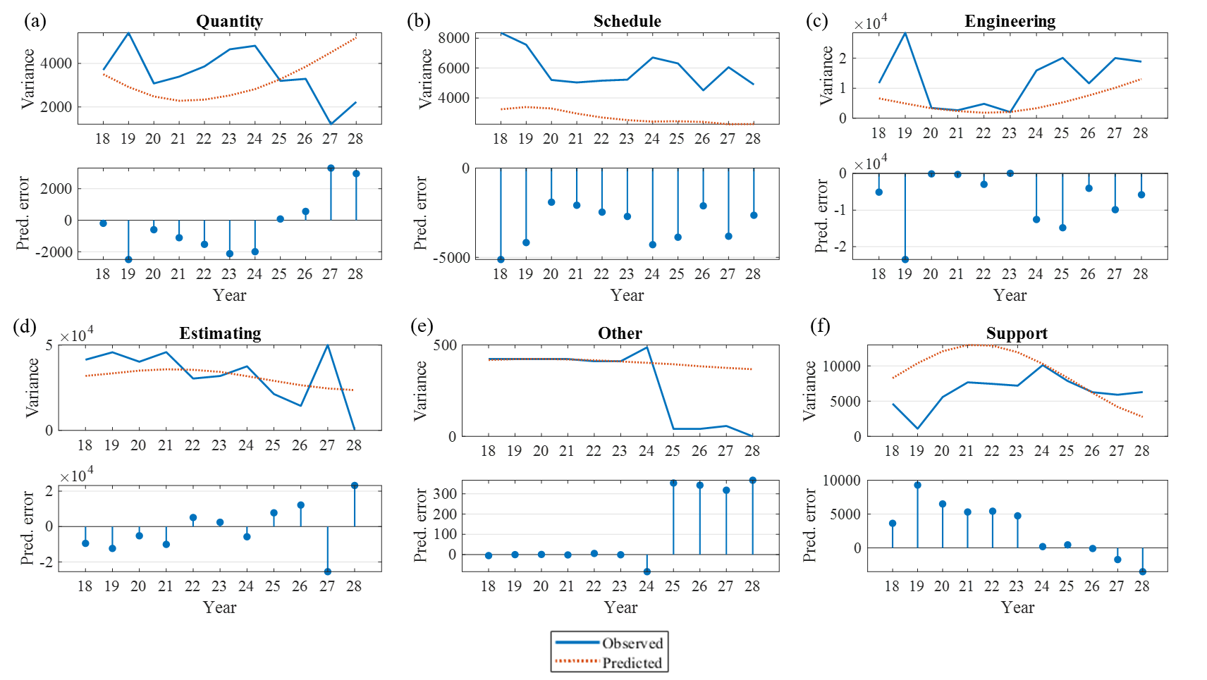
Figure 5.15. SAR data: Observed vs. predicted variance over the test period for each input dimension (a-f)

Slide 20
Table 5.4. SAR data: MAPE and RMSE of observed vs. predicted values over the test period
Input | MAPE | RMSE
Quantity | 140% | 2003
Schedule | 92% | 3834
Engineering | 64% | 8363
Estimating | 867% | 17110
Other | 381% | 208
Support | 248% | 4200

Slide 21
C-MAPSS data

Slide 22
Table 5.5. C-MAPSS data: Description of input dimensions to be forecast
Sensor number | Notation | Description
3 | T30 | Total temperature at HPC inlet
4 | T50 | Total temperature at LPT inlet
7 | P30 | Total pressure at HPC outlet
9 | Nc | Physical core speed
11 | Ps30 | Static pressure at HPC outlet
12 | Phi | Ratio of fuel flow to Ps30
14 | NRc | Corrected core speed
15 | BPR | Bypass ratio
20 | W31 | HPT coolant bleed
- | - | Process noise

Slide 23
Spatial geometry
(a)
(b)
Figure 5.16. C-MAPSS data: (a) Change in actual and reference shape area over time and (b) change in symmetry

Slide 24
Spatial geometry
Cumulative increase

Slide 25
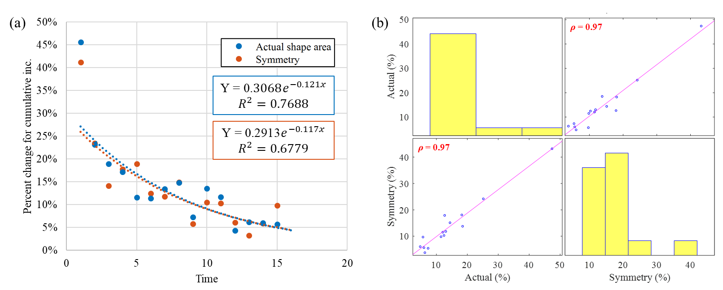
Spatial geometry Correlation factor
Figure 5.17. C-MAPSS data: (a) Percent change for cumulative increase and (b) correlation matrix

Slide 26
Spatial geometry Correlation factor
Figure 5.18. C-MAPSS data: Actual vs. symmetry correlation factor for exponential trend

Slide 27
Spatial geometry Correlation factor
Actual : Symmetry correlation factor linear
Actual : Symmetry correlation factor log

Slide 28
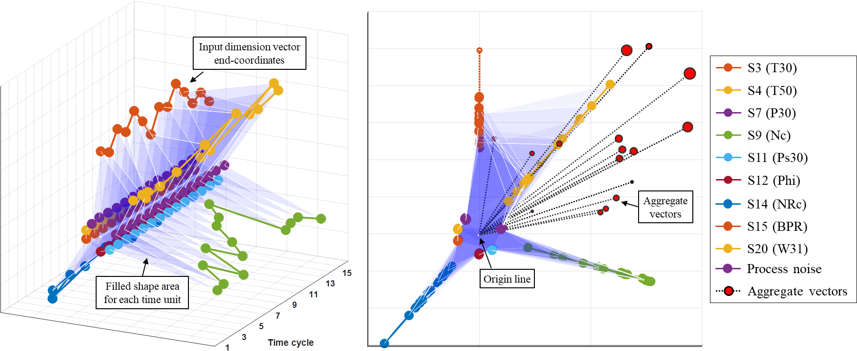
Figure 5.19. C-MAPSS data: Stacked vector 3D plot and face-on with aggregated vectors over 16 time units

Slide 29
LSTM parameter split
Not scaled
C-MAPSS data
Not scaled
Scaled
Variable | Range | Std Dev | Mean | Median | Mode | CV
S3 (T30) | 3 | 1 | 3 | 3 | 1 | 1
S4 (T50) | 3 | 1 | 3 | 3 | 1 | 1
S7 (P30) | 3 | 1 | 3 | 3 | 1 | 3
S9 (Nc) | 3 | 1 | 2 | 3 | 1 | 1
S11 (Ps30) | 3 | 1 | 3 | 3 | 1 | 3
S12 (Phi) | 3 | 1 | 3 | 3 | 1 | 3
S14 (NRc) | 3 | 1 | 3 | 3 | 1 | 1
S15 (BPR) | 3 | 1 | 3 | 3 | 1 | 3
S20 (W31) | 3 | 1 | 3 | 3 | 1 | 3
ProcssNoise | 3 | 3 | 3 | 3 | 1 | 3
Variable | Range | Std Dev | Mean | Median | Mode | CV
S3 (T30) | 3 | 1 | 3 | 3 | 1 | 3
S4 (T50) | 3 | 2 | 3 | 3 | 1 | 3
S7 (P30) | 3 | 2 | 3 | 3 | 1 | 3
S9 (Nc) | 3 | 1 | 2 | 3 | 1 | 1
S11 (Ps30) | 3 | 1 | 3 | 3 | 1 | 3
S12 (Phi) | 3 | 2 | 3 | 3 | 1 | 3
S14 (NRc) | 3 | 2 | 3 | 3 | 1 | 3
S15 (BPR) | 3 | 2 | 3 | 3 | 1 | 3
S20 (W31) | 3 | 1 | 3 | 3 | 1 | 2
ProcssNoise | 3 | 3 | 3 | 3 | 1 | 3
Figure 5.20. C-MAPSS data: Summary statistics for each input and corresponding LSTM network allocation
Scaled
3
3
3
1
3
3
3
3
2
3

Slide 30
LSTM architecture
CMAPSS data
LSTM layer 1
Hidden units 210
Sequence input
S20
Fully connected layer
Output size 100
Rectified Linear Unit (ReLU) layer
LSTM layer 2
Hidden units 210
Dropout layer
50%
Fully connected layer
Output size 1
Regression output
LSTM 1
LSTM layer 3
Hidden units 210
Fully connected layer
Output size 100
Rectified Linear Unit (ReLU) layer
Sequence input
S9
LSTM layer 1
Hidden units 220
Dropout layer
50%
Fully connected layer
Output size 4
Regression output
LSTM 2
Sequence input
S3, S4, S7, S11, S12, S14, S15, Process Noise
Fully connected layer
Output size 100
Rectified Linear Unit (ReLU) layer
LSTM layer 1
Hidden units 200
Dropout layer
50%
Fully connected layer
Output size 1
Regression output
LSTM 3
Figure 5.21. C-MAPSS data: LSTM network input allocation and structure following hyperparameter tuning

Slide 31
Table 5.6. C-MAPSS data: Defined training options following hyperparameter tuning
Training options | LSTM 1 | LSTM 2 | LSTM 3
Solver | Adam | Adam | Adam
Max. Epochs | 220 | 180 | 120
Initial Learn Rate | 0.009 | 0.009 | 0.021
Learn rate drop factor | 0.23 | 0.061 | 0.138

Slide 32
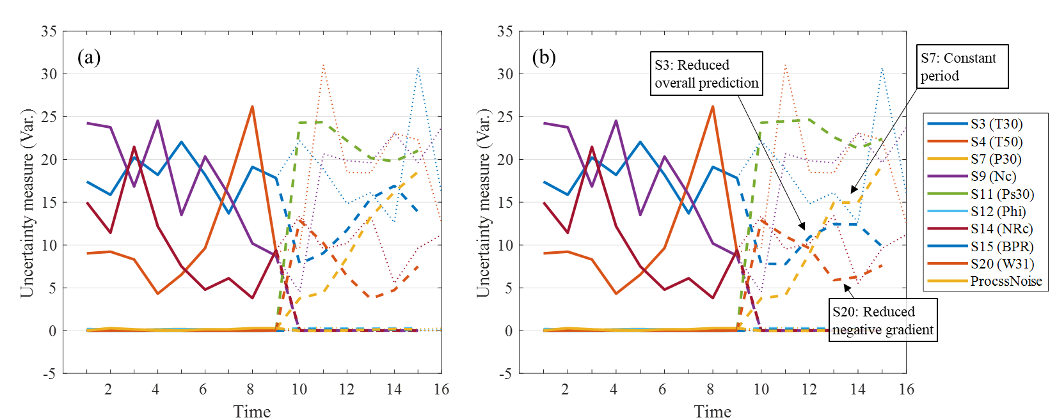
Figure 5.22. C-MAPSS data: Observed vs. predicted uncertainty for (a) initial forecast and (b) updated forecast

Slide 33
Table 5.7. C-MAPSS data: Observed vs. predicted symmetry and aggregate vector magnitude
 | Symmetry |  |  |  | Aggregate vector magnitude
Time | Observed | Predicted | Diff. | % Diff. | Observed | Predicted | Diff. | % Diff.
11 | 141.67 | 149.23 | 7.56 | 5% | 1.28 | 0.33 | 0.95 | 118%
12 | 155.55 | 196.87 | 41.32 | 23% | 0.83 | 0.40 | 0.42 | 69%
13 | 98.38 | 165.01 | 66.63 | 51% | 0.75 | 0.56 | 0.19 | 29%
14 | 53.42 | 124.97 | 71.56 | 80% | 1.10 | 0.78 | 0.32 | 34%
15 | 103.93 | 101.93 | 2.01 | 2% | 1.27 | 0.87 | 0.40 | 37%
16 | 191.93 | 149.66 | 42.27 | 25% | 0.74 | 0.86 | 0.12 | 15%

Slide 34
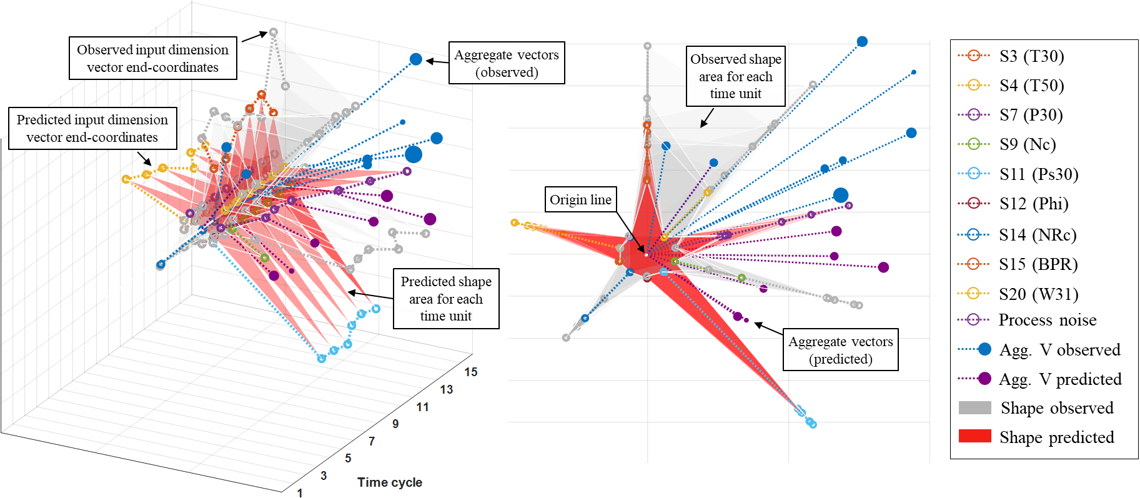
Forecasts
CMAPSS data
Figure 5.23. C-MAPSS data: Stacked 3D vector plot for observed and predicted data

Slide 35
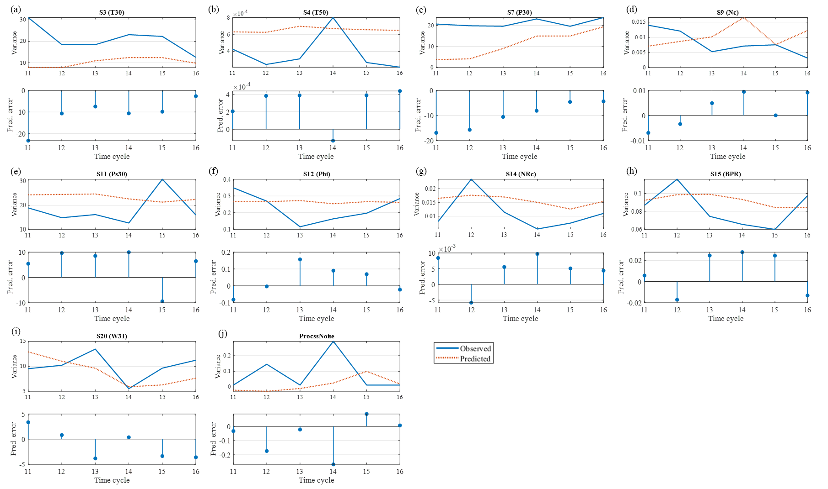
Figure 5.24. C-MAPSS data: Observed vs. predicted variance over test period for each input dimension (a-j)

Slide 36
Table 5.8. C-MAPSS data: MAPE and RMSE of observed vs. predicted values over test period
Input | MAPE | RMSE
S3 (T30) | 23% | 12.52
S4 (T50) | 70% | 0.00
S7 (P30) | 30% | 2.43
S9 (Nc) | 46% | 0.01
S11 (Ps30) | 26% | 7.25
S12 (Phi) | 20% | 0.09
S14 (NRc) | 40% | 0.01
S15 (BPR) | 16% | 0.02
S20 (W31) | 20% | 3.30
ProcssNoise | 314% | 0.12

Slide 37
Discussion

Slide 38
Table 5.9. Spatial geometry taxonomy for fixed and changeable parameters
Fixed parameters | Translation space | Changeable parameters (over time)
Scaling equation for all input dimensions Shape area calculation Symmetry calculation Radial degree between inputs Dimensional sequence of inputs Origin location | Layout/plotting functions for visualisation Computational complexity | Input dimension vector coordinates Shape area Symmetry Aggregate vector direction and magnitude Forecast most likely variance

Slide 39
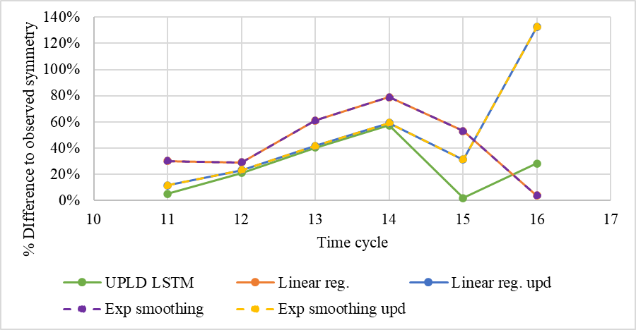
Figure 5.25. Forecast method comparison – percentage difference of observed and predicted symmetry

Slide 40
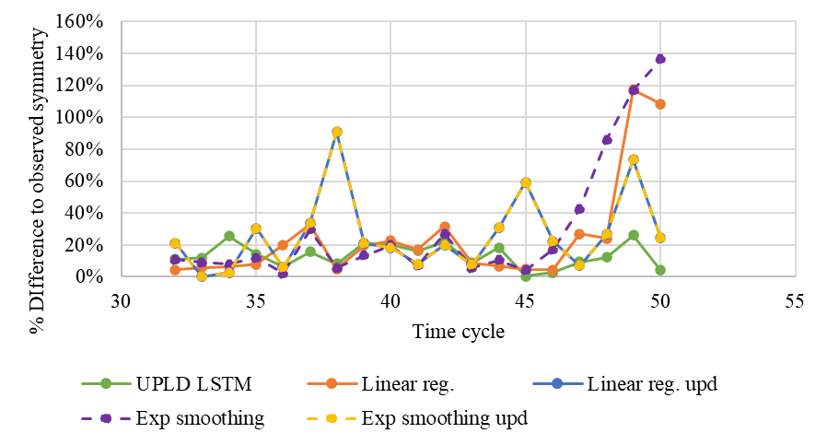
Figure 5.26. Forecast method comparison for extended time series data – percentage difference of observed and predicted symmetry

