Slide 1

Identifying challenges in quantifying uncertainty: Case study in infrared thermography
Alex Grenyer * Luke Oakey
Sri Addepalli John A. Erkoyuncu
Yifan Zhao Rajkumar Roy
29-31 May 2018

Slide 2





Academic background
PhD – Manufacturing
Cranfield University (2017-2021)
Advanced uncertainty quantification techniques for maintenance planning
MSc – Aerospace Manufacturing
Cranfield University (2016-2017)
BSc – Aerospace Engineering
Kingston University London (2013-2016)

Slide 3
Introduction
Aim & objectives
Literature review
Thermography system use case
Industrial challenges in UQ for PSS
Conclusions & future work
Agenda

Slide 4

Introduction
Complex engineering systems (CES) present multiple uncertainties
- From performance measurements to maintainability
- Through-life characteristics
A quantifiable understanding is vital to system optimisation
Uncertainty plays a key role in decision-making for manufacturing organisations
Impact on…
Manufacturing efficiency
Sourced from expert opinion
Profit
  Asset availability
Uncertainty
Well known
Statistical
Heuristic
Overlooked

Slide 5






Aim & objectives
Examine challenges that arise when quantifying heuristic uncertainties in CES in the context of industrial PSS
Aim
Need to question…
Operating conditions
Component complexity
Recording method
Accuracy
Maintainer training
  How can multiple interlinked variables influence decisions?
  Approaches
What effect will decisions for one subsystem have on the whole system?
Research theme
A clear picture of heuristic & statistical uncertainties aids decision making processes for cost-effective maintenance planning

Slide 6
Literature Review

Slide 7


Literature Review
What is uncertainty?
Error
Vs
Uncertainty
Information
Difference between measured & true value
Lack of information on magnitude of error
Required
Follow probability distributions
Utilised to aid decision making
Possessed
Cause?
Environmental conditions
Type A (statistical)
Epistemic
Vs
Aleatory
Human error
Type B (heuristic)
Known in principal, not in practice
Cannot be reduced
Cause?
Measurement models
Differ each time experiment is carried out
Result on overall performance
Reduce
Inaccurate measurements
More data, refine models

Slide 8
Literature Review
Uncertainty analysis
1
Specify measurand
2
Identify error sources & distributions
3
Estimate uncertainties
4
Combine uncertainties
Type A or B?
Monte Carlo analysis
Confidence level
Degrees of freedom
Most effective approach in many situations for various combinations
5
Report results
Extensive sampling of uncertainty ranges for individual variables

Slide 9

Literature review
IPS²
“Result of rapidly changing nature of industrial service provision whereby a client may interact with a product in their possession, but not take ownership” – Meier et al (2010)
Highly dynamic & complex
Shareholder relationships promoted by extensive product life cycles
Client
Affordability
Asset life-cycle
Maintenance technologies
NDT & degradation assessment, repair & remote maintenance
OEM
Provider
Sustainability
Profitability
Opportunities created by rapid digitalisation & connectivity
Considered in context to aid component health evaluation

Slide 10
Literature Review
Research gaps
Approaches that support SoS perspective to uncertainty quantification (UQ) are lacking
Lack of methods to determine heuristic uncertainties & effect on aggregated System of system (SoS) uncertainty
Necessary to capture full system impact
Individual components, uncertain states
Modern CES
Importance dependent on operational conditions & system environment
Multiple subsystems
Simultaneous & nonlinear interaction on multiple levels
Challenges to UQ
Lack of guidance for compound UQ in CES
Results in over or under estimation

Slide 11
Use case: Thermography
system demonstrator

Slide 12
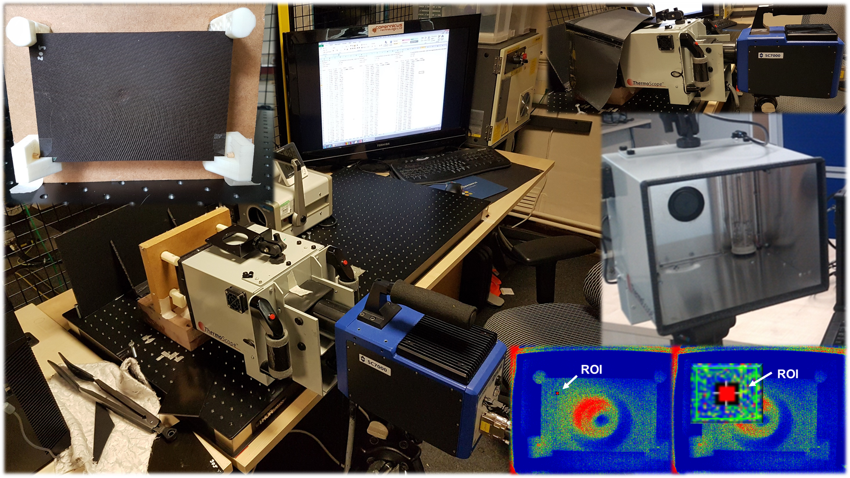
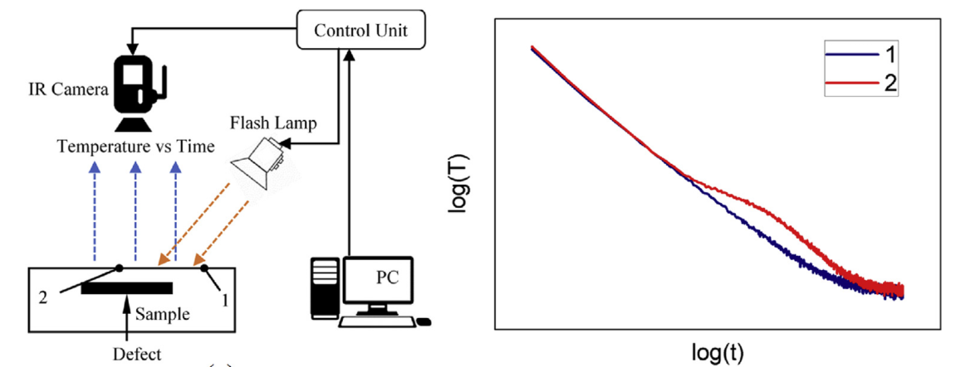
Use case: Thermography system demonstrator
What is thermography?
Sample heated by uniform pulse of light from flash box
NDT process
IR camera monitors sample surface temperature response over time
Used in various conditions to identify defects and in several materials
Heat flow obstructed in areas close to a wall or subsurface defect, causing increase in local surface temperature
Zhao et al (2018)

Slide 13
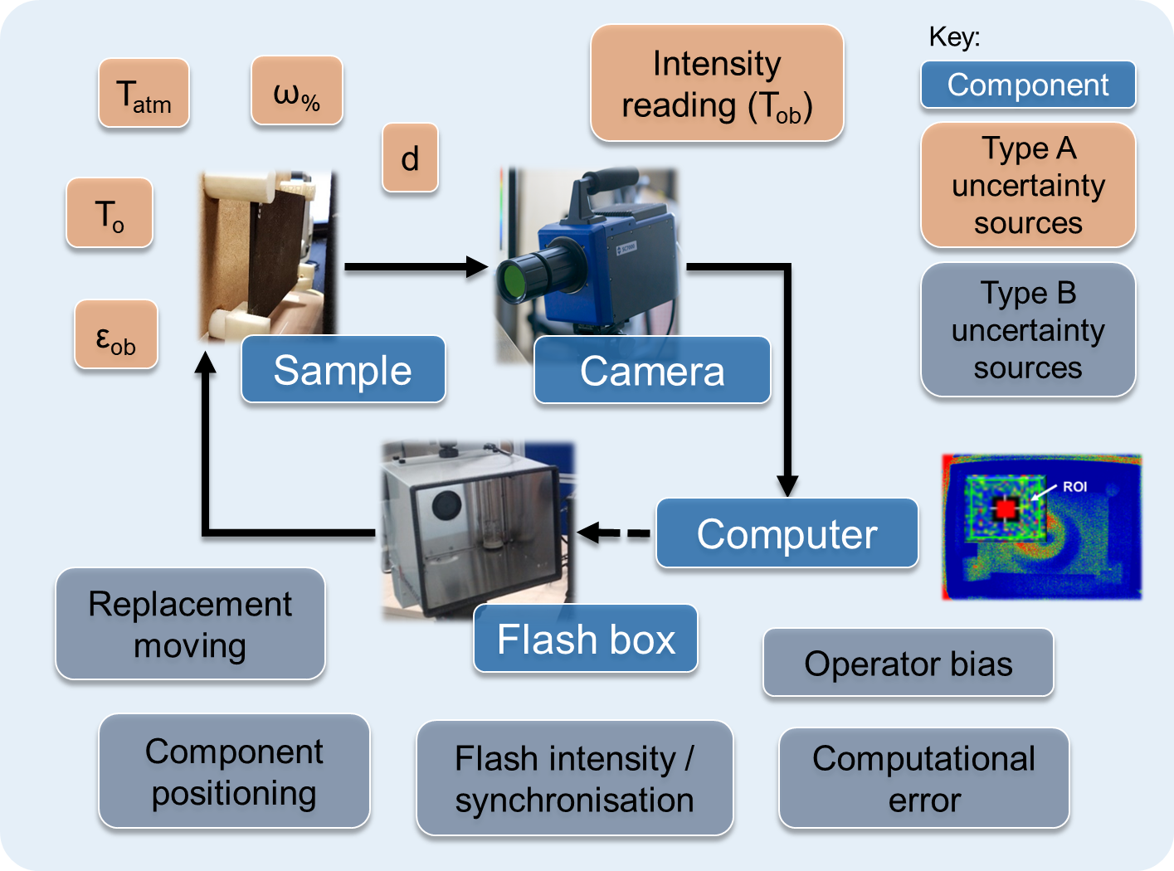
Use case: Thermography system demonstrator
Identification of uncertainties
Considered…
Measured data
Combined uncertainty from each module
Heuristic estimates
Measured value
Digital intensity level of reconstructed temperature decay profile from IR camera

Slide 14
Use case: Thermography system demonstrator
Identification of uncertainties
Subsystem | Uncertainty source | Nominal / mean value | Error margin | Probability distribution, uncertainty type
IR Camera | Atmospheric T., K (T_{atm}) | 294.34 | ±0.1 | Normal, A
 | Humidity, % (ω%) | 61 | ±0.1 | Normal, A
 | Distance, m (d) | 0.26 | ±0.01 | Uniform, A
 | Intensity reading (T_{ob}) | 5.13 | ±0.001 | Normal, A
 | Positioning | 0 | ±0.001 | Uniform, B
Flash Box | Flash intensity, % | 75 | ±0.001 | Uniform, B
 | Synchronisation, s | 0 | ±0.001 | Uniform, B
Sample | Emissivity (ε_{ob}) | 0.85 | ±0.02 | Uniform, A
 | Temperature, K (T_{o}) | 294.34 | ±0.1 | Normal, A
 | Mount Positioning | 0 | ±0.001 | Uniform, B
 | Replacement moving | 0 | ±0.02 | Uniform, B
Computer | Operator bias | 0 | ±0.01 | Uniform, B
 | Computation error | 0 | ±0.01 | Uniform, B

Slide 15
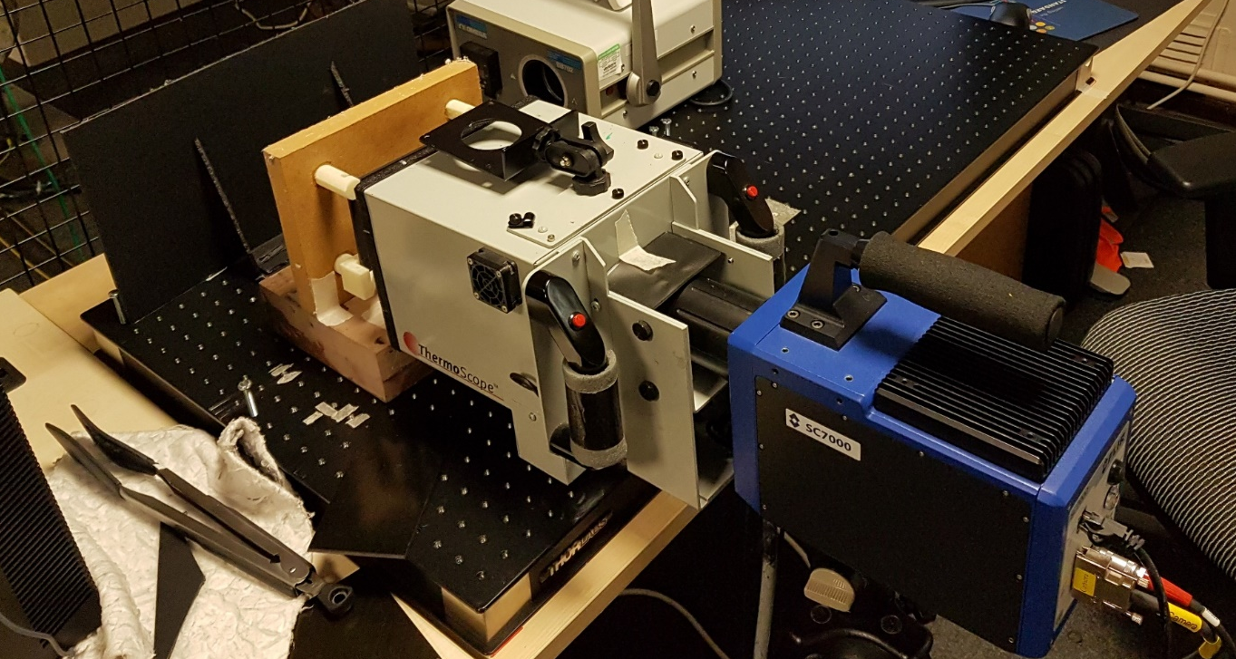
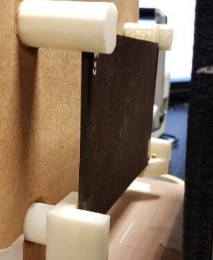
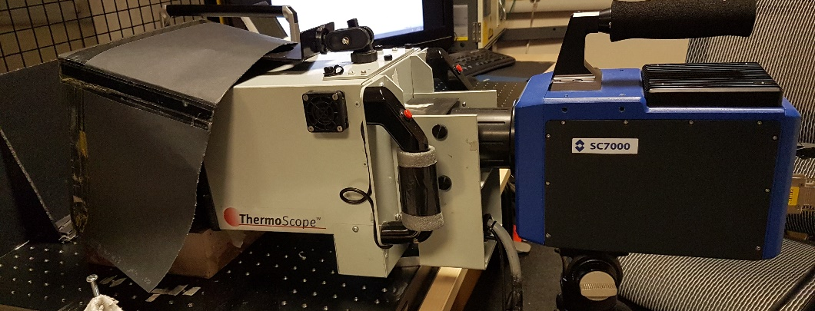
Use case: Thermography system demonstrator
Experimental procedure
Sample removed every 10 reps
Simulated positional uncertainty associated with operator & sample positioning
T_{atm} & hum recorded every 10 reps
Fixed position
Increase statistical accuracy & minimise error
Constant parameters
3 trails per rep – Total 30 datasets

Slide 16
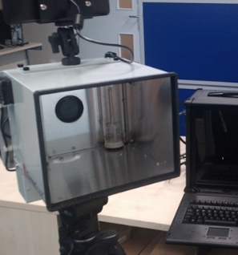
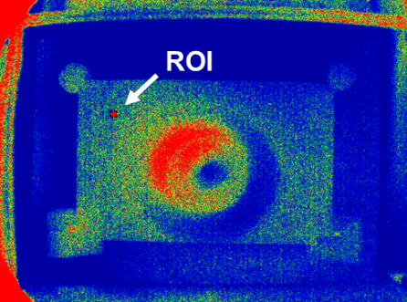
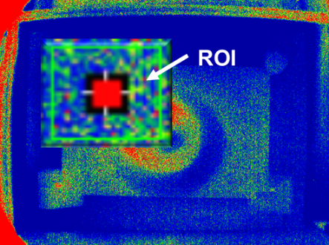
Use case: Thermography system demonstrator
Experimental procedure
25Hz
1000 frames in 40sec
75% power
15min cooling time between data captures
Constant parameters
Assumed T_{atm} = T_{sample}
15x15 pixel ROI

Slide 17

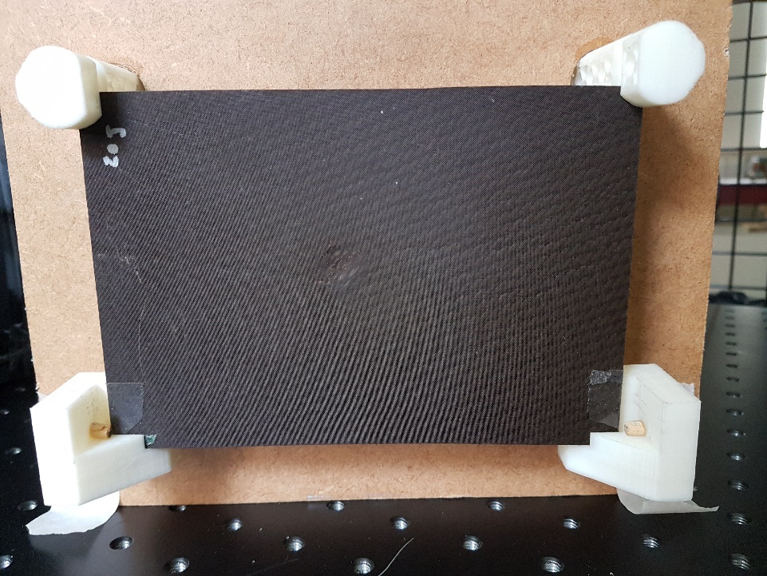

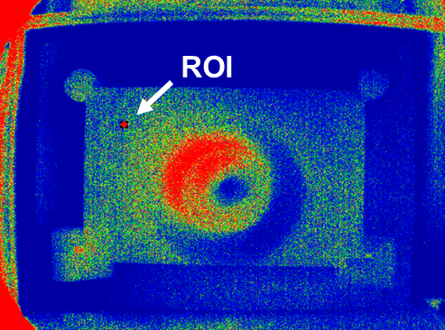


Slide 18

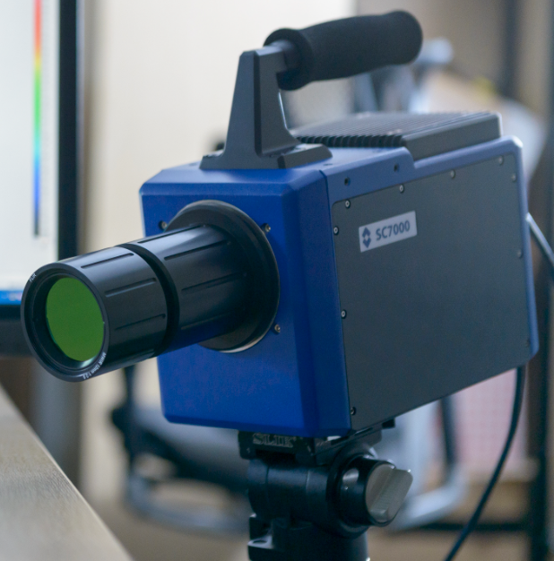


Use case: Thermography system demonstrator
Uncertainty estimation
StdDev of mean per frame
= uncertainty in recorded values
Monte Carlo analysis
Component uncertainty
Combined subsystem uncertainty
Combined system uncertainty
RSS
T_{atm}
ω%
Sensitivity coefficients
Sample
13%
System uncertainty
d
?
Degrees of freedom
Flash box
T_{ob}
Camera
0.1%
17.7%
Camera
12%
Pos
95% confidence
Computer
Effective degrees of freedom
1.4%

Slide 19




Use case: Thermography system demonstrator
Considerations for heuristic uncertainty estimation
Uniform distribution
Highly concentrated mean
Defined error limits dependent on…
Operational conditions
Impact on aleatory uncertainty
Environmental conditions
Changes over time?
Heuristic uncertainties considered:
Flash intensity
Alterations cause fluctuations in sample surface temp per recording
Operator bias & computation error
Component positioning
Inaccurate readings
Incorrect measurements
Inaccurate calculations
Flash sync
Alterations will move ROI & alter camera focus
Flash must sync with recording start to give accurate readings

Slide 20
Industrial challenges
in heuristic UQ for PSS

Slide 21
Industrial challenges in heuristic UQ
Adverse conditions impact what can be done
Real-world environment
Environmental factors
Maintainer wellbeing
Ability to carry out tasks
More pressure means less time & effort to carry out tasks
Client
Complex systems in PSS
Training level
Conflicts of interest
How can changes in uncertainty for one system affect that of another?
Maintenance quality
Equipment availability
Data availability / quality
?
Different components maintained by different parties in the same system
Mistrust in calibration – often repeated
Documentation from OEM
OEM
Decision making
Provider
“When defective, replace”
Maintenance regimes
Operational conditions
Contractors want to deliver what they always deliver
Accuracy of expert opinions
What makes them an “expert”?

Slide 22
Conclusions

Slide 23


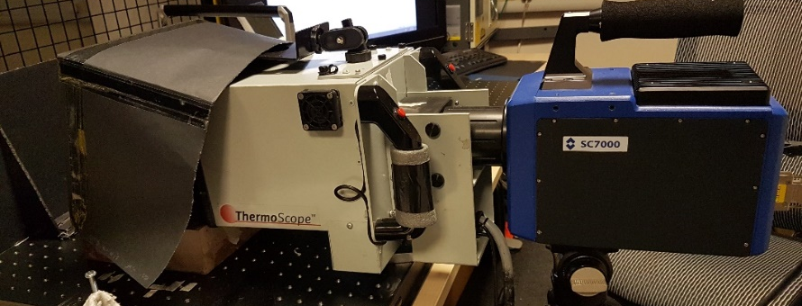
Conclusions
Examine challenges that arise when quantifying heuristic uncertainties in CES in the context of industrial PSS
Aim
Considering…
Training
Environmental conditions
Effect on maintainer & resulting maintenance quality
Relationships
Use case – Thermographic system demonstrator
Main challenge:
Accurate assessment of error margins & distributions for heuristic estimates
Influences uncertainty in measured value
Sourced from expert opinion
Maintenance based on opinions & live or historic data

Slide 24

Conclusions
Determination of how uncertainty in one subsystem affects another
Ability to track changes in uncertainty over time
Effect on level of compound uncertainty
Accuracy of cost estimations for long-term service contracts
Cost of service provision & performance targets in IPS²
Further research
Strategies to obtain statistically viable data concerning maintenance quality in dynamic working conditions
How might uncertainty traits differ between shareholders?
Trends in active decision making for given maintenance activities

Slide 25
Alex Grenyer
PhD Research Student
Cranfield University
E: a.h.grenyer@cranfield.ac.uk
W: www.cranfield.ac.uk/centres/throughlife-engineering-services-institute

