Slide 1
Nonlinear Vibration Analysis of a Complex Aerospace Structure
Samson.B.Cooper
University of Bristol
Department of Mechanical Engineering
Bristol, United Kingdom
Supervised By: Dr Dario DiMiao and Prof David Ewins

Slide 2
Myself
PhD research in Nonlinear Dynamics of Engineering Structures.
Department of Aerospace Engineering.
2008-2010: A Levels @Wigan and Leigh College
Maths, Physics and Further Maths
2010-2014: BEng, Degree @ U.W.E,Bristol.
Aerospace Design Engineering.
2011-2012: Placement @ General Electric.
Process and Design Engineer, Aviation Sector.
Since 2014:PhD Student @ University of Bristol.
Nonlinear Identification in Engineering Structure
Experimental and Computational Methods.

Slide 3
Outline
Motivation
Project Goal
Overview of Current Challenges
Proposed Methodology
Case Study – Missile Test Structure
Preliminary Results
Conclusion
Future Work

Slide 4
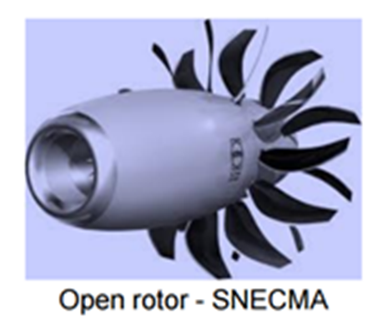

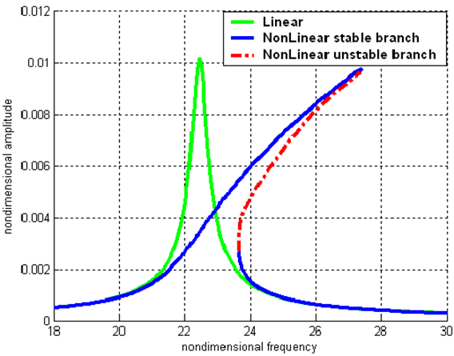
Motivation
Modelling the vibration response of Aircraft structures is challenging.
Current design have been proven to exhibit complex nonlinear behaviour.
Identification and modelling of nonlinearities in structural dynamics is an area of growing interest yet with limited knowledge.
Vibrations Response
Aircraft Structures

Slide 5
Project Goal
Integration of Nonlinearities in the development and validation of structural models.
Theoretical Model
Identification
Simulation
Numerical Analysis
Experimental Measurement
Validation

Slide 6
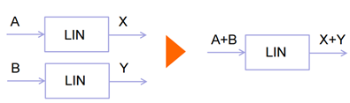
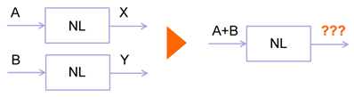
Engineering Nonlinearity
General Definition
Nonlinearity occurs when a system violates the homogeneity principle. i.e the absence of the superposition principle.
A linear system has an output directly proportional to its input.
Structural Dynamics
Nonlinearity occurs when the natural frequencies and mode shapes of a structure vary with the excitation amplitude.

Slide 7
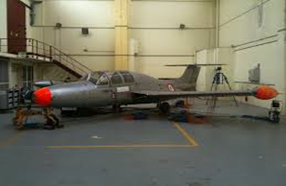
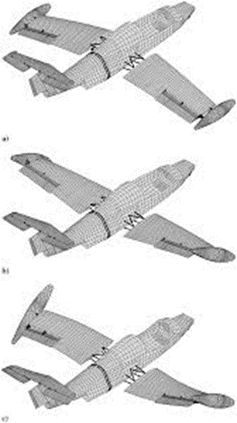
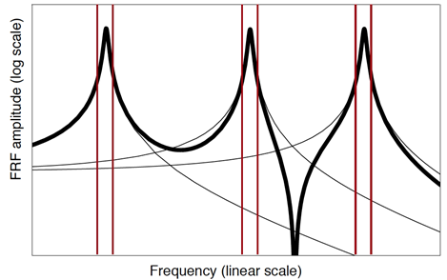
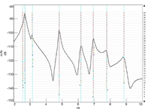
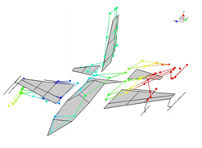
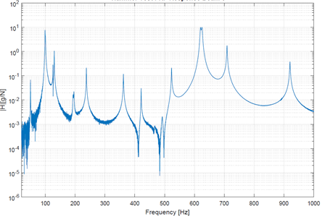

Overview on Linear Identification & Design
For a linear system, the Equation of motion:
$$M\ddot{x }(t)+C\dot{x}(t)+Kx(t)=f(t)$$
The solution of the system can be solved in two routes:
Experimental Route
Linear FEM
Identified Model
Linear Identification
Measured Response
Modal Analysis

Slide 8
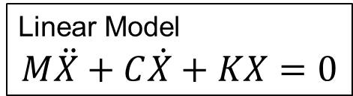

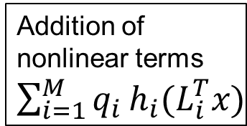
Nonlinear System
Equation of motion for a nonlinear system is expressed:
$M\ddot{x}(t)+C\dot{x}(t)+Kx(t)+\sum_{i=1}^{M}{q_{i}}h_{i}(L_{i}^{T}x)=0$
The solution for the type of problem often involves trying different approaches.
Linear Model
$$M\ddot{X}+C\dot{X}+KX=0$$
Modal Analysis
Linear Identification
The major challenge with nonlinear identification is the unknown function which maps the input unto the output of a system
The addition of these terms changes the system
Addition of nonlinear terms $\sum_{i=1}^{M}{q_{i}}h_{i}(L_{i}^{T}x)$
Identification of nonlinear terms is required

Slide 9
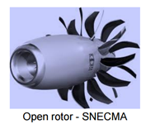
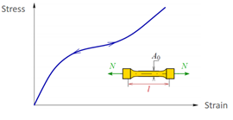
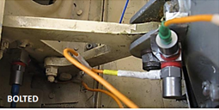
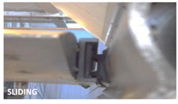
Sources of Nonlinearity in Structures
Nonlinearities can arise from a combination of different sources:
Material properties. i.e. nonlinear material behavior
The geometry of the structure. i.e. geometrical nonlinearity
Friction and Bolted Joints Which leads to different types nonlinearity
Sliding bodies

Slide 10
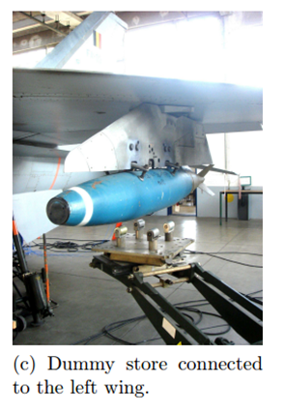
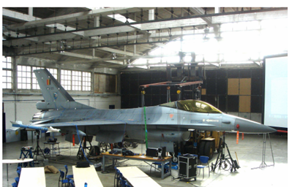
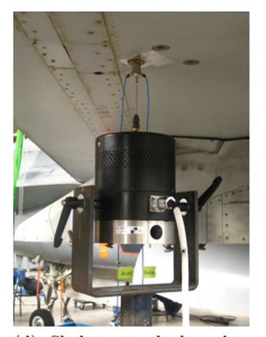
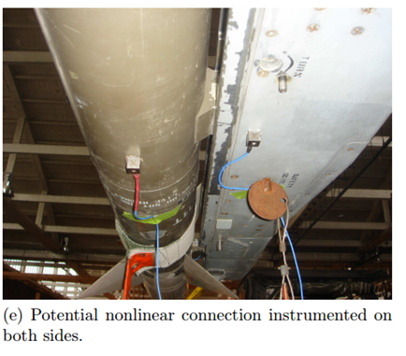
Nonlinearity in Current Design
An industrial case study-F-16 Aircraft
Nonlinearities were detected at the wing-to-payload mounting interfaces.
GVT Test Campaign
G.Kerschen et al., IFASD 2015, University of Liege Belgium

Slide 11
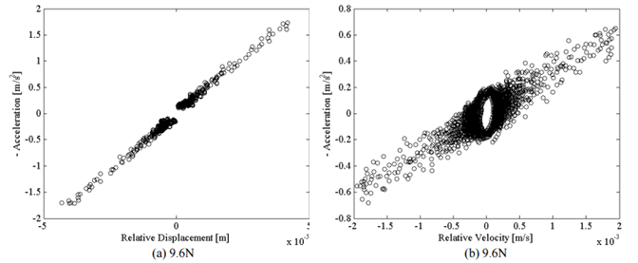
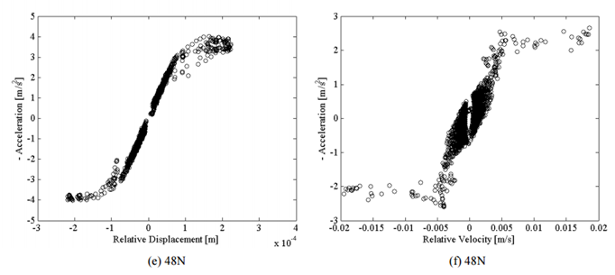
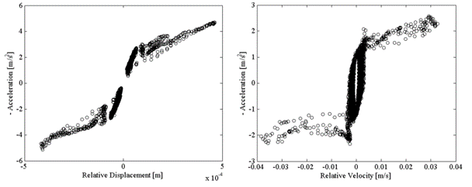
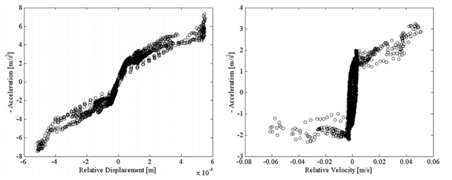
F-16-Aircraft GVT Campaign-Test Result
Stiffness and Damping characteristics of the wing-to-payload mounting interface across the back wing-to-payload connection.
Selected results around the third mode at different excitation levels.
Stiffness
Damping
Stiffness
Damping
9.6N
9.6N
48N
48N
Stiffness
Damping
Stiffness
Damping
76.6N
76.6N
95.6N
95.6N
G.Kerschen, K.Worden., A. F.Vakakis, J.C.Golinval,, Past, present and future of nonlinear system identification in structural dynamics. Mechanical Systems and Signal Processing, 2006. 20(3): p. 505-592.

Slide 12
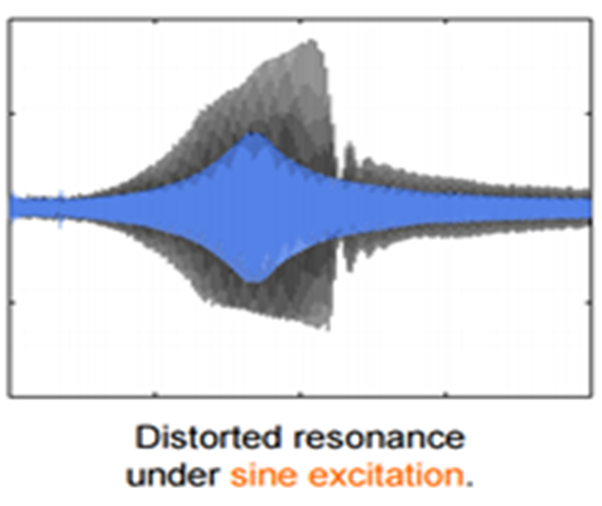
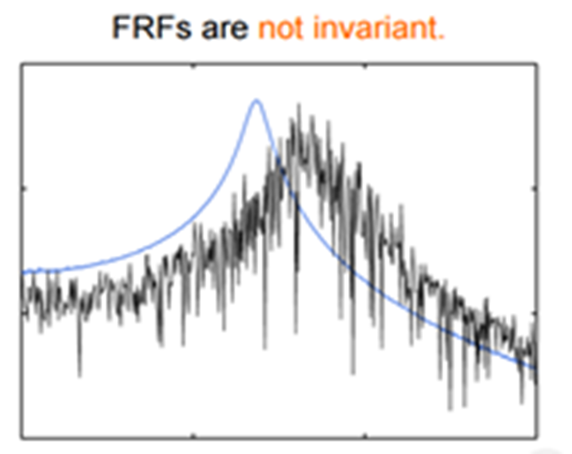
Challenges in Nonlinearity Identification
Inapplicability of Linear Identification Concepts.
Nonlinear structures are sensitive to input signals during experiments.

Slide 13
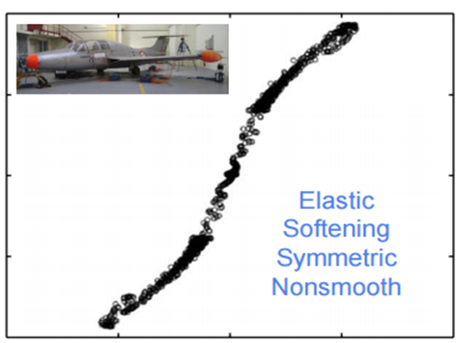
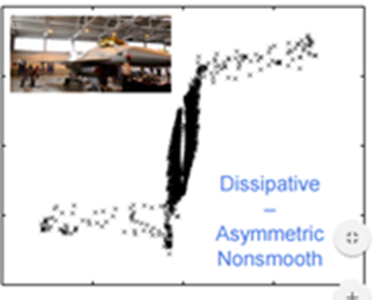

Challenges in Nonlinearity Identification
Nonlinear responses are individualistic in nature.
Obtaining the functional form of nonlinearity is an integral part of nonlinear identification, its arguably the most important and difficult task.
$$M\ddot{x}+C\dot{x}+Kx+g\left(x,\dot{x}\right)=F$$
Limited amount of prior knowledge on the nonlinear terms in the EOM.

Slide 14
Proposed Methodology
ULM
Modal Testing and Solution
FE/EMA Correlation
Model Updating
Linear Model Validation
Phase 1
NLFEA
Phase 2
NLMV
Model Upgrading
Nonlinear Model Updating
Nonlinear Model Verification
NL-ID
Detection of Nonlinearity
Location of Nonlinearity
Characterisation of Nonlinearity
Quantification of Nonlinearity
Phase 3

Slide 15
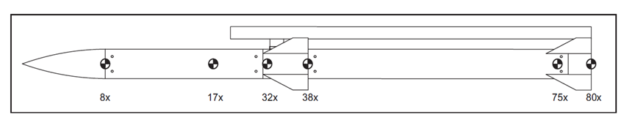
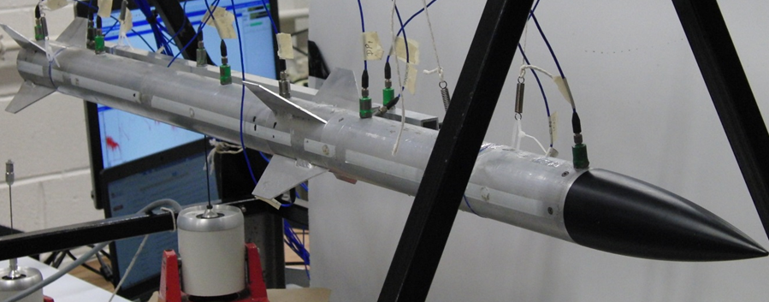
Case Study –Missile Test Structure
The missile assembly is designed to understand the effect of nonlinearities caused by bolted joints.

Slide 16
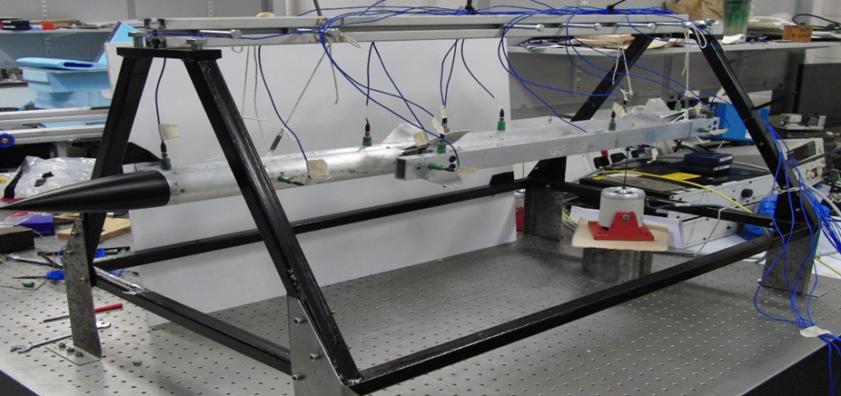
Phase 1- Modal Test
several type of test were performed on the structure.
Several excitation methods were attempted.
Test | Force Levels
Random | 3
Stepped Sine | 10
Impact | 1

Slide 17
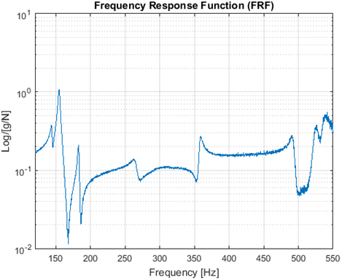
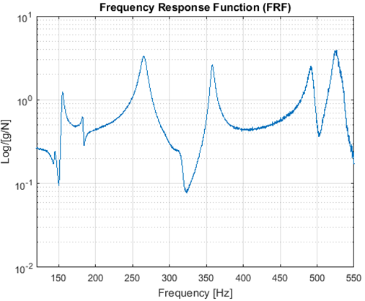
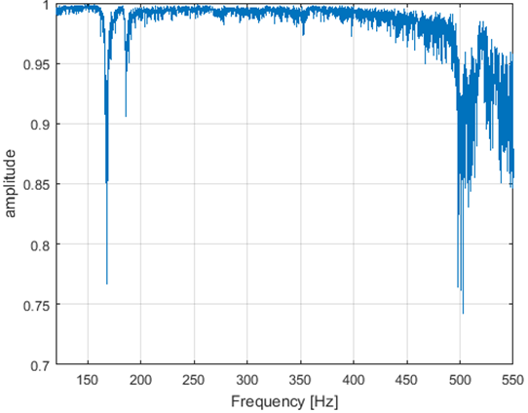
Phase 1-Broadband Excitation Test-Results (Step 1)
Random excitation specified between 120-600 Hz
FrFs and Coherence Function of selected points on the test structure

Slide 18
Phase 1-Linear Identification
FRFs and associated coherence functions obtained from the test were exploited to identify the linear modal properties of the test structure.
linear resonance frequencies and damping ratios were estimated using the Polymax frequency-domain identification method.
.

Slide 19
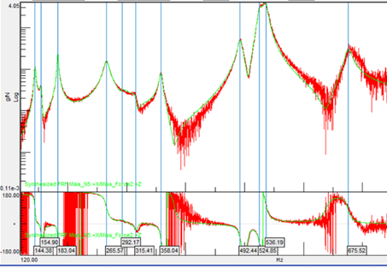
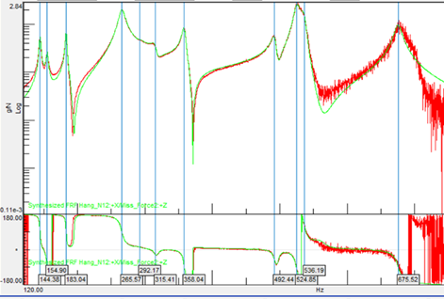
Phase 1- Validation of Linear Identification
Reconstructed Synthesised FRF compared with measured the FRF.
Measured
Reconstructed

Slide 20
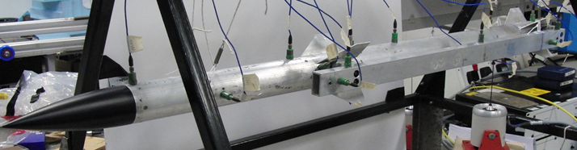
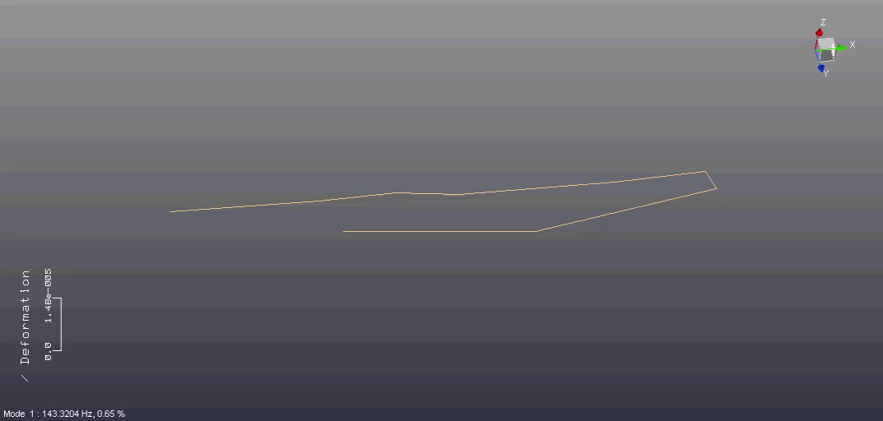
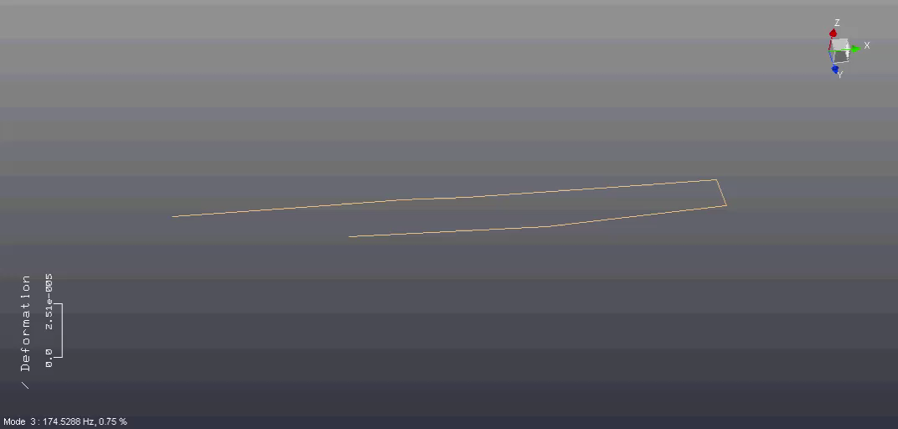
Experimental Mode-Shapes
MODE 1
MODE 3
Missile
Missile
Hanger
Hanger

Slide 21
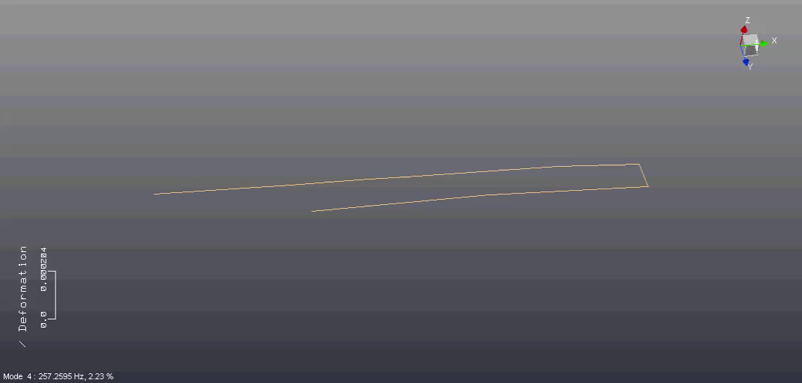
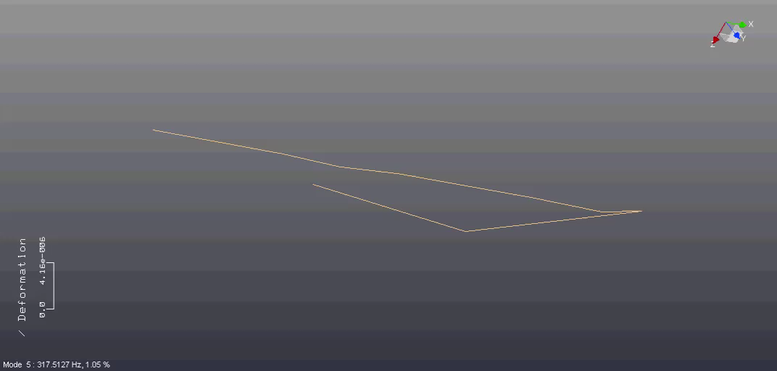
Experimental Mode-Shapes
MODE 4
MODE 6
Missile
Missile
Hanger
Hanger

Slide 22
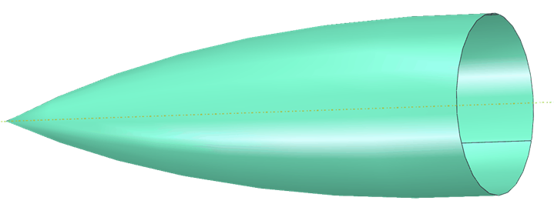
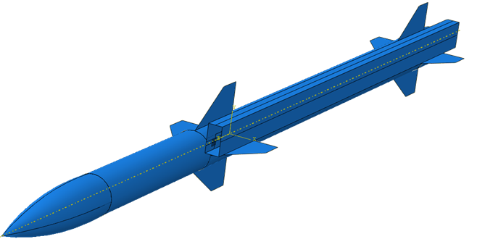
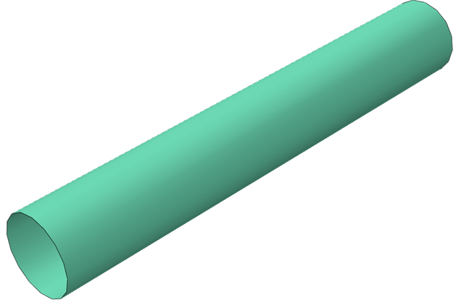

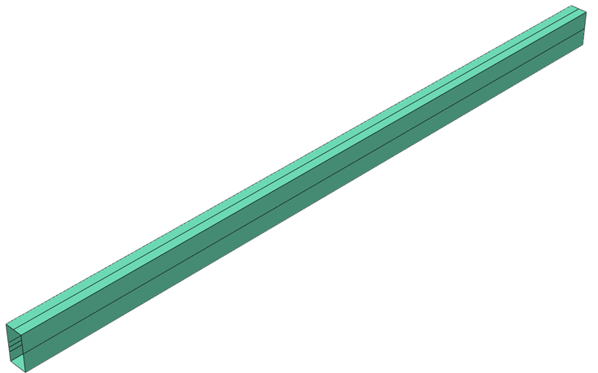
Phase 1-Linear Finite Element Model
Nose
The assembly was modelled using ABAQUS CAE simulation software.
Shell elements were used to model each part.
Complete Missile Assembly
Tube
Fin
Hanger

Slide 23
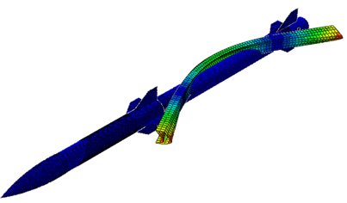
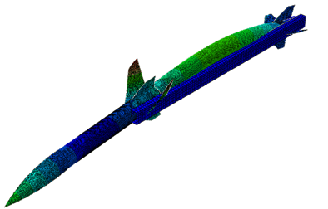
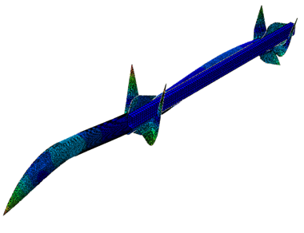

Linear FE Frequency and Modes Shapes
224 Hz
268 Hz
514 Hz
679 Hz

Slide 24
Phase 2 Nonlinear Identification
The whole nonlinear parametric identification was conducted based on experimental data. Mainly swept sine driven experiments.
Detection of Nonlinearity:
Time series inspection and time envelop analysis.
Characterization of Nonlinearity:
3D Representation of the measured acceleration response
Direct Parameter Estimation of Nonlinear Terms
Curve Fitting Approach

Slide 25


Phase 2- Detection of Nonlinearity
Evidence of nonlinear behaviour based on experimental data.
Envelope based analysis of swept time series data.
Time response expressed in terms of Acceleration and Sweep Frequency.
Absence of proportionality is noticed in the time envelope of 5N compared to 1N.
Sudden transition from large to small amplitude of vibration noticed at 10N can also be described as a jump phenomenon.
Mode 4
Mode 4

Slide 26


Phase 2 Detection of Nonlinearity
Frequency domain inspection
Distortions and non-smoothness of resonance peak of the FRF.
Nature of Nonlinearity Softening and damping nonlinearities .
FRF Response of the Missile Nose
FRF Response of the Hanger

Slide 27
Phase 2 Characterisation of Nonlinearity
The aim of this step is to characterise the aspect of motion that drives the nonlinearity in the nonlinear behaviour of the structure.
The strength of the nonlinearity. i.e is it weak or strong nonlinearity?
The source of the nonlinearity. i.e. is it stiffness or damping nonlinearity or both?
The nonlinear stiffness characteristic. i.e. is it hardening or softening?
The characteristic of the restoring force. i.e. is it symmetric or asymmetric?
The type of nonlinearity in the structure. i.e. is it geometric, material or contact nonlinearities?

Slide 28
Characterisation of Nonlinearity
linear sine-sweep excitation was applied on the test structure at low and high forcing amplitudes.
The swept sine excitation was conducted on the second, third and fourth vibration modes of the missile structure.
Modes 4 was selected were selected due to the severity of distortion observed around the resonance peak.

Slide 29

Application of the Restoring Force Surface Method (RFS).
The Restoring force is based on a 3D representation of the measured Acceleration, Velocity and displacement of a selected mode of interest.
The characterisation step is performed by taking the difference between to displacement and velocity of two measured DOF.
$m_{i,r}{\ddot{y}}_{i}+f_{i}(y_{i}−y_{r},{\dot{y}}_{i}−{\dot{y}}_{r})≈F_{i}$
where $y_{r},{\dot{y}}_{i}$ are the displacement and velocity of the nonlinear connection
$f_{i}\left(y_{i}−y_{r},{\dot{y}}_{i}−\dot{y_{r}}\right)=−m_{ir}\ddot{y_{i}}$
The method is based on computing the relative acceleration, velocity and displacement across a selected nonlinear connection or bolted joint.

Slide 30
Computation of the RFS for the Bolted connection of the Assembly
The restoring force surface was computed using the acceleration obtained from the swept-sine excitation test of mode 4 for 5N excitation.
To visualise the form of elastic nonlinearities in the this mode, a cross section along the axis of the zero velocity value of the restoring force surface was plotted.

Slide 31
Static Elastic Force Characterisation
The static elastic force was characterised using the acceleration obtained from the swept-sine excitation test of mode 4 for 5N excitation.
The Hilbert transform algorithm was used to compute the envelop of the measured signal and also extract the force displacement curve for the selected mode

Slide 32
Phase 2- Qualitative Parameter Estimation
The last step in the nonlinear identification is the estimation of the coefficients associated to the stiffness and damping parameters.
No Prior information on the mass of the system.
Least square fitting method for stiffness parameter estimation.

Slide 33
Phase 3. Nonlinear Finite Element Model Validation
The aim of this section is to compute the response of the structure with the identified nonlinear functions added to the validated linear Finite element model.
The nonlinear frequency response function (NLFRF) would be used a tool for understanding the mechanical response of the structure where the response amplitudes are normalized with the forcing amplitude.
New nonlinear numerical codes and solvers would be used to compute the numerical solution of the FE model in the frequency domain.

Slide 34
Conclusion and Facts of Nonlinearities in Structural Dynamics
Nonlinearity is individualistic in nature. i.e toolbox philosophy.
Nonlinearity leads to new phenomena.
Three important aspect are required for effective modelling of nonlinearities. i.e (Theory, Simulation and Experiments).
identification of nonlinearities in structures requires experimental measurement for appropriate nonlinear modelling.

Slide 35






Future Design Cycle For Structures With Nonlinear Response
DESIGN
FEM
MEASURE
MODEL
IDENTIFY
UNDERSTAND

Slide 36
Thanks for Listening
Any Questions

