Slide 1
Additional simulated data

Slide 2
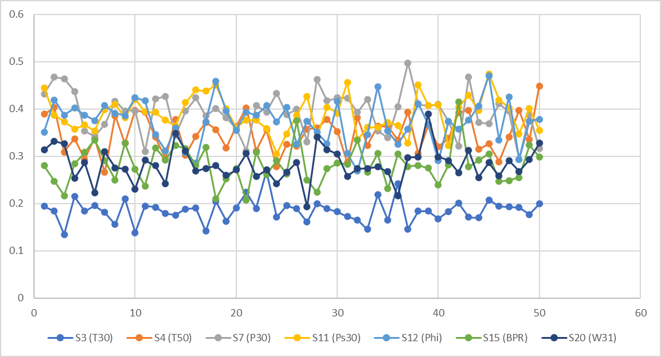
Time series data (50 time units)

Slide 3
Change in actual & reference area over time
Change in symmetry

Slide 4
Cumulative increase

Slide 5
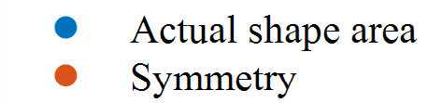


(a)
(b)
$$\text{Y}\text{ = 0.}1573e^{−0.05x}$$
$R^{2}=0.6432$
$$\text{Y}\text{ = 0.}1554e^{−0.049x}$$
$R^{2}=0.6807$
Percent change for cumulative increase
Actual : Symmetry correlation

Slide 6
Actual : Symmetry correlation factor exponential (Corrected ref & sym trend eqns)

Slide 7
Actual : Symmetry correlation factor linear
Actual : Symmetry correlation factor log

Slide 8
LSTM architecture
Additional data
LSTM layer 1
Hidden units 200
Fully connected layer
Output size 100
Rectified Linear Unit (ReLU) layer
Sequence input
6
LSTM layer 2
Hidden units 200
Dropout layer
50%
Fully connected layer
Output size 1
Regression output
LSTM 1
LSTM layer 1
Hidden units 246
Fully connected layer
Output size 100
Rectified Linear Unit (ReLU) layer
Sequence input
1
LSTM layer 2
Hidden units 246
Dropout layer
89%
Fully connected layer
Output size 4
Regression output
LSTM 2
LSTM layer 1
Hidden units 223
Fully connected layer
Output size 100
Rectified Linear Unit (ReLU) layer
Sequence input
0
LSTM layer 2
Hidden units 223
Dropout layer
90%
Fully connected layer
Output size 1
Regression output
LSTM 3
LSTM layer 3
Hidden units 223

Slide 9
Defined training options following hyperparameter tuning
Training options | LSTM 1 | LSTM 2 | LSTM 3
Solver | Adam | SGDM | SGDM
Max. Epochs | 100 | 178 | 101
Initial Learn Rate | 0.0020 | 0.0022 | 0.0093
Learn rate drop factor | 0.1000 | 0.3395 | 0.1141

Slide 10
Updated
Observed vs. predicted uncertainty for (a) initial forecast and (b) updated forecast

Slide 11
Observed vs. predicted symmetry and aggregate vector magnitude
 | Symmetry |  |  | Aggregate vector magnitude
Time | Observed | Predicted | % Diff. | Observed | Predicted | % Diff.
32 | 92.629 | 104.1715 | 11% | 0.5105 | 1.2616 | 60%
33 | 106.8738 | 95.5523 | 12% | 0.7906 | 1.2517 | 37%
34 | 112.213 | 89.479 | 25% | 0.6341 | 1.2427 | 49%
35 | 101.0656 | 88.534 | 14% | 0.688 | 1.2336 | 44%
36 | 91.8602 | 86.4408 | 6% | 0.6753 | 1.2240 | 45%
37 | 80.1403 | 69.2713 | 16% | 0.8215 | 1.2145 | 32%
38 | 118.1601 | 128.8332 | 8% | 0.9445 | 1.206 | 22%
39 | 103.4112 | 131.0811 | 21% | 0.5557 | 1.1995 | 54%
40 | 101.7574 | 127.8667 | 20% | 0.7621 | 1.1954 | 36%
41 | 109.9298 | 131.5239 | 16% | 0.5279 | 1.1936 | 56%
42 | 89.9378 | 73.8003 | 22% | 0.5667 | 1.1938 | 53%
43 | 116.5322 | 127.6724 | 9% | 0.9251 | 1.1956 | 23%
44 | 129.274 | 109.1592 | 18% | 0.8676 | 1.1984 | 28%
45 | 117.2868 | 117.6617 | 0% | 0.9969 | 1.2017 | 17%
46 | 105.3678 | 102.6005 | 3% | 0.8599 | 1.2052 | 29%
47 | 111.9071 | 102.3624 | 9% | 0.8225 | 1.2087 | 32%
48 | 92.4093 | 105.438 | 12% | 0.4416 | 1.2119 | 64%
49 | 130.4497 | 103.3316 | 26% | 0.7286 | 1.2148 | 40%
50 | 93.797 | 97.8427 | 4% | 0.3625 | 1.2171 | 70%

Slide 12
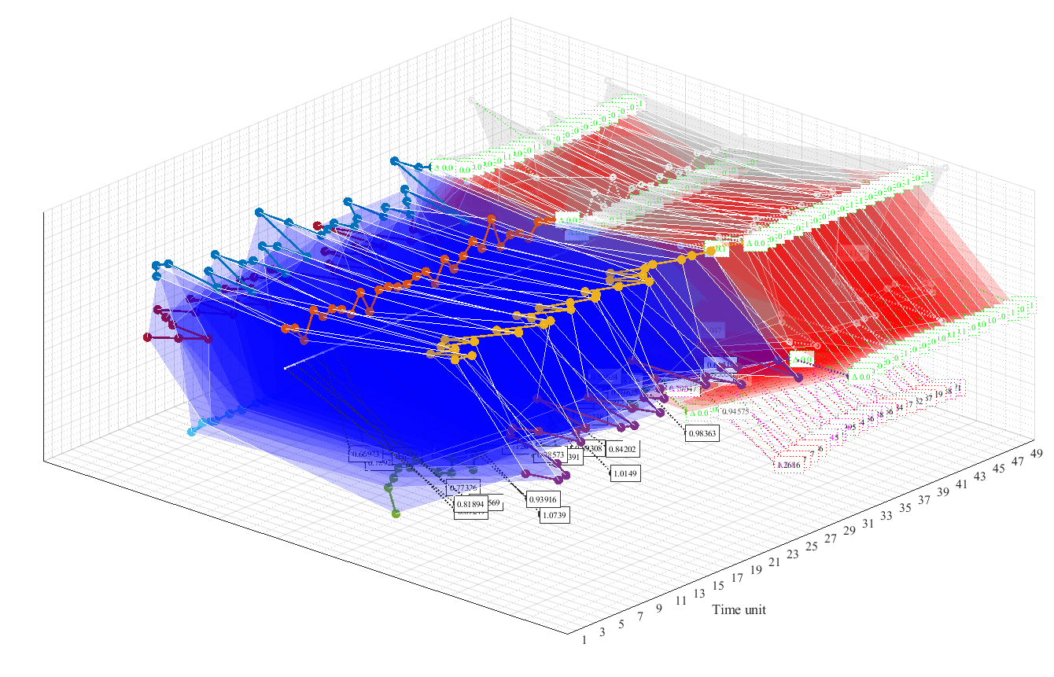
Forecasts

Slide 13
MAPE and RMSE of observed vs. predicted values over test period
Input | MAPE | RMSE
1 | 28% | 0.0241
2 | 24% | 0.0416
3 | 27% | 0.0485
4 | 27% | 0.043
5 | 31% | 0.0519
6 | 26% | 0.0414
7 | 23% | 0.0367

