Slide 1

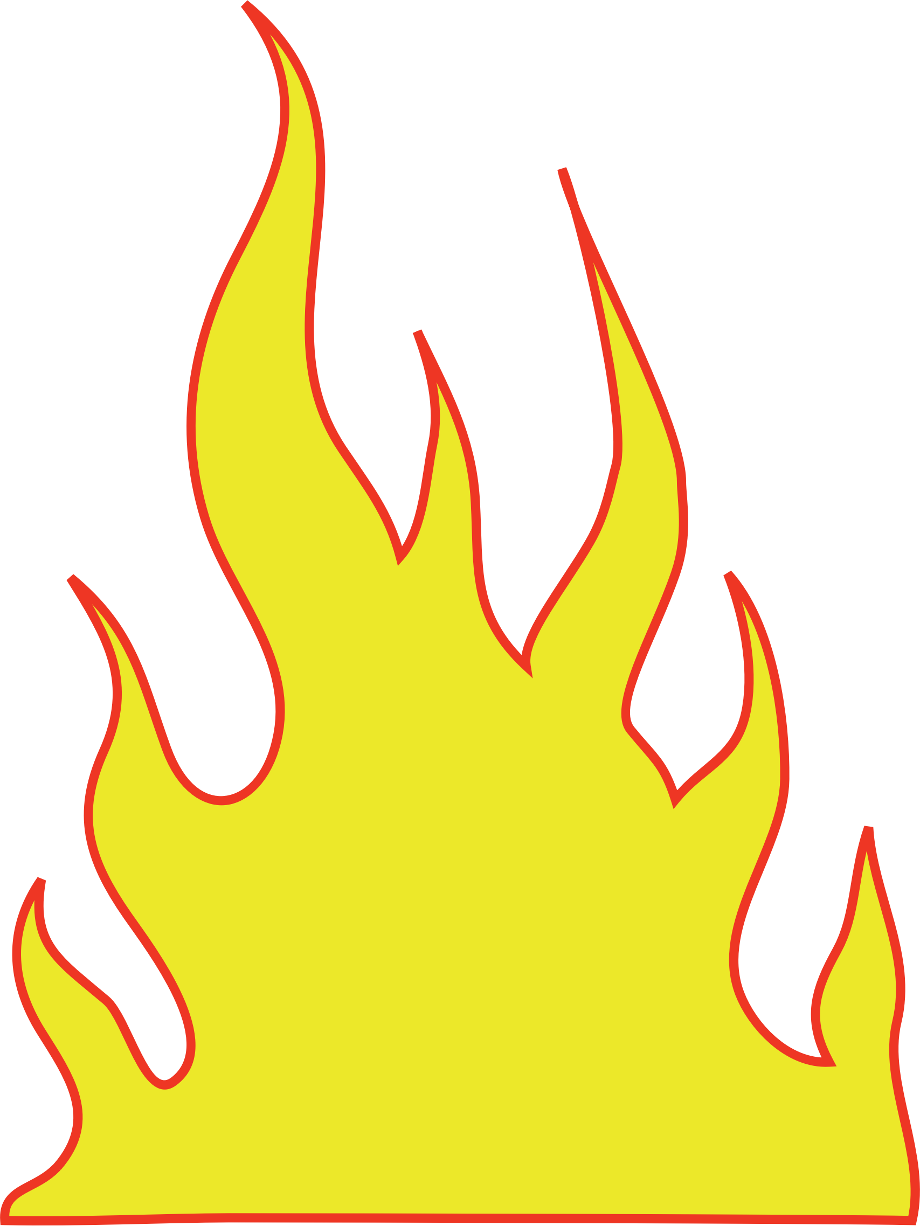
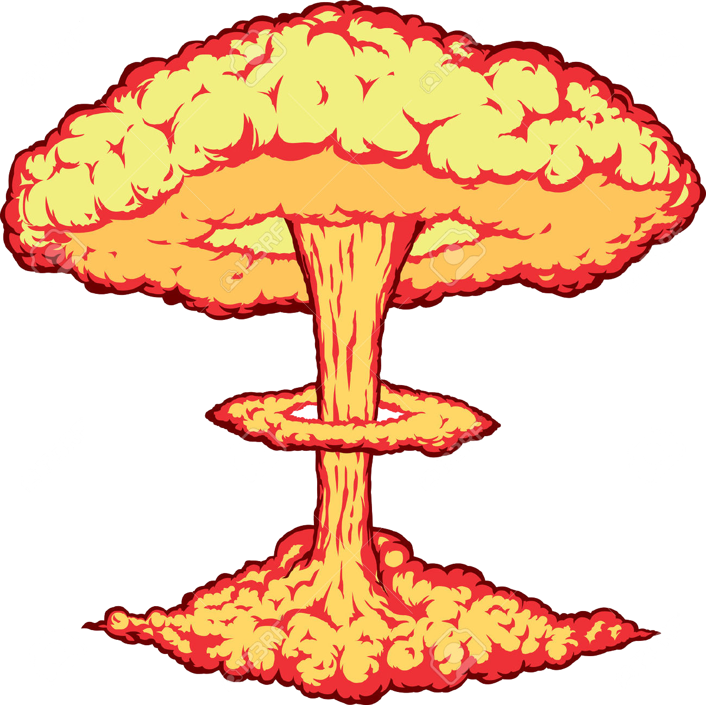


Influence of carbon fibre orientation on the post-fire tensile behaviour of carbon fibre reinforced polymer (CFRP) laminates
By Dr Tim Aspinall

Slide 2
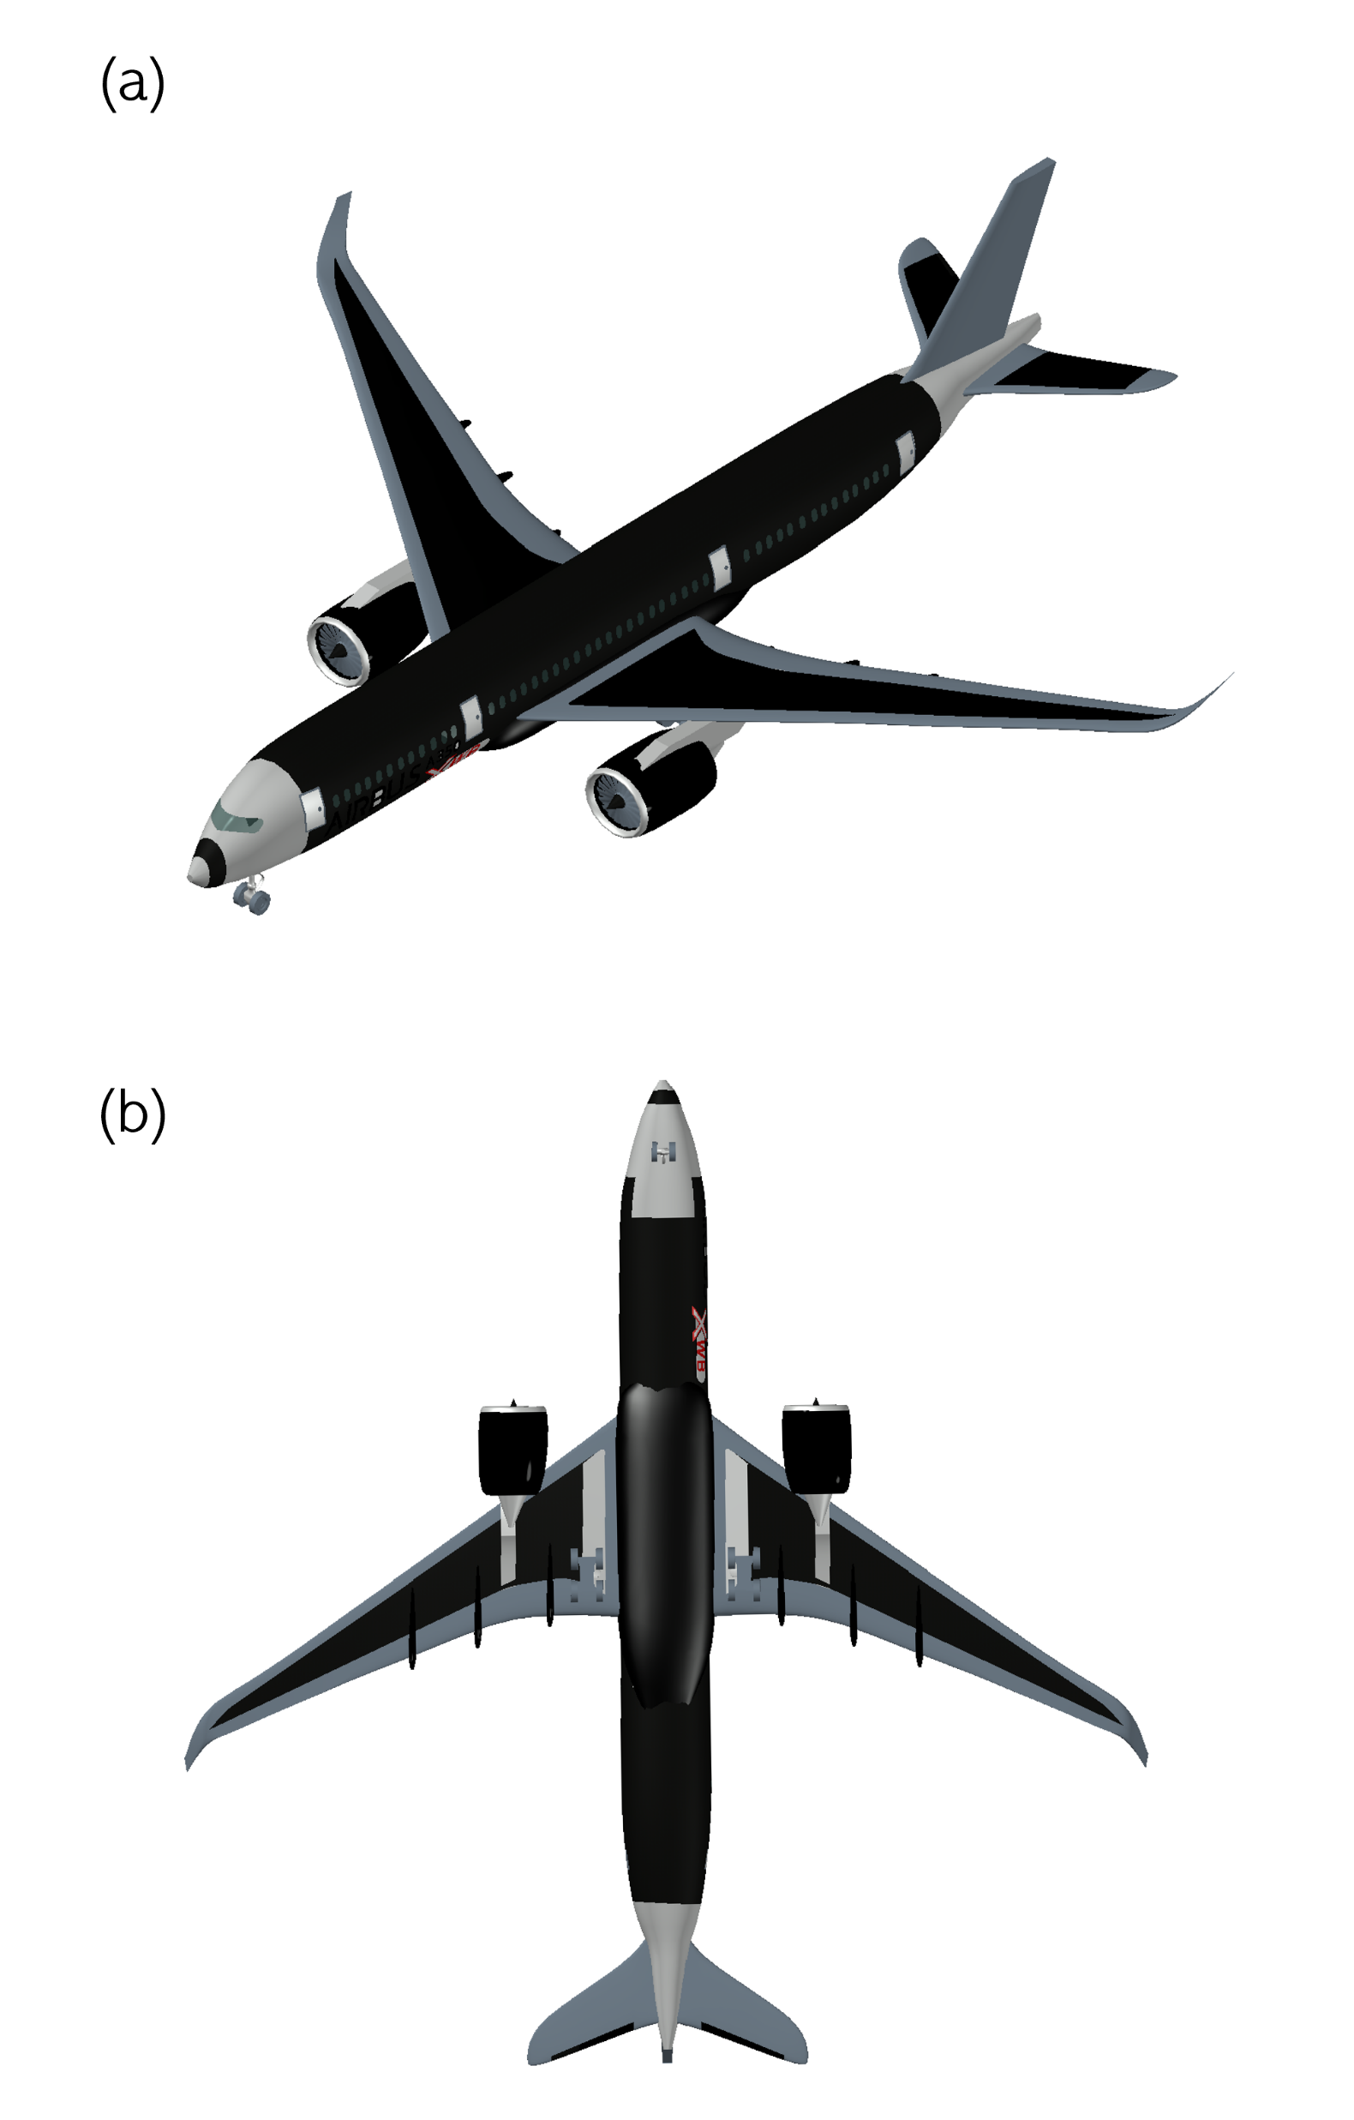
Introduction
Carbon fibre-reinforced polymer (CFRP) is a composite material consisting of carbon fibre (CF) reinforcement and a resin matrix (such as epoxy resin).
CFRP is used extensively in aerospace due to its high specific strength and stiffness and the ability to customise the CF reinforcement to suit the requirement, application or load.
In recent years, CFRP has been utilised in highly hazardous structural locations, such as main spar sections and near to or adjoining fuel tanks that are often load-bearing and placed under considerable tensile stress.
Figure 1 - Locations of CFRP in an Airbus A350 XWB [1].

Slide 3
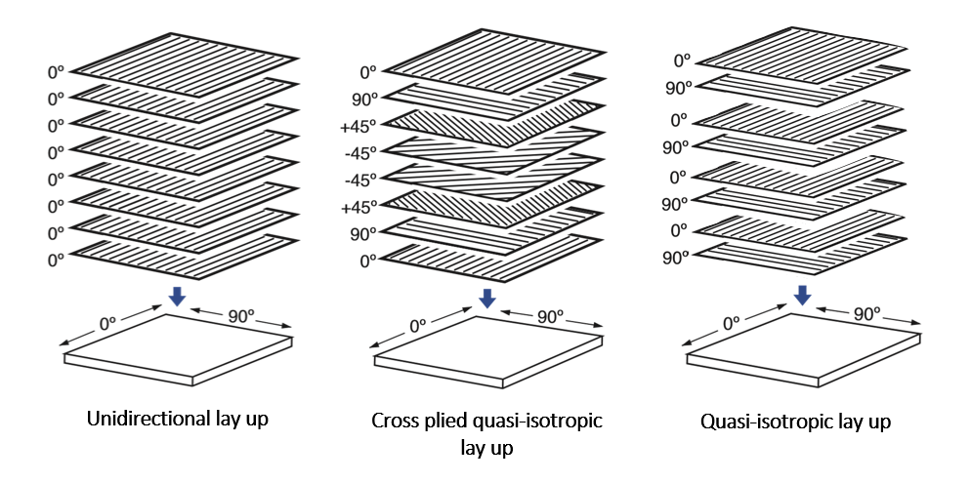
CFRP – Carbon fibre orientation
Unlike many metallic alloys – CFRP is not isotropic.
The mechanical properties can change depending on the orientation of the CF reinforcement, meaning their mechanical properties can be optimised to suit the application's requirements or load.
Therefore, the CF reinforcement of CFRP may take different forms and may be stronger in some directions than others.
Some examples of common CF orientations used to construct aircraft components that are often under tensile stress include unidirectional [0°], quasi-isotropic [0°,90°] and cross-plied quasi-isotropic [0°,±45°,90°].
Figure 2 – Common fibre orientations used to create CFRP.

Slide 4
Thermomechanical behaviour of CFRP
Despite its high specific strength and stiffness properties relative to metallic aviation materials, CFRP is highly combustible when exposed to the heat typical of fire and presents poor tensile performance following a fire due to the pyrolysis of the matrix resin and oxidation of the CF.
This behaviour means that in the case of an in-flight or post-crash fire, CFRP can ignite and burn uncontrollably, and even if quickly extinguished, the tensile performance may be reduced, and the material properties may be lower than their original values.
This behaviour results in complex thermomechanical mechanisms, which could severely affect air survivability as some CF orientations may withstand load longer than others.
The following study will therefore assess the post-fire tensile behaviour of CFRP specimens containing three unique CF orientations that are utilised adjacent to or close to fuel storage tanks onboard aircraft.

Slide 5
Background – CFRP fire behaviour
When fire heats a CFRP, the temperature of the solid phase nearest the heated surface will increase.
As the temperature rises, glass transition will begin causing the matrix to physically transition from a glassy state into a rubbery state. Mechanically, the effects of the glass transition can reduce the strength and stiffness properties of the matrix and reduce load distribution between the matrix and CF.
Further heating will lead to pyrolysis (thermal decomposition), specifically of the matrix. Mechanically, this can significantly impact the strength and load-transferring capacity due to a loss of interfacial bond strength. However, the high threshold temperature for the CF may allow them to carry some load in the tensile loading direction.
At high temperatures (above 600°C), when the CF is exposed directly to the heat from a fire, it may oxidise, resulting in surface damage and fibre ‘thinning’. Mechanically, oxidation of the CF can result in a significant loss in fibre-dominated properties, for example, tensile strength.

Slide 6
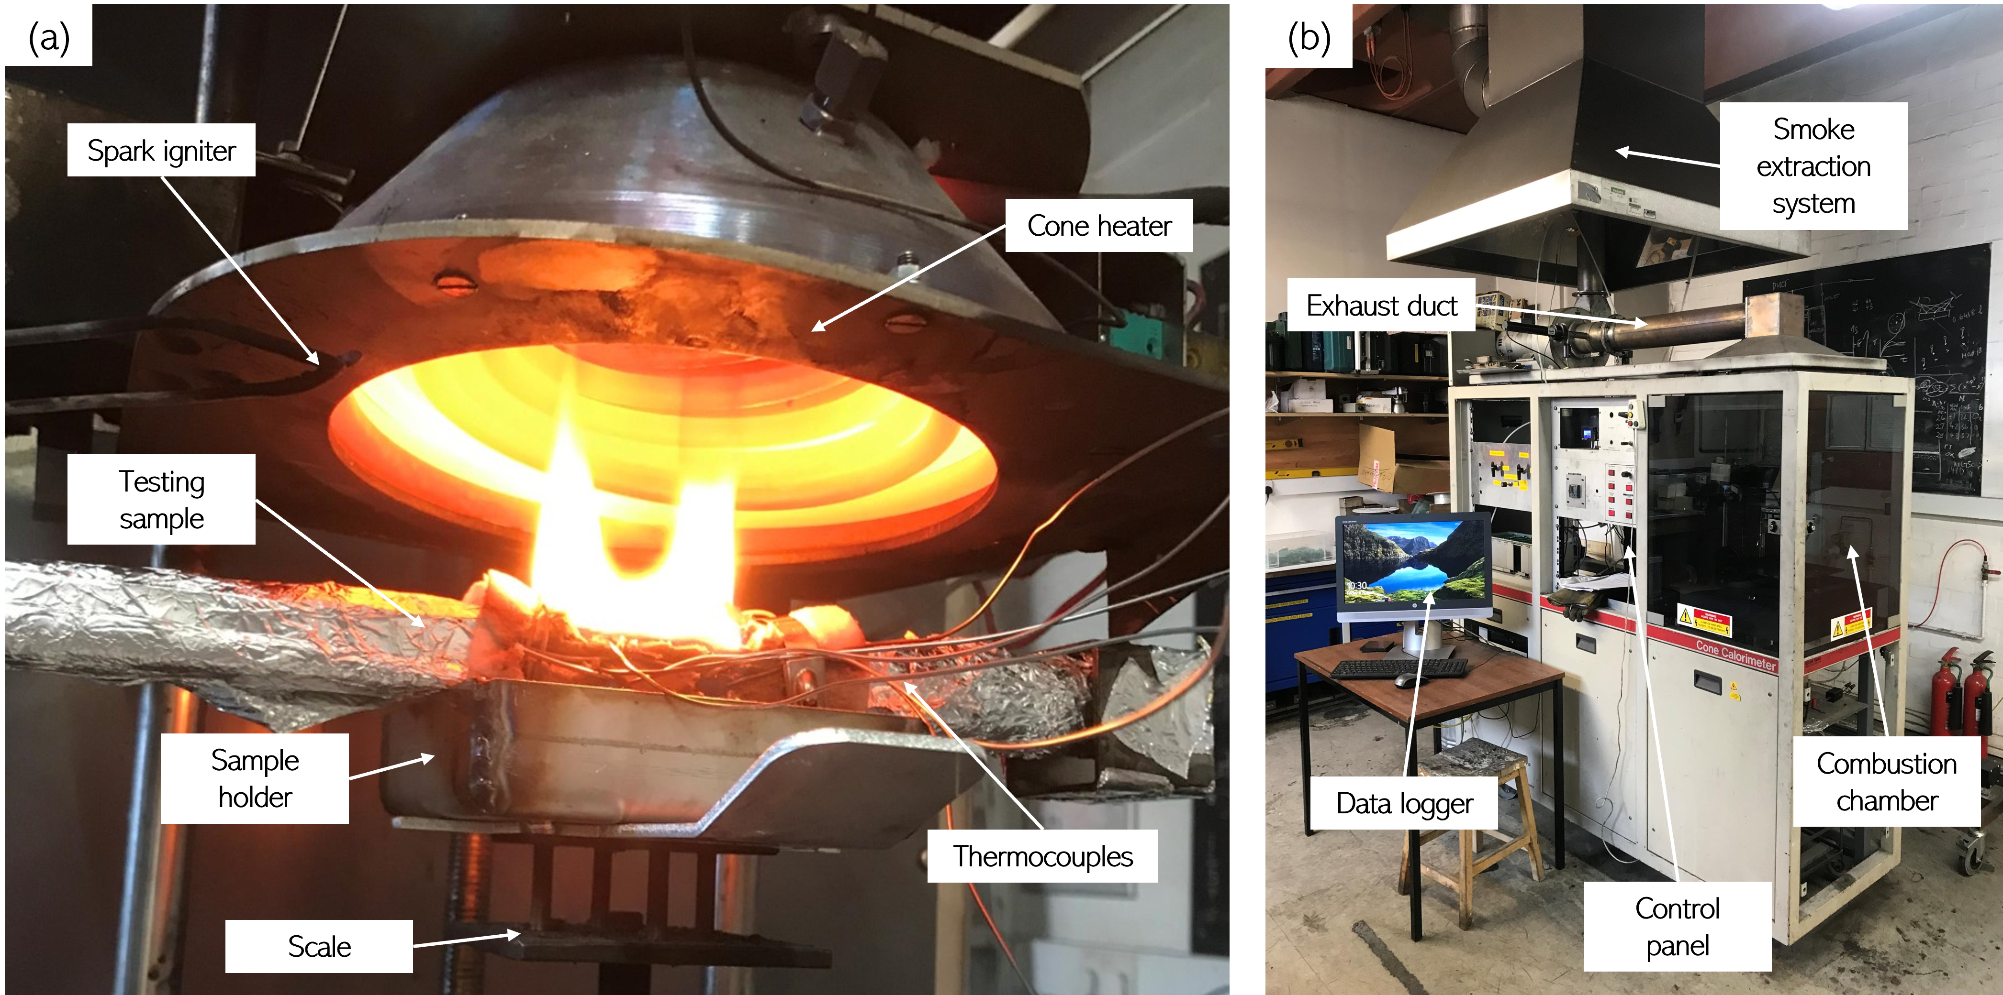
Experimental program (Part 1)
3 CFRP laminates were produced; (S1) unidirectional, (S2) bidirectional and (S3) multidirectional.
18 tensile specimens measuring 250mmx30mm were then produced (6 specimens for each CFRP laminate).
Details about the CFRP laminate composition are given in Table 1.
3 specimens of each laminate remained undamaged, and 3 were exposed to 40kW/m² using a cone calorimeter for 3 minutes.
The exposed area of the specimens was 100mmx30mm at the midspan-> Isolated heating.
Figure 3 – Experimental fire apparatus, showing: (a) a CFRP specimen within the combustion chamber during a fire test and (b) a photograph of a cone calorimeter.
Table 1 – Details about the CFRP laminates composition.
Laminate ID | Thickness | Ply Count | CF Orientation | No of specimens
S1 | 5mm | 7 | 0,0,0,0… | 6 (3 fire damaged, 3 not)
S2 | 5mm | 7 | 0,90,0,90… | 6 (3 fire damaged, 3 not)
S3 | 5mm | 7 | 0,±45,90, ±45,0… | 6 (3 fire damaged, 3 not)

Slide 7
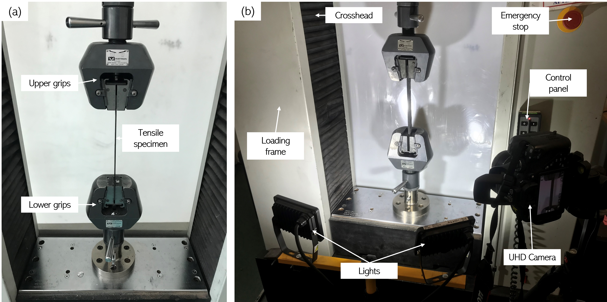
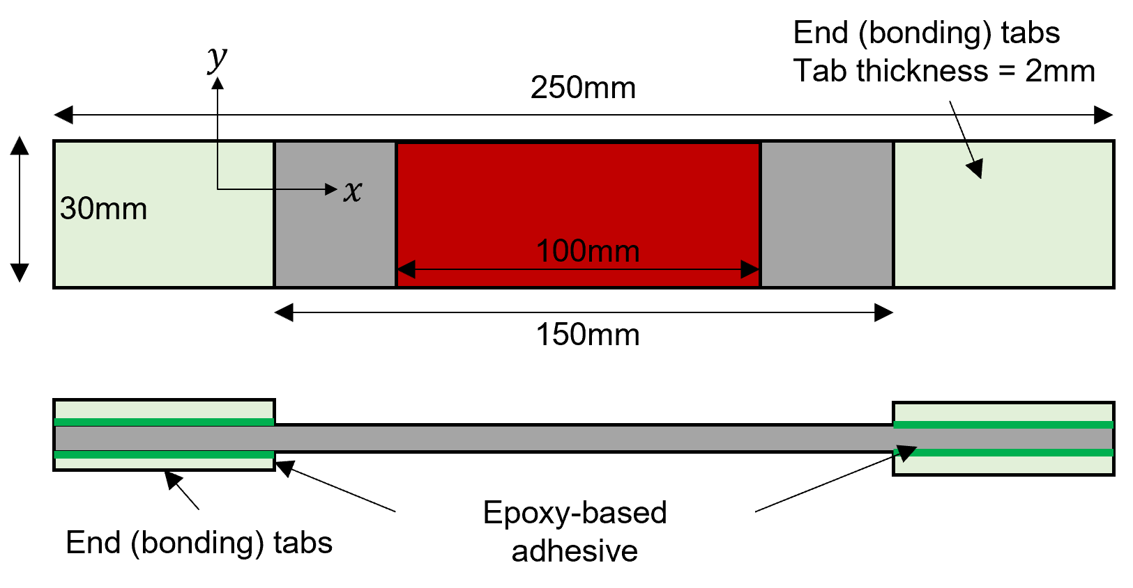
Experimental program (Part 2)
After the fire tests, all undamaged and damaged CFRP specimens were tested to failure and compared.
Post-fire tensile mechanical properties were obtained using an industry-standard universal testing machine (UTM) using a loading rate (cross-head speed) of 10mm/min.
Tensile specimens were loaded in the longitudinal x-direction using wedge action grips attached to the bonding tabs, as shown in Figure 4, 5.
Tests were stopped when mechanical failure of the specimens, indicated by a significant drop in load and a runaway displacement, was recorded.
Figure 4 – Method for obtaining the post-fire tensile properties, showing: (a) the tensile grips and (b) the
UTM apparatus.
Figure 5 – Dimensions and geometry of tensile specimens.

Slide 8
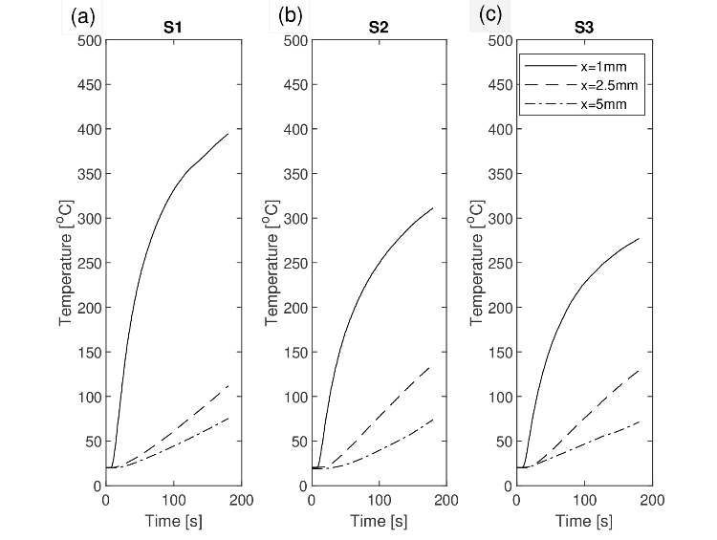
Experimental results (Temperature evolution and thermal degradation)
Data from the cone calorimeter.
When exposed to heat, the temperature at the exposed surface (x=1mm) increased to those required for pyrolysis of the epoxy resin. However, the temperatures behind the exposed surface (at x=2.5 and 5mm) remained lower, below the pyrolysis temperature and around the glass transition temperature.
These temperatures show that the epoxy matrix has been pyrolysed at the exposed surface of all the specimens following the fire test; however, pyrolysis has not occurred below the exposed surface.
It also shows that the temperatures change depending on the carbon fibre orientation. S1 highest, S3 lowest at 1mm.
This behaviour shows that the thermal decomposition does not occur uniformly in the through-thickness.
Pyrolysis zone
Glass transition zone
Figure 6 – Temperature evolution of the CFRP.

Slide 9
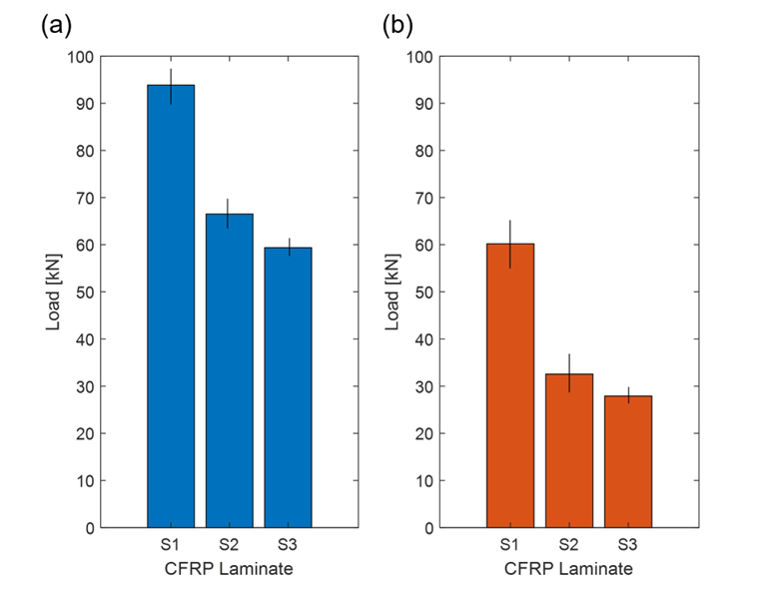
Post-fire tensile tests - Influence of thermal exposure on failure load
Figure 7 – Comparison showing the difference in the load-displacement relationship between the undamaged (blue) and thermally irradiated (orange) CFRP specimens. Each curve represents the average taken from three specimens.
Figure 8 – Influence of thermal irradiance on the tensile properties of CFRP specimens showing data for the (a) undamaged and (b) damaged specimens

Slide 10
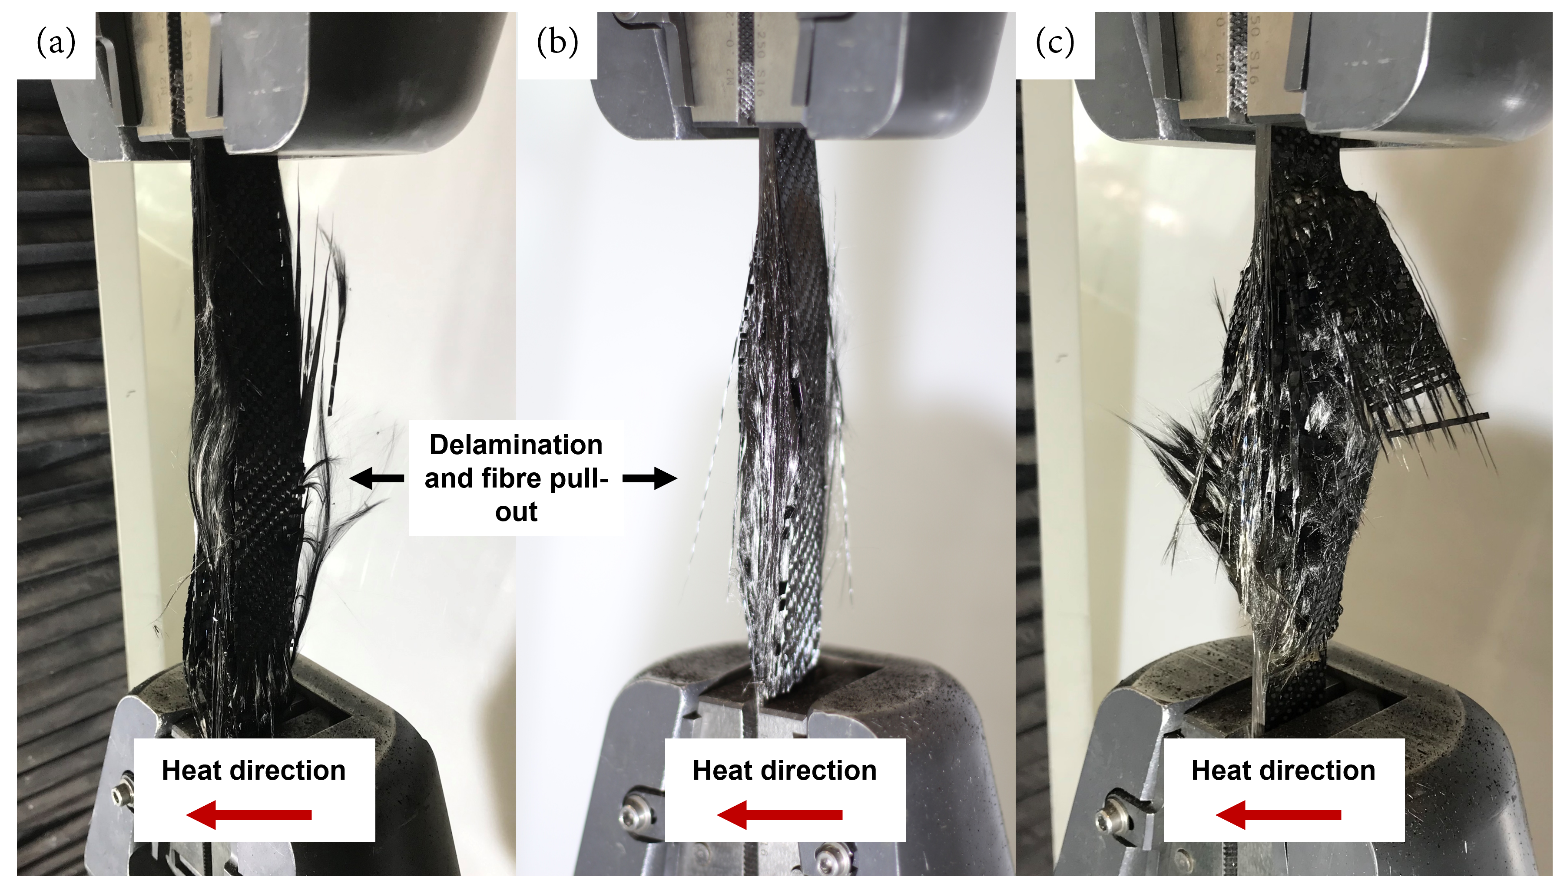
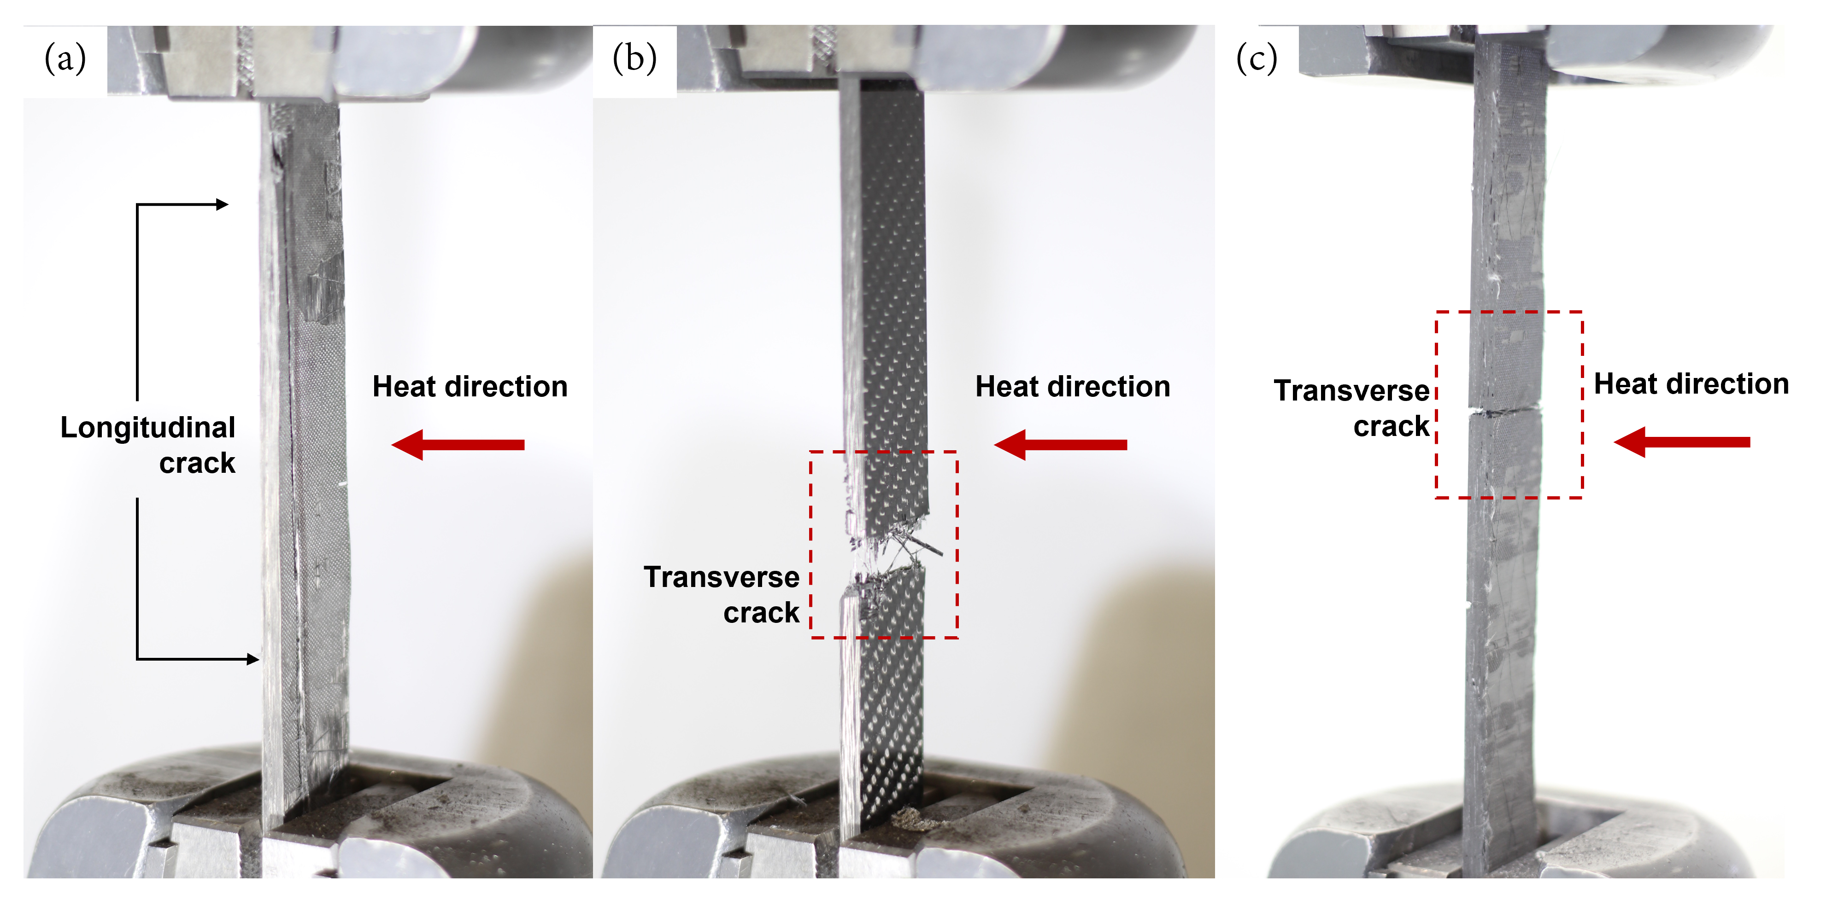
Post-fire tensile tests - Failure modes
Figure 9 – Failure modes before thermal irradiance.
Figure 10– Failure modes after thermal irradiance.

Slide 11
Conclusions
This study has investigated the influence of CF orientation on the post-fire tensile behaviour of CFRP. Three CFRP laminates were produced, each containing a unique CF orientation commonly found on commercial aircraft and exposed to thermal irradiance using a cone calorimeter.
In total, 18 CFRP specimens were produced, 9 from each of the CFRP laminates. This quantity meant that the S1, S2 and S3 specimens could be tested in triplicate initially in their undamaged state and then after thermal irradiance to compare behaviour.
Before thermal irradiance, the S1 CFRP demonstrated the highest tensile performance, whereas the S3 CFRP had the lowest. This behaviour can be attributed to the CF orientation.
After thermal irradiance, the specimens exhibited a 46\% average loss of load capacity between their undamaged and post-fire state and a 35\%, 51\% and 52\% loss in load-bearing properties for the S1, S2 and S3 specimens, respectively, between their undamaged and thermally irradiated states.
Reduction is attributed to the pyrolysis of the epoxy resin and loss in interfacial support. It shows that the matrix plays a more significant role in supporting and redistributing the tensile stress across the laminate in bidirectional and multidirectional CFRP specimens after thermal irradiance than it does for unidirectional CFRP. Hence, the pyrolysis of the epoxy resin appears to have a more significant influence on the loss of tensile properties than was previously thought.
This study has also found that the tensile failure modes are sensitive to thermal irradiation. In their undamaged state, failure modes appear to be sudden and brittle, consisting of a large longitudinal (S1) or transverse (S2, S3) crack. However, after exposure, the failure can be characterised as explosive due to a large amount of stored energy released simultaneously, irrespective of the carbon fibre orientation resulting in a degree of ply splitting which has developed before fibre fracture, aka ‘brooming’.

Slide 12
Thanks for listening
References
[1] T. J. Aspinall, “Quantifying the Thermomechanical Behaviour of Carbon Fibre Reinforced Polymer Materials Exposed to Fire Conditions,” The University of Edinburgh, 2022.
[2] T. J. Aspinall, E. L. Erskine, D. Taylor, and R. M. Hadden, “A study of the thermomechanical behaviour of CFRP laminate using small-scale apparatus,” Compos. Struct., p. 116206, 2022, doi: 10.1016/j.compstruct.2022.116206.
Any questions?
The author gratefully acknowledges the financial support for this work from the Defence Science and Technology Laboratory (Dstl).

