Slide 1

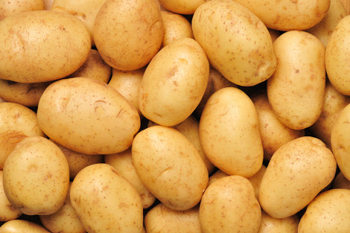
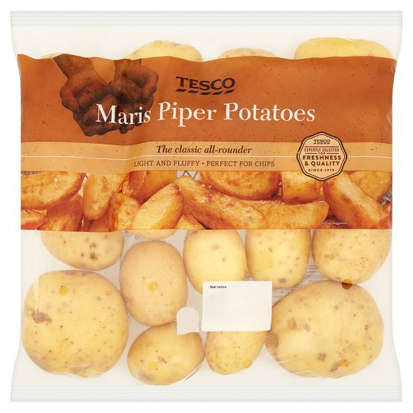
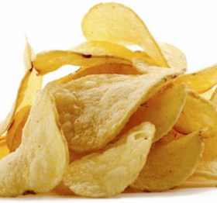
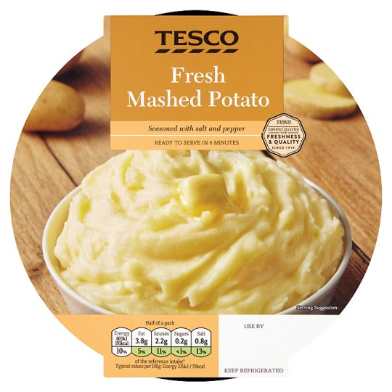




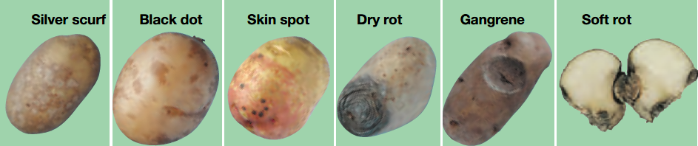

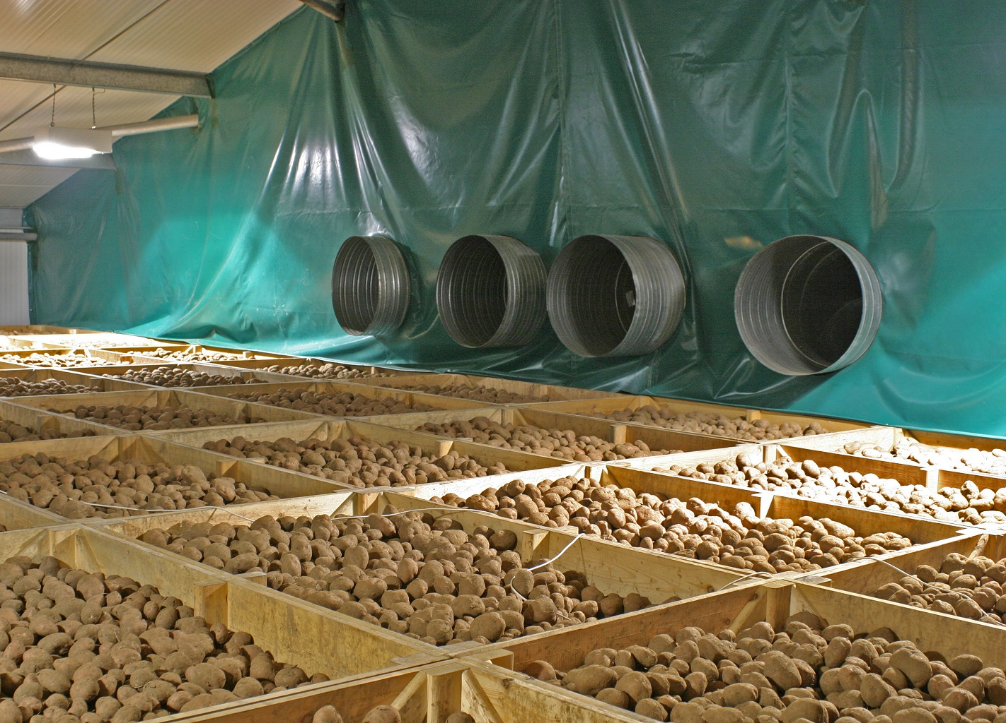
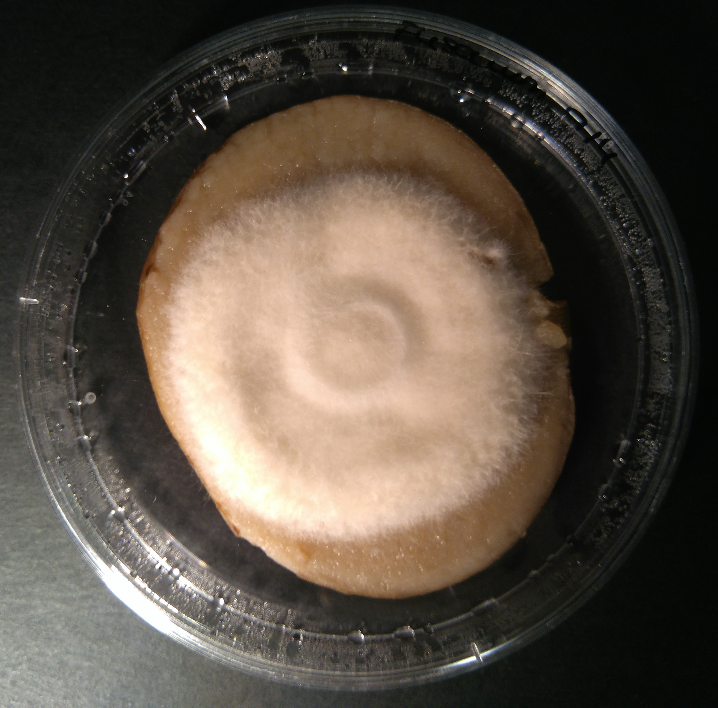

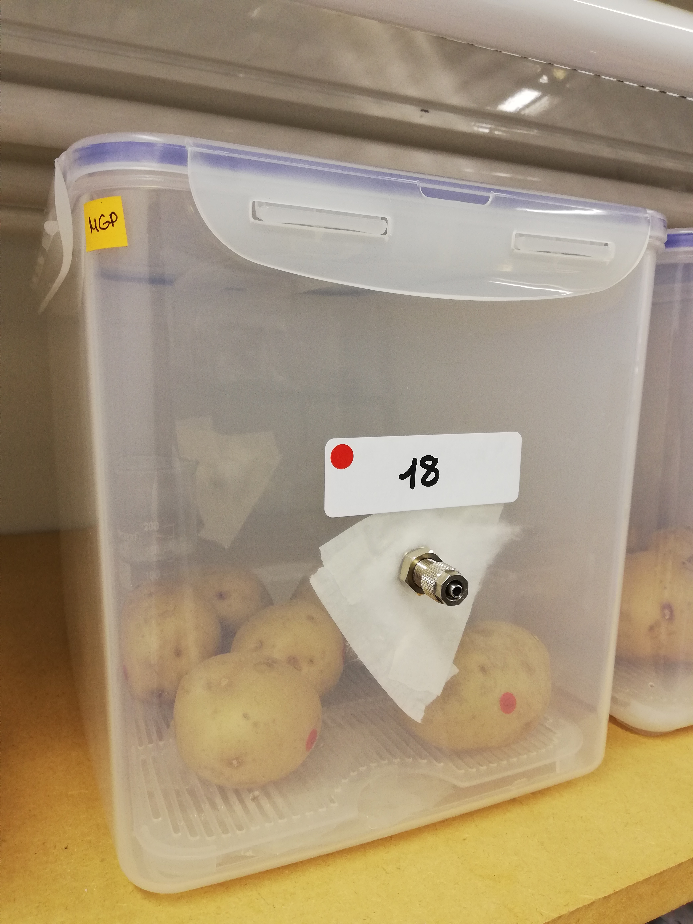
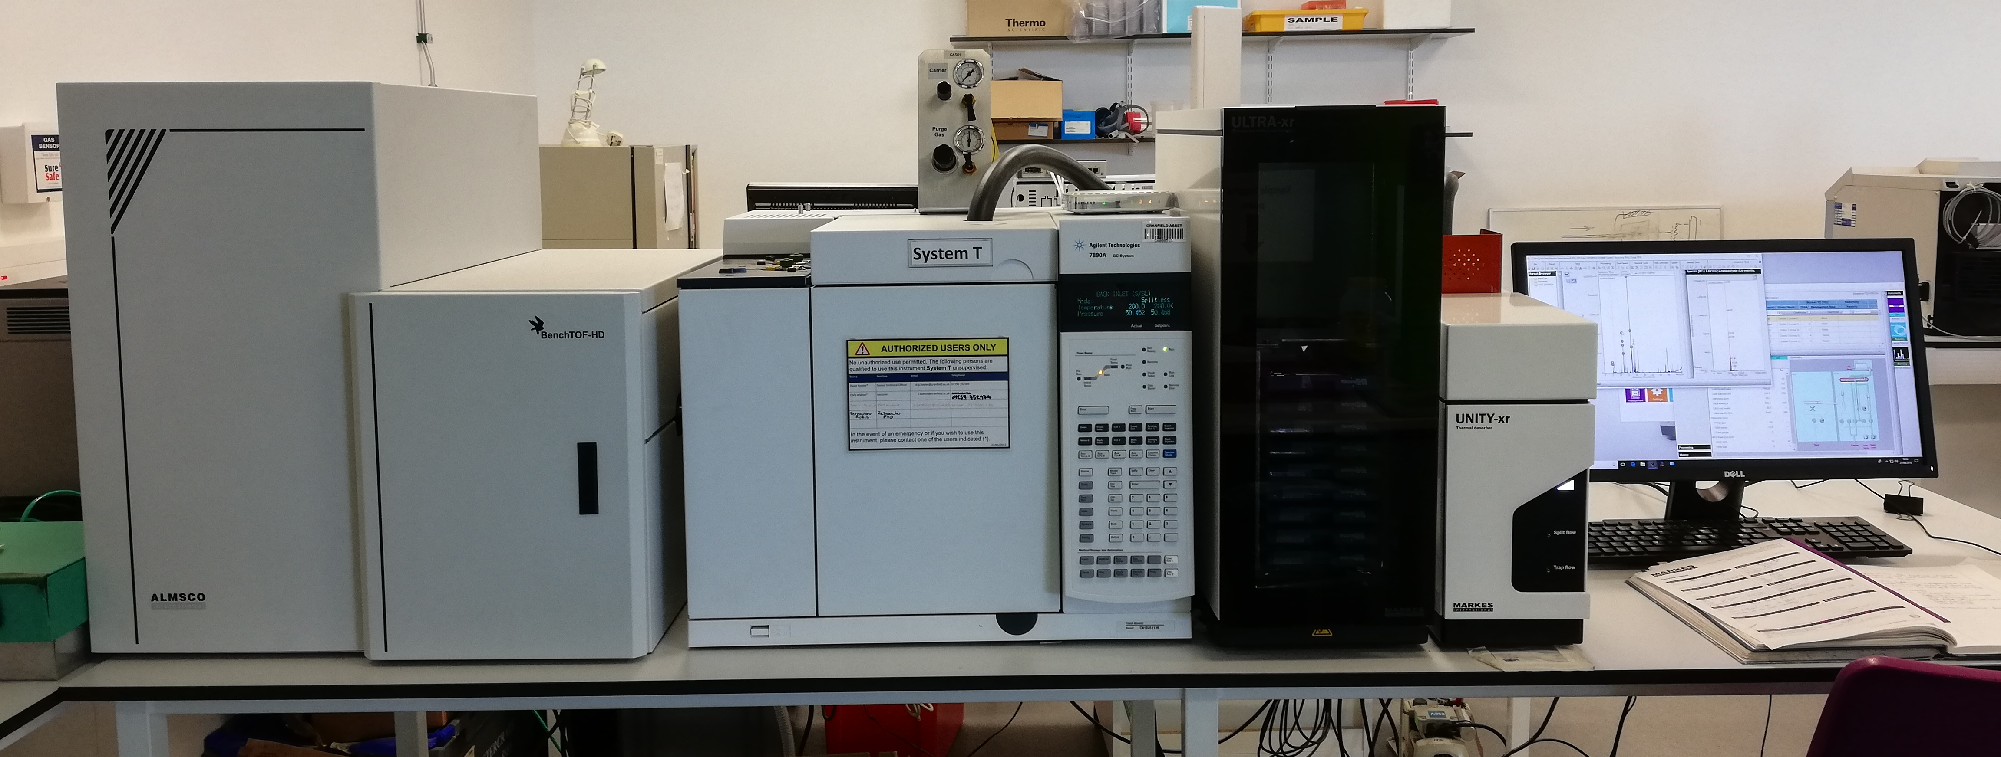
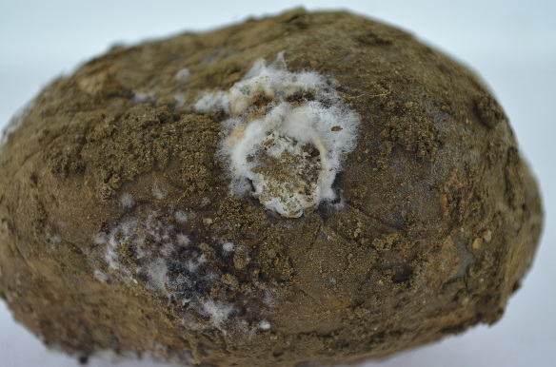
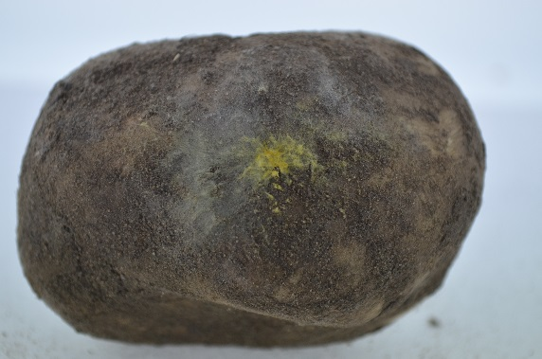
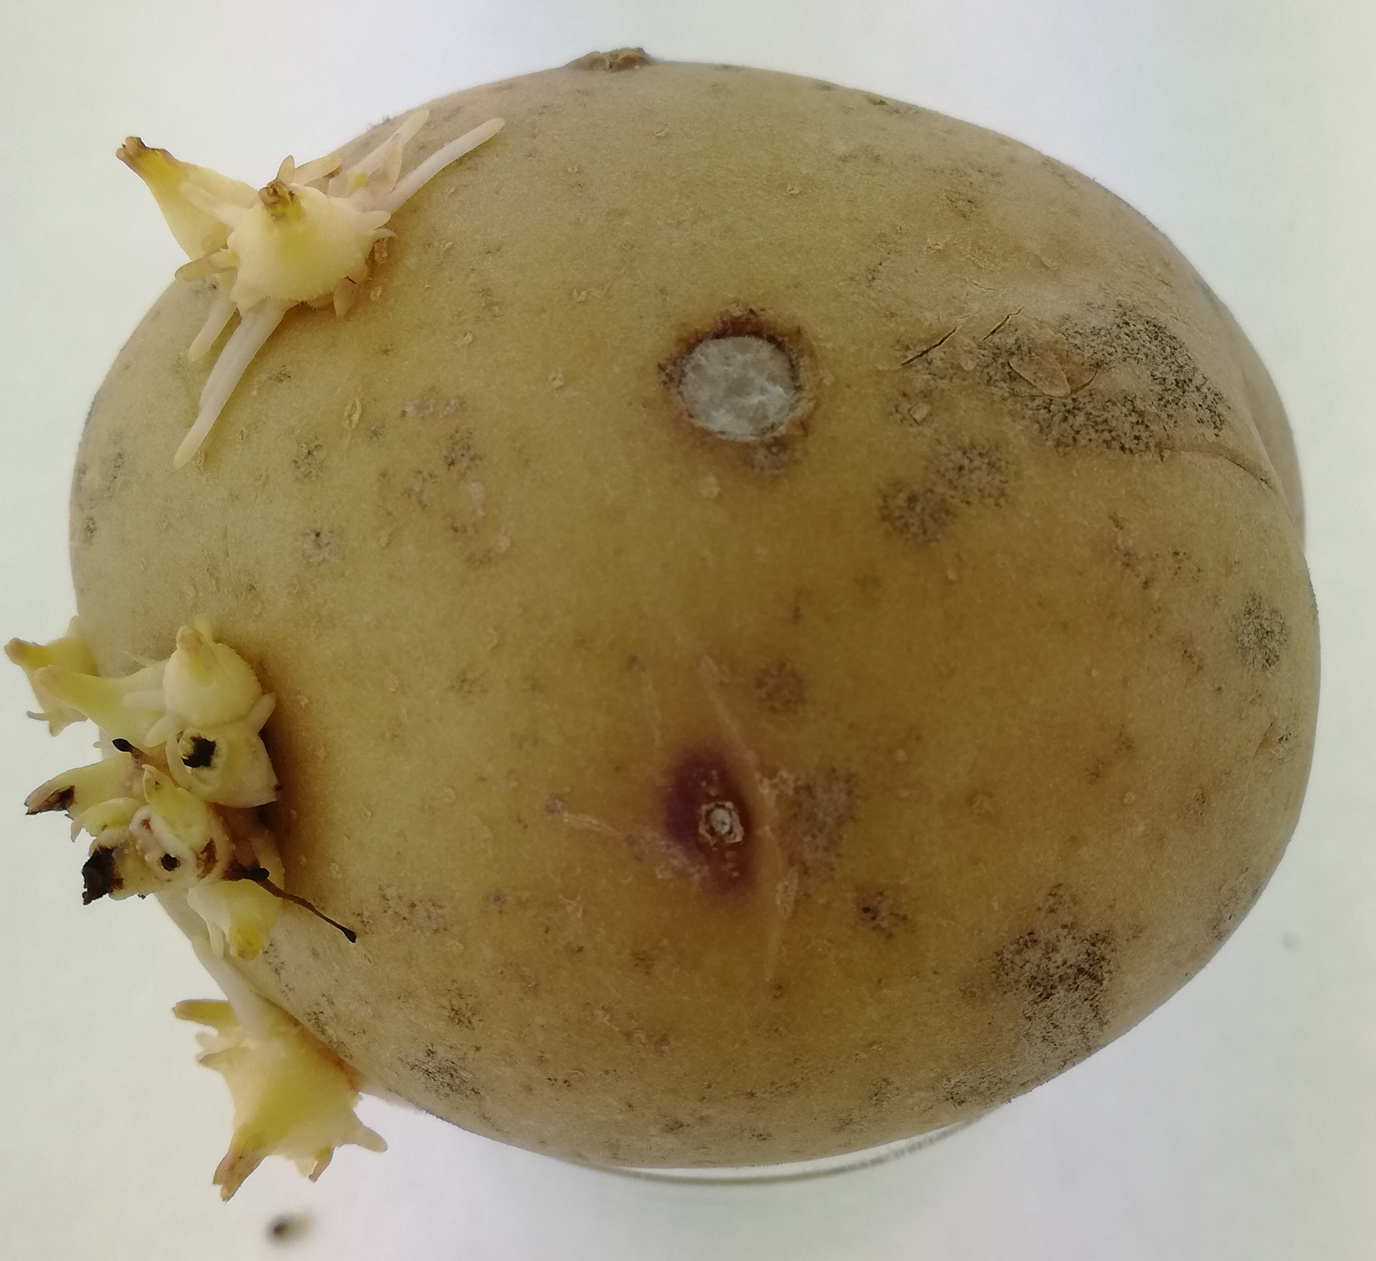
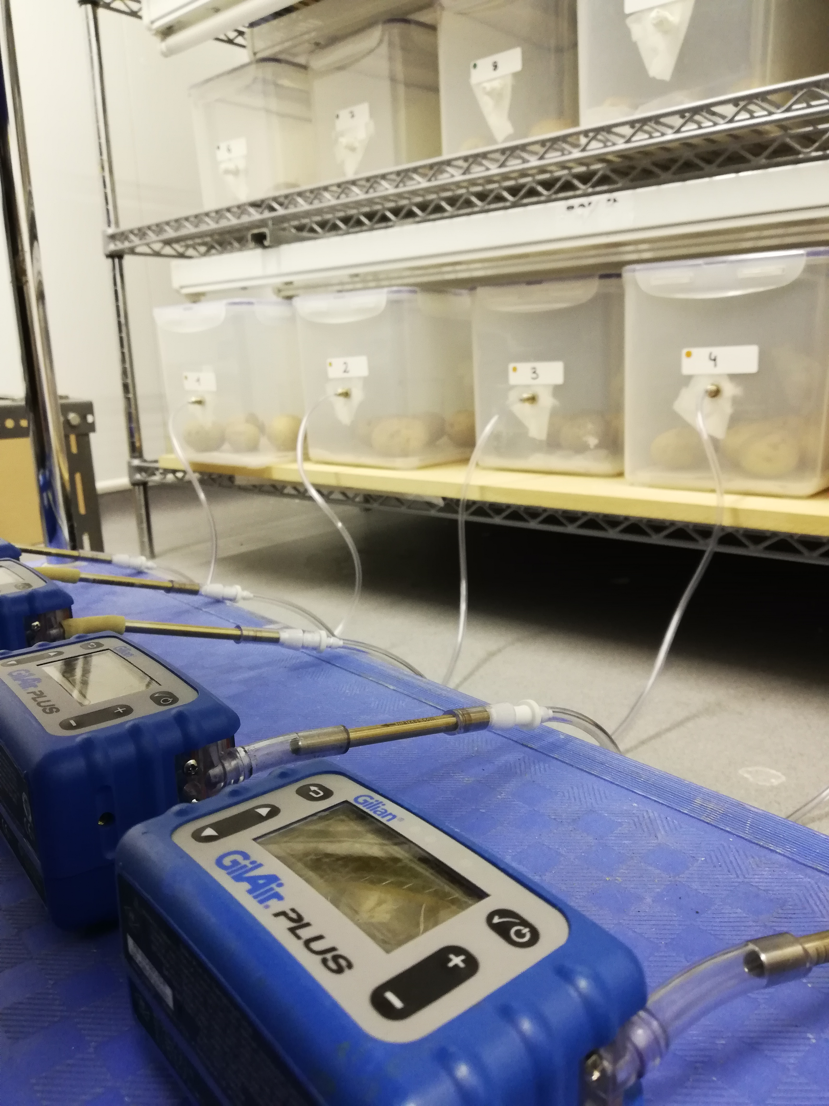
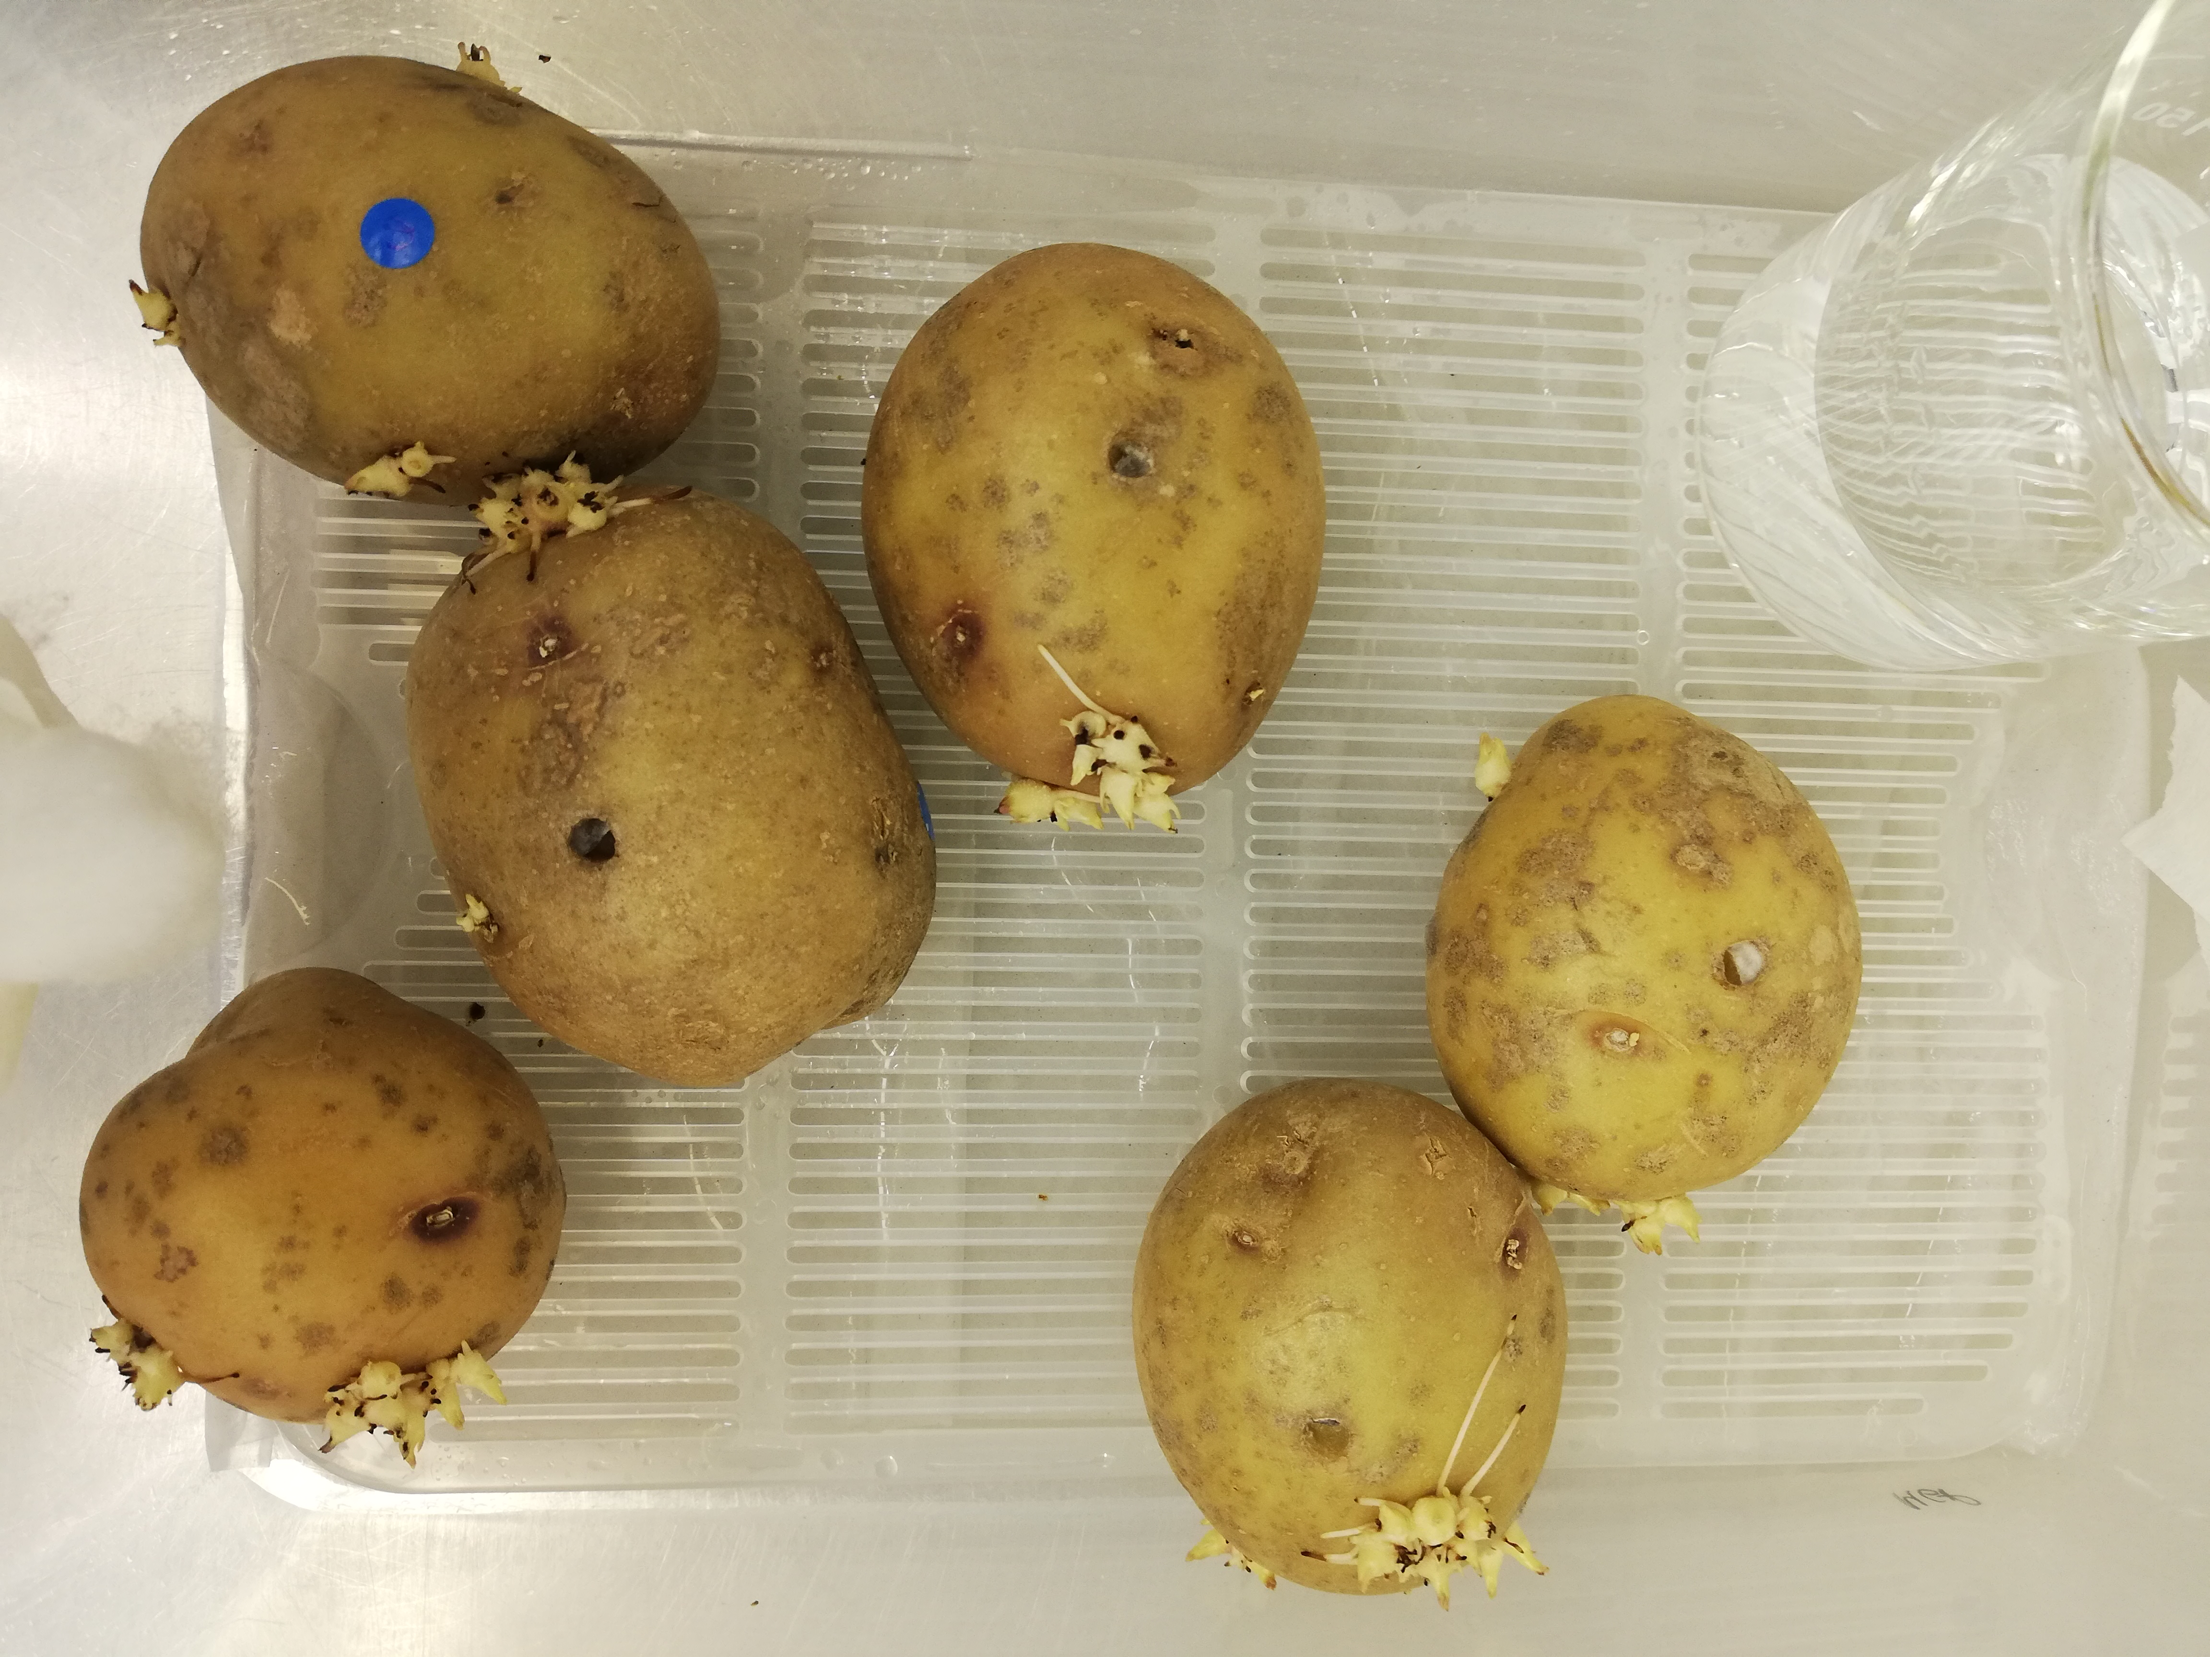
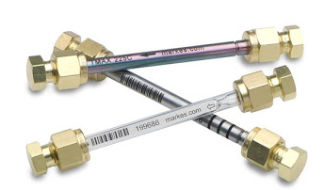
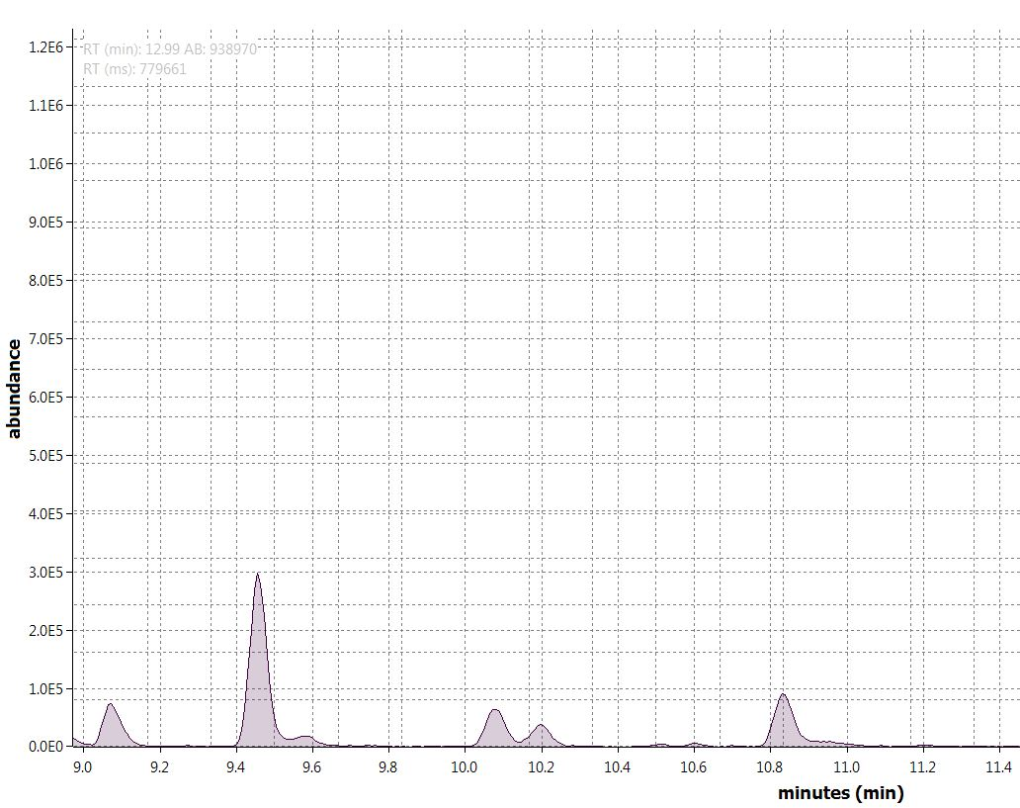
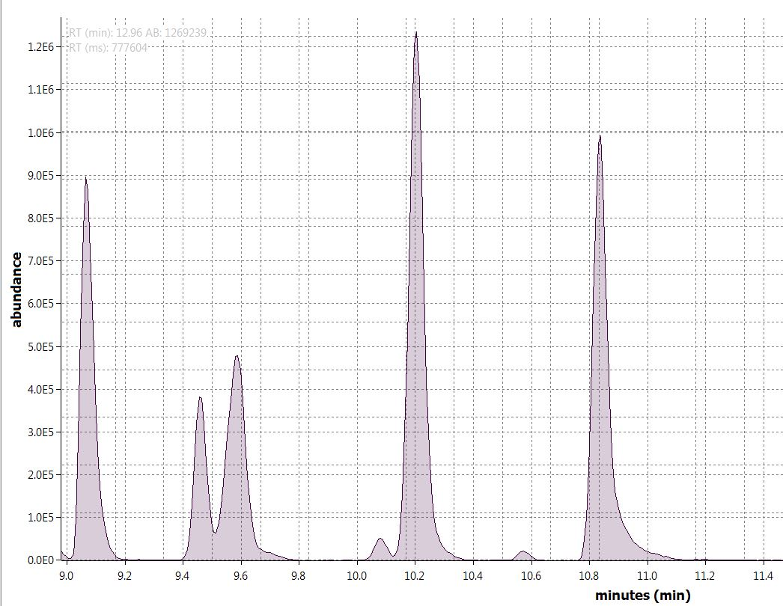


Volatile fingerprinting of potato rots during cold storage
Maria Gutiérrez-Pozo, Fernando Rubio-López, Leon Terry, Sofia Kourmpetli & Ángel Medina
Background
Potato is one of the main food crops in the world. Half of the potato crop is stored for up to 12 months
Environmental conditions
Potato storage is a dynamic process where environmental conditions must be able to react to changes by the optimization of the conditions during the storage
R.H (90-100%)
T (4-10ºC)
Retail or processing
Fungal and bacterial growth on potatoes. Potato storage diseases are acquiring more and more importance due to the increased demand of the pre-process potato market
Potato spoilage and waste
Wrong or insufficient management of storage conditions
Requirement
Perfect skin finish without any blemishes
Early identification of potato rots
Aim and objective
Determine the pathogen-specific VOCs released by the potato and the pathogen.
Identification of potato rots Volatile Organic Compound (VOC) – biomarkers for the development of a low cost, compact and sensitive multi-species trace gas sensor for the early detection of potato diseases under commercial storage conditions.
Methodology
The three main diseases that affected potato tubers in the last year; soft rot (Pectobacterium carotovorum atrosepticum), dry rot (Fusarium solani coeruleum) and gangrene (Boeremia foveata) have been studied. VOCs have been analysed by Thermal Desorption-Gas Chromatography-Time of Flight-Mass Spectrometry (TD-GC-ToF-MS) under laboratory conditions, while the developed sensor will be used under commercial conditions.
Trace gas sensor
TD-GC-ToF-MS
Potato surface sterilisation
Potato inoculation
Potato incubation
VOC sampling with Thermal Desorption tubes (TD)
Analysis & VOC identification
Results
a
Methyl ester acetic acid
b
Volatile Organic Compound biomarkers search was carried out by comparing the chromatograms resulted from VOC sampling of non-infected potato tubers with those infected with the different pathogens. Figure 1 shows an example of the different VOC profiles of non-infected potato tubers (Fig.1a) and Pectobacterium - infected ones (Fig.1b). Current work is being focused on the identification of possible biomarkers based on the presence and abundance of characteristic VOCs on the samples from infected tubers. This data will be used for the development of a low cost, sensitive, multi-species trace gas sensor.
Methyl ester acetic acid
3-methyl pentane
2-methyl butane
Methylene chloride
2-methyl butane
Methylene chloride
3-methyl pentane
Figure 1. Chromatograms resulted from VOC sampling of a. non-infected potato tubers and b. potato tubers infected with Pectobacterium carotovorum atrosepticum.
m.gutierrez-pozo@cranfield.ac.uk
QCAP

