Slide 1


Advanced rapid monitoring of bioaerosols
Sonia García Alcega
Sean Tyrrel
Frederic Coulon

Slide 2
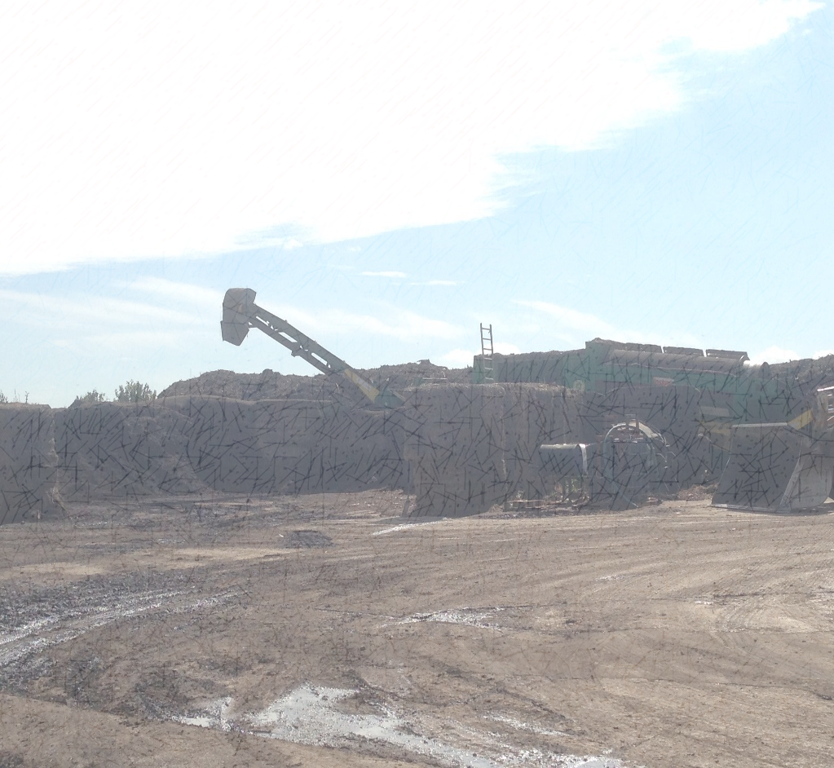
Introduction
Bioarosols: biological particles in aerosol form in air (bacteria, fungi, viruses).
Adverse health effects.
No standardized methods,
no comparable results.
Rapid determination of composition of bioaerosols from PLFAs and MVOCs.

Slide 3
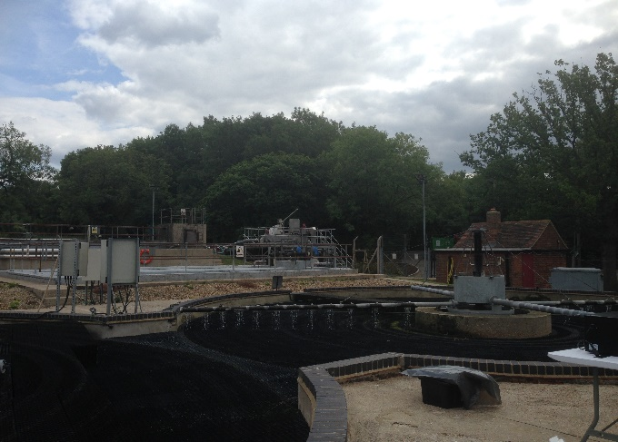
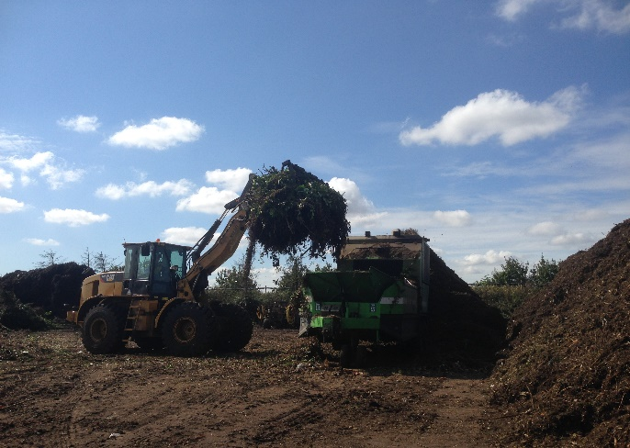

Material and Methods
Sample collection
From industrial, rural and urban environments with different sampling devices.

Slide 4
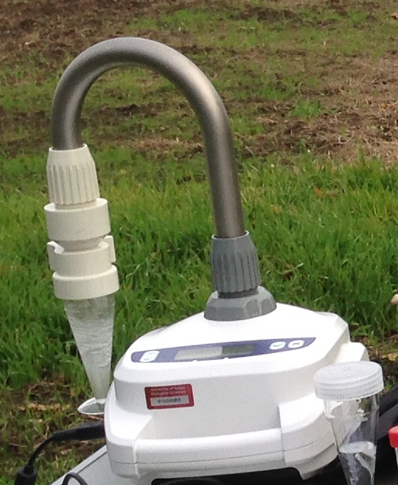
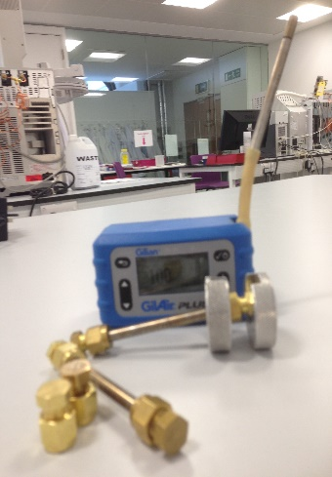
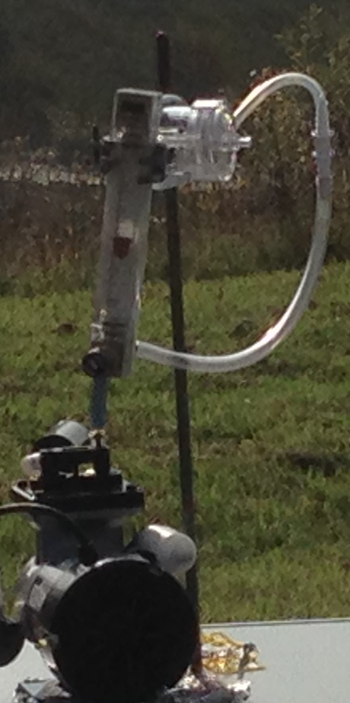
Material and Methods
Sampling methods
Chemical analysis
TD-GC-MS (MVOCs)
Solvent extracted & GC-MS (MVOCs & PLFAs)
HS-GC-MS (MVOCs)
Coriolis
OpenChrom: Peak identification & PCA analysis
TD-Tubes
SKC pumps

Slide 5
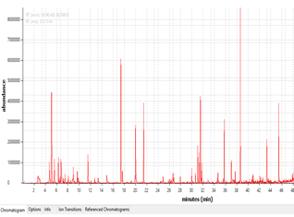
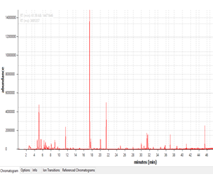
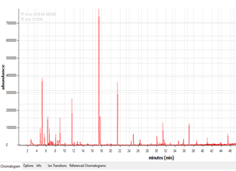
Preliminary Results
1,3,3,3 tetramethyl butyl acetamide
4-{2-Dimethylamino)ethyl}morpholine
Digitoxin
9,1 antracenedione
Dodecane
Sec-butyl nitrite
9 tetradecen-1-ol
Octadecanoic acid 2 hydroxyetoxy ethyl ester
Prednisolone acetate
Thiocyanic acid methyl ester
Tetraethyl silicate
2 ethyl heptanoic acid
Pentaethyl thiocyanate
Benzene
Colchicine
Waste water treatment plant
Rural Park
4,2 Dimethyl amino ethyl morpholine
Butanamide N-2 methoxyphenyl 3-oxo
Dibutyl methanephosphonate
Thyocyanic acid methyl ester
2,3,6 Trichlorobenzaldehyde
3-Methyl pentane
Acetophenone
Benzaldehyde
Park next to a lake

