Slide 1
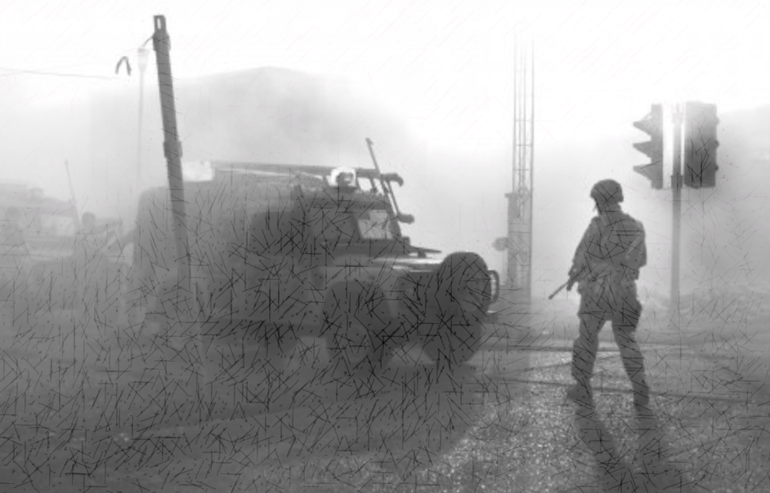







Veterans resident in Northern Ireland: a hidden population
‘The relationship between trauma, mental health, alcohol and help-seeking’
Troubles Reservist status predicted collective mental health;
Comorbid mental health rates were high BUT risky alcohol in all classes;
Mental health and transition predicted medication use;
Transition predicated therapy use;
Support was considered poor;
HOW DO YOU REACH THOSE WHO WISH TO REMAIN HIDDEN??
Catherine Hitch, MSc – chitch01@qub.ac.uk
Supervisors: Paul Toner, PhD and Cherie Armour, PhD
Image courtesy of R Doherty Photography ©

