Slide 1
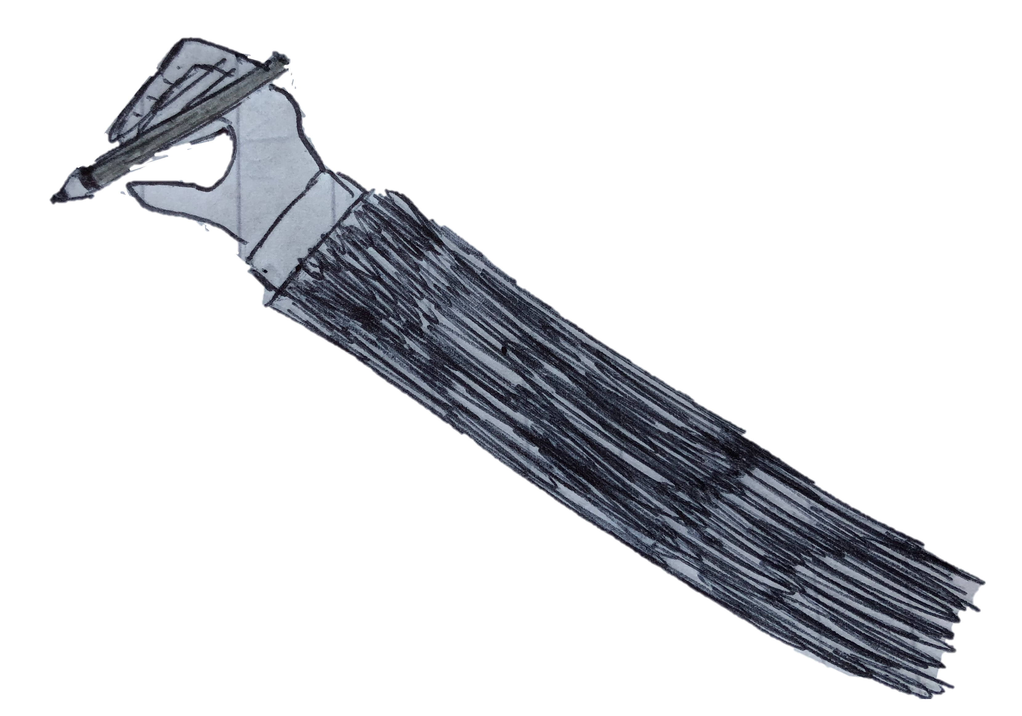




















De-Sovereignisation As AN INSTRUMENT OF RUSSIA’S FOREIGN POLICY in the post-soviet region
Photo credit: foreignpolicy.com

