Slide 1
Quantifying the thermomechanical behaviour of Carbon Fibre Reinforced Polymer exposed to fire conditions
Presented by Tim Aspinall

Slide 2
Introduction
Little is known about the performance of Carbon Fibre-Reinforced Polymer (CFRP) at high temperatures and those typical of fire exposure.
CFRP is a fibre-reinforced composite material that uses carbon fibre as the primary structural component bonded with a resin for stiffness.
The material properties suggest that performance at high temperature is challenging:
Glass transition of epoxy ~100°C
Thermal decomposition (pyrolysis) of the epoxy at ~300-400°C
Oxidation of fibres at ~700°C
This results in complex thermomechanical mechanisms which could have severe consequences on air-survivability.

Slide 3
Research Aims and Objectives
Aim
To understand the thermomechanical behaviour of CFRP exposed to fire conditions.
Objectives
Construct an apparatus to simultaneously evaluate the response of CFRP to applied thermal and bending loads.
Quantify the effect of the thermal degradation/decomposition processes on the performance of the CFRP and the effect on the failure mode(s).
Exploring the role of the failure mode(s) due to the propagation of the glass transition isotherm and char oxidation of the samples. The data is used to assess the failure modes of CFRP in load-bearing aircraft structural components.

Slide 4
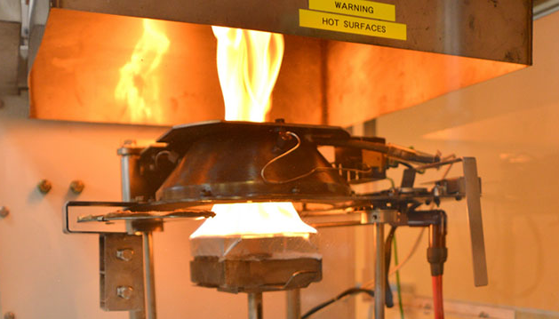
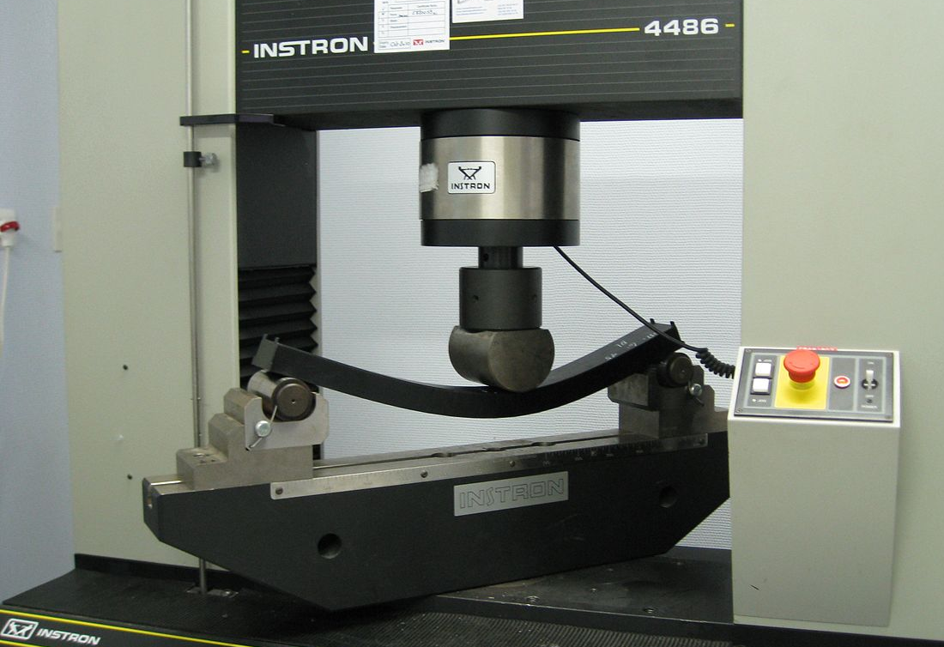
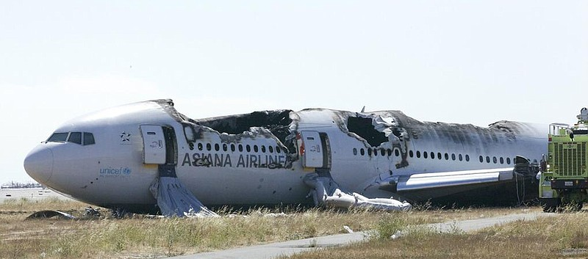
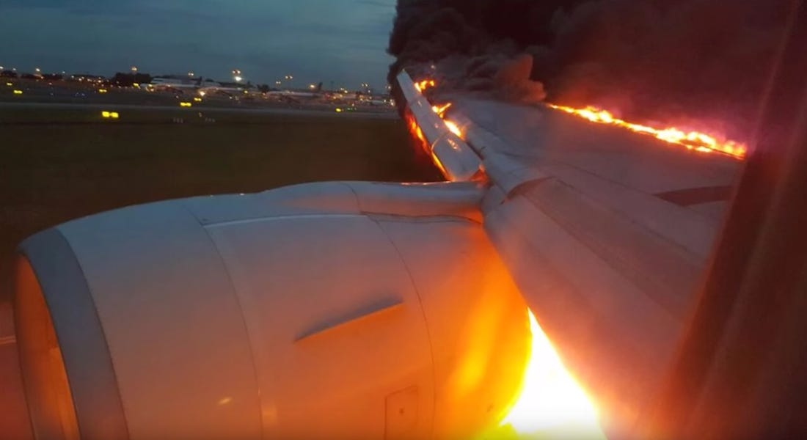
Current Approaches and its Limitations
a
b
https://udayton.edu/udri/capabilities/energy_and_power/fire_safety_science_and_material_flammability.php
https://en.wikipedia.org/wiki/Universal_testing_machine
Which assumes….
c
d
https://en.wikipedia.org/wiki/Asiana_Airlines_Flight_214
https://www.businessinsider.com/afp-fire-engulfs-singapore-airlines-plane-wing-after-emergency-landing-2016-6?r=US&IR=T

Slide 5
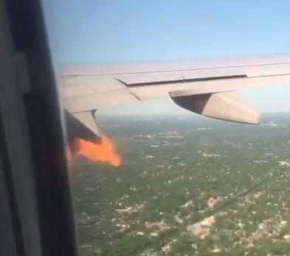
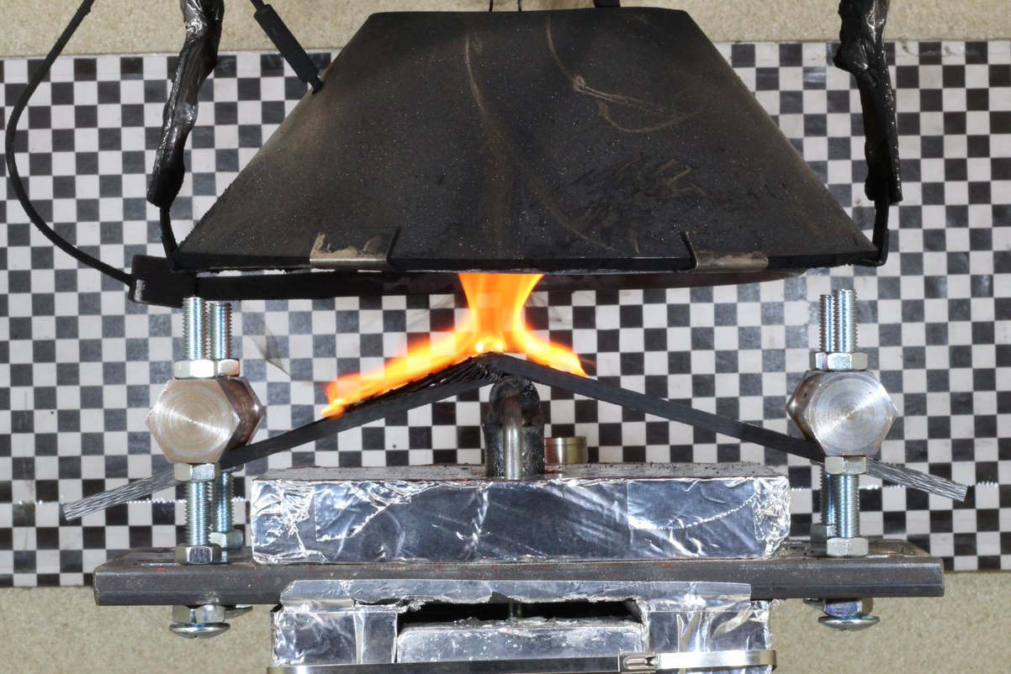
A new method - Thermal and Stress Inducing Device (TSID)
a
b
https://www.airlive.net/emergency-united-ua1738-returned-to-ord-after-engine-2-caught-fire-video/

Slide 6
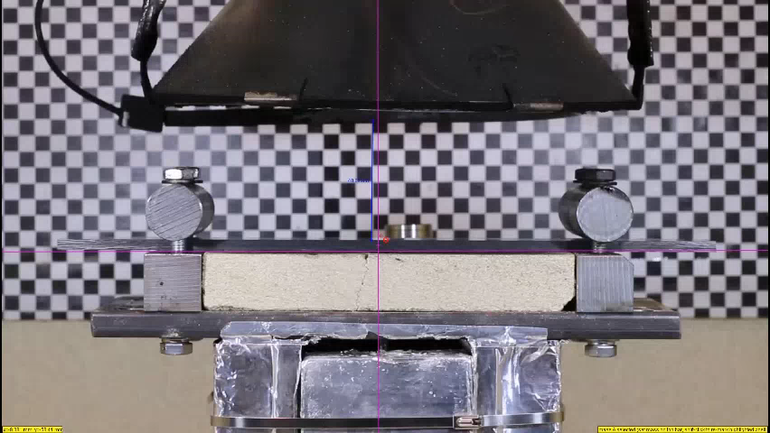

Slide 7
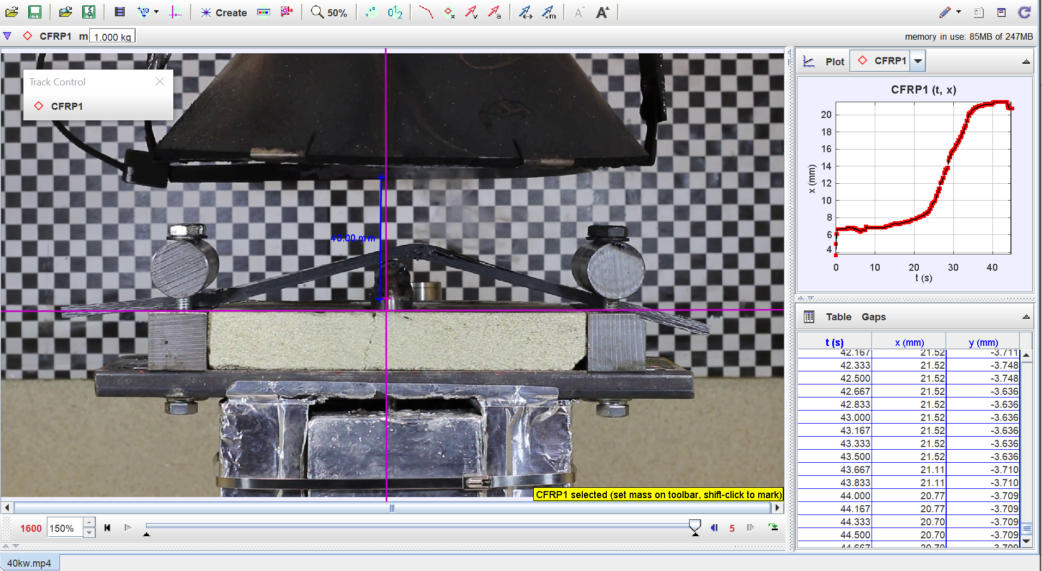
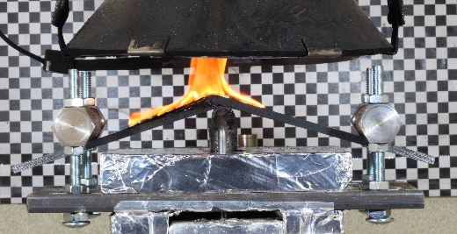
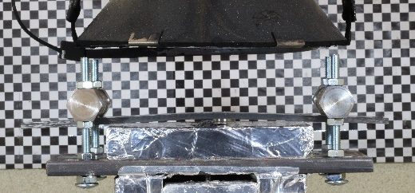
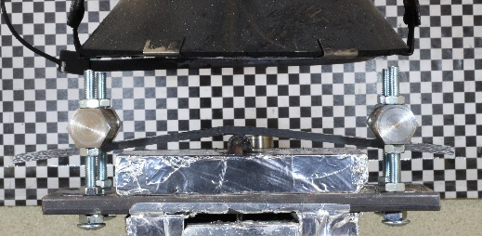
How can the TSID accurately quantify displacement?
Ignition
Failure
Load Applied
Beginning of Glass Transition

Slide 8
Displacement and failure at midspan
a
b

Slide 9
Temperature distribution
a
b

Slide 10
Failure modes and observations
a
b
c
Side elevation of sample tested at a range of heat flux
Slower glass transition induced failure of samples tested at lower heat fluxes
Sudden failure following ignition at higher heat fluxes, demonstrating significant delamination

Slide 11
To Conclude
The TSID can accurately assess the thermomechanical response of CFRP and accurately quantify the thermomechanical behaviour encountered in an aircraft fire.
The data generated from this study has the potential to significantly improve air-survivability.
Tests have shown that failure mode is influenced by heat flux. At higher heat fluxes, samples had a tendency to exhibit brittle behaviour at failure, whilst at lower heat flux samples exhibited less brittle behaviour at failure.
Time-to-failure is influenced by heat flux, with samples tested at higher heat fluxes undergoing failure in a shorter time than samples tested at lower heat fluxes.
Lastly, the results demonstrated that the TSID can be utilised to accurately assess the coupled interaction between the fire and mechanical properties, due to its ability to quantify load-displacement and time-to-failure.

Slide 12



Thanks for listening!

