Slide 1


DSDS 2020 Technical Paper
Dissolution rates of chemical components of an Insensitive High Explosive formulation
Encina Gutierrez Carazo
Supervisors: Dr. Melissa Ladyman, Dr. Frederic Coulon and Dr. Tracey Temple
10th November 2020

Slide 2
INTRODUCTION

Slide 3
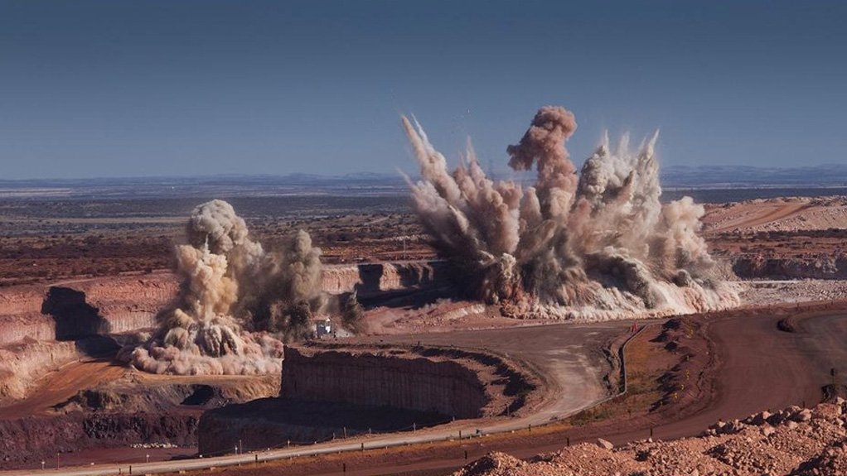
Introduction
Challenges posed by Insensitive High Explosives
Insensitive High Explosives (IHE) are explosives that are less likely to be accidentally detonated.
IHE fills have different physico-chemical properties than traditional explosives
IHE compounds are more mobile through the environment and can degrade into other chemicals that may be harmful in the environment
Little is still known about their behaviour, toxicity and persistence in the environment.
What is the real impact of these chemicals on the environment? How can they be assessed?

Slide 4
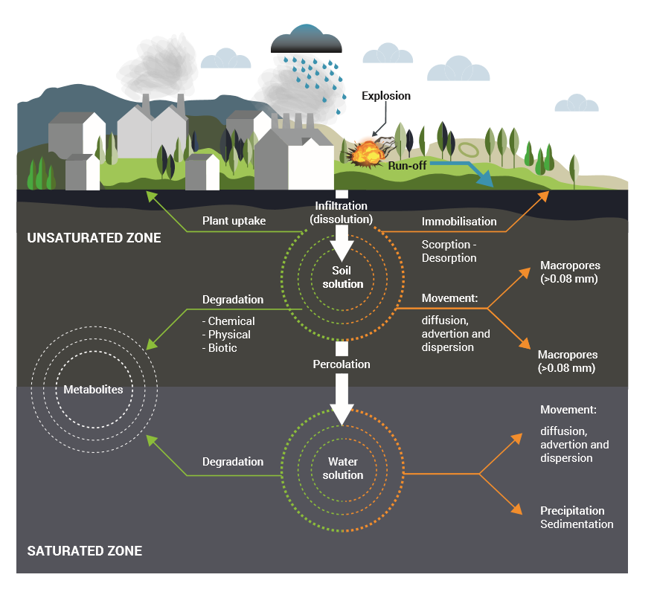
Introduction
Processes influencing fate and transport of IHE in the environment
An explosive is detonated
IHE residues infiltrate to the soil matrix
Dissolution → first process IHE undergo before spreading over the environment

Slide 5
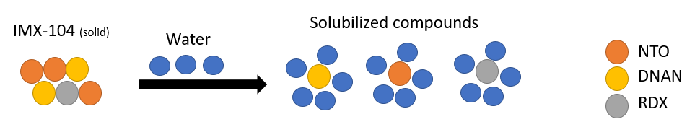
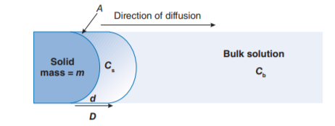
Introduction
Solubility Vs dissolution rate
Solubility is a thermodynamic process that explains the propensity for a solute to dissolve in a solvent and how much (capacity).
Dissolution rate is a kinetic process that studies the speed of a solute to dissolve in a determined solvent under certain circumstances. It describes when the compound is dissolved.
Environmental purposes → dissolution rate

Slide 6
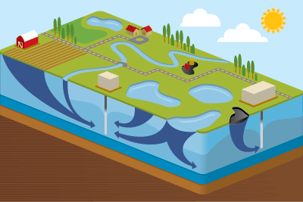
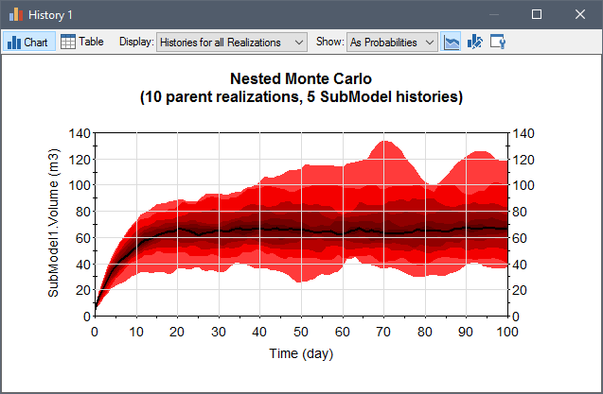
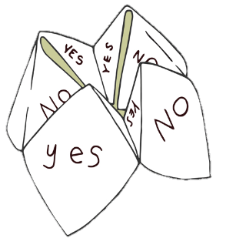
Introduction
Computational Modelling (CM) for risk assessment purposes
CM allows the study of real scenarios without the need to undertake actual laboratory or field experiments
CM simulates contaminant behaviour in complex systems either poorly understood or difficult to study
Stochastic approach used for uncertainty assessment and decision-making
GoldSim has a Contaminant Transport Module and stochastic approach (Monte Carlo)

Slide 7
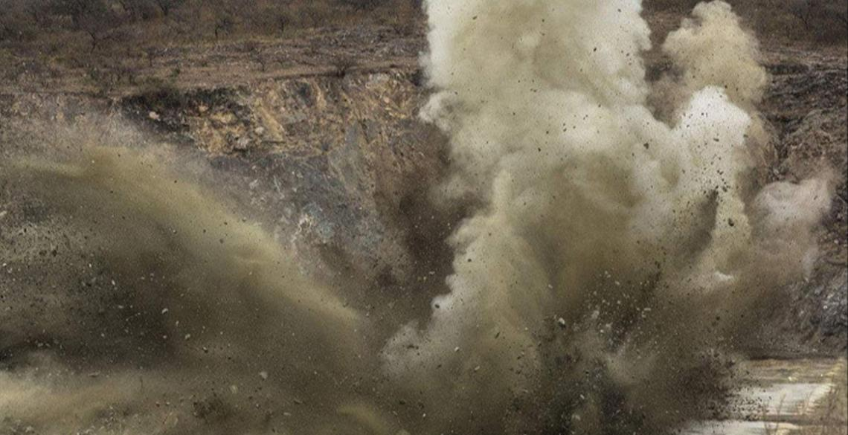
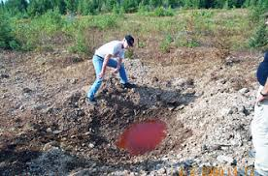
Introduction
Aim of the research
To develop a representative computational model to simulate the dissolution rates of individual chemical compounds present in an IHE formulation. This model will serve to support further environmental risk assessment and remediation strategies.
Let’s save our environment!

Slide 8
MATERIALS AND METHODS

Slide 9
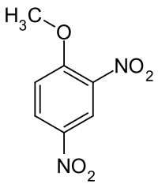
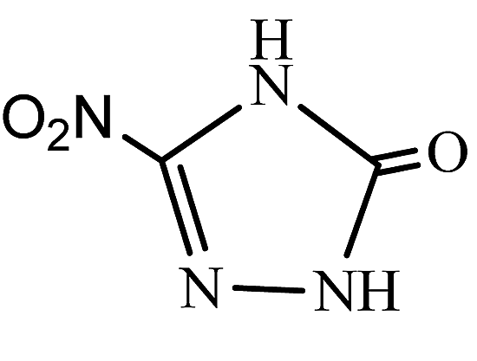
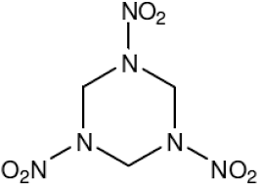
Material and methods
Chemical compounds in the IHE formulation of interest
NTO
(5-nitro-1,2,4-triazol-3-one)
DNAN
(2,4-dinitroanisole)
RDX
(hexahydro-1,3,5-trinitro-1,3,5-triazine)
High solubility 12000 mg/L
Toxicity > 5000 mg/kg
Solubility 276 mg/L
Toxicity 199 mg/kg
Solubility 60 mg/L
Toxicity 100 mg/kg
53%
32%
15%

Slide 10
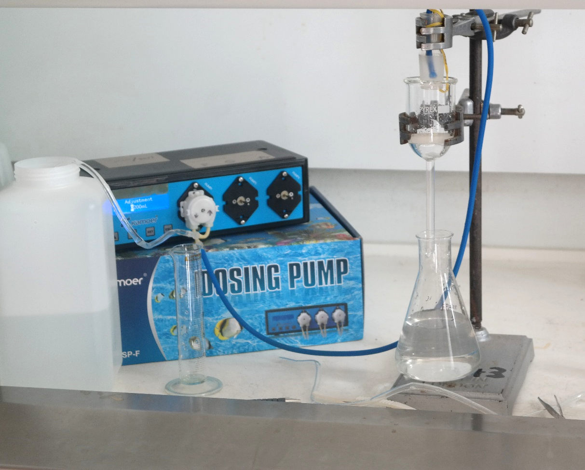
Material and methods
Dripping tests
Conditions:
Container: DI water at room temperature and pH=6.1
Flow rate: 40 ml/min
Funnel contains IHE flake (30 - 60 mg)
Leachate was collected every 5 minutes (~200 mL) for 100 minutes
2. Pumping system
3. Funnel
1. Container
4. Leachate

Slide 11
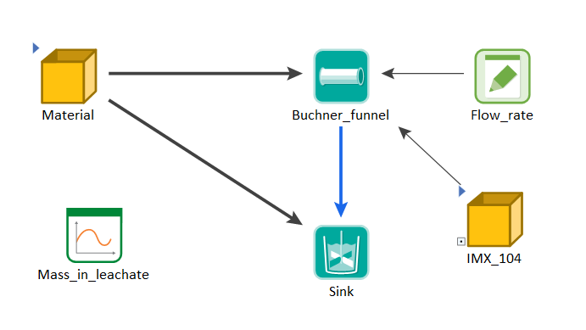
Material and methods
Construction of the model in GoldSim
Construction of the model: similarity to the experimental work
IHE compounds (species) and their properties
Elements: container, funnel and leachate
Links between elements species
Simulation settings: Monte Carlo method:
Dissolution rates inputted as a normal distribution
Data every 5 minutes
101 realizations

Slide 12
RESULTS

Slide 13
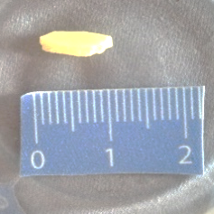
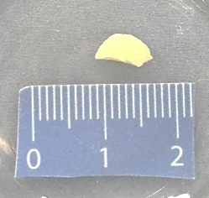
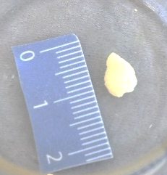
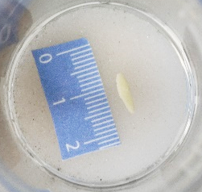
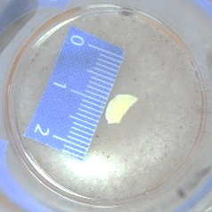
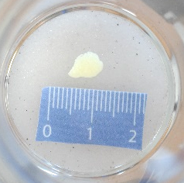
Results
Visual observations
Flake A
Flake B
Flake C
Initial irregular flakes
Apparently similar size between initial and final flake
Loss of yellow coloration
Presence of small pores
Initial
Final

Slide 14
Results
Mass balance
Average of three different flakes
78% of the flake remains→ IHE formulation difficult to dissolve
38% NTO was dissolved against 27% DNAN and 28% RDX
NTO dissolves faster of the matrix → pores in the flake

Slide 15
Results
Dissolved cumulative mass over time
Same tendency in all flakes --> dissolves faster when the surface contact is bigger
NTO (3 sections): first quickly dissolves, then dissolution rate decrease (except flake 3)
DNAN (2 sections): after 50 minutes the dissolution rate decrease
RDX (2 sections) → similar behaviour to DNAN, smoother curve.

Slide 16
Results
Experimental dissolution rates
 | Dissolution rate (mg min⁻¹)
Time (min) | NTO | DNAN | RDX
0-15 | 0.26 ± 0.11 | 0.056 ± 0.02 | 0.026 ± 0.008
15-50 | 0.105 ± 0.03
50-100 | 0.057 ± 0.03 | 0.033 ± 0.01 | 0.014 ± 0.006
Obtained by calculating the slope of the cumulative mass (mg) over time (min)
Dissolution rates NTO > DNAN > RDX
NTO dissolves 4 times slower after 15 minutes, and 8 times slower after 50 minutes
High standard deviation in NTO data
DNAN and RDX dissolution rates reduced 30-50% after 50 minutes

Slide 17
Results
GoldSim simulations using a stochastic approach
Experiential dissolution rates added as stochastic inputs.
Comparison between average, maximum and minimum mass dissolved over time.
Experimental dissolved mass are inside the range simulated in all the cases
Model not validated yet
- - - - GS minimum; -- • -- GS maximum;
… GS average; • experimental (Flake 3)

Slide 18
Results
Estimation of time needed to dissolve the flakes
Assumption: last dissolution rates constant overtime
Rainfall data from Malborough Weather Station (Wiltshire, UK)
Approx. 100 minutes = 3 months of rain
 | NTO |  | DNAN |  | RDX
 | GoldSim (minutes) | Estimation (months) | GoldSim (minutes) | Estimation (months) | GoldSim (minutes) | Estimation (months)
Flake A | 403 | 12 | 469 | 14 | 531 | 16
Flake B | 186 | 6 | 246 | 7 | 279 | 8
Flake C | 468 | 14 | 535 | 16 | 606 | 18
Small flakes (30-60 mg) need roughly one year to dissolve!
NTO is the first to fully dissolve between 6 and 14 months
DNAN requires between 7 and 16 months to dissolve
RDX is the slowest to dissolve requiring between 8 and 18 months.

Slide 19
CONCLUSIONS

Slide 20
Conclusions
IHE residues can remain in the environment after detonation, thus their presence and toxicity in the environment must be correctly assessed.
Dissolution rates are key in the movement of IHE to the environment as they determine when and how much these chemicals pass through the soil matrix and must be experimentally measured.
Experimental dissolution rates were very variable and not constant over time, which hampered the study of the IHE dissolution.
Nevertheless, the stochastic model developed in GoldSim was simple but representative enough to simulate how the explosive compounds dissolve in under specific conditions.
This initial model developed in GoldSim needs further development but it will serve for to assess environmental risks and help remediation strategies caused by IHE

Slide 21

Thank you for your attention
I will be happy to answer all your questions!

Slide 22
encina.gutierrez-carazo@cranfield.ac.uk

