Slide 1
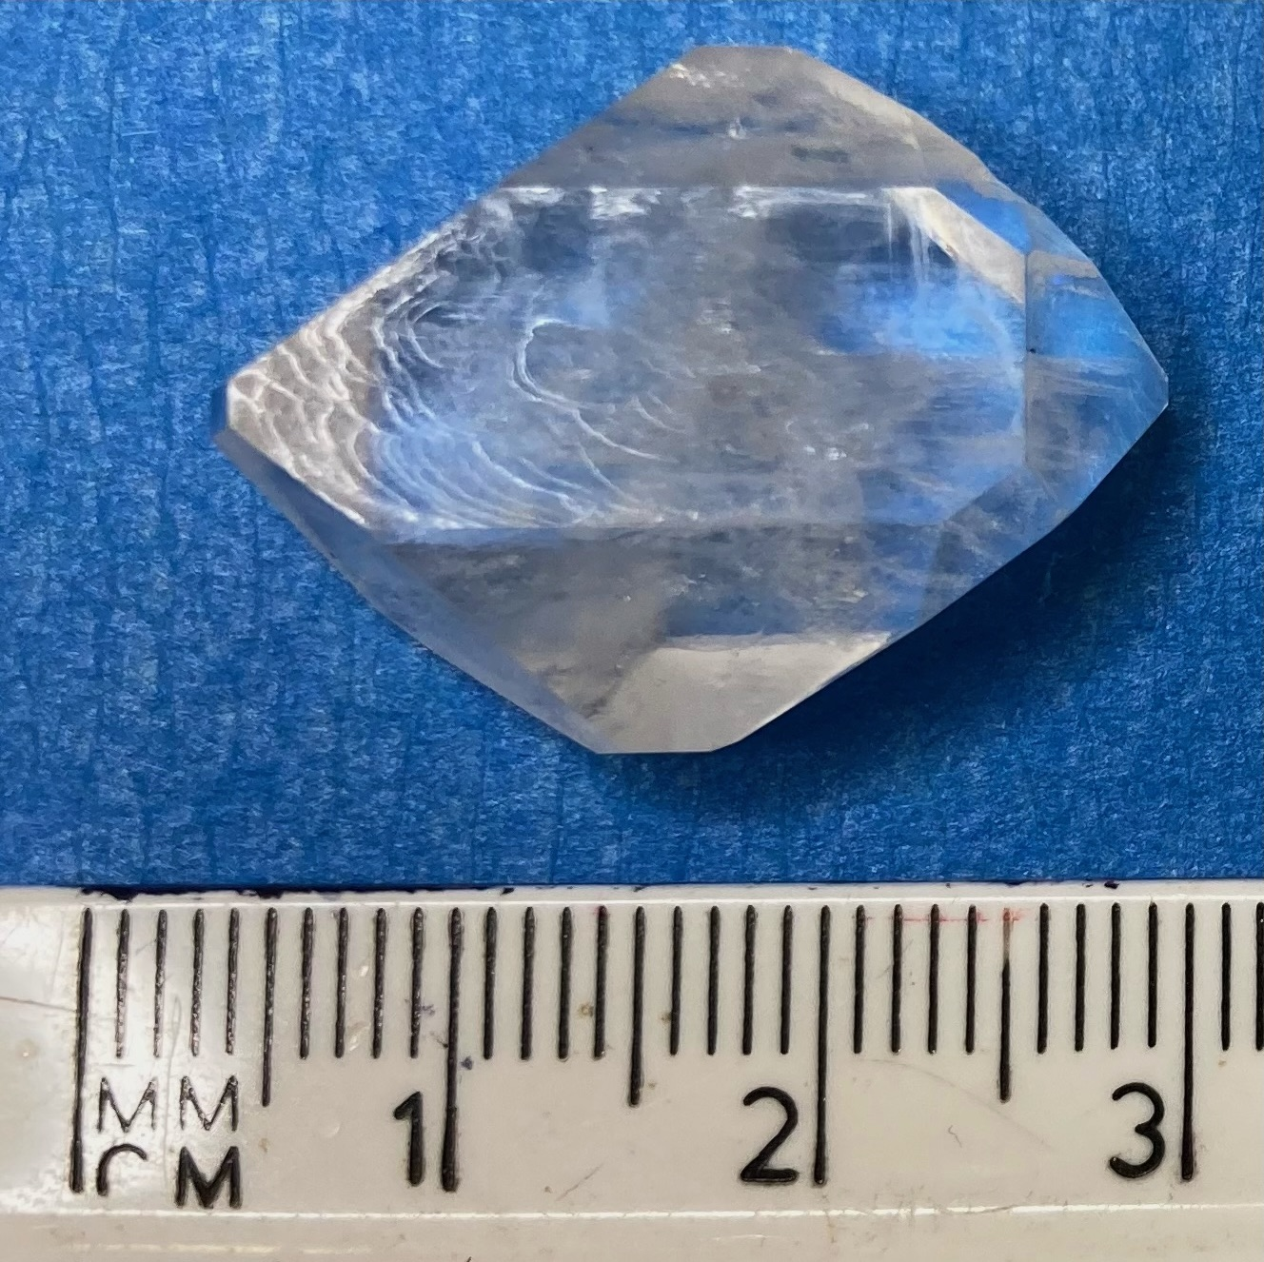
The influence of crystalline defects on the initiation of crystalline nitramine explosives.
Notes:
Octahydro-1,3,5,7-tetranitro-1,3,5,7-tetrazocine, or HMX, to its close friends is a nitramine energetic material and is the focus of my PhD studies.
My PhD project can be broken down into a few small and simple steps. 1. Grow some crystals 2. image these crystals 3. fire shockwaves through the crystal 4. Look at how the defects in this crystal influence initiation. But what’s the point I hear you ask? Well that’s easy enough too, energetic materials are widely used, mostly within the defence industry. These materials are used in a powder form and because of this we do not know the true inherent sensitivity of these materials because when it powder form, it is easy for dust and grit to get mixed in which changes the material slightly. By using various crystal growth techniques, in my case a temperature lowering method, single crystals of HMX can be grown. Single crystals of energetics provides a better look into the true sensitivity of the material thanks to the absence of grit and dust.
All energetic solids are crystalline materials. All solid materials can be defined as either crystalline or amorphous. Crystalline materials have long range order, amorphous ones do not. An analogy of this would be to look at spaghetti. Uncooked spag comes in packs of long sticks, if a packet of spag was cut in half, the long range order seen initially would continue and the shape and forms are undisturbed by the slicing. Cooked spag loses this long ranger order and if a plate of uncooked spag was cut in half, there would be no shape or form to the mass on either side. This analogy applies to materials. Crystalline materials have a long range order, a repeating block within this. This repeating unit is the unit cell.
Solid energetic materials are no different to other crystalline materials, there is a repeating unit cell and slicing the crystal up, or grinding it down into a powder does not in any way change this. Within the defence industry, energetic materials are often used in this powder form. However, within this powder form, the true sensitivity of the material can not be known. This is because there is often a lot of dirt and dust mixed in and this is almost impossible to separate. A good way to learn the true sensitivity of an energetic material is to look at the energetic material in a single crystal form.
Within all crystalline materials there are defects from growth, these defects can come as point, line, surface, substitutional or interstitial defects.

