Slide 1
The Power of Information – Threats and Opportunities in Defence Export Control
CADE 2021
Joe G Dunn
– WMG, University of Warwick, Coventry & BAE Systems plc, Farnborough
Carsten Maple
– WMG, University of Warwick, Coventry
Gregory Epiphaniou
– WMG, University of Warwick, Coventry

Slide 2
Content
Introduction
Background to the Research
Method
Results & Discussion
Limitations
Conclusions
References

Slide 3
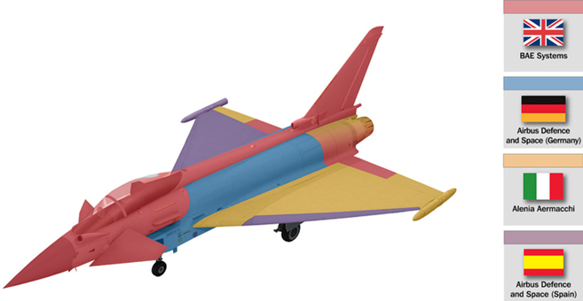
1. Introduction
Collaboration:
University of Warwick and BAE Systems plc
IT Automation Programme to strengthen approach to Export Control compliance
Example: How to build a Typhoon workshare
Source: Ref. 1

Slide 4
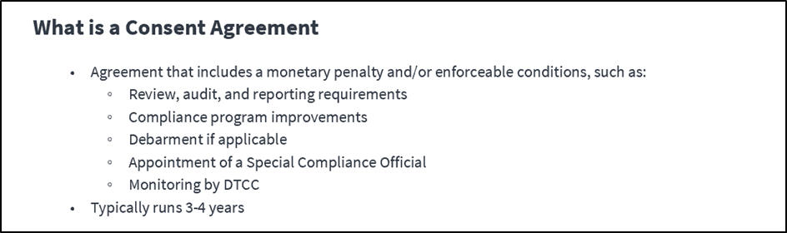
2.1 Background to the Research – US Export Control (EC) Legislation –
Some definitions and acronyms
International Traffic in Arms Regulation (ITAR) governed by US Department of State (US DoS) utilising the US Munitions List (USML)
Directorate of Defense Trade Controls (DDTC) within US DoS administers the ITAR
Consent Agreement mechanism has been used many times to settle alleged violations against the ITAR (see panel 1)
Export Administration Regulations (EAR) governed by US Department of Commerce (US DoC) utilising the Commerce Control List (CCL) covering Dual Use (see panel 2) items
US Export Control key features:
  The law is extra-territorial
  It apples to Defense Articles (including Technical Data) and Defense Services
  It applies to re-exports
  Access to EC items by non-licensed foreign (from a US perspective) persons to EC information is considered an export control breach
Focus of this review is US EC and Defence – however applies across all sectors
UK EC law also applies to items being exported from UK (see panel 3)
Panel 1: What is a Consent Agreement in this context
Source: US DoS – DDTC web site accessed 15th Oct 21 Ref. 2
Dual use items refers to items with military and commercial end uses
e.g. A missile would be an example of a military item whereas a radar could be dual use
Panel 2: What are Dual Use Items?
UK Export Control Legislation has many parallels (e.g. Dual Use, Information in addition to hardware) and is applied to exports from the UK
US origin Exports are therefore subject to UK and US Export Controls when exported from the UK
Panel 3: A note on UK Export Controls? See also Ref. 3

Slide 5
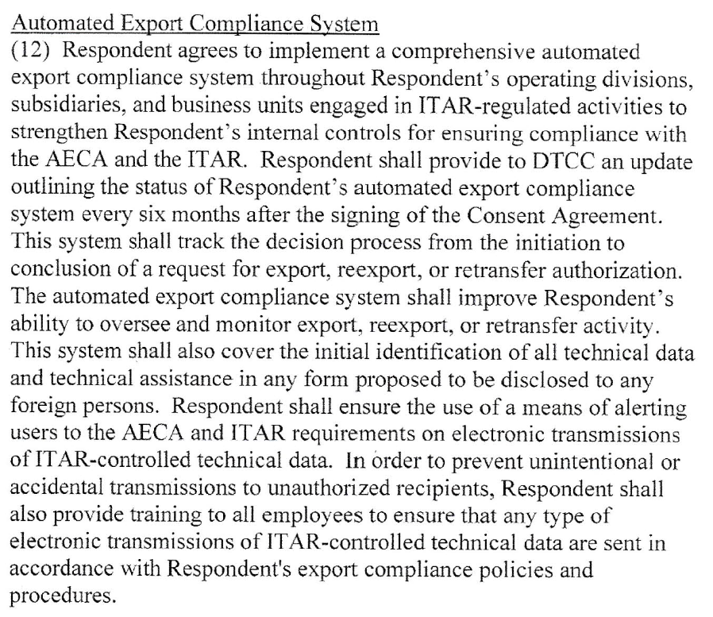
2.2 Background to the Research
Consent Agreements (CAs) often commit companies to implement Automated Export Control Compliance Systems
Obligations far reaching, high level and not too prescriptive
Obligations are tailored to the company and the allegations
Little information exists on how companies have addressed
A comprehensive Literature Review of all CAs reveals powerful themes & trends on Information as a risk
The research project is examining the use of IT Automation as an Opportunity to mitigate these risks
Example
Source: US DoS – A 2021 Consent Agreement Ref. 4

Slide 6
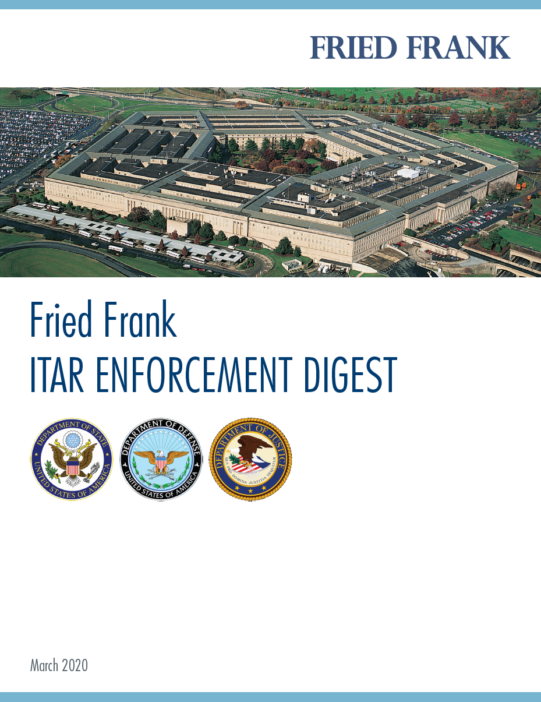
3. Method
Analysis of all Consent Agreements
Tabulate Facts & Establish Themes
Focus on Key Information Themes
Establish Risks Associated With Information
Identify Generic Risk Mitigation Technologies & Steps
Fried Frank LLP ITAR Enforcement Digest Ref. 5. Recommended summary from a Legal perspective.
Ongoing

Slide 7
4.1 Results and Discussion - General Themes
Monetary fines (occasional debarment) plus commitments to address
  Export Control Policy, Procedures and Training
  Compliance Program
  Communications including Anonymous hotlines
  Use of Classification Reviews to classify all assets and avoid misclassifications going forward
  IT Automation
Mechanisms
  Typically 36-48 month term
  Use of Internal & External Auditors (typically 2 audits – 1 after signature and 1 prior to nominal closure)
  Access to a Company’s records, personnel, sites
  Internal & external Special Compliance Officers (SCO) – Policy & Procedure, Management Duties, Reporting
  Ad-hoc site visits
  Senior Management Engagement
  Ability to demand organisational changes and removal of individuals from posts
  Company certification that obligations have been met – verified by SCO
  Use of portion of fine to part fund compliance measures
Expectations
  Consistency required across business unit and subsidiaries
  Acquisitions and disposals take forward obligations
Observations
  Repeat offenders
  Due diligence on acquisition
  All mechanisms strengthened through time
  Importance of Information risk versus hardware risk and increasing demands of IT Automation
Based on DDTC source Ref. 6
Information Risks and IT Automation Theme Developed – see next slide for Summary

Slide 8
4.2 Results & Discussion - Summary Timeline: 1. Four Periods of CAs Proposed by Information attributes
2. Increasing IT Automation Demands
Period*
1978-1997
Hardware Focus - Transactional
1998-2003
Technical Data Focus - Still Transactional
2004-2010
Information Security Focus – includes Non-Transactional
2011-2021
Expectation of Integrated Control Systems
Record Keeping
Computerised
Document Control
Systems
Electronic tracking systems
(Physical then Information)
Automated Export Control System
Comprehensive and reasonably uniform automated export compliance systems across business
Increasing IT Automation Demands
Computerised Document Control Systems
Electronic tracking systems (Physical then Information
Computer Control System
Automated Export Control System
Comprehensive and reasonably uniform automated export compliance systems across business
* Some attributes in cases may overlap. Periods are proposed by key cases and trends
Hardware still important often in combination with Information
Since 1998 >66% of cases Information explicitly referenced Of these >75% of cases required a level of IT automation.

Slide 9
4.2 Results & Discussion - Summary Timeline: 1. Four Periods of CAs Proposed by Information attributes
2. Increasing IT Automation Demands
Period*
Hardware Focus
1978-1997
Primarily focus on physical items (e.g. gyroscopes, compounds, night vision)
Often smaller companies
Tech Data Focus
1998-2003
Tech Data Explicitly referenced – often as part of Defense Services (e.g. manuals, know-how)
Information Security
2004-2010
Major non-transactional cases (i.e. access granted and breaches occur resulting from Info Security issues)
Integrated Information Control Systems
2011-2021
1st all Tech Data case (i.e. no physical items) and software as Tech Data
Inclusion of large Defense Prime Contractors
Tech data rarely referenced & if so, in an implied or supporting role
Inclusion of Overseas Defense Prime Contractors
Expectation of Uniformity across Divisions
Largely still transactional (e.g. includes export of information via eMail)
Focus on nationality of users (including dual & 3rd country nationals) + use of collaboration services
References to Classified Technical Data (US and NATO) – Linkage across US Government (e.g. DoJ)
Embedded software of modified commercial units – dual use and classification reviews increase
Mainly transactional (e.g. breaches of Manufacturing Licenses and Technical Assistance Agreements)
High Profile Cases - Larger Fines the norm
Expectation of Information being ‘front and centre’ of compliance measures (Hardware as a hygiene factor)
Record Keeping
Computerised
Document Control
Systems
Electronic tracking systems
(Physical then Information)
Automated Export Control System
Comprehensive and reasonably uniform automated export compliance systems across business
Details
Increasing IT Automation Demands
Computerised Document Control Systems
Electronic tracking systems (Physical then Information
Computer Control System
Automated Export Control System
Comprehensive and reasonably uniform automated export compliance systems across business
* Some attributes in cases may overlap. Periods are proposed by key cases and trends
Hardware still important often in combination with Information
Since 1998 >66% of cases Information explicitly referenced Of these >75% of cases required a level of IT automation.

Slide 10
4.3 Results and Discussion – Key Risks Identified – from CA Analysis
Lack of clarity of policy, procedure and training regarding Export Control (EC)
Lack of Senior Management Ownership of EC obligations
Failure to recognise that EC legislation applies to all organisations
Poor Record Keeping of EC transactions (Hardware and Information)
Inappropriate and accidental transfers of EC Information (i.e. occurs without knowledge)
Inadequate identification and marking of EC Information
Inadequate Information Security protection of EC Information
Granting unlicensed access to EC Information
Management of 3rd party asset EC Information
Lack of recognition re. need for compliance investments
Tangible versus intangible assets
Hardware versus Information
Information risks much higher
(e.g. Easy to access, transmit, copy)
Information risks more difficult to manage
Power of information
(e.g. design data versus physical assets)

Slide 11
4.4 Results & Discussion – Export Control a Simple Model – So why is it Complex?
Licences
Governance
People / Organisations
Controlled Hardware / Information
Receive
Store/Track
Process
Ship

Slide 12
4.4 Results & Discussion – Export Control a Simple Model – So why is it Complex?
6
Number and complexity of Licences and Jurisdictions
Licences
1
Number of Staff and Joiners, Movers and Leavers
7
Number of Shipping
Authorisations
8
Number of eMails attachments,
No. of Web files uploaded and Hardware Shipments
Governance
2
Number of Customers, Suppliers,
Contractors, Partners
People / Organisations
Controlled Hardware / Information
9
Number of controlled information items
11 Volume of Record Keeping, Management Review, Audit and Assurance Activities
3
Number of Key Attributes needed
4
Number of IT &
non-IT Administrators
5
Number of Access
Authorisations
Receive
Store/Track
Process
Ship
10
Number of controlled physical items

Slide 13
4.5 Results & Discussion - Risk Mitigation – Key IT Technologies Identified
Toolsets addressing many EC information risks available
Limited Case studies on toolset application to EC issues
Several tools already in use at the Company –e.g. Enterprise Resource Planning (ERP), others required development
These technologies should be considered in the construction of an Automated Export Compliance System - a system of systems
Propose application lessons learned for areas marked * – see CADE paper for DLP (eMail Boundary Control) Ref. 7
Data Leakage Prevention
(DLP)*
ERP System
(Tracking / Receiving)
Licence
Management
Case
Management
Tool
Metadata Visual Marking
(MVM)*
Network Access / Security
Product Lifecycle Management (PLM)
Jurisdiction & Classification Collection*
Access Review
(Audit)*
Authorisation
Service*

Slide 14

4.6 Results & Discussion – Risk Mitigation Process Steps – Under Development
Exporter of Hardware / Information?
Understand legal obligations? (In UK – UK, EU* and US legislation)
Policy and Process Guidance to population?
Not just Defence companies – e.g. University of Warwick’s
comprehensive Export Controls procedures
How do we meet our obligations?
Risk Assessment especially concerning Information (use risks as guidance)
Are mitigations required?
  E.g. Processes, IT Toolsets
Have we sufficient mitigations to manage the risk?
University of Warwick’s Export Control guidance.
Source: Ref 8
* During transition

Slide 15
5. Limitations
Literature Review of Consent Agreements to understand the risks and specifically the information risks associated with Export Control
Key risk mitigation technologies identified, however, whilst some are mature, others have less information on how they are applied – future research planned
US focus but much applies to UK EC legislation (See Ref. 3)
Initial view of generic process steps – further development planned

Slide 16
6. Conclusions
Focus of EC has significantly shifted from Hardware to Information. Hardware still important, ‘hygiene factor’
Many organisations still grappling with effective management of information
Management of Export Controlled information is a significant risk to organisations that export
Non-Defence organisations do export e.g. academic institutions – these risks also apply
Information Technology also offers a wide range of tools (mature and novel) to mitigate risks
Automated Export Compliance Systems are systems constructed from these tools
More research is planned on how these tools may be applied to mitigate risk

Slide 17
7. References
[Ref. 1] | BAE Systems plc, “How to build a Typhoon - workshare,” [Online]. Available: https://www.baesystems.com/sites/Satellite?c=BAEMedia_C&childpagename=UK%2FBAELayout&cid=1434554727458&d=Touch&pagename=UKWrapper. [Accessed 26 10 2021].
[Ref. 2] | US Department of State - Directorate of Defense Trade Controls, “DDTC Compliance Actions,” [Online]. Available: https://www.pmddtc.state.gov/ddtc_public?id=ddtc_kb_article_page&sys_id=e1999c7fdb78d300d0a370131f96193d. [Accessed 26 10 2021].
[Ref. 3] | HM Government UK, “Guidance - Exporting Controlled Goods,” 21 12 2020. [Online]. Available: https://www.gov.uk/export-goods. [Accessed 28 10 2021].
[Ref. 4] | US Department of State, “Consent Agreement,” [Online]. Available: https://www.pmddtc.state.gov/sys_attachment.do?sysparm_referring_url=tear_off&view=true&sys_id=e83eab0b1bb764902dc36311f54bcb3b. [Accessed 2021 10 26].
[Ref. 5] | Fried, Frank, Harris, Shriver & Jacobson LLP, “Fried Frank ITAR ENFORCEMENT DIGEST,” 03 2020. [Online]. Available: https://www.friedfrank.com/siteFiles/Publications/_ITAR%20Enforcement%20Digest%20on%20US%20Defense%20Trade%20Enforcement_Gershberg_2020%20update.pdf. [Accessed 26 10 2021].
[Ref. 6] | US Department of State DDTC, “US Department of State DDTC - Compliance Actions - Penalties & Oversight Agreements,” [Online]. Available: https://www.pmddtc.state.gov/ddtc_public?id=ddtc_kb_article_page&sys_id=384b968adb3cd30044f9ff621f961941. [Accessed 26 10 2021].
[Ref. 7] | J. Dunn, C. Maple and G. Epiphaniou, “Management Challenges in the Implementation of an email Boundary Control for Data Leakage Prevention,” in Competitive Advantage in the Digital Economy (CADE) 7th CADE Conference, 02/06/2021-03/06/2021, Online (Virtual Venice), 2021.
[Ref. 8] | University of Warwick, “Research & Impact Services,” [Online]. Available: https://warwick.ac.uk/services/ris. [Accessed 28 10 2021]

