Slide 1
Craig Harvey
Kings College London

Slide 2

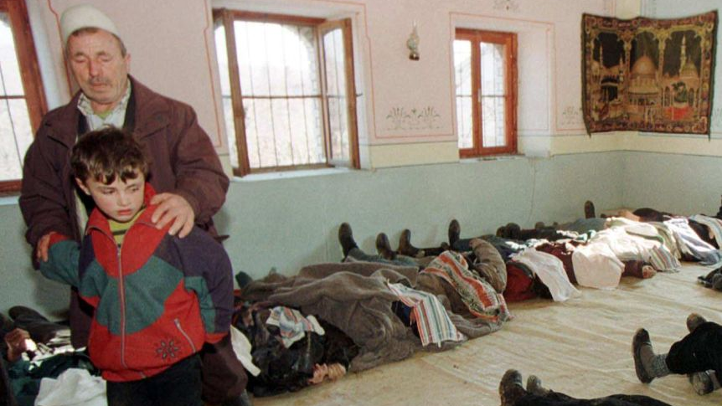
External Security Guarantees and their Impact on Civil War Termination
1
2
3
CLICK TO START
9
3
4
5
6
7
8
10
11
12
13
14
15
16
17
18
19
20
21
22
23
24
25
26
27
28
29
1
30
2
mins
mins
mins
secs
secs
secs
secs
secs
secs
secs
secs
secs
secs
secs
secs
secs
secs
secs
secs
secs
secs
secs
secs
secs
secs
secs
secs
secs
secs
secs
secs
secs
secs
Source: https://www.abc.net.au/news/2019-01-15/kosovo-racak-massacre-yugoslavia-balkans-serbians-bosnians/10715936

