Slide 1
Federica Persico
Cranfield University

Slide 2

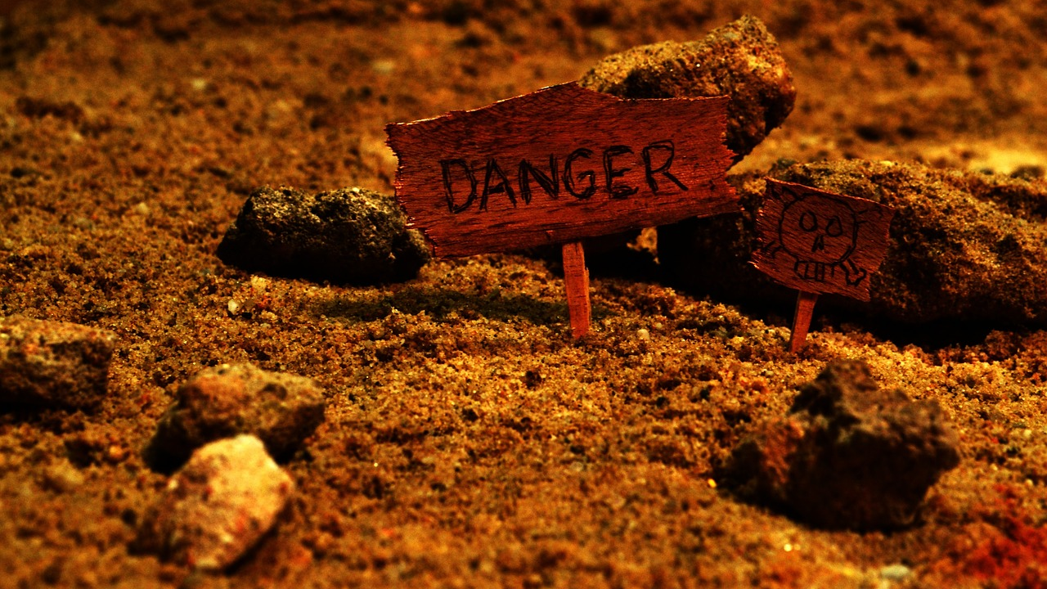

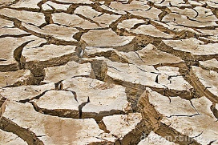

Evaluation of Soil Health in Response to Insensitive High Explosive (IHE) Exposure
1
2
3
CLICK TO START
9
3
4
5
6
7
8
10
11
12
13
14
15
16
17
18
19
20
21
22
23
24
25
26
27
28
29
1
30
2
mins
mins
mins
secs
secs
secs
secs
secs
secs
secs
secs
secs
secs
secs
secs
secs
secs
secs
secs
secs
secs
secs
secs
secs
secs
secs
secs
secs
secs
secs
secs
secs
secs
Soil Health

