Slide 1
Development of a soil analytical framework to facilitate early identification of the deleterious effects of emerging contaminants and chemicals of military concern on soil
Ms Federica Persico
10/11/2022
Supervisors:
Tracey Temple
Frederic Coulon

Slide 2
AIM AND OBJECTIVES
AIM
To develop a soil analytical framework to facilitate early identification of the deleterious effects of emerging contaminants and chemicals of military concern on soil
To critically review how environmental risk posed by chemicals, especially for emerging contaminants and chemicals of military concern is conducted and identify research needs and opportunities
Objective 1
Objective 2
To evaluate the environmental impact of selected defence-related chemicals using an integrated toxicity scale approach based on secondary data
Objective 3
To assess the dispersion of post detonation residues from full order detonations of a 155mm artillery shell filled with an Insensitive High Explosive (IHE) mixture.
Objective 4
To develop an integrated analytical framework for assessing the environmental risk posed by emerging contaminants and chemicals of military concerns in soil
Notes:
Here I will describe the project in overall and I will define the objectives

Slide 3
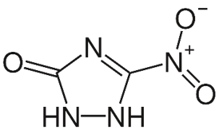
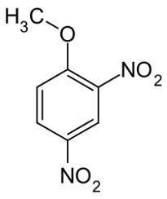
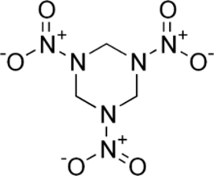
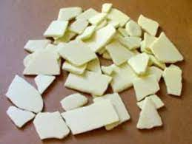
Insensitive High Explosives
Melt-Castable
Stable compounds
Increased safety
Substitute traditional explosives
Missing studies on environmental impacts
Ecotoxicological studies present
Wider usage
NTO​
3-Nitro-1,2,4-triazol-5-one
RDX​
hexahydro-1,3,5-trinitro-1,3,5-triazine
DNAN​
2,4-Dinitroanisole

Slide 4
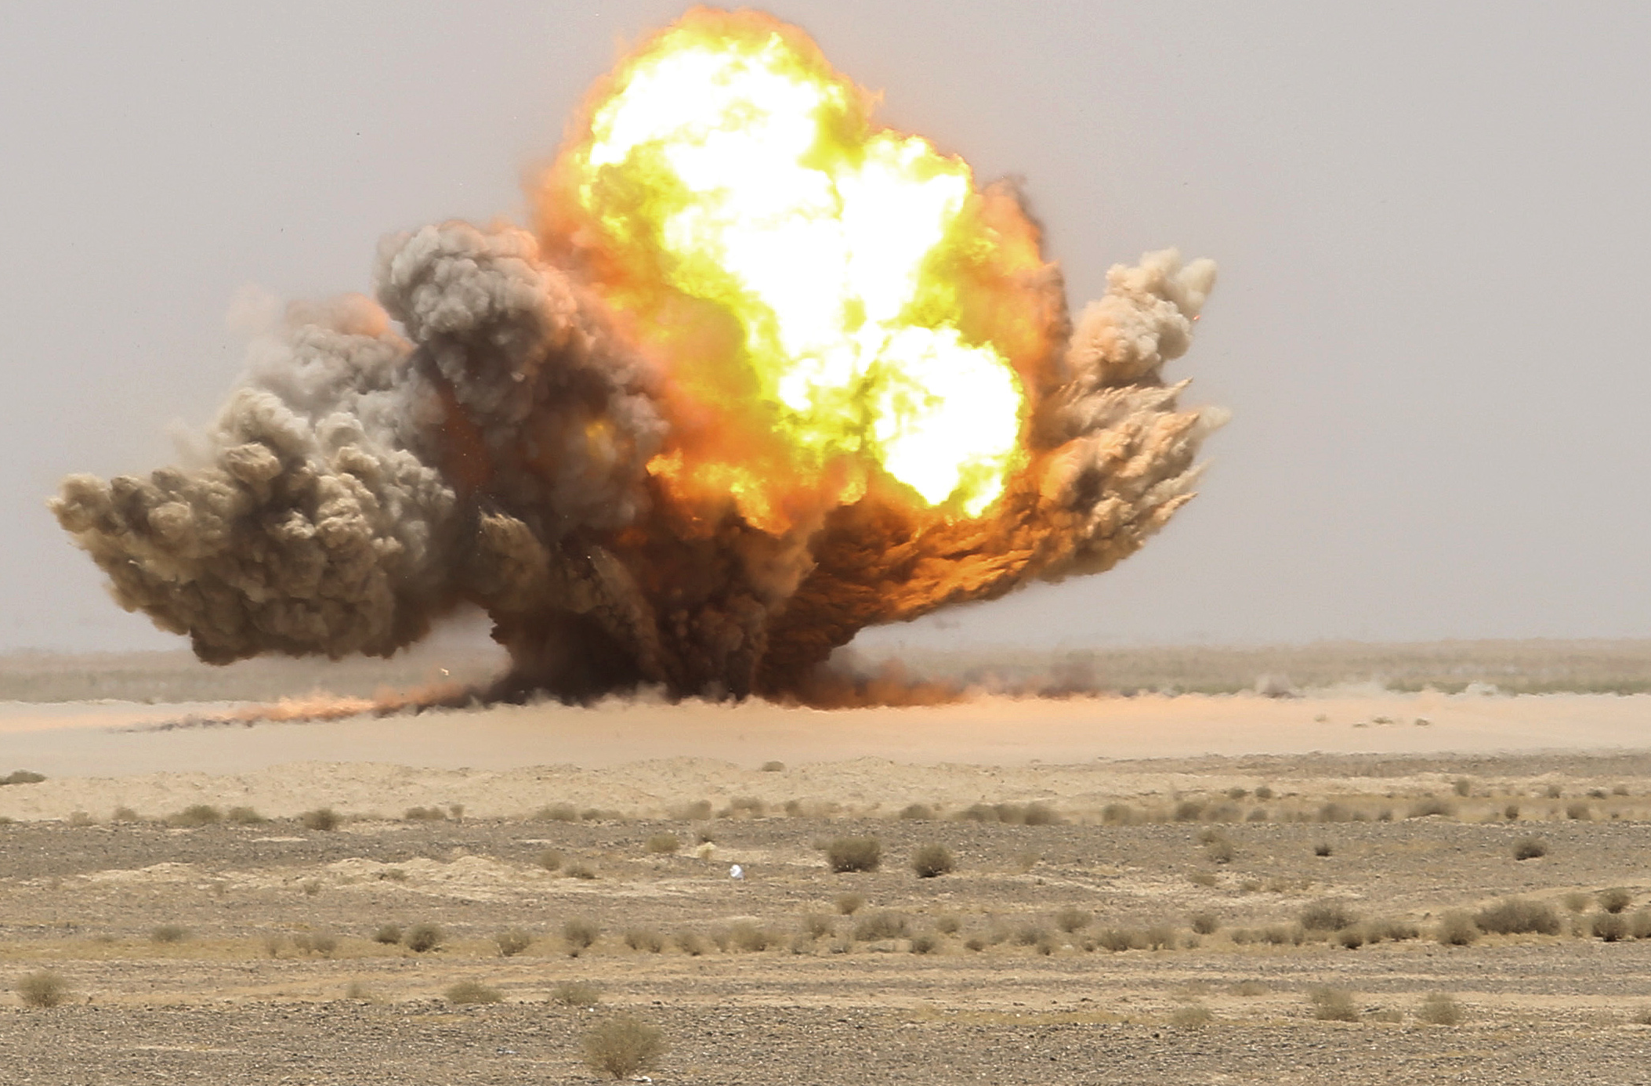
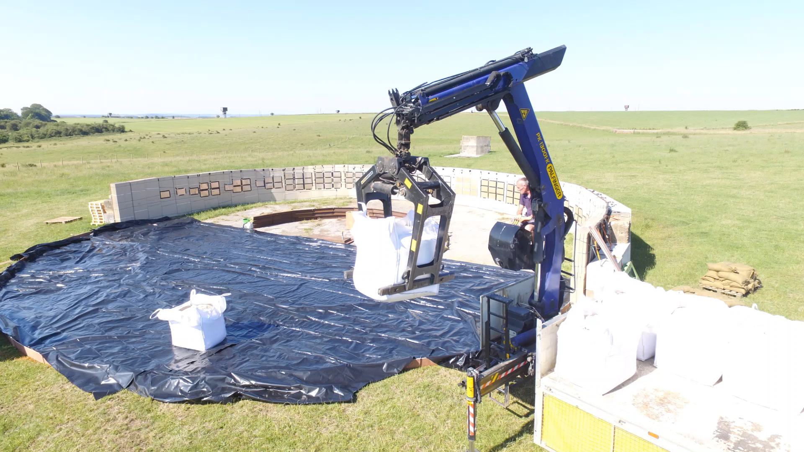
The Arena - development process

Slide 5
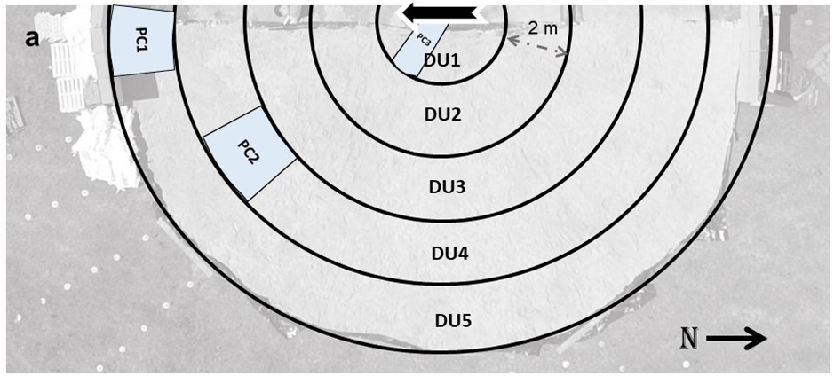
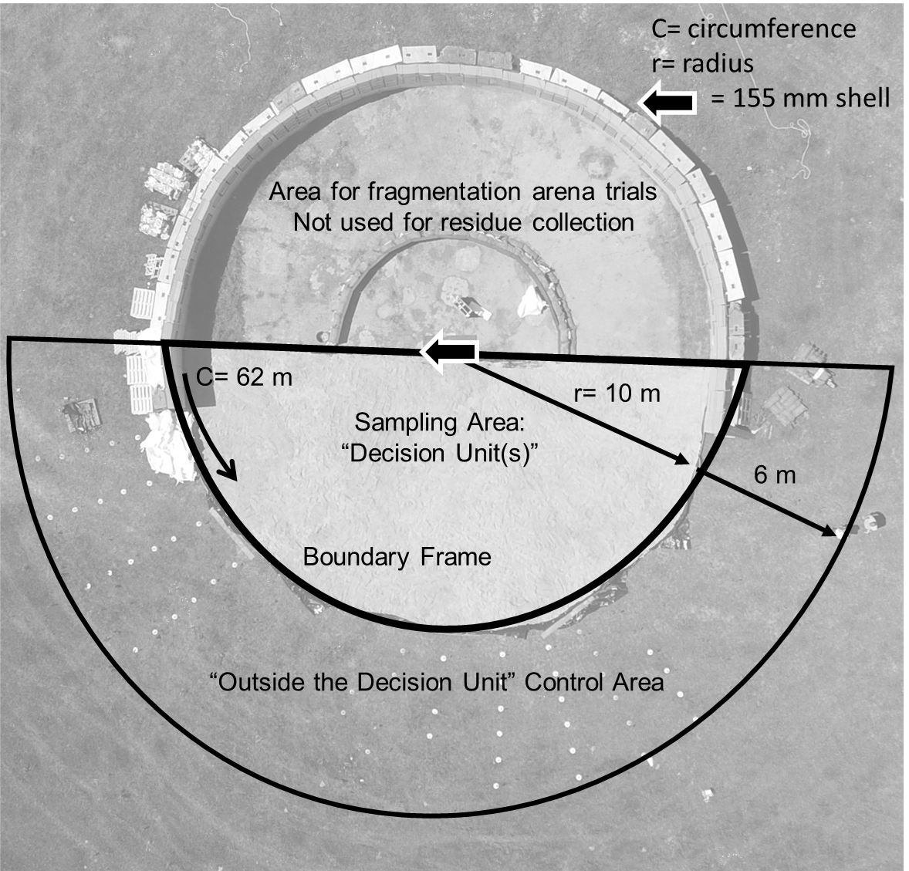
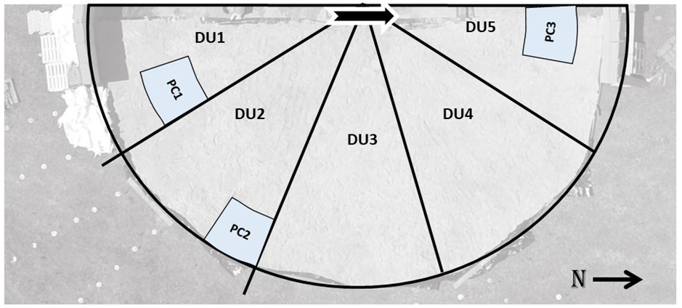
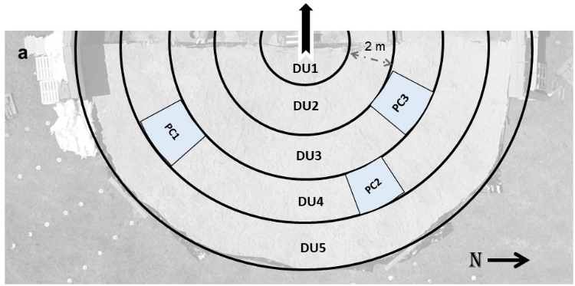
Multi-Increment Sampling
Detonation 1
Detonation of a 155mm
Detonation 2
Detonation 3
ARENA TRIAL
Notes:
In objective 3, the question was. What happens if you don`t have enough secondary data? For example for IHE and specifically IMX-104 there are no ecotoxicological studies that can help to determine a toxicity scale. Therefore we detonated a 155mm filled with 10 kg of IMX-104 which had a double purpose. First of all it was the first time that anyone has done that therefore new data for manufacturing purposes and secondly knowing the residue deposition of the munition could help to quantify possible future contaminations. So, during the last review I spoke about how me collected the samples. I just added the images to then show you the results. So, we collected samples by usnign multi-increment sampling in different shapes, 2 as arc shaped and one as slices shaped. Then we added some positive controls to evaluate the reliability of the results.

Slide 6
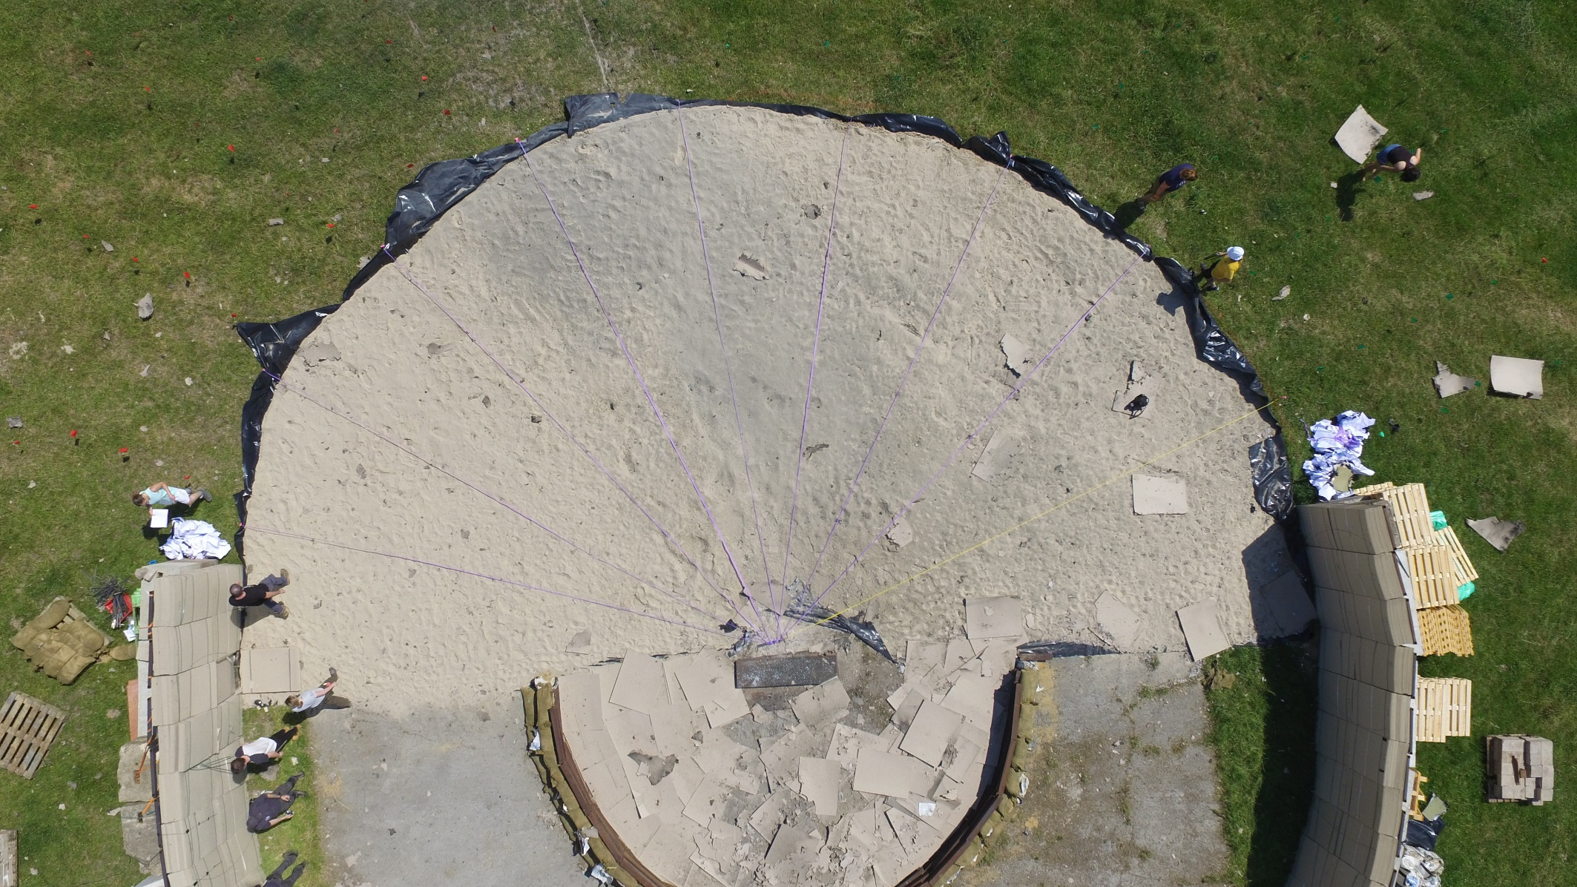
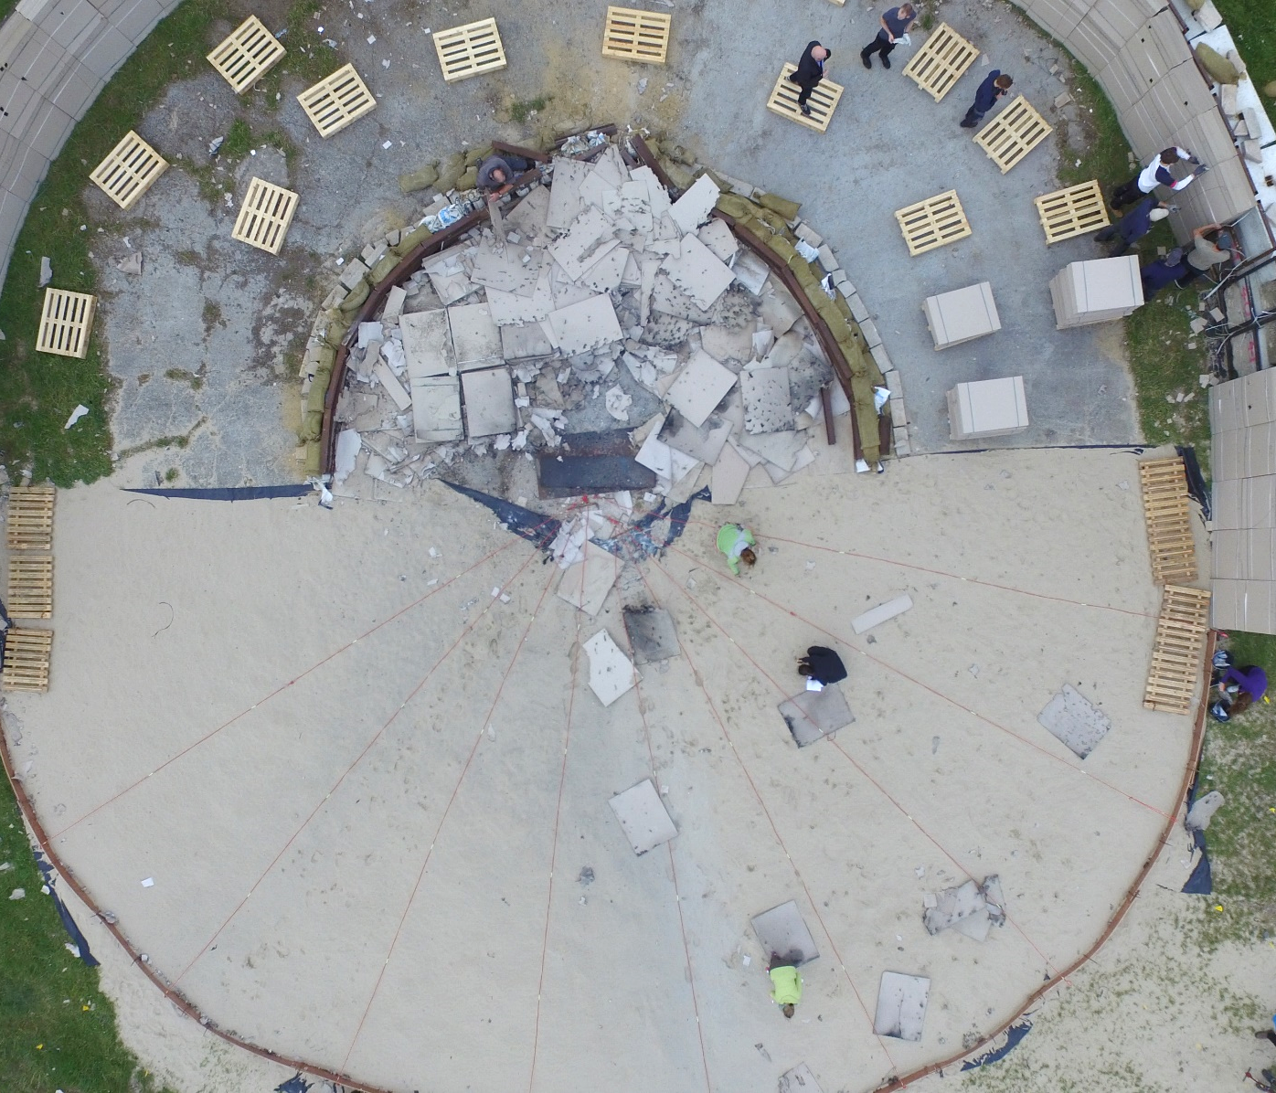
Post-detonation
First Detonation
Second Detonation

Slide 7
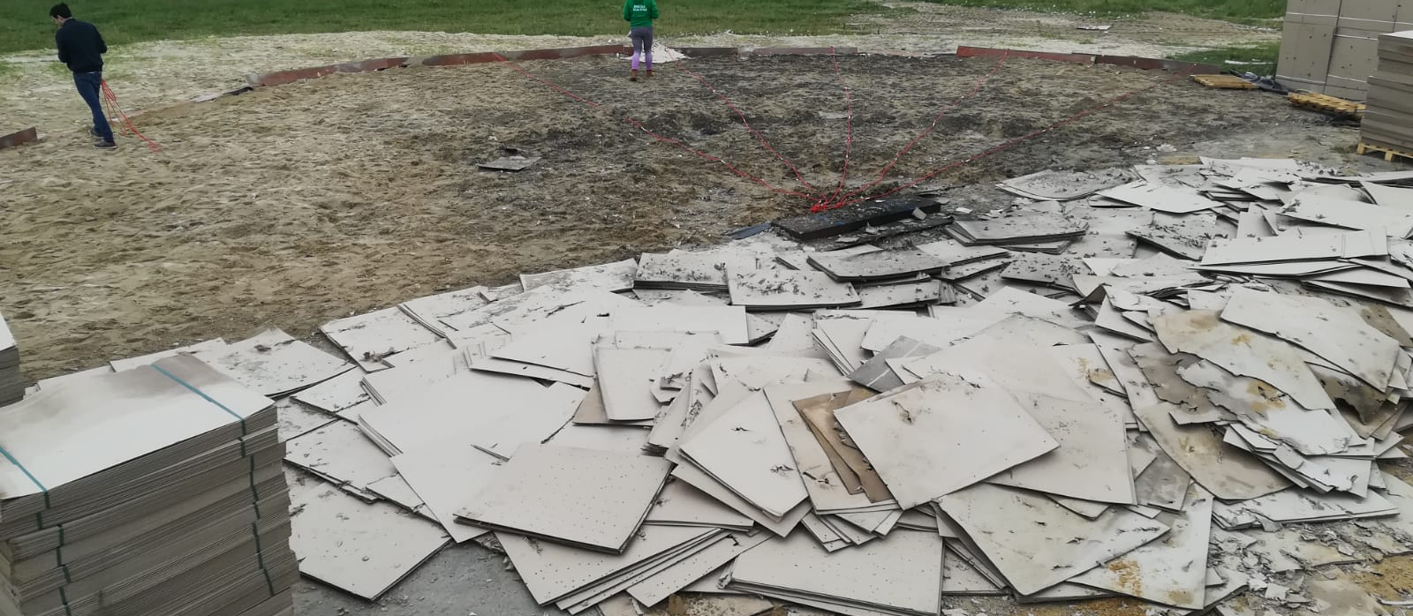
Post-detonation
Third Detonation

Slide 8
Results
Decision Unit | Horizontal orientation- DU Arcs |  |  | Horizontal orientation- DU Radial |  |  | Vertical orientation- DU Arcs
 | NTO mg kg⁻¹ | DNAN mg kg⁻¹ | RDX mg kg⁻¹ | NTO mg kg⁻¹ | DNAN mg kg⁻¹ | RDX mg kg⁻¹ | NTO mg kg⁻¹ | DNAN mg kg⁻¹ | RDX mg kg⁻¹
Blank (sand) | 0 | 0 | 0 | 0 | 0 | 0 | 0 | 0 | 0
Area control | 0 | 0 | Detect | 0 | 0 | Detect | 0 | 0 | Detect
DU1 | Trace | 0.24 ± 0.20 | 0 | Trace | 0 | 0 | Trace | 0 | 0
DU2 | Trace | 0.0009 ± 0.0009 | 0 | Trace | 0.055± 0.055 | 0 | Trace | 0.0008 ±0.003 | 0
DU3 | Trace | 0.11 ± 0.11 | 0 | Trace | 0 | 0 | Trace | 0 | 0
DU4 | Trace | 0 | 0 | Trace | 0 | 0 | 0 | 0 | 0
DU5 | Trace | 0.24 ± 0.24 | 0 | 0.16 ± 0.48 | 0 | 0 | 0 | 0.16 ±0.16 | 0
PC1 | Trace | 0.002 ± 0.001 | 0 | Trace | 0.17 ± 0.17 | 0 | Trace | 0 | 0
PC2 | Trace | 0 | 0 | Trace | 0 | 0 | 0 | 0 | 0
PC3 | Trace | 0.0008 ± 0.0008 | 0 | Trace | 0 | 0 | Trace | 0 | 0
Whole area | 0 | 0 | 0 | 0 | 0 | 0 | 0 | 0 | 0
High standard deviations due to the matrix used. Sand is an heterogeneous matrix.

Slide 9
Results
Decision Unit | Horizontal orientation- DU Arcs |  |  | Horizontal orientation- DU Radial |  |  | Vertical orientation- DU Arcs
 | NTO mg kg⁻¹ | DNAN mg kg⁻¹ | RDX mg kg⁻¹ | NTO mg kg⁻¹ | DNAN mg kg⁻¹ | RDX mg kg⁻¹ | NTO mg kg⁻¹ | DNAN mg kg⁻¹ | RDX mg kg⁻¹
Blank (sand) | 0 | 0 | 0 | 0 | 0 | 0 | 0 | 0 | 0
Area control | 0 | 0 | Detect | 0 | 0 | Detect | 0 | 0 | Detect
DU1 | Trace | 0.24 ± 0.20 | 0 | Trace | 0 | 0 | Trace | 0 | 0
DU2 | Trace | 0.0009 ± 0.0009 | 0 | Trace | 0.055± 0.055 | 0 | Trace | 0.0008 ±0.003 | 0
DU3 | Trace | 0.11 ± 0.11 | 0 | Trace | 0 | 0 | Trace | 0 | 0
DU4 | Trace | 0 | 0 | Trace | 0 | 0 | 0 | 0 | 0
DU5 | Trace | 0.24 ± 0.24 | 0 | 0.16 ± 0.48 | 0 | 0 | 0 | 0.16 ±0.16 | 0
PC1 | Trace | 0.002 ± 0.001 | 0 | Trace | 0.17 ± 0.17 | 0 | Trace | 0 | 0
PC2 | Trace | 0 | 0 | Trace | 0 | 0 | 0 | 0 | 0
PC3 | Trace | 0.0008 ± 0.0008 | 0 | Trace | 0 | 0 | Trace | 0 | 0
Whole area | 0 | 0 | 0 | 0 | 0 | 0 | 0 | 0 | 0
RDX was found underneat the Arena before the setting up

Slide 10
Results
Decision Unit | Horizontal orientation- DU Arcs |  |  | Horizontal orientation- DU Radial |  |  | Vertical orientation- DU Arcs
 | NTO mg kg⁻¹ | DNAN mg kg⁻¹ | RDX mg kg⁻¹ | NTO mg kg⁻¹ | DNAN mg kg⁻¹ | RDX mg kg⁻¹ | NTO mg kg⁻¹ | DNAN mg kg⁻¹ | RDX mg kg⁻¹
Blank (sand) | 0 | 0 | 0 | 0 | 0 | 0 | 0 | 0 | 0
Area control | 0 | 0 | Detect | 0 | 0 | Detect | 0 | 0 | Detect
DU1 | Trace | 0.24 ± 0.20 | 0 | Trace | 0 | 0 | Trace | 0 | 0
DU2 | Trace | 0.0009 ± 0.0009 | 0 | Trace | 0.055± 0.055 | 0 | Trace | 0.0008 ±0.003 | 0
DU3 | Trace | 0.11 ± 0.11 | 0 | Trace | 0 | 0 | Trace | 0 | 0
DU4 | Trace | 0 | 0 | Trace | 0 | 0 | 0 | 0 | 0
DU5 | Trace | 0.24 ± 0.24 | 0 | 0.16 ± 0.48 | 0 | 0 | 0 | 0.16 ±0.16 | 0
PC1 | Trace | 0.002 ± 0.001 | 0 | Trace | 0.17 ± 0.17 | 0 | Trace | 0 | 0
PC2 | Trace | 0 | 0 | Trace | 0 | 0 | 0 | 0 | 0
PC3 | Trace | 0.0008 ± 0.0008 | 0 | Trace | 0 | 0 | Trace | 0 | 0
Whole area | 0 | 0 | 0 | 0 | 0 | 0 | 0 | 0 | 0
NTO non quantifiable but detectable
Possibilities for some more toxic degradation products

Slide 11
Results
Decision Unit | Horizontal orientation- DU Arcs |  |  | Horizontal orientation- DU Radial |  |  | Vertical orientation- DU Arcs
 | NTO mg kg⁻¹ | DNAN mg kg⁻¹ | RDX mg kg⁻¹ | NTO mg kg⁻¹ | DNAN mg kg⁻¹ | RDX mg kg⁻¹ | NTO mg kg⁻¹ | DNAN mg kg⁻¹ | RDX mg kg⁻¹
Blank (sand) | 0 | 0 | 0 | 0 | 0 | 0 | 0 | 0 | 0
Area control | 0 | 0 | Detect | 0 | 0 | Detect | 0 | 0 | Detect
DU1 | Trace | 0.24 ± 0.20 | 0 | Trace | 0 | 0 | Trace | 0 | 0
DU2 | Trace | 0.0009 ± 0.0009 | 0 | Trace | 0.055± 0.055 | 0 | Trace | 0.0008 ±0.003 | 0
DU3 | Trace | 0.11 ± 0.11 | 0 | Trace | 0 | 0 | Trace | 0 | 0
DU4 | Trace | 0 | 0 | Trace | 0 | 0 | 0 | 0 | 0
DU5 | Trace | 0.24 ± 0.24 | 0 | 0.16 ± 0.48 | 0 | 0 | 0 | 0.16 ±0.16 | 0
PC1 | Trace | 0.002 ± 0.001 | 0 | Trace | 0.17 ± 0.17 | 0 | Trace | 0 | 0
PC2 | Trace | 0 | 0 | Trace | 0 | 0 | 0 | 0 | 0
PC3 | Trace | 0.0008 ± 0.0008 | 0 | Trace | 0 | 0 | Trace | 0 | 0
Whole area | 0 | 0 | 0 | 0 | 0 | 0 | 0 | 0 | 0
DNAN more stable after the detonation
DNAN has the highest found concentration compared to NTO and RDX even though it`s just 32% of the composition

Slide 12
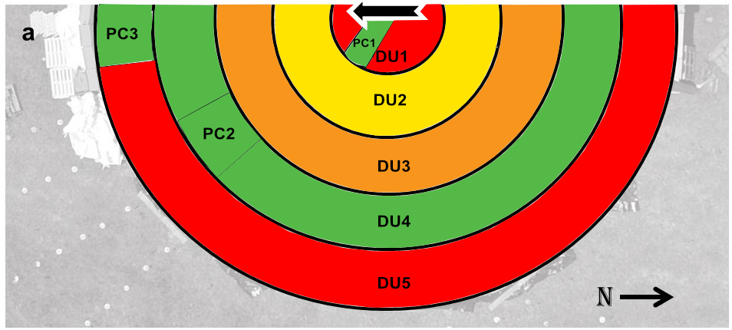
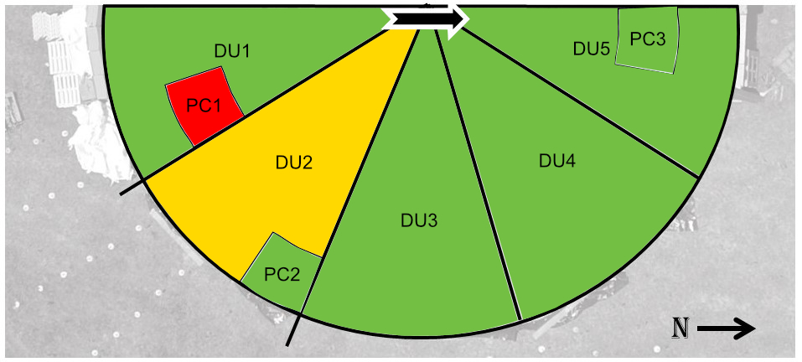
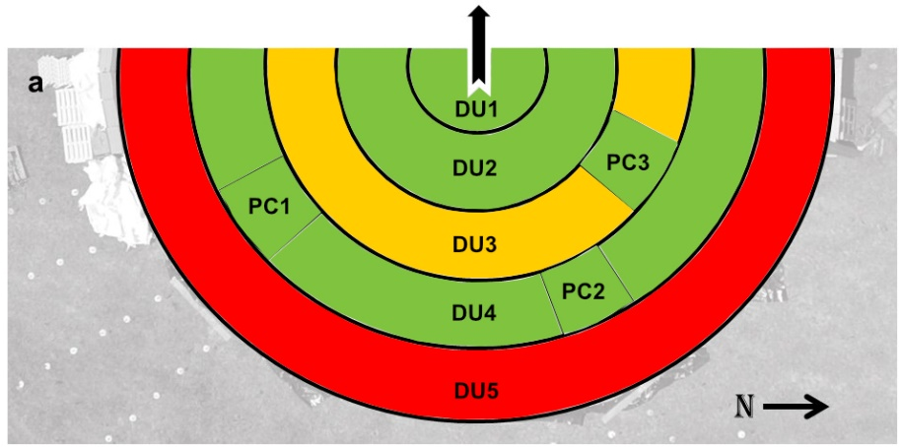
Results - DNAN collected
Detonation 1
Detonation 2
Findings:
The Arena set up avoided cross-contamination
DNAN and NTO were deposited.
RDX too low in concentration to be detected.
DNAN was quantifiable in part of the samples although in many of them DNAN was detected but not quantifiable.
Potential concentration after 1000 rounds can constitute a problem to the environment.
Limitations:
Small scale experiment
Site specific.
Detonation 3

Slide 13
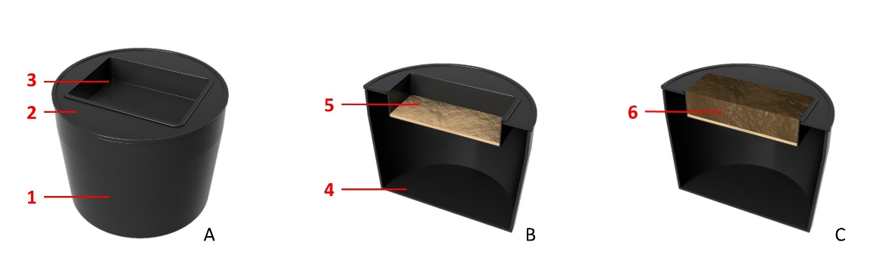
Soil Health assessment for IHE
Methodology
Mesocosm set up. The empty set up: A) the bucket (1) with sealed lid (2) and the plastic heavy duty seeds tray (3); B) The mesocosms were filled 0.5 cm of damp inert sand (4) on the empty bucket (4) where water leachate was collected; C) And contaminated soil (6) was added on the dump inert sand.
12% OM
7.9% OM

Slide 14
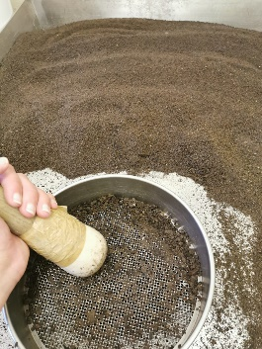
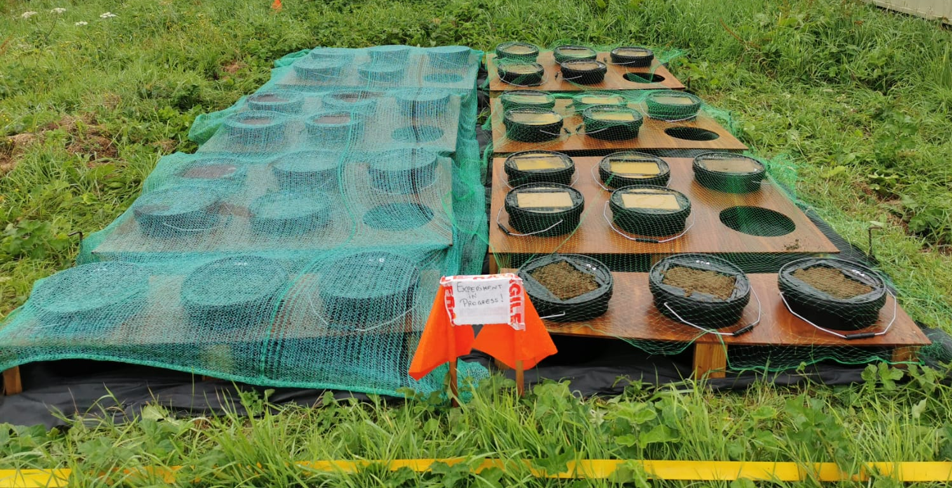
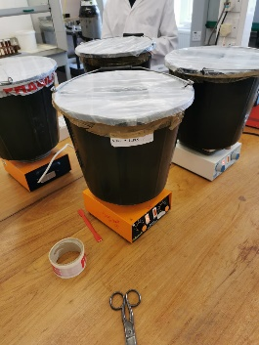
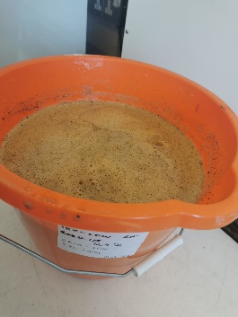
Soil Evaluation - Methodology
HIGH
MEDIUM
LOW
CONTROL
PRISTINE
SOIL
DEGRADED SOIL
Risk - level | Control | Low | Medium | High
Concentration (ppm) | 0 | 0.215 | 215.5 | 581
Weight (mg) | 0 | 125 | 1250 | 3375

Slide 15
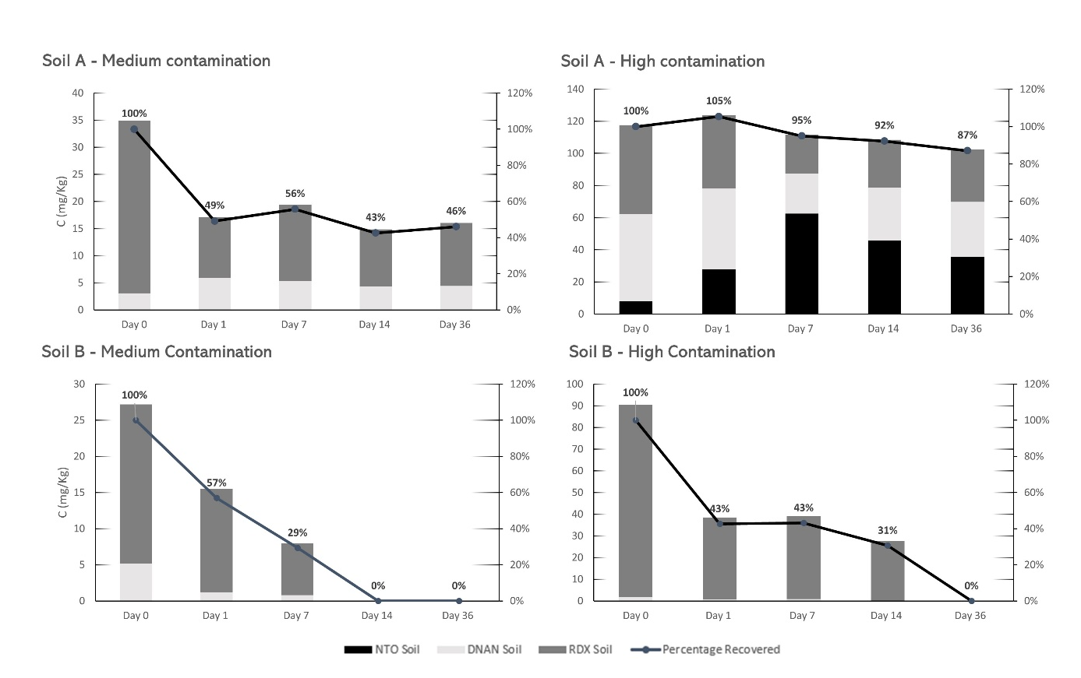
Explosive Recovery

Slide 16
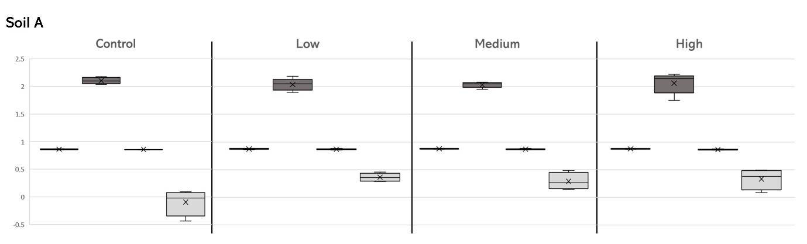
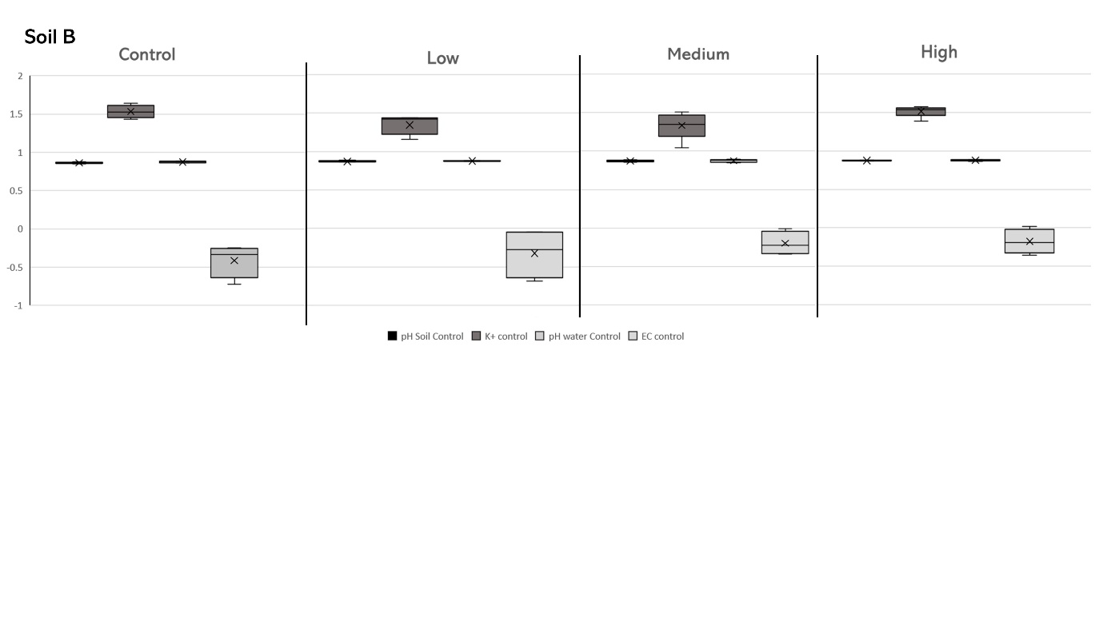
Chemical Changes

Slide 17
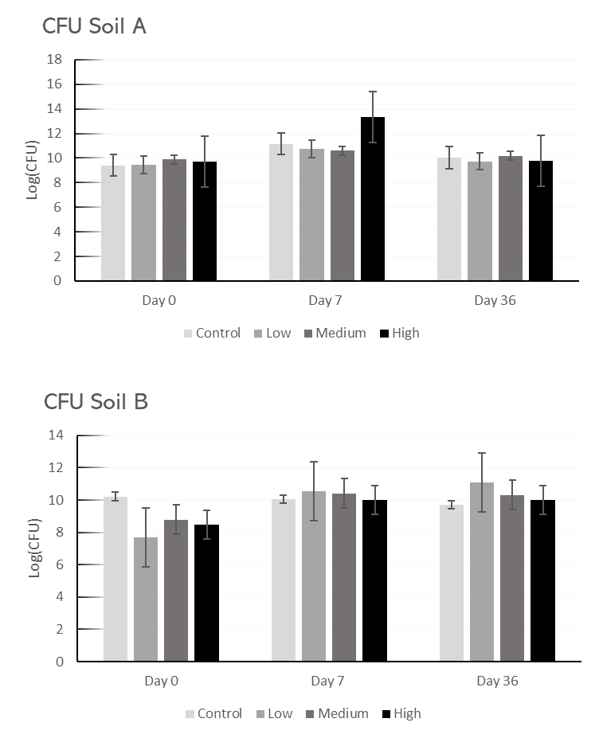
Biological Changes

Slide 18
Environmental Quality Index
EQI
SQI
Soil Indicators based on land management
Soil assessment indicators
Principal Component Analyses
Scoring of the values
Scoring of the values
Environmental Quality Index calculation
Soil Quality Index calculation

Slide 19
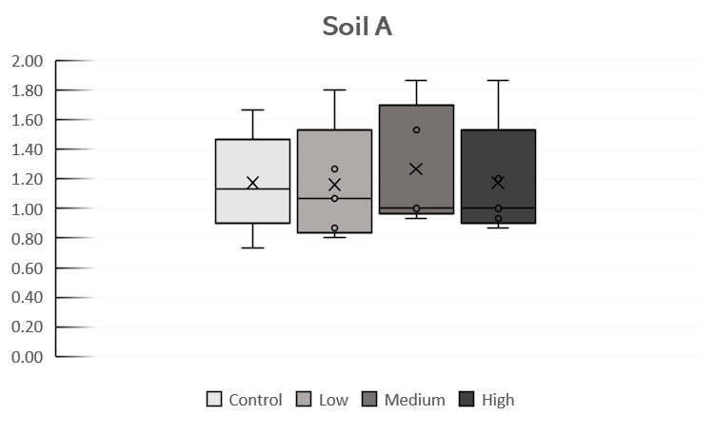
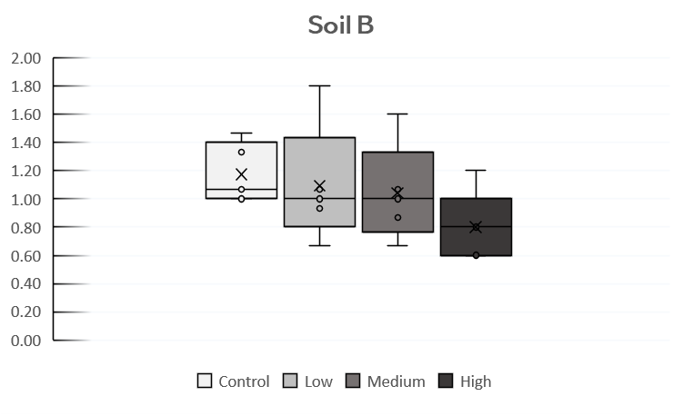
Environmental Quality Index

Slide 20
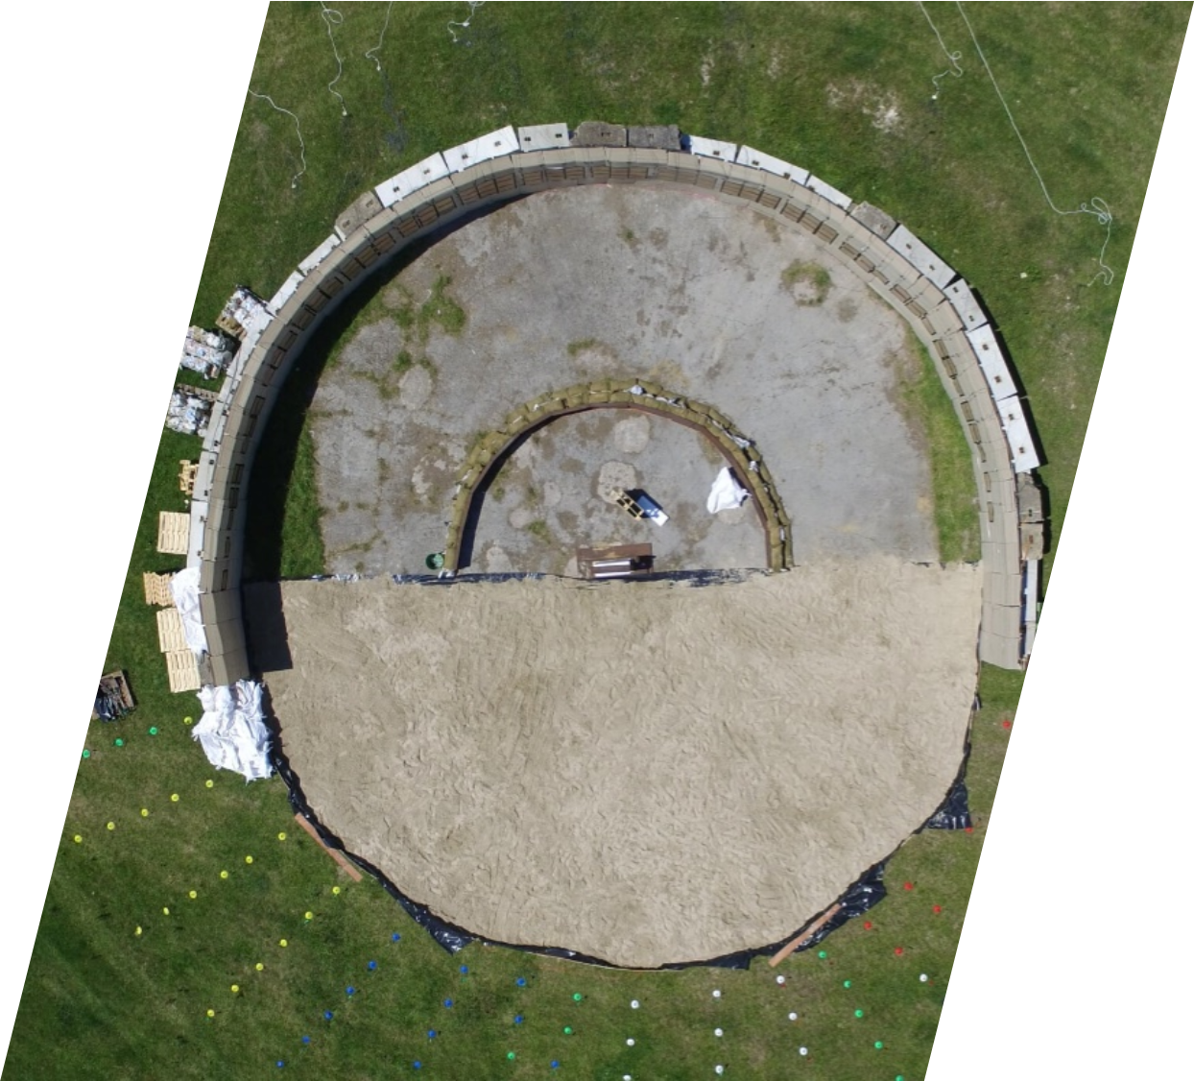
Conclusions
IHE deposition is higher compared to traditional explosives
The explosive behaviour is influenced by weather conditions and soil characteristics
For a 155 mm, 100 detonations is a safe threshold for non-degraded soils.

Slide 21
Limitations and Future work
Analyses mostly qualitative than quantitative
Tests are expected with higher concentration – Limited although by the ability of the explosive to dissolve in water
Analyses of degradation products
More analyses with EQI integrated

Slide 22



Questions?
Thank you!
federica.persico@cranfield.ac.uk
@fede_persico
https://www.linkedin.com/in/federica-persico/

