Slide 1
Manlio Valerio Morganti
Transport

Slide 2
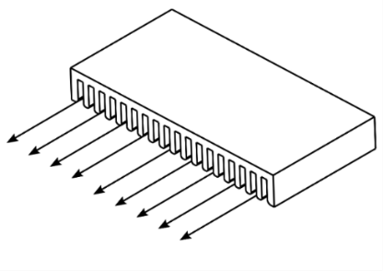
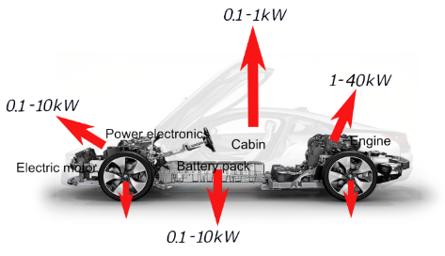

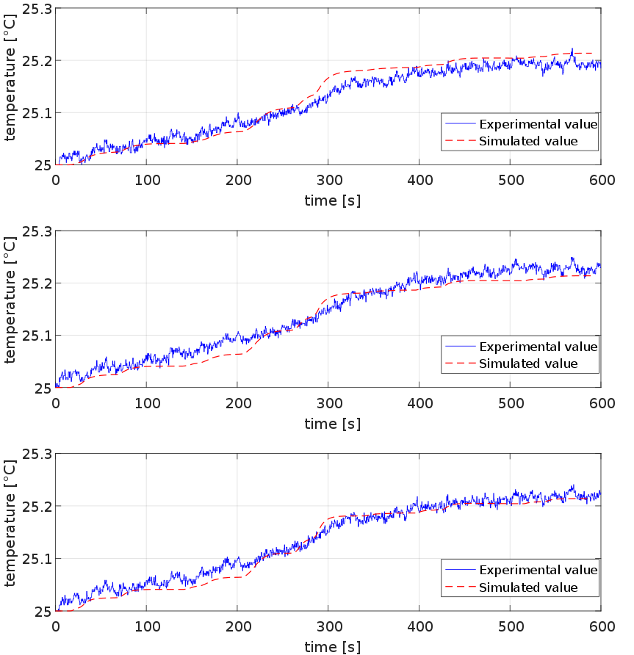
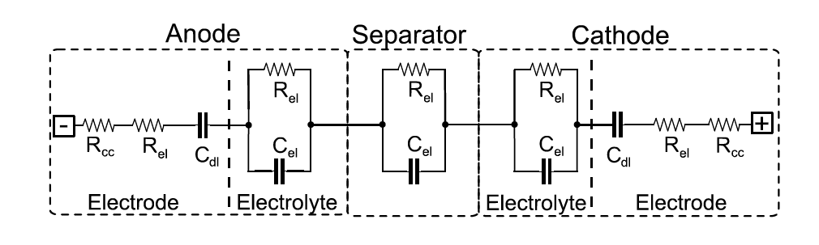
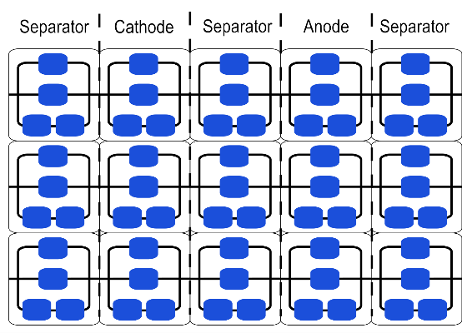
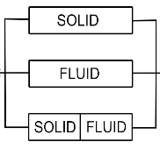
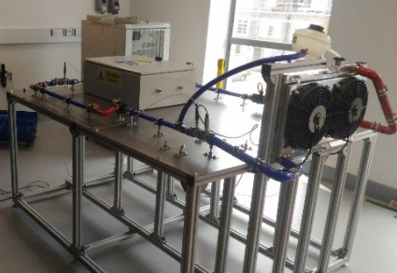
BATTERY THERMAL MANAGEMENT SYSTEMS DESIGN, MODELLING AND OPTIMISATION
CONCEPT:
Implementing a novel cell thermal model and scaling it up to a module model
Equivalent circuit
Chemistry parameters
Scale up to a module model
Heat exchanger model
RESEARCH GAP:
Specific cell thermal models
Systematic methodology for BTMS design optimisation
Internal heat transfer
Boundaries
Test-rig validation
MODEL:
“Bricks” can build different cell geometries, EC models can be swapped
VALIDATION:
Single cell
Module
TEST RIG:
Possible to simulate different layouts
THIS AREA OF YOUR SLIDE WILL BE COVERED BY A TIMER
WLTC-3rd Class, Low-Phase @ 25°C

