Slide 1
Framework

Slide 3
HEx data

Slide 4
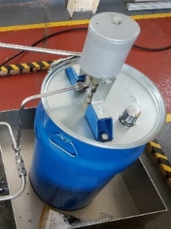
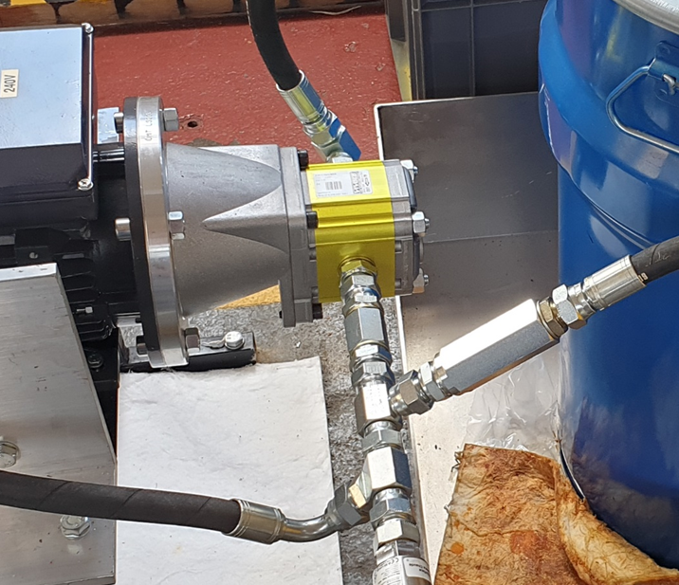
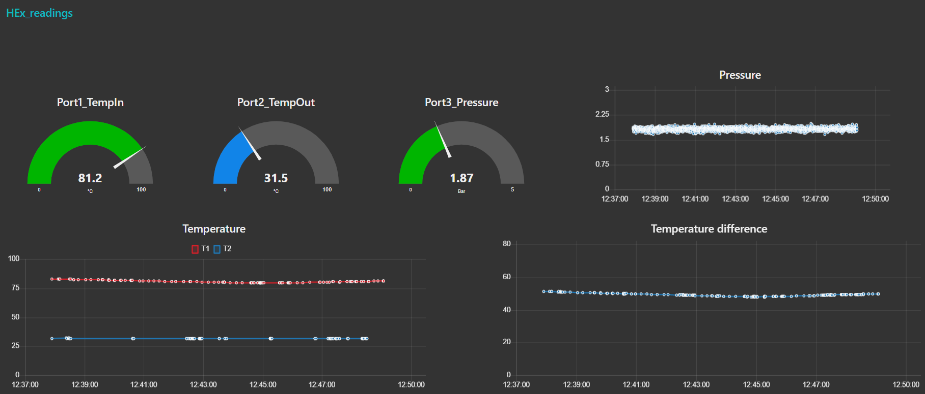
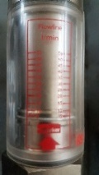
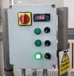
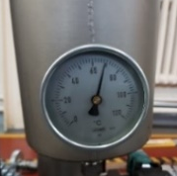
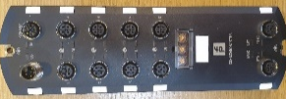

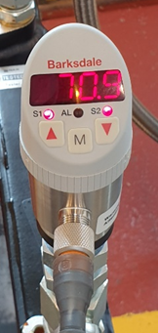
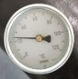
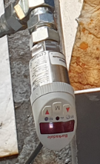

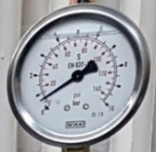
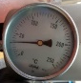
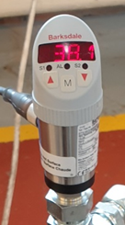
PC
Data controller
Flow
T₀
Oil tank
Pump
Pressure relief valve
Heater
Filter
P₁
T₄
T₁
Return line
Air blower
Heat exchanger
T₂
P₂
Filter
T₃
Cooler
(Water tank, if required)

Slide 5
Second run (used in paper)
Maximum
75th quartile
Median
25th quartile
Minimum
Outliers

Slide 6
T₁
T₂
P₁

Slide 8
Automatic selection for S_{i} (86)

Slide 9
CV = 14.13
CV = 3.5
CV = 1.15
CV = 0.55
CV = 0.23

Slide 10
Log, T in
SD = 0.10 CV = 14.13
SD = 0.50 CV = 0.78
SD = 1.50 CV = 0.42
SD = 1.00 CV = 0.00

Slide 11
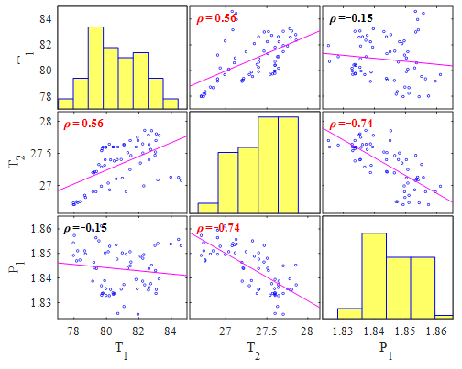
IO-Link data

Slide 12
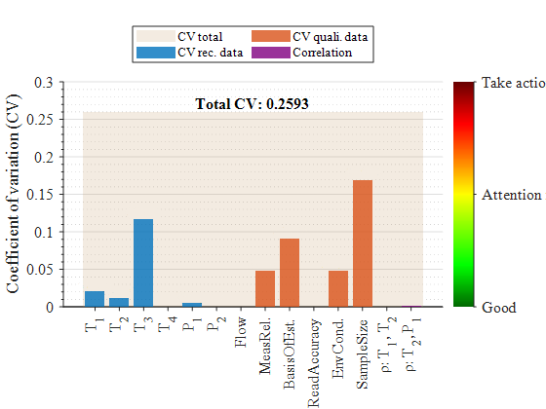
Take action
Take action
0.1694
Attention required
Attention required
0.1171
0.0914
0.0477
0.0477
0.0207
0.0123
0.0048
0.0000
0.0000
0.0000
0.0000
0.0001
0.0011

Slide 13
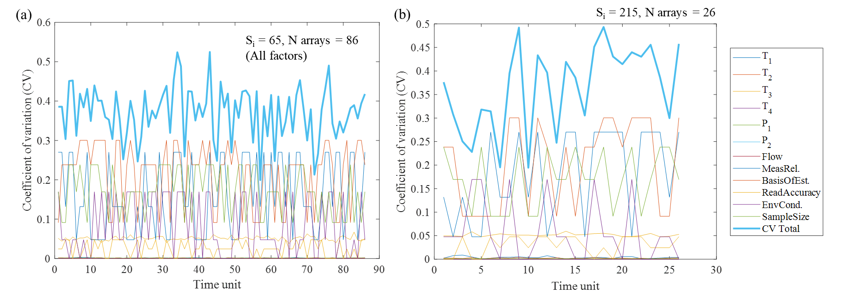

Slide 14
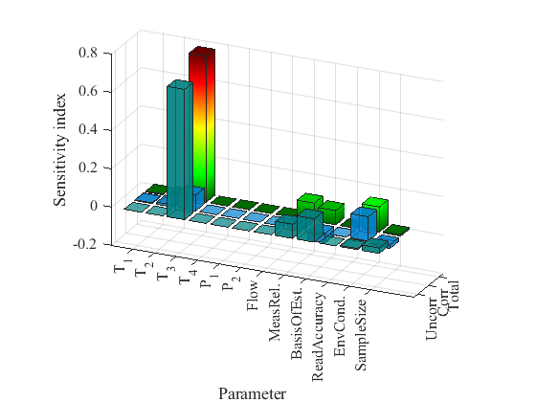
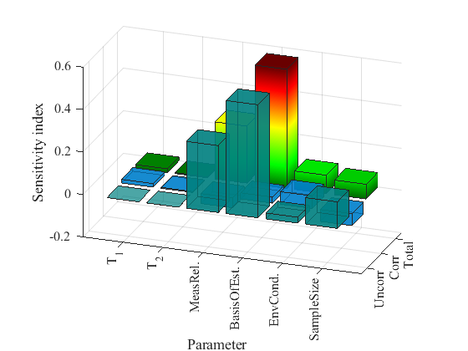
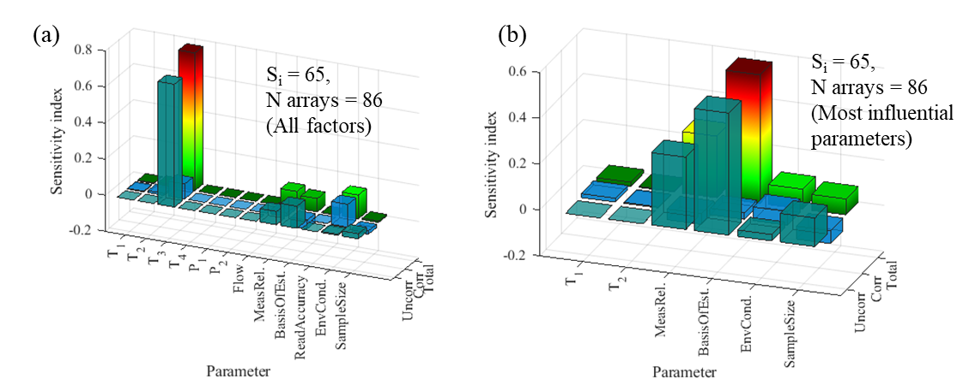
Size65, num86
IN PAPER
(a)
(b)
S_{i} = 65,
N arrays = 86
(All factors)
S_{i} = 65,
N arrays = 86
(Most influential parameters)

Slide 15
NASA CMAPSS data

Slide 16
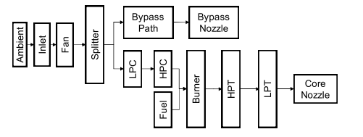
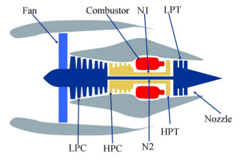
Bypass valve
Bypass nozzle
Ambient
Inlet
Fan
Splitter
LPC
HPC
Burner
HPT
LPT
Core nozzle
Fuel

Slide 18
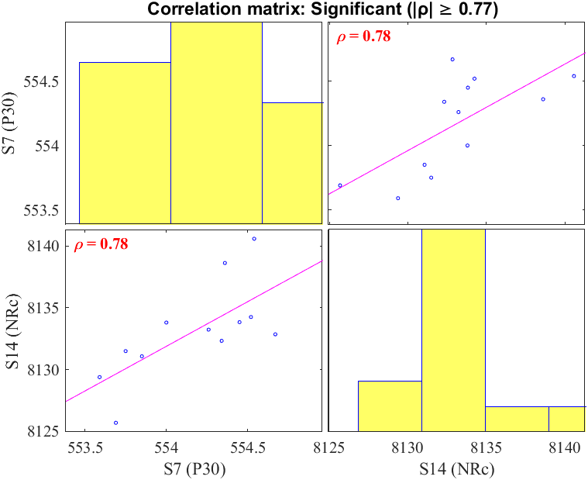
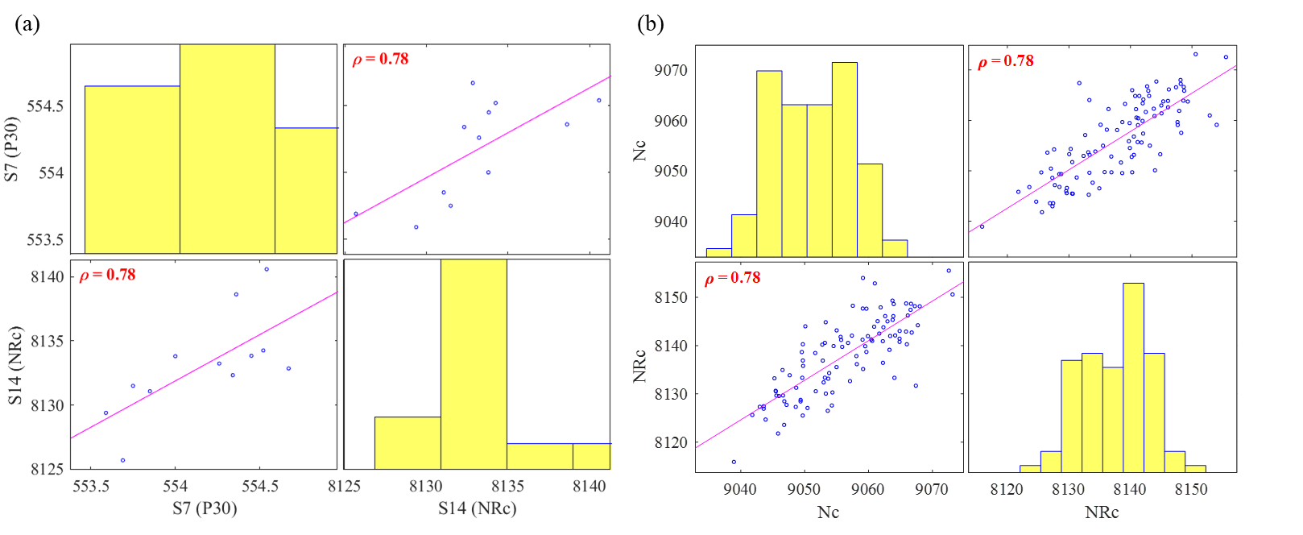
(a)
(b)

Slide 19
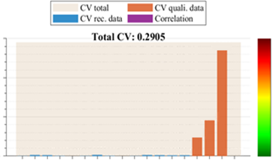
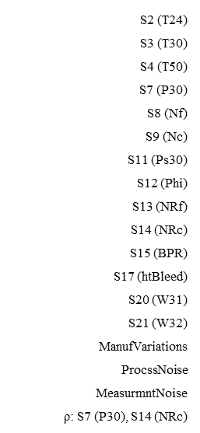
CV total
CV quali. data
CV rec. data
Correlation
0.3
Total CV: 0.2905
0.2701
0.2
Coefficient of variation (CV)
Acceptability to application
0.1
0.0914
0.0477
0.0004
0.0026
0.0021
0.0007
0.0000
0.0005
0.0029
0.0008
0.0005
0.0027
0.0022
0.0018
0.0000
0.0021
0.0000
0

Slide 20
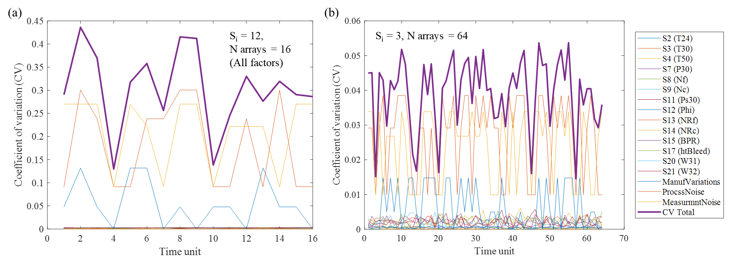

Slide 21
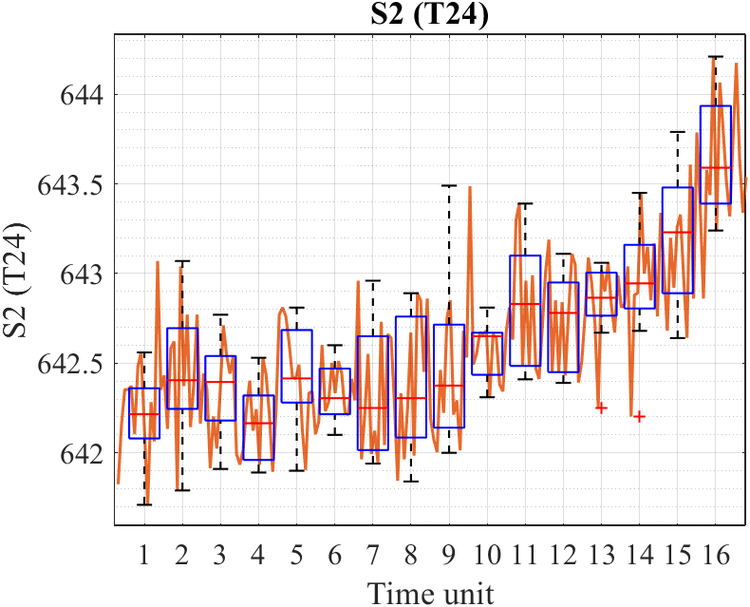
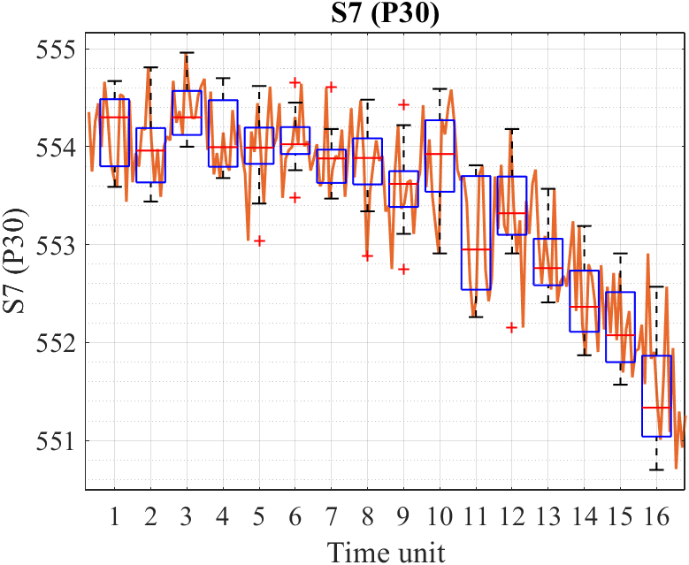
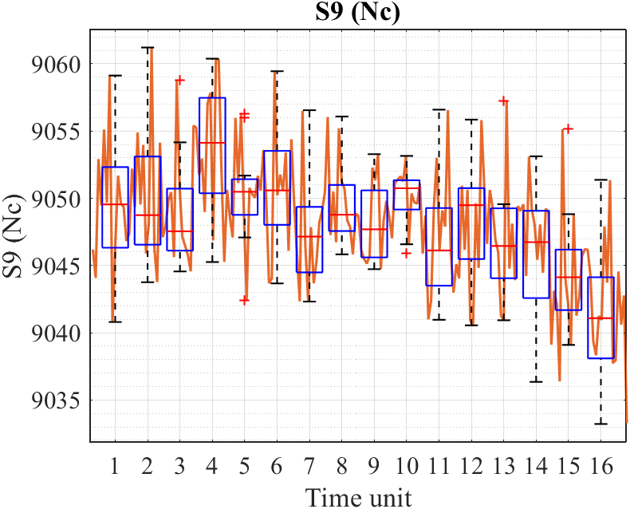
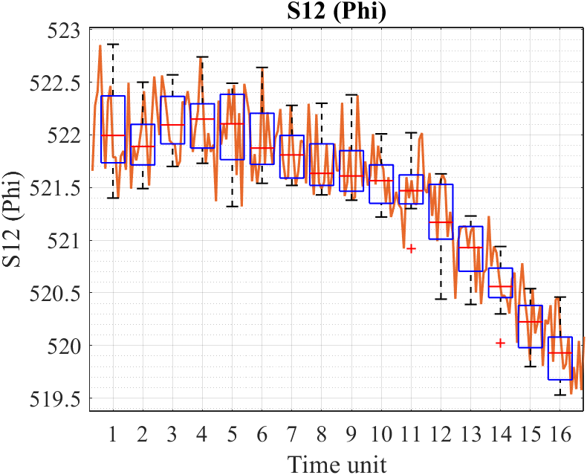
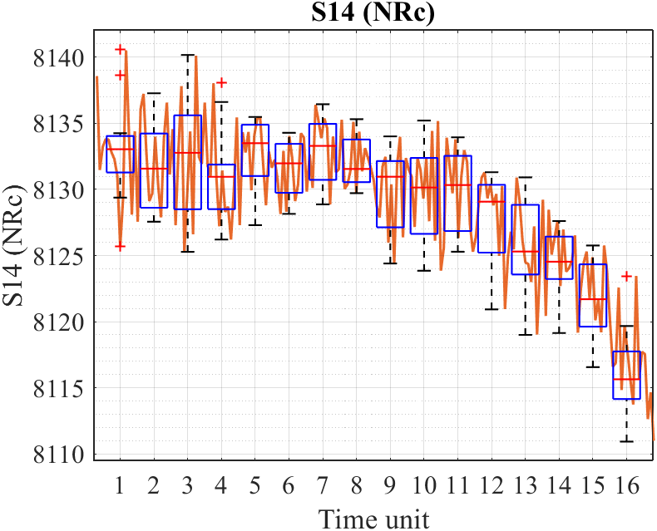
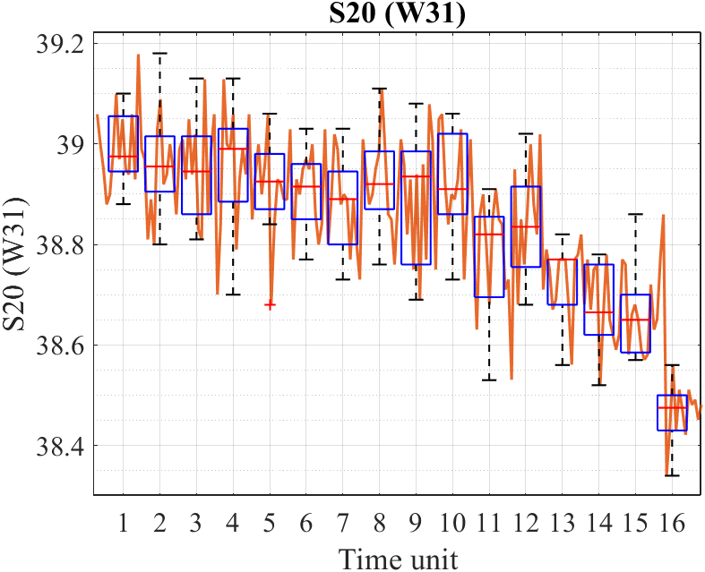

Slide 22
Automatic selection for S_{i} (16)

Slide 23
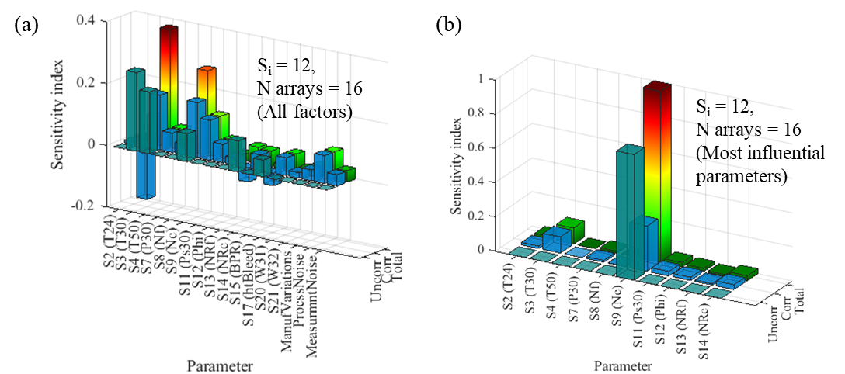
IN PAPER

