Slide 1

Efficient Space-Time Finite Elements for Thermo-Mechanical Problems
Kieran Quaine^{1,2}
Heiko Gimperlein², Andrew Lacey², John Curtis^{3,4}
November 10, 2020
¹School of Mathematics, University of Edinburgh ²Department of Mathematics, Heriot-Watt University ³Atomic Weapons Establishment plc ⁴Department of Mathematics, University College London
 |  | 1 / 18

Slide 2
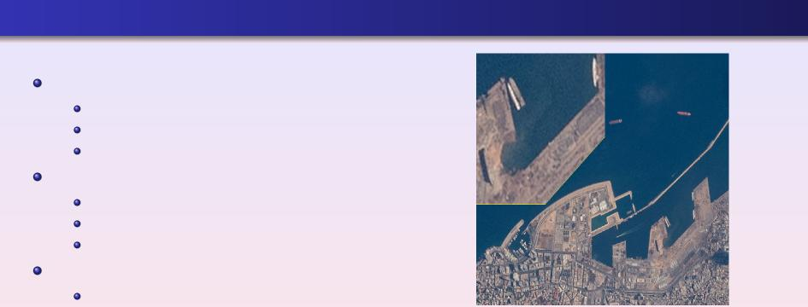
Motivation and History
The Halifax Explosion 1917
Collision
9,000 Tonnes of High Explosive (HE)
2,000 Killed
Evangelos Florakis Naval Base 2011
Fire
98 Containers of Gunpowder
13 Killed
Beirut Explosion August 2020
Poor Storage and Fire
2750 Tonnes of Ammonium Nitrate 203 Dead and 6500 Injured
300,000 Displaced
Figure: Damage after the Beirut Explosion August 4th 2020 - Photo from NASA. Note the crater is 43 meters deep and
124 meters wide.
2 / 18

Slide 3

How an Explosion H
appens
Rate of Gain of Heat = Rate of Gain from Mechanical Dissipation
+ Rate of Heat Gain from Reaction
+ Rate of Heat Gain from Conduction
39
pC_{v} = crij ˙ij + p r ˙ + icΔ9 (1) 3t
θ - Heat t - Time
r˙ - Reaction Rate κ - Diffusivity
ρ - Density
C_{v} - Specific Heat Capacity
˙ij - Strain Rate σij - Stress
3 / 18

Slide 4
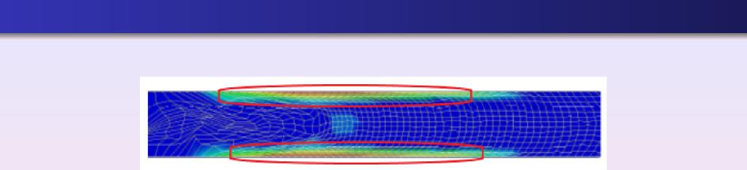
Industrial Computational Modelling: HERMES
Figure: Heat generated by shear bands (HERMES) when simulating pinch of the high explosive HMX
The Lawrence Livermore National Laboratory and AWE have co-developed the High Explosive Response to MEchanical Stimulus (HERMES) model.
HERMES enables the modelling of the onset and progression of an explosive reaction caused by low-speed insults etc.
HERMES struggles with steep shear or temperature change leading to low accuracy or
premature termination of the simulations.
4 / 18

Slide 5
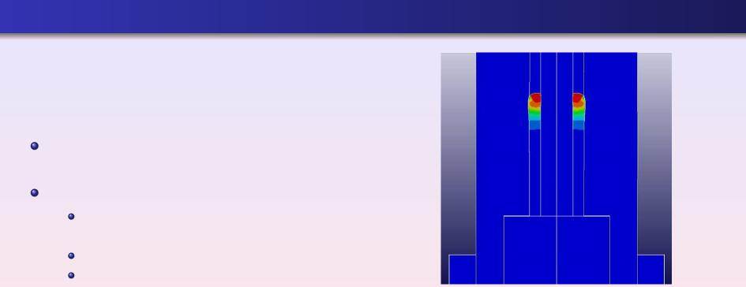
Aims of Our Research
Understand the response of high explosives (HE) to mechanical and thermal stimuli
Rigorous numerical modelling:
Assessing and reducing risk in extreme
situations
Experimental costs
Capturing initial reaction and dynamics
Figure: Temperature gradients associated with a spigot being pinched, causing mesh distortion⁵
⁵John Curtis: Modelling High Explosive Violent Reaction
 |  | 5 / 18

Slide 6
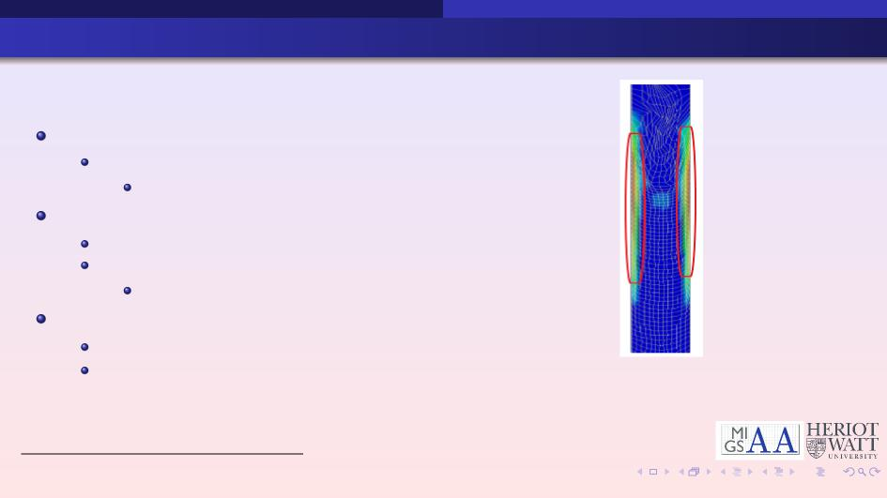
Contents of This Talk
Standard Finite Elements
Unsuitable for Extreme Physics Mesh Distortion
Adaptive Finite Elements
A Posteriori Error Estimates How Does it Work?
Autonomous Algorithms
Enriched Finite Elements (EFEM)
Why use EFEM? How do they work?
Figure: Regions of high ignition parameters correlating to the creation shear bands⁶
⁶John Curtis: Modelling High Explosive Violent Reaction
6 / 18

Slide 7
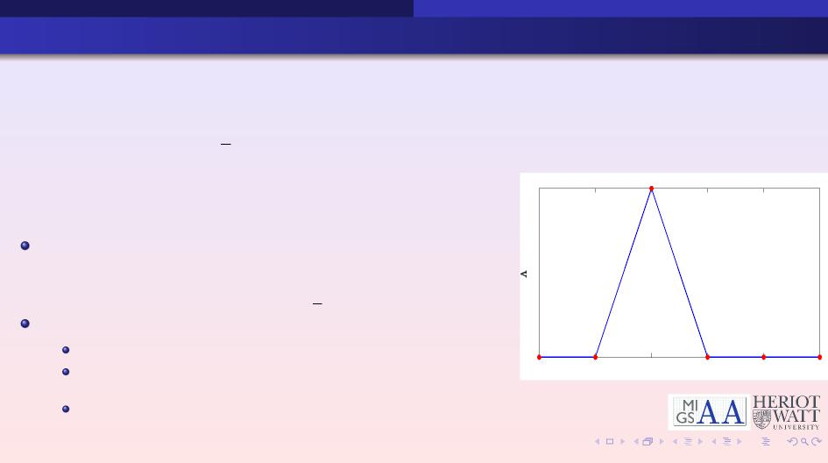
Time-depende
nt Problem
Consider heat singularities and mechanical problems
⎧
⎨⎪
⎪⎩
ut − V • (AVu) + a • Vu = δf (u) on Ω x [0, T)
u(x, 0) = u0
u(x, t) = 0 on ΓD
1
Weak Formulation - multiply by a test function, v E H1ΓD(Ω), and integrate:
j
_{φ}
c2
utvdx + A φc2 Vu • Vudx + a φc2 Vuvdx = δ φc2 fvdx
Discretisation of the domain
Triangulate Ω
Piecewise linear functions on the triangulation, Hh
(
1, i = j
Continuous basis function in Hh given by Λi =
0, i =6 j
0
^{x}i-2 ^{x}i-1 x_{i} ^{x}i+1 ^{x}i+2 ^{x}i+3
7 / 18

Slide 8
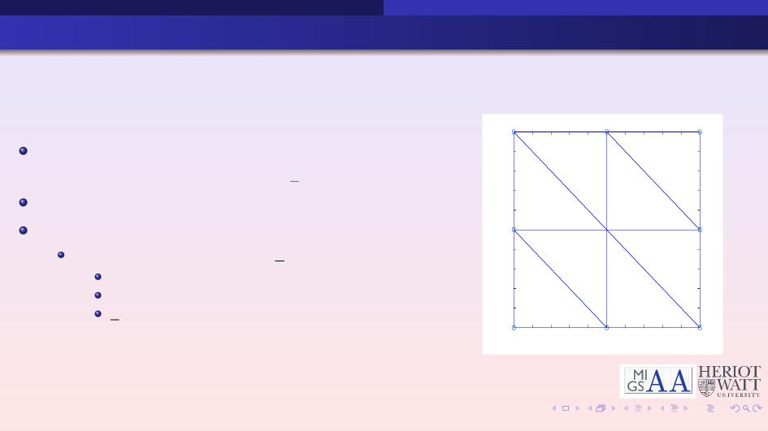
Using Finite Elements
1
Weak formulation:
φΩ utvdx + A φΩ ∇u • ∇udx + a φΩ ∇uvdx = δ φΩ fvdx
Choose v = Λi,j and uh = >i,j uhi,jΛi,j
Leads to a linear system:
(ΔtA + I + ΔtC)un+1 = I • f (u_{n}) + I • u_{n}
A - Stiffness Matrix
I - Mass Matrix
f - Load Vectors
0.9
0.8
0.7
0.6
0.5
0.4
0.3
0.2
0.1
0
0 0.1 0.2 0.3 0.4 0.5 0.6 0.7 0.8 0.9 1
8 / 18

Slide 9
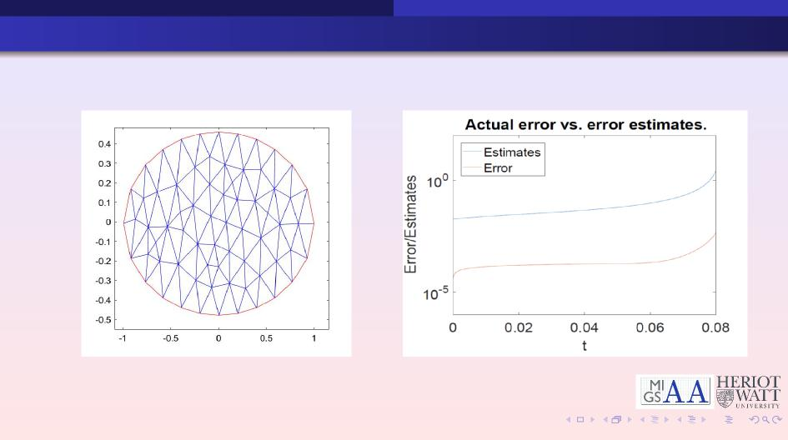
Finite Element Approximation and Blow-Up
9 / 18

Slide 10
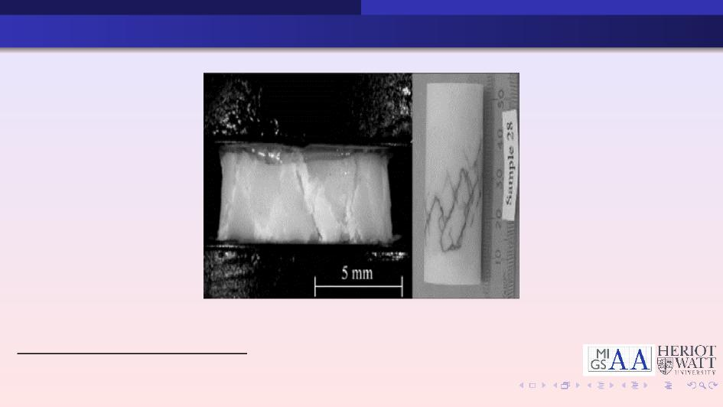
Why Use Adaptive Finite Elements
Figure: Photograph of shear bands in EDC37⁶
⁶John Curtis: Modelling of the Effects of Friction and Compression on Explosives
10 / 18

Slide 11
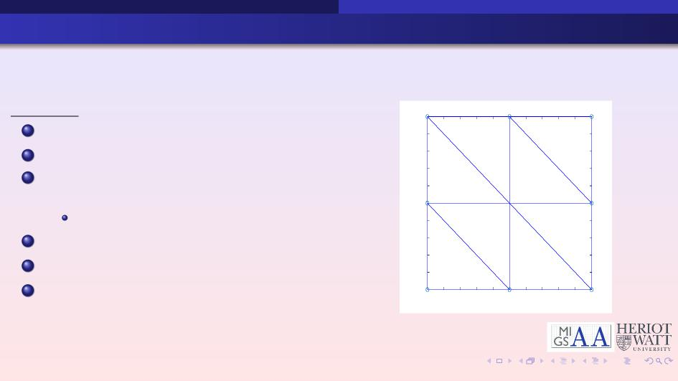
Adaptive Finite Elements
Algorithm
1
1 Create a coarse space-time mesh
2 Solve the linear system
3 Compute space-time error indicators (η)
for each triangle
If accuracy is attained - stop
4 Mark the triangles based on η
5 Refine marked triangles
6 Repeat from (2)
0.9
0.8
0.7
0.6
0.5
0.4
0.3
0.2
0.1
0
0 0.1 0.2 0.3 0.4 0.5 0.6 0.7 0.8 0.9 1
11 / 18

Slide 12
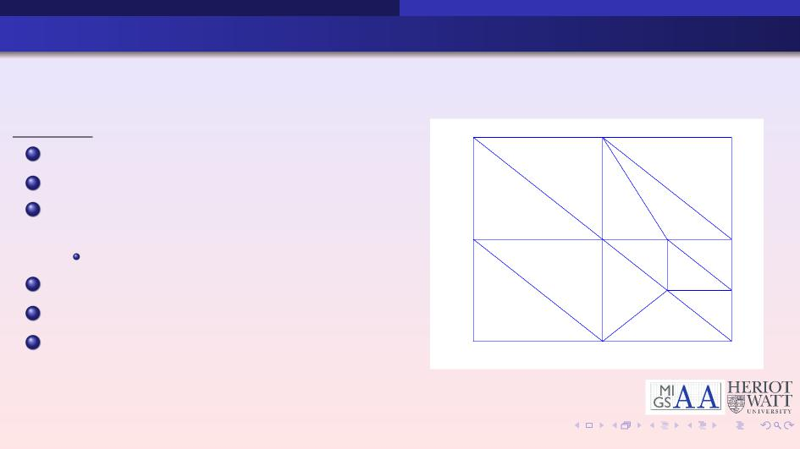
Adaptive Finite Elements
Algorithm
1 Create a coarse space-time mesh
2 Solve the linear system
3 Compute space-time error indicators (η)
for each triangle
If accuracy is attained - stop
4 Mark the triangles based on η
5 Refine marked triangles
6 Repeat from (2)
11 / 18

Slide 13
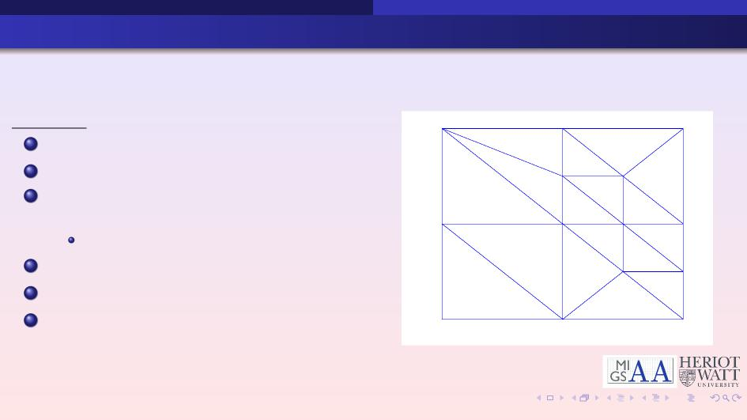
Adaptive Finite Elements
Algorithm
1 Create a coarse space-time mesh
2 Solve the linear system
3 Compute space-time error indicators (η)
for each triangle
If accuracy is attained - stop
4 Mark the triangles based on η
5 Refine marked triangles
6 Repeat from (2)
11 / 18

Slide 14
Adaptive Finite Elements
Algorithm
1 Create a coarse space-time mesh
2 Solve the linear system
3 Compute space-time error indicators (η)
for each triangle
If accuracy is attained - stop
4 Mark the triangles based on η
5Refine marked triangles
6 Repeat from (2)
11 / 18

Slide 15
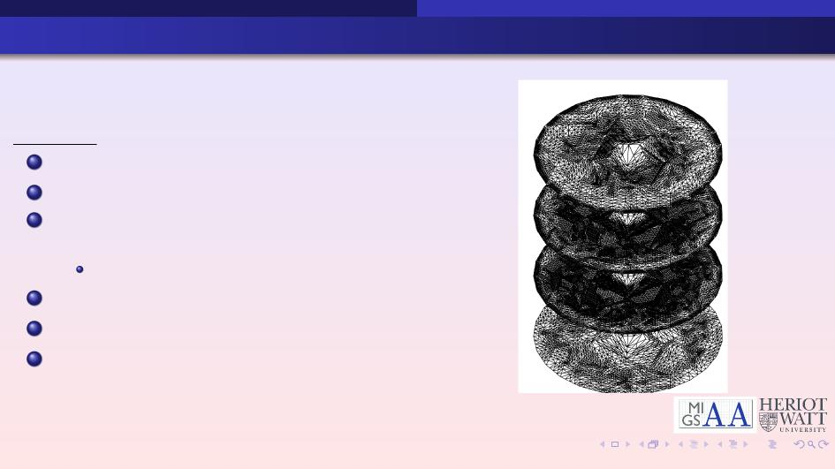
Adaptive Finite Elements
Algorithm
1 Create a coarse space-time mesh
2 Solve the linear system
3 Compute space-time error indicators (η)
for each triangle
If accuracy is attained - stop
4 Mark the triangles based on η
5 Refine marked triangles
6 Repeat from (2)
11 / 18

Slide 16
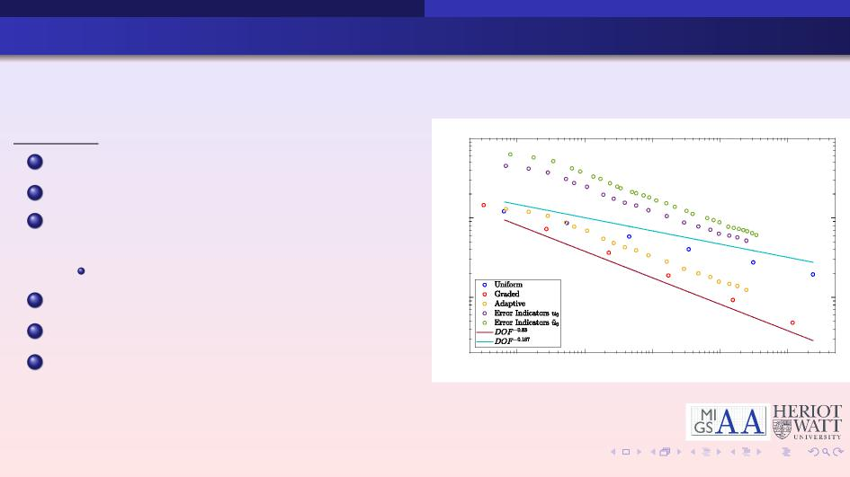
Adaptive Finite Elements
Algorithm
10 0
1 Create a coarse space-time mesh
2 Solve the linear system
3 Compute space-time error indicators (η)
for each triangle
If accuracy is attained - stop
4 Mark the triangles based on η
5 Refine marked triangles
6 Repeat from (2)
10 -1
Energy Error
10
-2
10 3 10 4 10 5 10 6 10 7
DOF
11 / 18

Slide 17
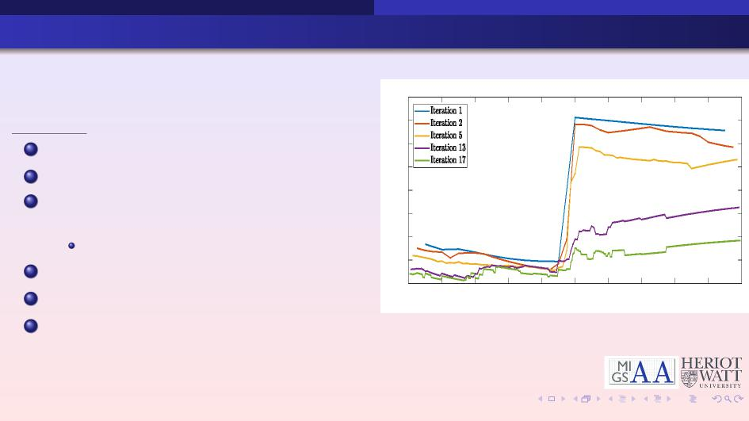
Adaptive Finite Elements
0.8
0.7
Algorithm
0.6
1 Create a coarse space-time mesh
2 Solve the linear system
3 Compute space-time error indicators (η)
for each triangle
If accuracy is attained - stop
4 Mark the triangles based on η
5 Refine marked triangles
6 Repeat from (2)
0.5
Error Indicator
0.4
0.3
0.2
0.1
0
0 0.1 0.2 0.3 0.4 0.5 0.6 0.7 0.8 0.9 1
Time
Figure: Error indicators after an induced thermal
insult.
11 / 18

Slide 18
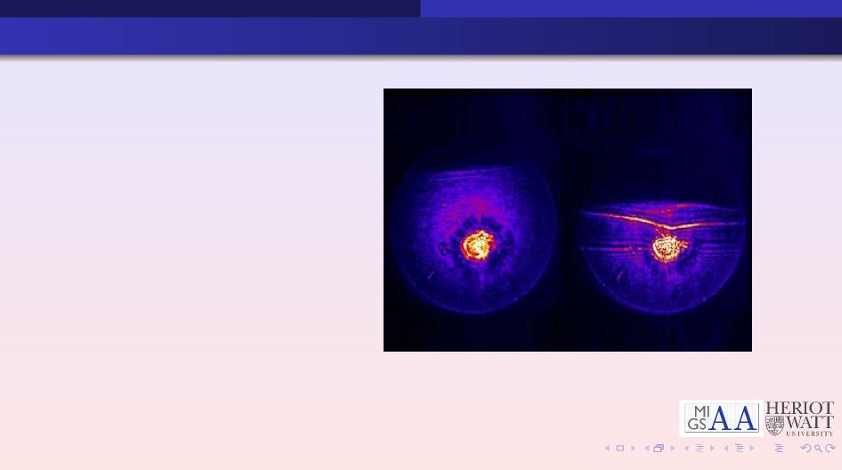
Why Use Enriched Finite Elements (EFEM)
Inclusion of prior
information into a numerical scheme:
For example, inclusion of physical and asymptotic information
Figure: Dynamic x-ray image of void collapse in shocked explosive. The void collapses as the shock wave passes through it - Los Alamos National Laboratory.
12 / 18

Slide 19
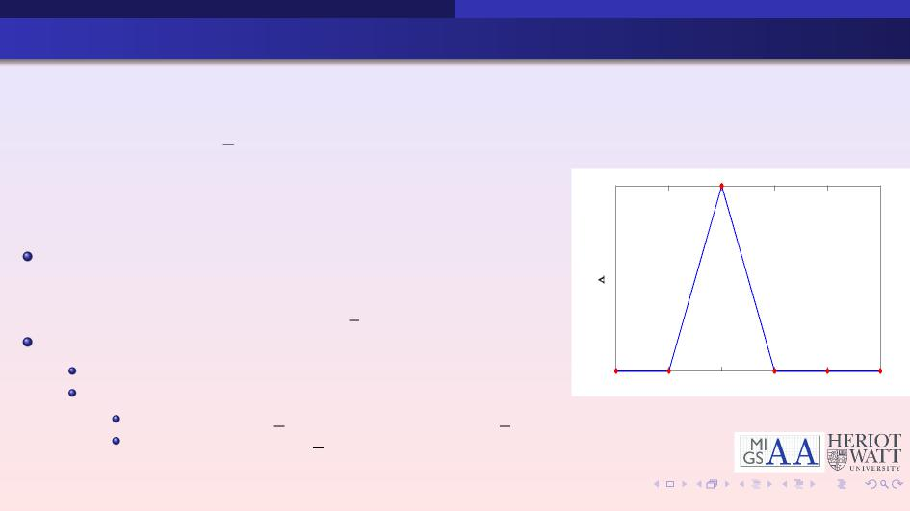
Enriched Finite Elements (EFEM)
⎧
⎨⎪
⎪⎩
utt − V • (AVu) + a • Vu = δf (u) on K = Ω x [0, T)
u(x, 0) = u0, u_{t}(x, 0) = u1
u(x, t) = 0 on ΓD
1
Weak Formulation - multiply by a test function, v E H1ΓD(Ω), and integrate:
j
_{φ}
K
uttvdx + A φK Vu • Vudx + a φK Vuvdx = δ φK fvdx
Discretisation of the domain
Triangulate Ω
0
^{x}i-2 ^{x}i-1 x_{i} ^{x}i+1 ^{x}i+2 ^{x}i+3
Basis functions with prior knowledge Ι
Choose v = Λj Gq j (x) and uh = Π i uhi Λi Gq i (x)
q
Choose enrichments G(x) with respect to the problem.
13 / 18

Slide 20
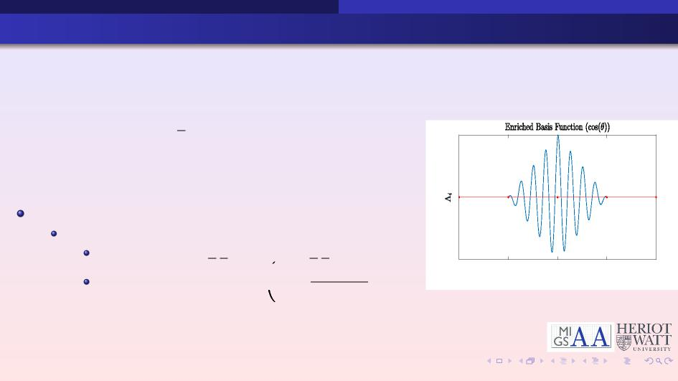
Enriched Finite Element (EFEM)
⎧
⎨⎪
⎪⎩
utt − V(AVu) + a − Vu = δf (u) on Ω x [0, T) u(x, 0) = u0, u_{t}(x, 0) = u1
u(x, t) = 0 on ΓD
1
0
How do you choose an appropriate G?
Consider the type of problem:
Elastic - cos(ωit ± κ_{i}x) or sin(ωit ± κix)x0 _{]2} )
− _{Π} xi −
Localised Heat Sources - exp i
i
2σ2 _{i}
^{x}i-2 ^{x}i-1 x_{i} ^{x}i+1 ^{x}i+2
Nodes
14 / 18

Slide 21
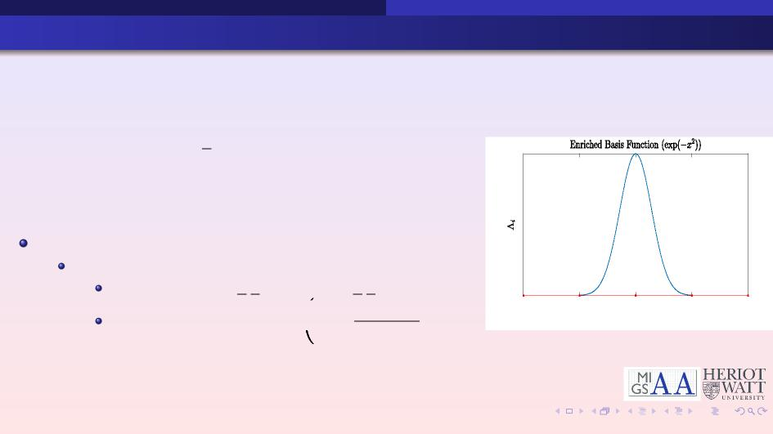
Enriched Finite Element (EFEM)
⎧
⎨⎪
⎪⎩
utt − V(AVu) + a − Vu = δf (u) on Ω x [0, T) u(x, 0) = u0, u_{t}(x, 0) = u1
u(x, t) = 0 on ΓD
1
How do you choose an appropriate G?
Consider the type of problem:
i
2σ2 _{i}
0
Elastic - cos(ωit ± κ_{i}x) or sin(ωit ± κix)x0 _{]2} )
− _{Π} xi −
Localised Heat Sources - exp i
^{x}i-2 ^{x}i-1 x_{i} ^{x}i+1 ^{x}i+2
Nodes
14 / 18

Slide 22

Gaussian Explosion
Gaussian Explosion
⎧
⎨⎪
⎪⎩
{
0 < t < 2t0
f1(t)f2(x, y) (x − x0)² +
f (x, y, t) =
(y − y0)² < R2
0
−π2f 2 ( ₎₂₎
f1(t) = 4 exp t − 1
0 f0
( 1 − (x − x0)² + (y − y0)2 )3
f2(x, y) = R2
15 / 18

Slide 23
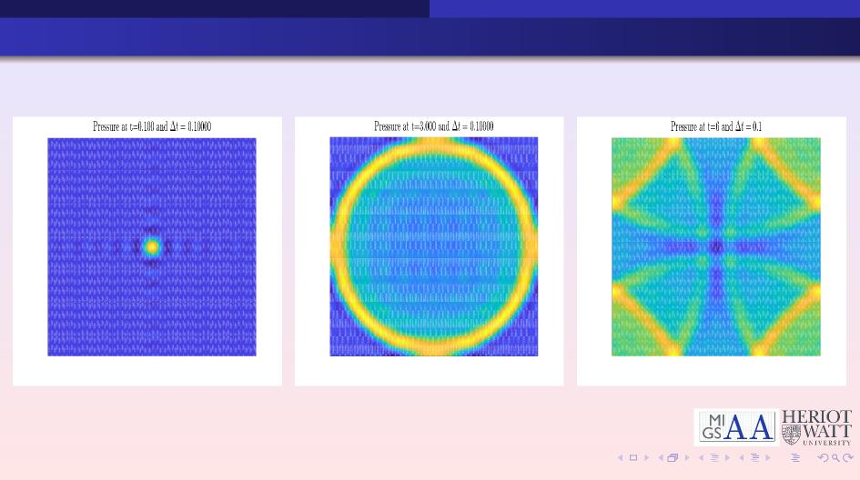
Advantages and Disadvantages of EFEM
16 / 18

Slide 24
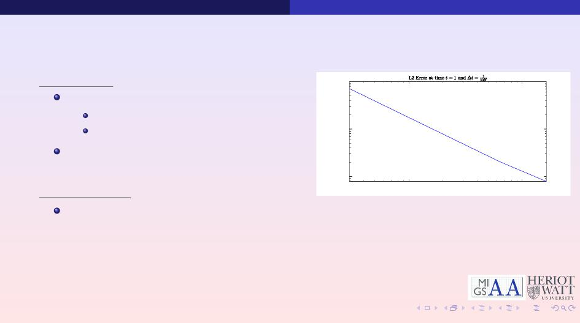
Advantages:
10⁻²
Computational Efficiency Fewer Degrees of Freedom
Fast Error Reduction
Inclusion of information from physics and asymptotics
L2 Error
10⁻³
10⁻⁴
Disadvantages:
Where the nature of the solution is unknown
10¹ 10²
Number of Enrichments
Figure: L² error for the pressure.
17 / 18

Slide 25
Conclusion and Sum
mary
 | Challenges: Inefficient numerical methods and error control Aim: Efficient, stable and reliable methods for extreme physics Error control and efficient adaptive mesh refinements for time dependent problems Enriched Finite Elements to include physics and asymptotics into FEM
18 / 18

