Slide 1
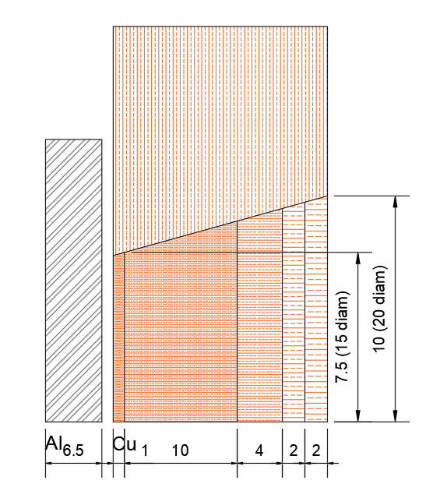
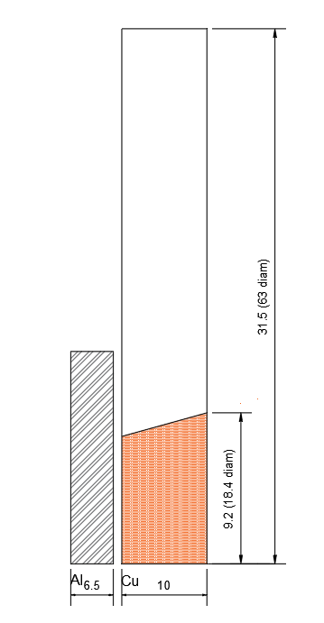
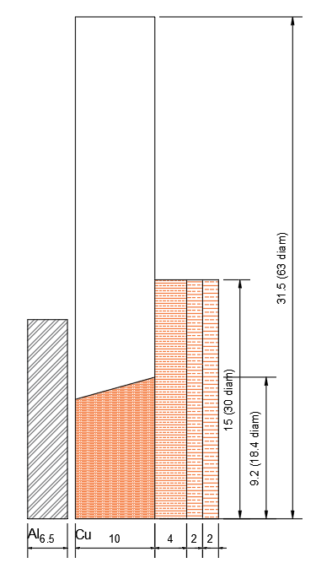

Metals in Extreme Environments: Design and Development of Passive recovery systems
Introduction
Systems for the recovery of spalled and non-spalled samples have been used for several years¹. These tend to involve the sample and a series of interior spall plates at the rear of the target through which the shock wave can propagate and reflect. The geometry of these plates is intended to be such that the tension will not occur in the sample, thus preventing spall.
The assembly of recovery targets requires great precision, and the construction of a single target can take close to 100-man hours. This work looks at developing a ‘passive’ recovery system with external spall plate attached to the target momentum ring. This would significantly reduce the number of man hours required to produce a target, reducing the cost of recovery shots and allowing for more recovery shots to be performed within an experimental run.
Objectives
Refine and simplify existing recovery geometry
Demonstrate void development through spall testing
Demonstrate spall prevention through no-spall testing
Reassemble spalled samples for no-spall testing for phase 3 recompression shots
Investigate recompaction² using 2 stage shots
Current/Future Work
Phase 2a: Quantifying Deformation
How does Phase 1 deformation affect reassembly
How does Phase 1 deformation compare to Phase 2
Phase 3:
Shots combining Phase 1 and Phase 2 shots
Phase 1 to generate spall, Phase 2 to close voids
How does Phase 1 deformation affect Phase 3 shot
Completed Work
Phase 1: Spall testing – Approx 175m/s
Impact test on tapered sample at incipient pressures
Void development shown in expected region
Demonstration of sample/momentum ring separation
Quantify void percentage in sample
Phase 2: No-Spall testing – Approx 175m/s
Impact test using spall plates to prevent tension
No void development in sample
Demonstrates effectiveness of spall plates
Geometry of a ‘typical’ recovery shot
Sample geometry and micrograph for Phase 1 testing
Author: John-Joseph Stephenson
Sample geometry and micrograph for Phase 2 testing
References
Follansbee and Gray, “Dynamic deformation of shock prestrained copper” Materials and Science Engineering, 138, 23-31 (1991)
Hawkins, M.C., Hixson, R., Thomas, S. and Fensin, S., 2019. Spall and re-compaction in OFHC copper under high velocity impact (No. DOE/NV/03624-0536).
© British Crown Copyright 2022/AWE
Sponsors:
john-joseph.stephenson@cranfield.ac.uk
Supervisors: Jonathan Painter, Gareth Appleby-Thomas

