Slide 1
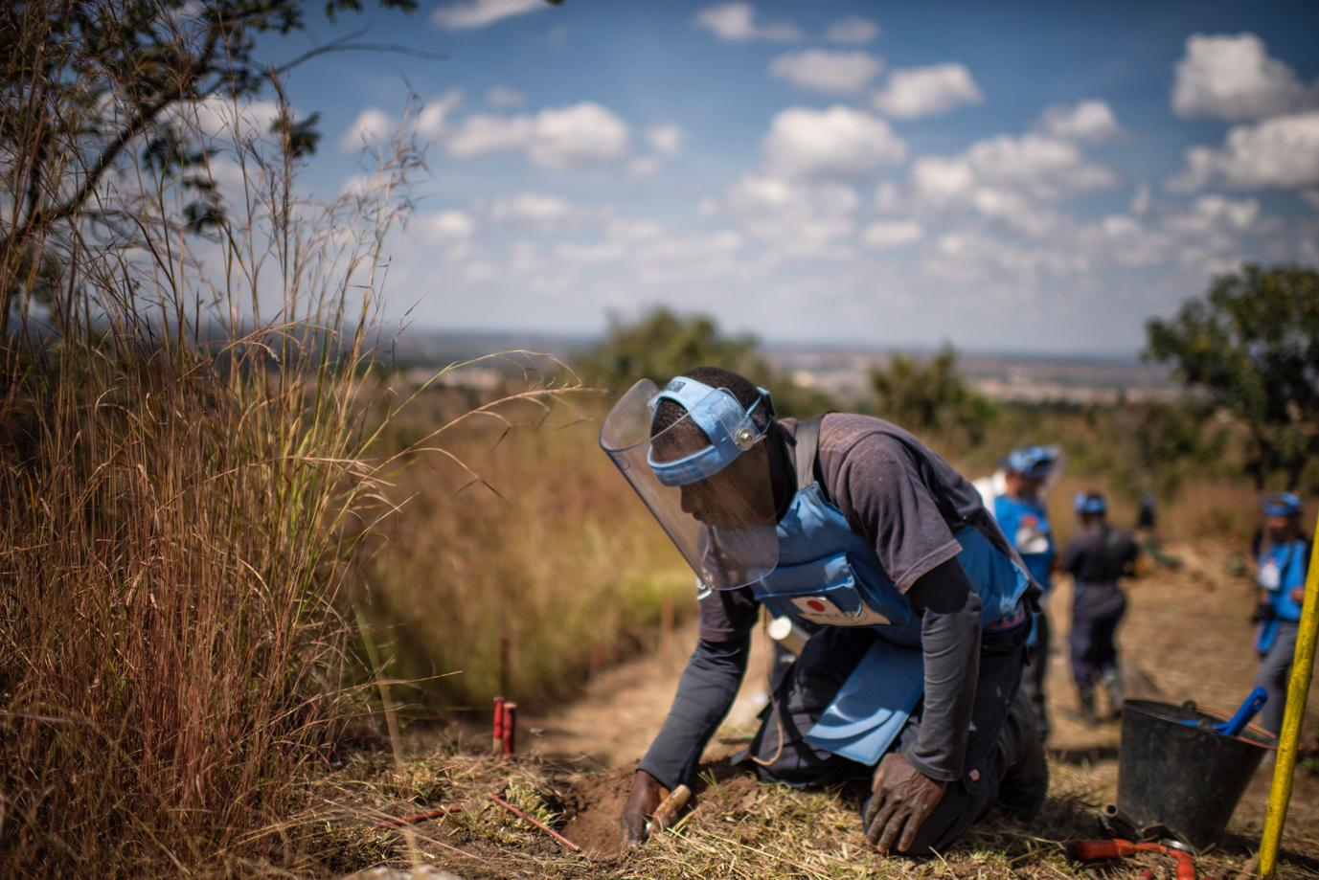




Development of Sustainable PPE for Higher Threat Clearance Operations by Humanitarian Organisations
Learning from previous incidents
Knowledge Databases
Demining Vest
Sensor
(Free field)
Charge
Sensor
1m
0.6m
0.6m
Methodology
Natural Materials
“PPE shall also be capable of protecting the chest, abdomen and groin area against the blast effects of 240gm of TNT at 60 cm from the closest part of the body,”
Miss Laura Brown
l.brown@cranfield.ac.uk
International Standards
Supervisors – Dr Rachael Hazael and Dr Richard Critchley

