Slide 1


Knowledge Management and the Adoption of Innovation in Defence: the case of PeSCo
M.Pengili- University of Leeds
T.Santos- University of Cranfield & Federal University of Rio Grande do Sul

Slide 2

Content
1. Scope of the Analysis, Study Objectives and Hypothesis
2. Methodology –the Causal Loop Diagram
3. Results
4. Conclusions and Suggestions for further research

Slide 3

“…knowledge has gone from being an adjunct of money power and muscle power, to being their very essence. It is, in fact, the ultimate amplifier. This is the key to the powershift that lies ahead.”
(Alvin Toffler)

Slide 4
1. Scope of the Analysis, Study Objectives and Hypothesis
Why?
How?
What?
KM & the adoption of innovative defence policies
Contribution to knowledge
Applying CLDs to analyse PeSCo projects
Notes:
Suggestion here: include below the answers, one line only. It helps the audience!

Slide 5
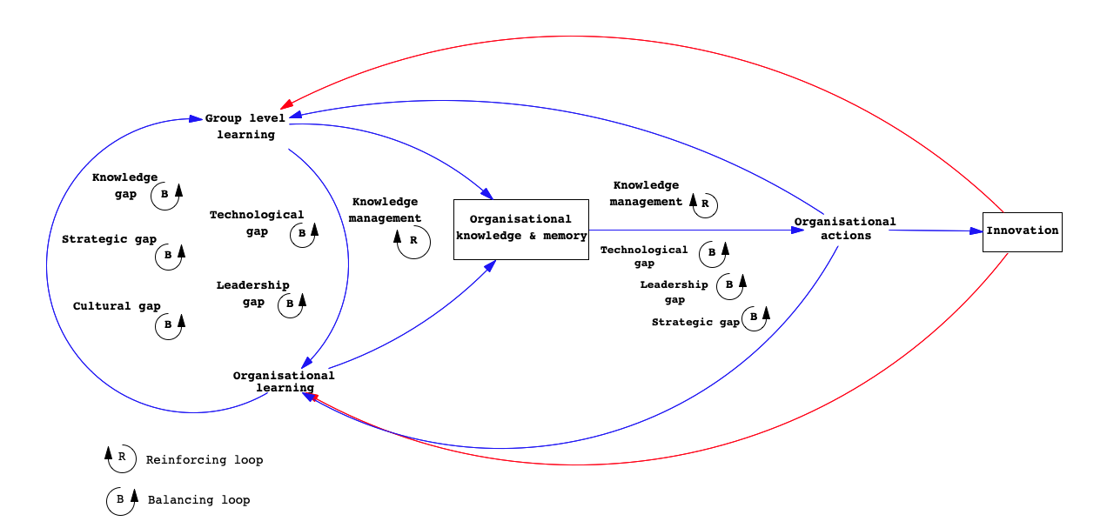
2. Methodology – introducing the Causal Loop Diagram

Slide 6
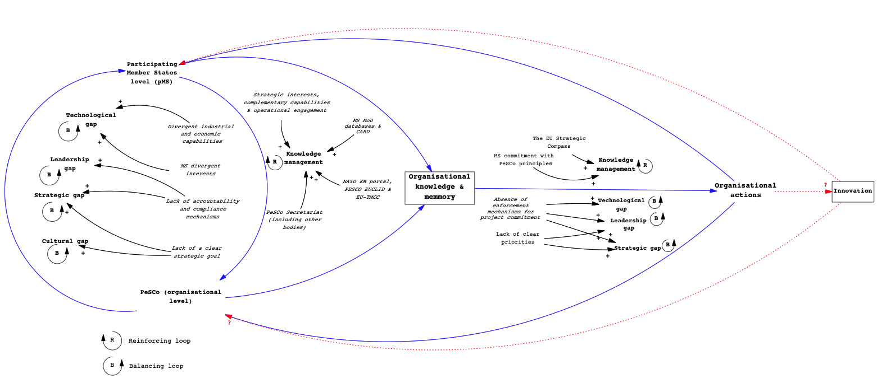
2.Methodology- applying CLD onto PeSCo (macro level)

Slide 7
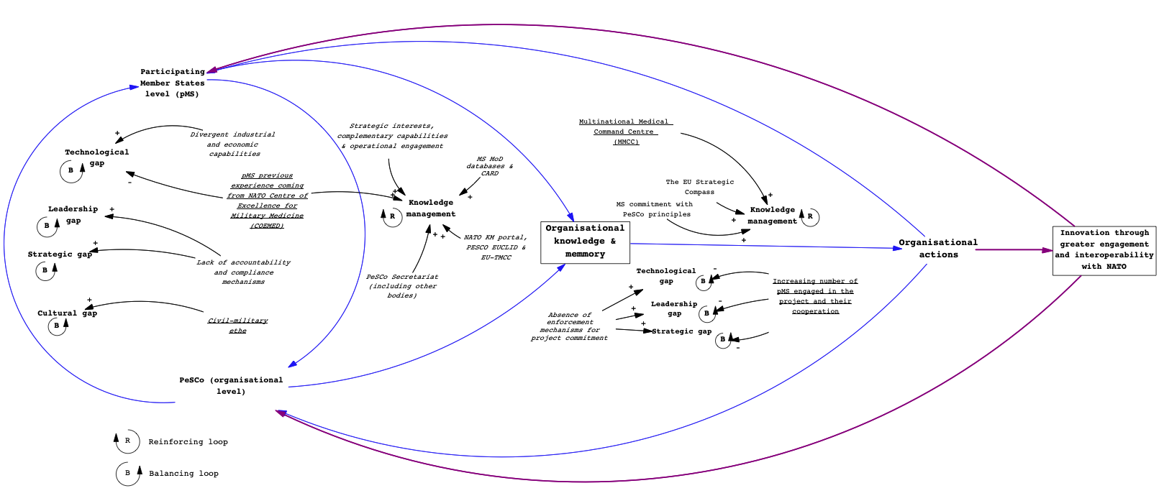
2. Methodology- applying CLDs onto EMC and MAC-EU projects (meso level)
European Medical Command (EMC)
Notes:
I’ve duplicated the slide in order to show the images with a better resolution, as I suppose it’s our aim ☺

Slide 8
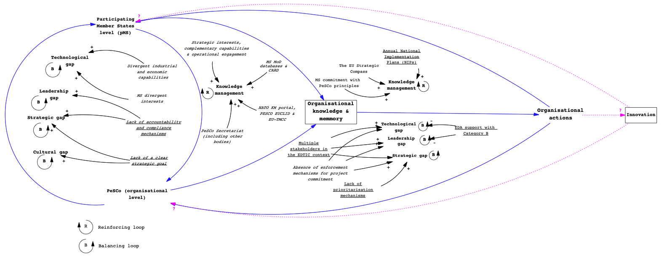
2. Methodology- applying CLDs onto EMC and MAC-EU projects (meso level)
Materials and Components for Technological EU Competitiveness (MAC-EU)

Slide 9
3.Results
Macro level
Meso level
Differences and similarities across levels
Our hypothesis

Slide 10

4. Conclusions
RQ: How and to what extent knowledge management (KM) affects the adoption of innovation in defence?
Goal: Model KM influence in the adoption of innovation in defence
What CLD tell us about our hypothesis
Limitations and areas for further research
Notes:
Suggestion: I guess that the first topic should rescue the research question and our aim. Stating it over again might reinforce our points and allow the audience to stick their attention to that ☺

Slide 11


M. Pengili- ptmp@leeds.ac.uk
T. Santos- tamiris.santos@ufrgs.br / tpsantos88@gmail.com

