Slide 1
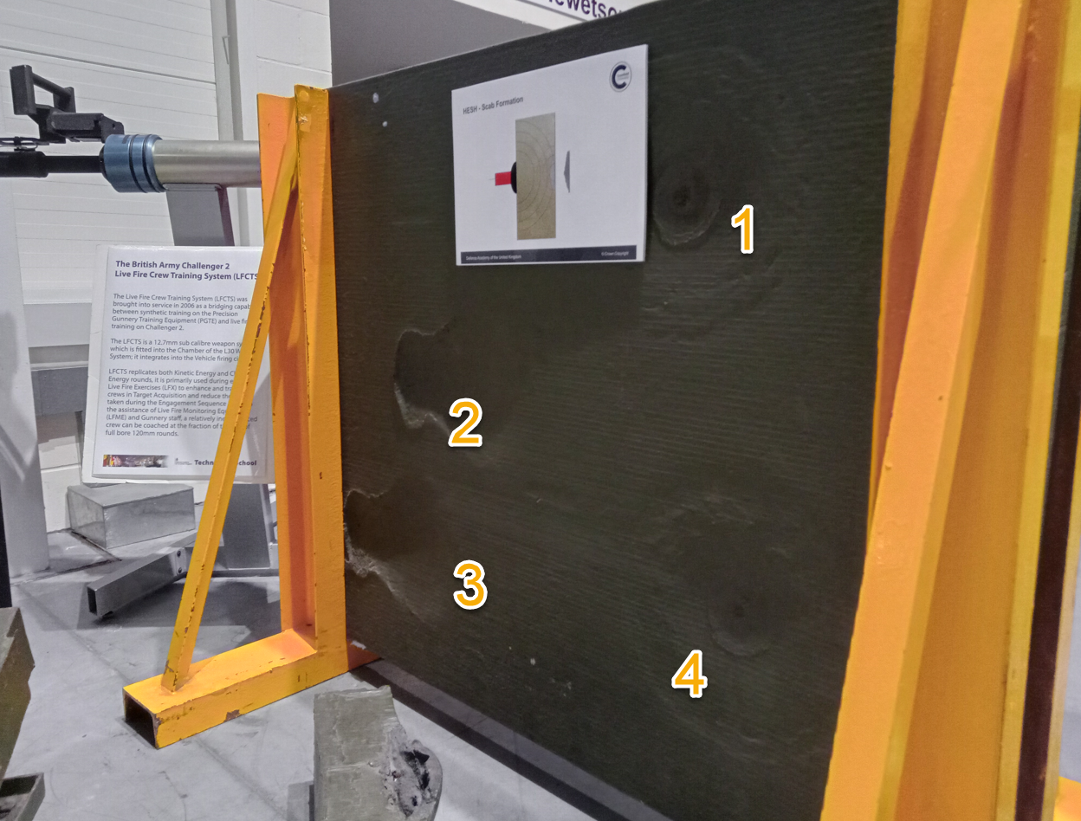
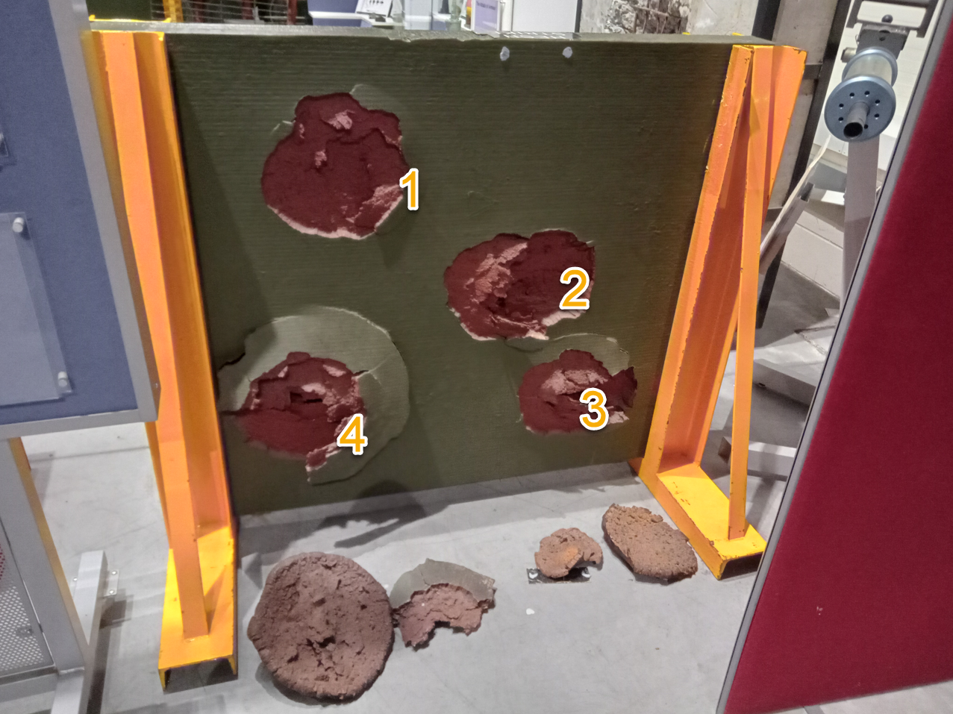
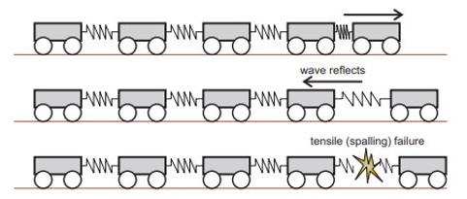
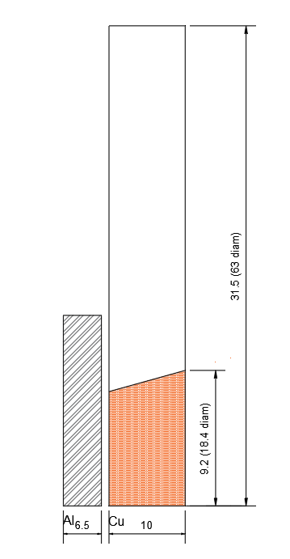
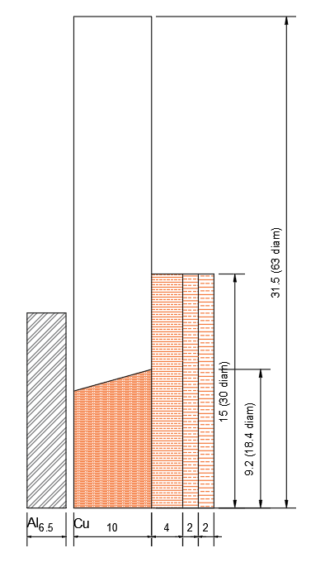
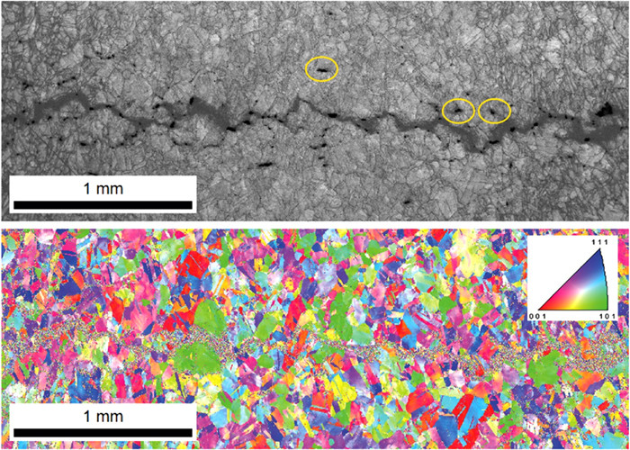
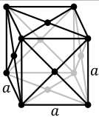
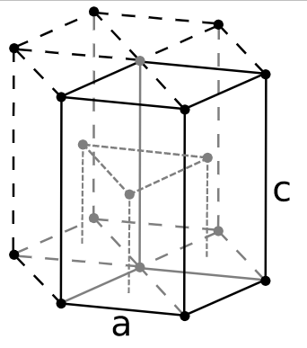
1
Why?
Train carriage analogy
Impact face
Rear (spall) face
2
How?
Sample geometry and micrograph for Phase 1 testing
Sample geometry and micrograph for Phase 2 testing
3
What?
Aluminium
Titanium
Micrograph and EBSD of recompacted Copper taken from Hawkins et al (2020)
© British Crown Copyright 2022/AWE

