Slide 1

Estimating the cost of
no fault found (Input and Output)
Syed Mohammed Fazal Hussain,
MSc EMMS

Slide 2
Input of the model
The model requires input values for seventeen detailed cost drivers identified
1. Cost drivers of customer (9)
          Lost Man-hour
          Maintenance Cost
          Warranty cover
          Increased product cost
          Machine unavailability
          Product dissatisfaction
          Loss of business
          Safety issue
          Liquidate damage

Slide 3
Input of the model
2. Cost drivers of supply chain (4)
          Transportation cost
          Machine down time cost
          Packaging and handling cost
          Intangible cost
3. Cost drivers of OEM (4)
          Capital expenditure cost
          Inventory maintenance cost
          Obsolescence cost
          Repair cost

Slide 4
Relationships between the agents
It depends upon the rate of occurrence of various parameters.
For example at the top level ,the corrective and preventive maintenance cost comprises of three main factors such as Customer, Supply Chain and OEM. The rate of all these three are obtained during the workshop and uses the state chart utility called “RATE”.
Similarly, the occurrence of corrective and preventive maintenance is controlled by the PARAMETER – “FACTOR” defined in the model. (if the FACTOR is set at 0.8, it means that the occurrence of NFF during corrective maintenance is 80% and for preventive maintenance is 20%).

Slide 5
Output
(500 times NFF occurs in a year

Slide 6
Output
(500 times NFF occurs in a year
Corrective Maintenance Cost | Contribution (%) | Unit cost
Customer cost | 60.0 | 2368.1
OEM cost | 17.3 | 683.2
Supply chain cost | 22.7 | 896
Total cost | 100 | 3947.3
Preventive Maintenance Cost | Contribution (%) | Unit cost
Customer cost | 55.6 | 595
OEM cost | 20.4 | 218.4
Supply chain cost | 23.9 | 256
Total cost | 100 | 1069.4
Total Cost | Contribution (%) | Unit cost
Total cost Corrective Maintenance | 78.6 | 3947.3
Total cost Preventive Maintenance | 21.4 | 1069.4
Total NFF cost | 100 | 5016.7

Slide 7
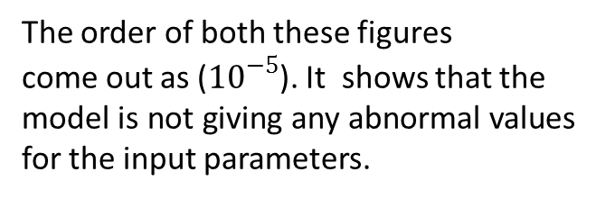
Variability of the model
To know the variability of the model output at three population level are calculated and variance and standard error are calculated
Sample | Size | Value | Sample Mean (µ) | Mean (x) | Standard Deviation (s) | Variance (s2)
Sample I | 100 | 981.20 | 9.812 | 10.02 | -0.21 | 0.04326
Sample II | 500 | 5016.70 | 10.033 | 10.02 | 0.01 | 0.00018
Sample III | 1000 | 10028.90 | 10.029 | 10.02 | 0.01 | 0.00008
Variance | 0.00003
Standard error | 0.00011
The order of both these figures
come out as (${10}^{−5}$). It shows that the
model is not giving any abnormal values for the input parameters.

Slide 8
Default values of the parameter
In the absence of real data from the industry, during the workshop parametric values were collected and after normalising, these values were considered as default values. These values are defined in the AnyLogic Model and the output depends upon it. These default values are either defined as parameter or the variable in the AnyLogic moel.

Slide 9
Default values Generation
For the execution of the simulation model, input parameters were required. As the real data from the industry was not available, the research finds the default values. The values for the parameters were collected during a workshop on NFF organised at Cranfield Univerisity. During the workshop a brief of the thesis was presented. Data were collected on a feedback form in which rank were assigned to the different cost drivers on a 1 to 10 point basis, 1 being the lowest and 10 being the highest.

Slide 10
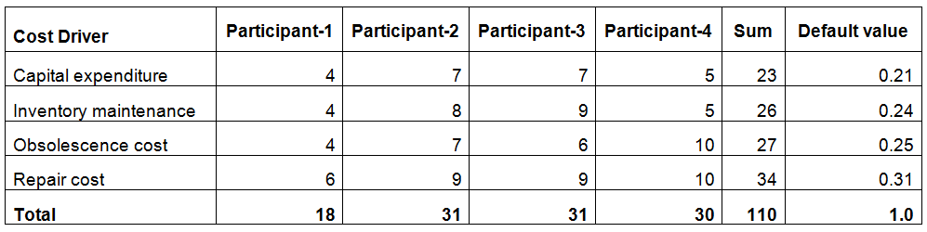
Default values of the parameter
(OEM Cost Drivers)

Slide 11
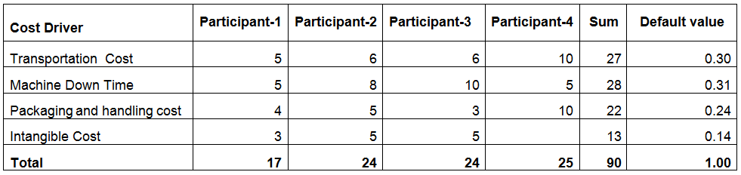
Default values of the parameter
(Supply Chain Cost Drivers)

Slide 12
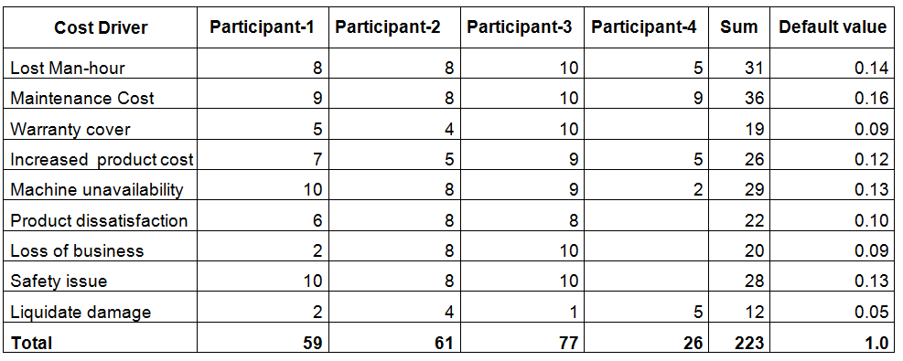
Default values of the parameter
(Customer Cost Drivers)

Slide 13
Optimisation of the parameters
Optimal values of the parameters are calculated as below
Parameter | Default Value | Best Solution
OEM | 0.3 | 0.40
Supply Chain | 0.2 | 0.15
Factor | 0.8 | 0.998
Customer | 0.5 | 0.55

