Slide 1
Stuart Morris
University of York

Slide 2

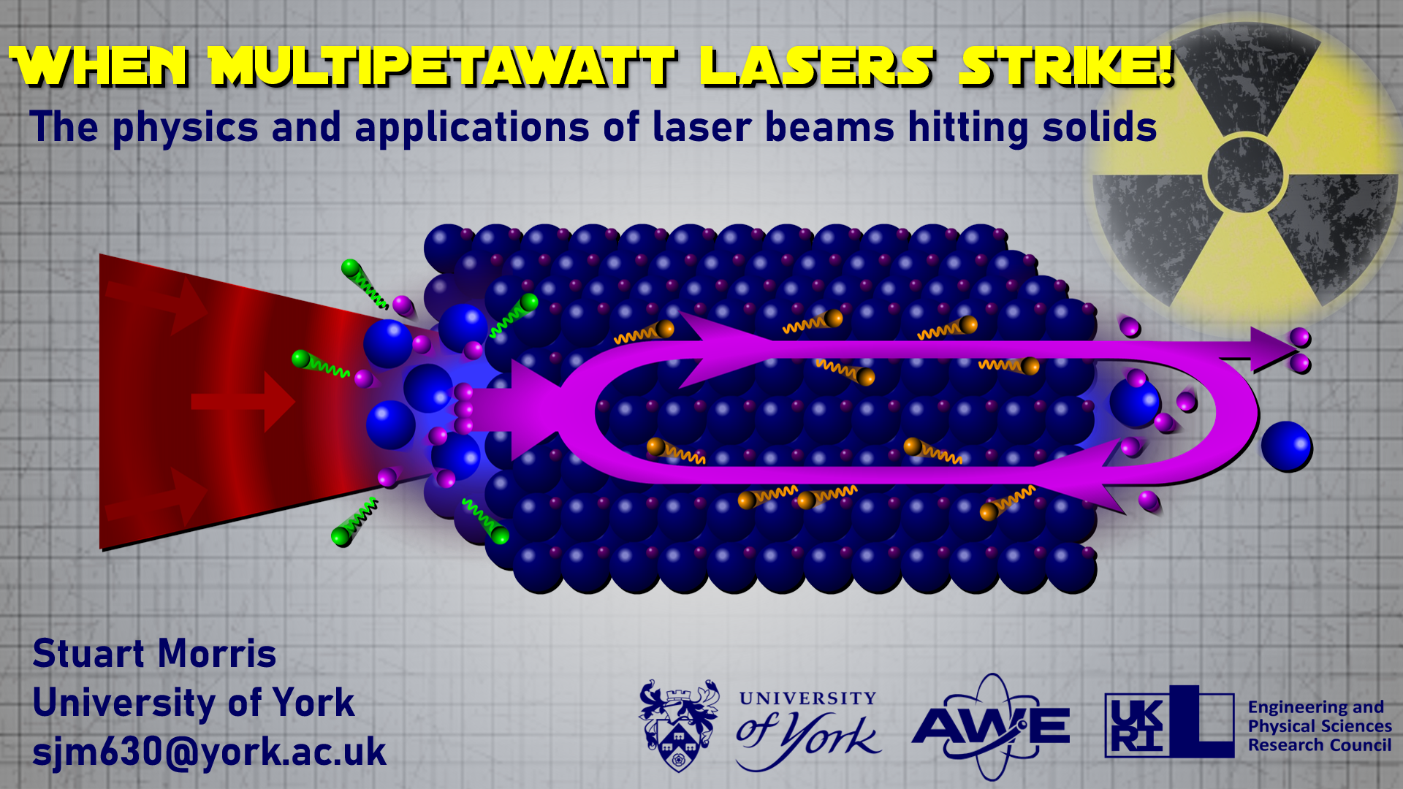
When Multipetawatt Lasers Strike!
The physics and applications of laser beams hitting solids
1
2
3
CLICK TO START
9
3
4
5
6
7
8
10
11
12
13
14
15
16
17
18
19
20
21
22
23
24
25
26
27
28
29
1
30
2
mins
mins
mins
secs
secs
secs
secs
secs
secs
secs
secs
secs
secs
secs
secs
secs
secs
secs
secs
secs
secs
secs
secs
secs
secs
secs
secs
secs
secs
secs
secs
secs
secs

