Slide 1
Judith Ugbeh
Effects of Particulate Contamination and Jet Fuel Chemistry on the Nucleation of Water and Ice in Aircraft Fuel Systems
13th November 2018

Slide 2
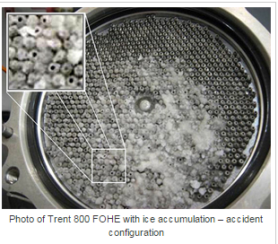
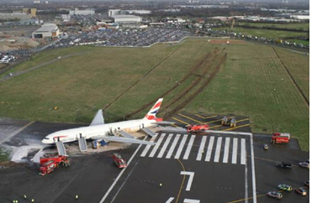
Effects of Particulate Contamination and Jet Fuel Chemistry on the Nucleation
of Water and Ice in Aircraft Fuel Systems
Ice blocking the fuel oil heat exchanger
THIS AREA OF YOUR SLIDE WILL BE COVERED BY A TIMER
Heathrow Accident: British Airways jet lost power as it came into land because ice had blocked the fuel supply

