Slide 1
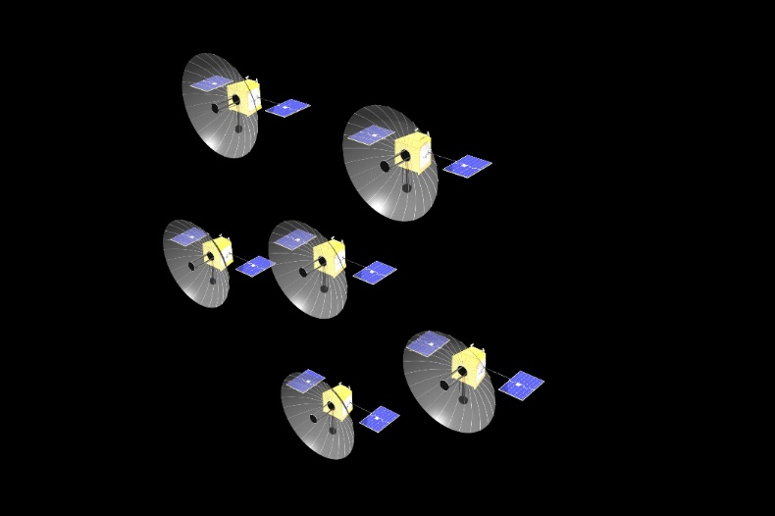
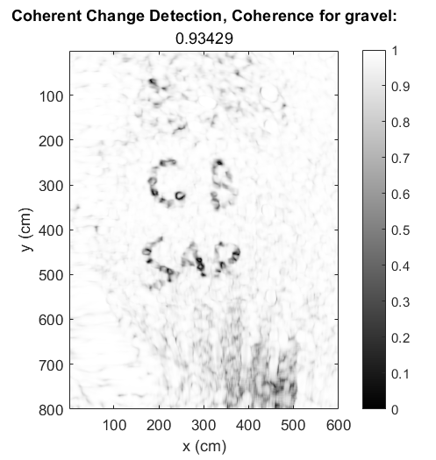
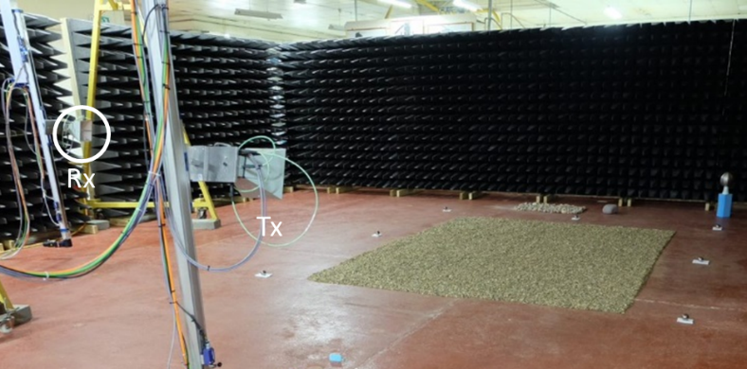

Multistatic Synthetic Aperture Radar Phenomenology and Interferometry
This work has been funded by DSTL.

